Slide 1

4th Division Crime Summary
1/10/2021 – 1/16/2021

Slide 2

Beat 1

Slide 3

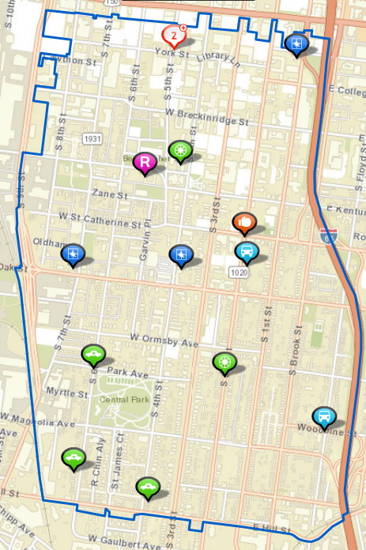
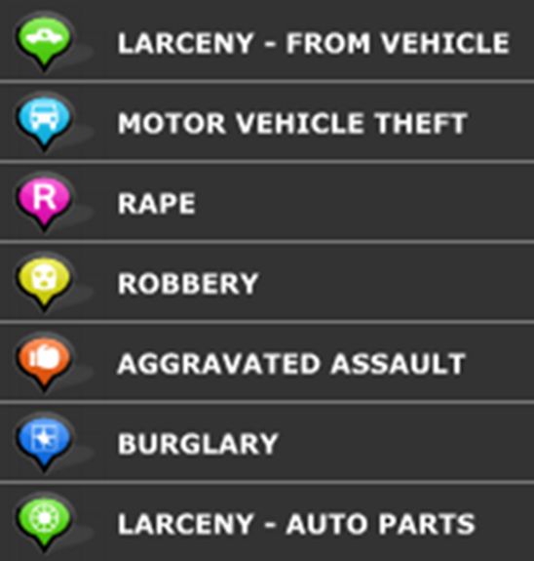
Beat 1 Map

Slide 4
Beat 2

Slide 5
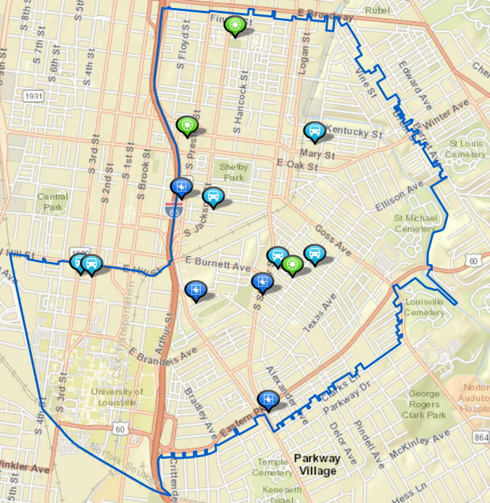
Beat 2 Map

Slide 6
Beat 3

Slide 7
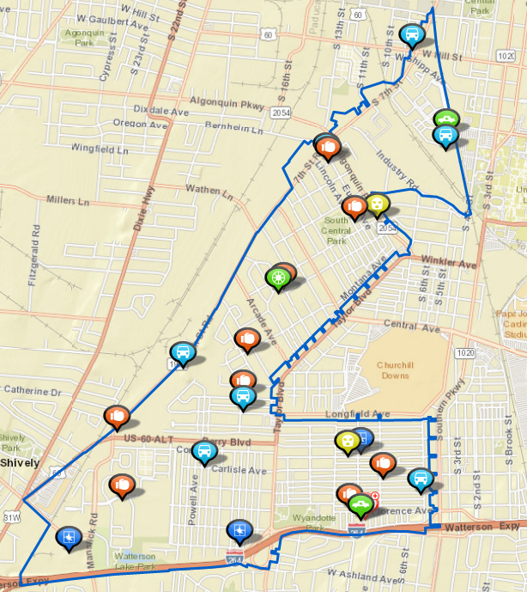
Beat 3 Map

Slide 8
Beat 4

Slide 9
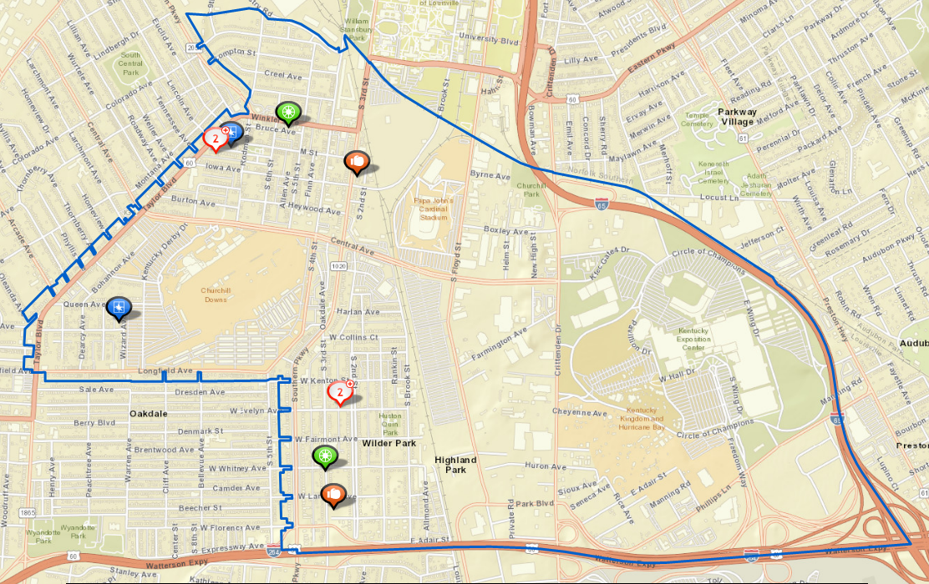
Beat 4 Map

Slide 10
Beat 5

Slide 11

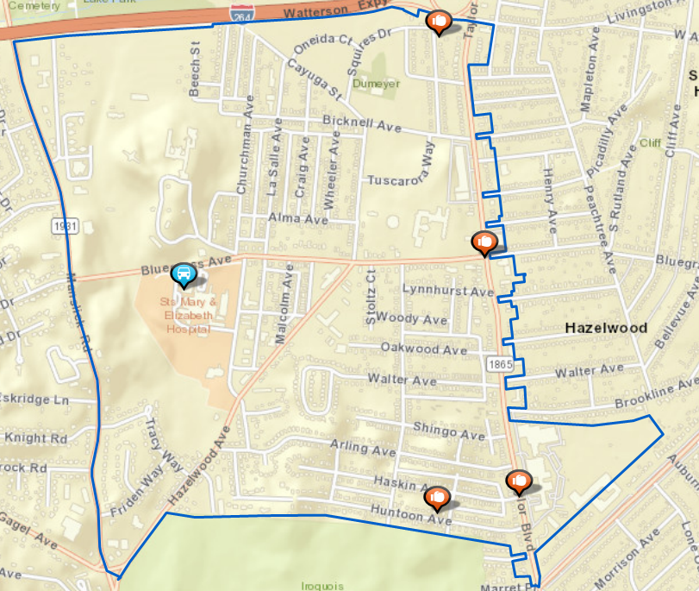
Beat 5 Map

Slide 12
Beat 6

Slide 13
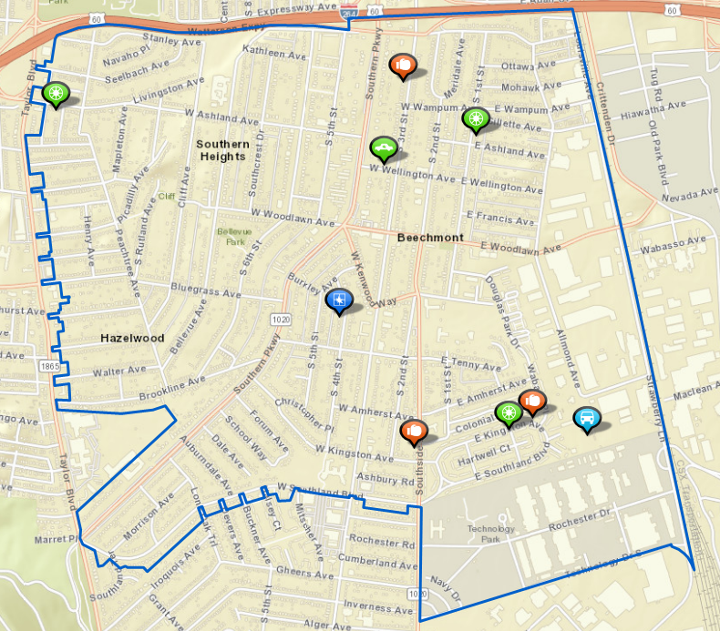
Beat 6 Map

