Slide 1
Cigna Telehealth Connection
Presenter
Offered by: Cigna Health and Life Insurance Company or its affiliates
900005 d 02/19

Slide 2
Cigna Telehealth Connection overview
What is it
Telehealth vendors provide on-demand 24/7/365 access to cost-effective, quality nonurgent care through a national network of licensed, board-certified U.S.-based doctors, including pediatricians.
Telehealth Services will be provided by both American Well (AmwellTM) and MDLIVE®.
Cigna Telehealth Connection provides your employees access to various telehealth services.
Covered employees can also have a consultation with providers who offer telehealth visits in our Cigna Behavioral Health network. Behavioral health care providers who offer telehealth visits are listed in the directory on myCigna.com.
Amwell and MDLIVE are independent companies/entities and are not affiliated with Cigna. The services, websites and mobile apps are provided exclusively by Amwell and MDLIVE and not by Cigna. Providers are solely responsible for any treatment provided. Availability of Amwell and MDLIVE services may vary by location and is subject to change. Not all providers have video chat capabilities. Video chat is not available in all areas. Amwell/MDLIVE services are separate from your health plan’s provider network. Telehealth services may not be available to all plan types. A Primary Care Provider referral is not required for Amwell/MDLIVE services. See your plan materials for costs and details of coverage, including other telehealth/telemedicine benefits that may be available under your specific health plan.

Slide 3
How it works
Medical Telehealth
Register with one or both vendors
Register online Employee registers online with one or both vendors so they are ready to use service when needed.
By phone
By video conference
Step 1: Call toll-free
Employee calls toll-free hotline available 24/7/365 including holidays. MDLIVE 888.726.3171. American Well 855.667.9722
Step 1: Visit website Employee seamlessly accesses services with a single sign-on via myCigna.com or visits each vendor’s website and mobile app directly
Step 2: Speak with a coordinator A consultation coordinator locates the next available doctor and prepares employee for the consultation.
Step 2: Find a doctor System helps the employee search for a doctor by a criteria, such as specialty, language, gender, location, or simply finds the next available doctor.
Step 3: Speak with the doctor Once an available doctor is located, the system automatically calls and connects the doctor to the employee.
Step 3: See the doctor online Once an available doctor is located, the system automatically connects the doctor to the patient through video.
Post-visit
Email communication
Employee can elect for consultation history to be sent to personal doctor.
Prescription services Amwell and MDLIVE doctors may prescribe medication when appropriate and send the prescription directly to their pharmacy.*
Health care services are delivered by American Well and MDLIVE participating doctors and not by Cigna. Availability may vary by location and is subject to change. See vendor sites for details. *American Well and MDLIVE do not guarantee that a prescription will be written. Not all prescriptions are available.

Slide 4
Conditions treated by Amwell and MDLIVE doctors
Medical Telehealth
General health
Pediatric care
Acne
Allergies
Asthma
Bronchitis
Cold & Flu
Diarrhea
Ear Aches
Fever
Head Ache
Infections
Acne
Allergies
Asthma
Bronchitis
Cold and flu
Diarrhea
Earaches
Fever
Headache
Infections
Insect bites
Joint aches
Nausea
Pinkeye
Rashes
Respiratory infections
Shingles
Sinus infections
Skin infections
Sore throat
Urinary tract infections
Cold and flu
Constipation
Earaches
Nausea
Pinkeye
Health care services are delivered by American Well and MDLIVE participating doctors and not by Cigna.

Slide 5
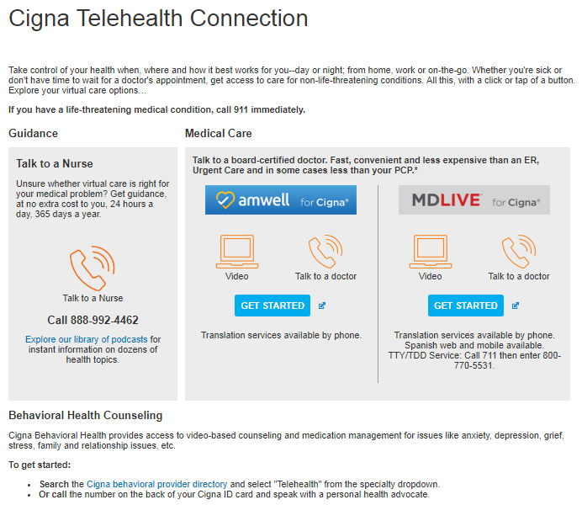
Cigna Telehealth Connection
How to access
Your employees can seamlessly access both MDLIVE and Amwell with a single sign-on through myCigna.com.
Your employees can also access Cigna Telehealth Connection by visiting:
Amwell for Cigna:
Visit AmwellforCigna.com
Call 855.667.9722
MDLIVE for Cigna:
Visit MDLIVEforCigna.com
Call 888.726.3171
They may also download the MyCigna® App and will be able to access both Telehealth providers through the app.
Customers seeking a behavioral health provider will be able to search on the provider directory on myCigna.com
Availability may vary by location and is subject to change. See vendor sites for details.
Amwell and MDLIVE are exclusively for medical telehealth services. Behavioral telehealth is not provided through Amwell or MDLIVE and is
provided by Cigna Behavioral Health contracted providers

Slide 6
American Well vs. MDLIVE
 | American Well | MDLIVE
Access to vendor doctors 24/7/365 | Yes. Provided by the Online Care Group | Yes
Coverage area Limitations due to state regulations and vendor interpretation of state regulations | 21 States and DC: Consultation and prescribing can occur as a result of both video and phone visits 29 States: Consultation and prescribing can occur as a result of video visits. Consultation only (without prescribing) can occur as a result of a phone-only visit. See the “Amwell Telehealth” slide for details | 48 States and DC: Full services – video & phone Idaho: Services limited to video Arkansas: Initial visit via video; subsequent visits via video or phone See the “MDLIVE Telehealth universal landscape” slide for details
Branding | Cigna Telehealth Connection (on myCigna.com) American Well for Cigna (on vendor site) | Cigna Telehealth Connection (on myCigna.com) MDLIVE for Cigna (on vendor site)
URL and phone number Cigna universal URLs and phone numbers | URL: AmwellforCigna.com Phone Number: 1.855.667.9722 | URL: MDLIVEforCigna.com Phone number: 1.888.726.3171
Link on myCigna.com web and mobile | Yes. From Cigna Telehealth Connection page | Yes. From Cigna Telehealth Connection page
Mobile app | The MyCigna® App is available to download to smartphones/mobile devices. Access both telehealth providers when and where needed.
Benefit differentials Standard: Telehealth benefit = PCP benefit | Yes for ASO; No for Fully Insured
Fee-for-service* | For 2019, MDLIVE rates will be $45; and Amwell $49
Credit card/payment | Accept all major credit cards/debit cards
IVR, CSA, HIL | Yes
Client cost | Telehealth is included as part of employee’s plan.
Reporting | Cigna Book of Business reporting across both vendors. Telehealth reporting is also included on Cigna Consultative Analytics Platform (CAP) reports.
* Actual costs may vary depending on plan design. Costs are subject to contract renewal. Not all services are eligible or may be covered under your specific medical plan. The following services are generally not covered: services that aren’t medically necessary; experimental, investigational or unproven services; services for an injury or illness that occurs while working for pay or profit, including services covered by Worker’s Compensation benefits; treatment of sexual dysfunction. This is a summary only and the terms of your specific medical plan may vary.

Slide 7
Know before you go
 | Cost | Wait times | Severity
Cigna Telehealth Connection
Convenience Care Clinics
Primary Care Provider
Urgent Care Center
Free Standing Emergency Rooms
Emergency Rooms
For illustrative purposes only. Actual costs and wait times will vary.
Cigna 24 Hour Health Information Line
A telephone service staffed by nurses that helps you understand and make informed decisions about health issues you are experiencing, at no extra cost. It can help you choose the right care in the right setting at the right time, whether it’s reviewing home treatment options, following up on a doctor’s appointment, or finding the nearest urgent care center.
Just call the number on your Cigna ID card. Open 24/7.

Slide 8
Cigna Telehealth Connection Behavioral Telehealth
Product details specific to behavioral Telehealth

Slide 9
Cigna Telehealth Connection
Behavioral Telehealth product details
Base features
Capabilities and administration
Employees who have mental health/substance abuse benefits with Cigna will have the option to see providers for individual therapy or medication management through video-based services through the Cigna Behavioral Health network of providers
There is no additional cost to you or your employees
Same cost share applies to video-based services as to face-to-face services
Your employees will be able to identify behavioral providers who offer telehealth visits on the myCigna.com provider directory
Providers will submit claims for the employee, and use a code to signify a video consult took place.
Note: Services are offered by providers in the Cigna Behavioral Health network, not through Amwell or MDLIVE.

Slide 10
APPENDIX

Slide 11
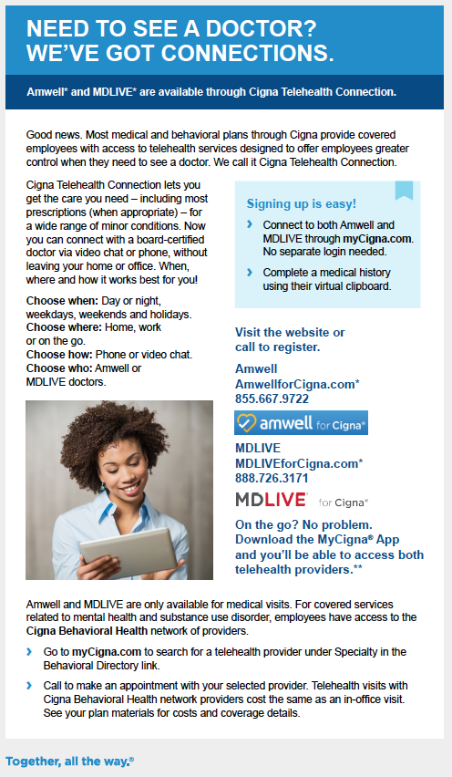
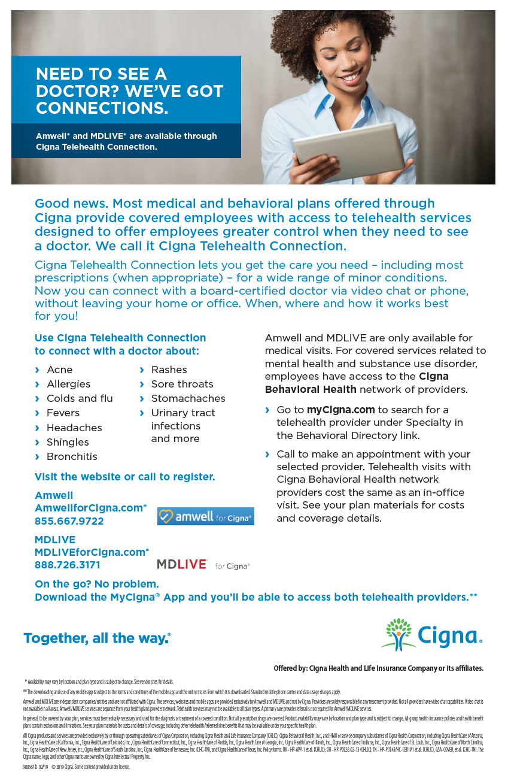
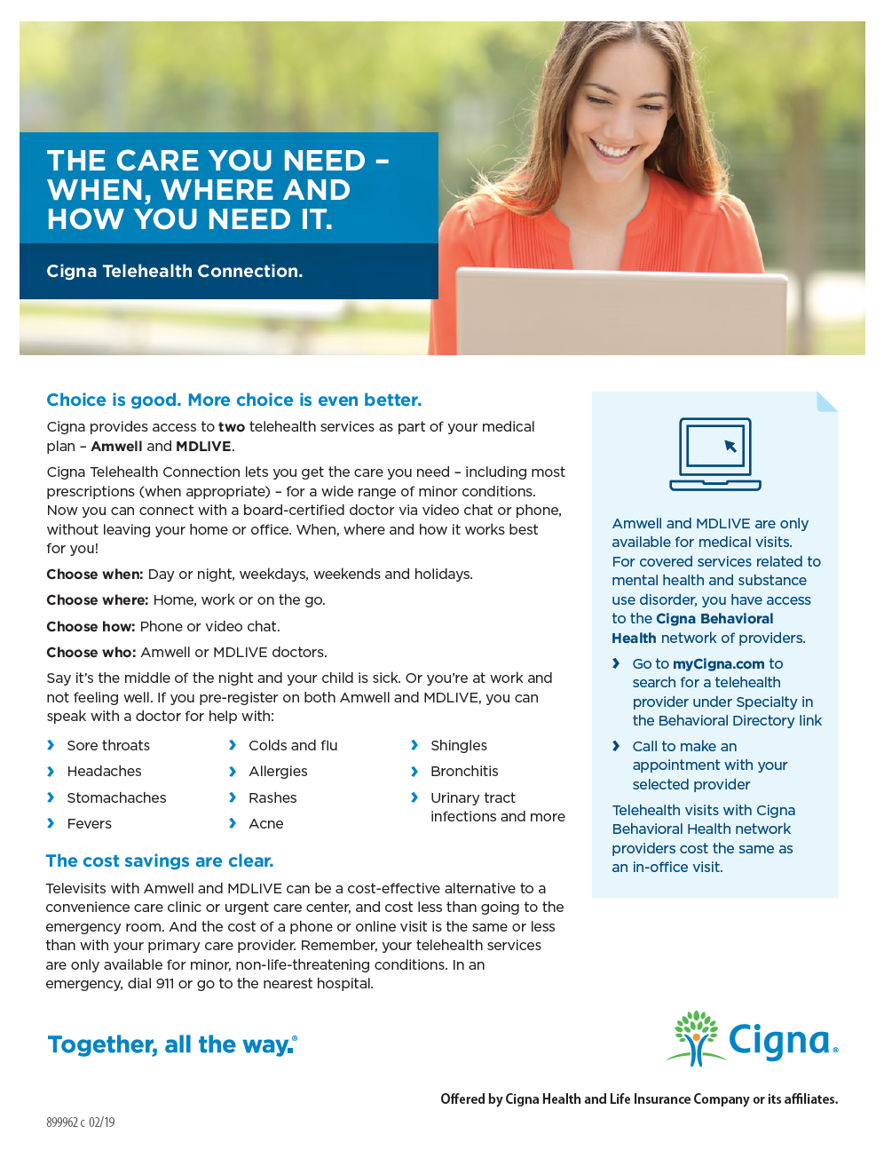
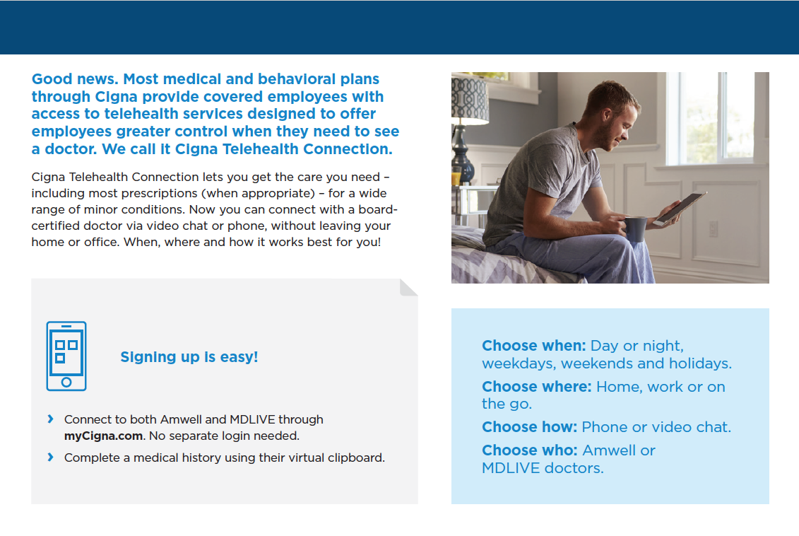
Program media
Medical Telehealth
Spreading the word about telehealth services can help increase employee awareness and utilization of the service.
All materials available both with Cigna behavioral and without Cigna behavioral
Notes:
Communication is key. This slide depicts the look & feel of the Telehealth communication materials available.
Examples of Customer Facing Materials include:
-Telehealth included in Cigna Welcome Kit
-Electronic Flyer (pre Reg)
-Electronic Welcome Kit (post Reg)
-Postcards
-Quarterly campaigns, designed to coincide with common seasonal afflictions such as flu and allergy season.

Slide 12
Amwell Telehealth
WA
MT
ND
ME
OR
MN
VT
ID
SD
WI
NY
NH
WY
MI
MA
NE
IA
PA
CT
RI
NV
IN
OH
CA
UT
IL
WV
NJ
CO
KS
MO
VA
KY
DE
TN
NC
DC
AZ
OK
MD
NM
AR
SC
MS
AL
GA
AK
TX
LA
FL
HI
DARK BLUE - 21 STATES and DC
Consultation and prescribing can occur as a result of both video and phone visits
LIGHT BLUE - 29 STATES
Consultation and prescribing can occur as a result of video visits. Consultation only (without prescribing) can occur as a result of a phone-only visit.
This map is not a legal opinion. Rather, it represents our understanding as of August 31, 2017 regarding the permissibility of providing clinical care on this platform in the absence of either a prior provider-patient relationship or a patient facilitator, and a patient presenting from non-clinical originating site. Due to the dynamic nature of telehealth, laws, statutes, or policies regarding telehealth are subject to rapid change. Doctors can not issue prescriptions for controlled substances or lifestyle drugs in any state.

Slide 13
MDLIVE Telehealth universal landscape
ME
RI
ME
WA
VT
CT
MT
ND
OR
MN
NY
NJ
NH
ID
SD
WI
MI
WY
PA
DE
MA
NE
IA
OH
NV
IL
IN
WV
VA
DC
MD
CA
UT
CO
KS
MO
KY
NC
TN
OK
AR
SC
AZ
NM
AL
GA
MS
TX
LA
Alaska
Hawaii
Puerto Rico
US Virgin Islands
FL
Full Services – Video + Phone
Services Limited to Video
*In Arkansas, 1st consultation is via video; thereafter phone consultations are permissible.
This map is not a legal opinion. It represents MDLIVE's understanding of state telehealth regulations and the applicability to MDLIVE's program. Please seek the advice of counsel for a legal opinion as to specific state regulations. MDLIVE reserves the right to revise this document at anytime in its sole discretion

Slide 14
Amwell and MDLIVE are independent companies/entities and are not affiliated with Cigna. The services and websites are provided exclusively by Amwell and MDLIVE and not by Cigna. Providers are solely responsible for any treatment provided. Not all providers have video chat capabilities. Video chat is not available in all areas. Amwell/MDLIVE services are separate from your health plan’s provider network. Telehealth services may not be available to all plan types. A Primary Care Provider referral is not required for Amwell/MDLIVE services.
Product availability may vary by location and plan type and is subject to change. All group health insurance policies and health benefit plans contain exclusions and limitations. See your plan materials for costs and details of coverage, including other telehealth/telemedicine benefits that may be available under your specific health plan.
All Cigna products and services are provided exclusively by or through operating subsidiaries of Cigna Corporation, including Cigna Health and Life Insurance Company (CHLIC), Cigna Behavioral Health, Inc., and HMO or service company subsidiaries of Cigna Health Corporation, including Cigna HealthCare of Arizona, Inc., Cigna HealthCare of California, Inc., Cigna HealthCare of Colorado, Inc., Cigna HealthCare of Connecticut, Inc., Cigna HealthCare of Florida, Inc., Cigna HealthCare of Georgia, Inc., Cigna HealthCare of Illinois, Inc., Cigna HealthCare of Indiana, Inc., Cigna HealthCare of St. Louis, Inc., Cigna HealthCare of North Carolina, Inc., Cigna HealthCare of New Jersey, Inc., Cigna HealthCare of South Carolina, Inc., Cigna HealthCare of Tennessee, Inc. (CHC-TN), and Cigna HealthCare of Texas, Inc. Policy forms: OK - HP-APP-1 et al (CHLIC); OR - HP-POL38 02-13; TN - HP-POL43/HC-CER1V1 et al (CHLIC), GSA-COVER, et al (CHC-TN). The Cigna name, logo, and other Cigna marks are owned by Cigna Intellectual Property, Inc.
900005 d 02/19 © 2019 Cigna. Some content provided under license.

