Slide 1
Public assistance
Michigan state police
damage assessment
Notes:
FEMA Public Assistance Grant Program – Cost Share 75/25

Slide 2
Agenda
Objective: Provide an overview of the damage assessment process as it relates to the FEMA Public Assistance (PA) Grant Program.
PA Overview/Eligibility
Damage Assessment Overview
Additional Considerations
Important Points to Remember
Next Steps
Questions
Notes:
FEMA makes the final decision on eligibility and funding

Slide 3
Public assistance overview & eligibility
Notes:
IF the Governor requests and the President DECLARES a major disaster declaration.
1. Initial Damage Assessment by locals
2. State validates the information to see if the estimates meet the thresholds
3. Request to FEMA for a Joint Preliminary Damage Assessment
4. Joint PDA for FEMA to review and validate damage information that meets eligibility requirements
5. Governor request to the President
6. Presidential disaster declaration
7. FEMA Public Assistance Grant Program opens

Slide 4
FEMA Public Assistance
FEMA’s Public Assistance Program provides supplemental grants to state, tribal, territorial, and local governments, and certain types of private non-profits so that communities can quickly respond to and recover from major disasters or emergencies.
More detailed information can also be found in the FEMA Public Assistance Program and Policy Guide.
Notes:
The program provides funding for emergency assistance to save lives and protect property and assists with funding for permanently restoring community infrastructure affected by a federally declared incident.
The PA program also encourages protection of damaged facilities from future incidents by providing assistance for hazard mitigation measures.

Slide 5
Public assistance Program
Assists in the restoration of community infrastructure to pre-disaster conditions
Provides supplemental cost reimbursement with specific eligibility requirements
FEMA provides funds to the State (Recipient) who reimburses eligible applicants for eligible activities

Slide 6
Per Capita indicators/project thresholds
FY 2023 Statewide Indicator for Presidential Declaration = $18.4 million
Notes:
Updated by FEMA each fiscal year.
Used to determine if the disaster is of a size and magnitude to warrant Federal assistance a total estimated program cost is developed and compared to the indicators.
After local “initial damage assessment” the state, MSP/EMHSD PA staff validates local documentation to determine if a joint PDA is warranted.
Each county also has to meet or exceed it’s countywide indicator in FEMA validated damage to be eligible for the program
Other factors include economic impacts to critical infrastructure and the number of disasters within a period of time
Historically, these indicators are primarily what are used when FEMA makes a recommendation to the President
During the PDA’s w/FEMA, FEMA continues to validate eligible costs until the statewide and countywide indicators are met

Slide 7
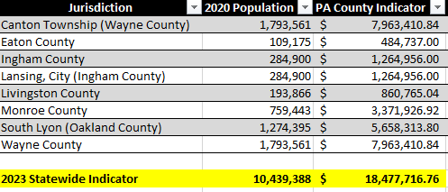
COUNTY indicators - fema public assistance
FY 2023 Statewide Indicator for Presidential Declaration = $18.4 million
Notes:
2020 Decennial Census – 10,077,331

Slide 8
APPLICANT ELIGIBILITY
State, Tribal, Territorial, and Local Governments
State Agencies
Tribes
Counties, Cities, Townships, and Villages
Local public authorities
School districts
Special districts established under state law
Certain Private Non-Profit (PNP) Organizations
Notes:
Critical service PNPs including:
Fire/Emergency Rescue
Medical Treatment
Power, Water, and Sewer Utilities
Communications Systems
Educational Institutions
Social service PNPs including:
Community Centers
Houses of Worship
Homeless Shelters
Custodial Care
Museums, Libraries, Zoos

Slide 9
Facility Eligibility
Buildings, works, systems, or equipment, built or manufactured, or an improved and maintained natural feature
Actively used at the time of the disaster
Legally owned, operated, and regularly maintained
Notes:
In general, a facility must be determined eligible for work to be eligible. A facility is a building, system, or equipment, built or manufactured, or an improved and maintained natural feature.
Facilities must be proven to be maintained and in the case of a natural feature it must be shown to have an constructed improvement maintained on a regular basis.
NOTE:
Dams must be owned by a public entity, privately owned are ineligible
Dams that are publicly owned but leased out must provide a lease agreement (repairs may be under the jurisdiction)
EXAMPLE 1: Water distribution “system” is an example (mechanical, electrical, plumbing and other systems are components and considered part of that facility)
EXAMPLE 2: Roads, bridges, culverts that are the legal responsibility and on a regular maintenance schedule
***Non-FHWA (Federal Highway program roads) – MAKE SURE TO SEPARATE THESE OUT!
A natural feature is improved and maintained if it meets all of the following conditions:
The natural feature has a designed and constructed improvement to its natural characteristics, such as a terraced slope or realigned channel
The constructed improvement enhances the function of the unimproved natural feature
The Applicant maintains the improvement on a regular schedule to ensure that the improvement performs as designed

Slide 10
Work eligibility
Be disaster-related
Be located in the designated disaster
area
Be the legal responsibility
Not fundable by another Federal
agency
Notes:
*Measures to protect life, public health, and safety are generally the responsibility of state, local, tribal, and territorial (SLTT) governments; to be eligible for PA reimbursement, work must be the legal responsibility of an eligible applicant.
Applicants will have to provide proof to FEMA
Procurement and Contracting – MUST follow either your agency’s procurement rules OR the Federal rules in the CFR, whichever is more restrictive!!!

Slide 11
Types of work
Emergency Work
A – Debris Removal
B – Emergency Protective Measures
Permanent Work
C – Road and Bridge Systems
D – Water Control Facilities
E – Public Buildings/Equipment
F – Public Utilities
G – Parks, Recreational, and Other Facilities
Notes:
FEMA breaks work up by category to facilitate the process of PA funding.
It is separated into two categories: Emergency Work, which addresses an immediate threat, and Permanent Work, which is for restoration work.

Slide 12
Emergency work
Category A – Debris Removal
Eliminates an immediate threat to life, health, and safety
Eliminates an immediate threat of significant damage to improved property
Ensures economic recovery of the community and provides a benefit for the community-at-large
Notes:
EGLE (formerly DEQ) requirements (i.e., Permits) must be followed
Alternate procedure - straight time labor costs may be reimbursed
Legal responsibility issue (private property)
FEMA has several tools on line to assist you with debris management:
FEMA Debris Removal Fact Sheet – Tips
FEMA Private Property Debris Removal Fact Sheet
FEMA Debris Management Handbook, which also includes, a DEBRIS MANAGEMENT PLAN TEMPLATE

Slide 13
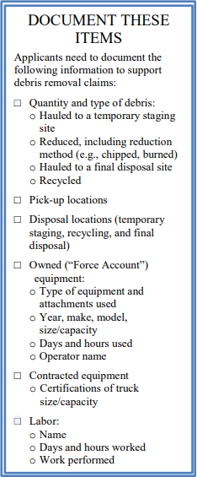
Category a – debris removal
Removal of incident-related debris from public property and public rights-of-way (ROW)
If residents are authorized to place incident-related debris on the ROW, costs to remove the debris may be reimbursable.
Private property debris removal considerations (may not be eligible for PA)
Generally, the responsibility of individual property owners.
Must prove debris is a public health hazard and an immediate threat to life, public health, or safety, or economic recovery of the community at large.
Requires written request and FEMA approval.
**See FEMA Public Assistance: Debris Removal Tips and Private Property Debris Removal Fact Sheets
**See FEMA Public Assistance: Private Property Debris Removal Fact Sheet
Notes:
**See FEMA Public Assistance: Debris Removal Tips Fact Sheet
FEMA reimburses costs to remove incident-related debris from public property and public rights-of-way (ROW).
If residents are authorized (by press release, informational flier) to place incident-related debris on the ROW, costs to remove the debris may be reimbursable.
Include list of items required to track (see FEMA PA Fact Sheet).
**See FEMA Public Assistance: Private Property Debris Removal Fact Sheet
Private property debris removal considerations (may not be eligible for PA; prove it is a public health hazard)
Generally, the responsibility of individual property owners.
Requires written request and FEMA approval.
Must demonstrate:
Applicant’s legal authority to maintain the ROW AND
provide an authorized determination that disaster- generated debris on private property is an immediate threat to life, public health, or safety, or economic recovery of the community at large.

Slide 14
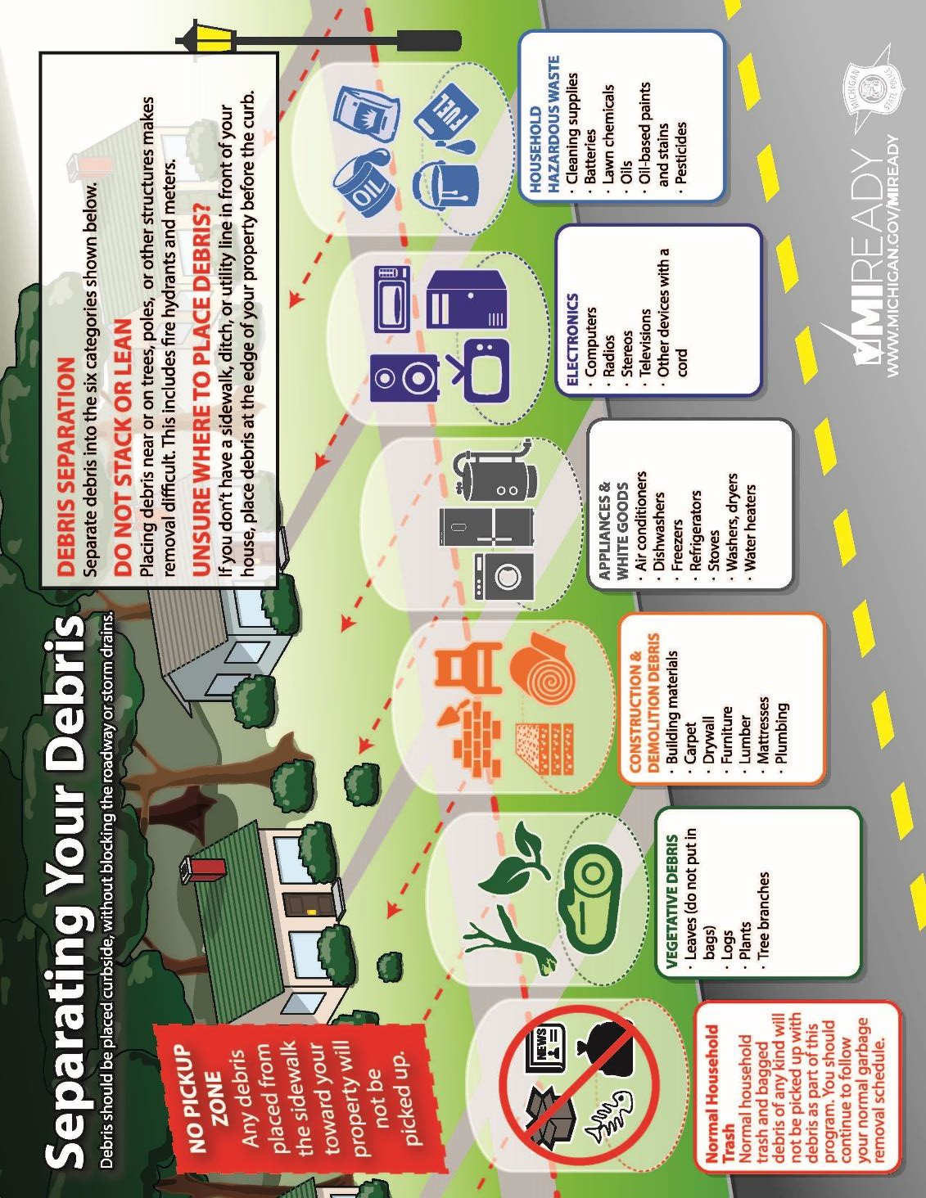
Example – debris staging area

Slide 15
Example – debris staging area

Slide 16
Emergency work
Category B – Emergency Protective Measures
Saves lives
Protects public health and safety
Protects improved property, or
Eliminates or lessens an immediate threat of additional damage
Notes:
Examples: sandbagging, pumping, barricades for road closures or public safety, fire and law enforcement services, search and rescue, EOC-related costs
Only category separating out straight time and overtime (budgeted and non-budgeted); permanent work of roads, buildings, other facilities, etc.

Slide 17
Permanent work
Categories C – G
Must repair, restore, or replace disaster-damaged facilities
Must restore to pre-disaster design, capacity, and function, in accordance with applicable codes and standards
Must be required as a result of the disaster
Conforms to current codes and standards
May include cost-effective hazard mitigation measures
Notes:
Work required to restore a facility to its pre-disaster design (size and capacity) and function in accordance with applicable codes and standards.

Slide 18
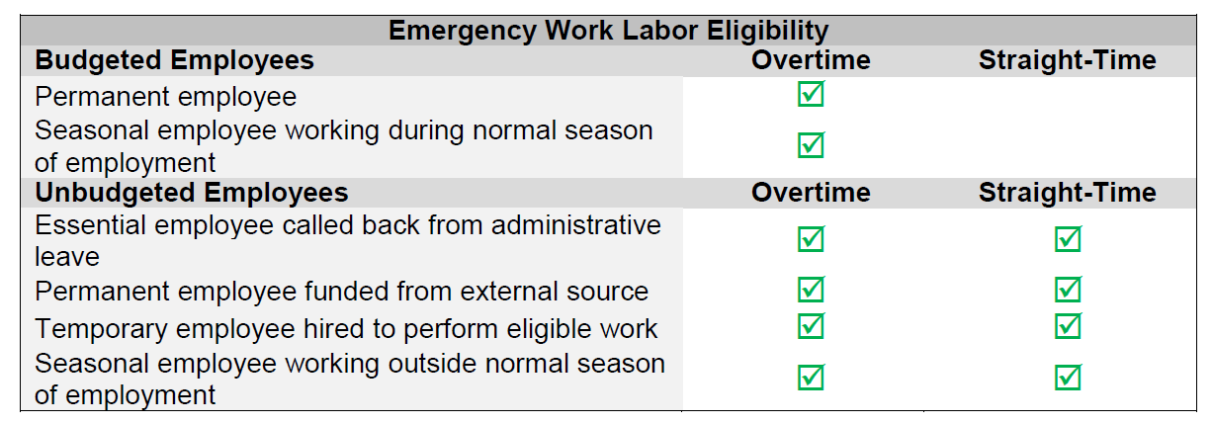
CATEGORY B: FORCE ACCOUNT LABOR
Permanent Work Labor Eligibility
Overtime Straight-Time
Budgeted Employees
Unbudgeted Employees
Notes:
For Emergency Work (Categories A-B), only overtime labor is eligible for budgeted employees. For unbudgeted employees performing Emergency Work, both straight time and overtime labor are eligible.
For permanent work (Categories C-G), both straight-time and overtime labor are eligible for budgeted and unbudgeted employees.

Slide 19
COST ELIGIBILITY
To be eligible for reimbursement, costs must be:
Incurred from eligible work and adequately documented;
Reduced by insurance proceeds, salvage value, or other credits;
Authorized and permitted under Federal, State, Tribal, or local government laws or regulations;
Consistent with the Applicant’s internal policies, regulations, and procedures; and
Necessary and reasonable to accomplish the work properly and efficiently.
Notes:
To be eligible, Costs must be:
Directly tied to the performance of eligible work;
Adequately documented;
Reduced by credits, such as insurance proceeds or salvage value;
Authorized and not prohibited under Federal, State, Tribal, or local government laws or regulations;
Consistent with the Applicant’s internal policies, regulations, and procedures that apply uniformly to both Federal awards and other activities of the Applicant; and
Necessary and reasonable to accomplish the work properly and efficiently.

Slide 20
damage assessment overview

Slide 21
Damage assessment process
Three-Step Process
Locals – Identify damages during the “Initial Damage Assessment”
State – Verify and analyze damages
State and Federal – the State and FEMA conduct a “Joint Preliminary Damage Assessment (PDA)”

Slide 22
Damage assessment process
Local Level: Initial Damage Assessment
The local emergency manager is responsible for collecting data to determine the amount of damage caused by the disaster:
Coordinating assessment activity in the jurisdiction
Charging damage assessment teams with identifying and collecting data on damages
Submitting data to MI CIMS normally within 72 hours of the incident
Notes:
Local emergency managers – identify potential applicants to collect damages

Slide 23
Local (Initial) Damage Assessment
Essential Elements of Information/Documentation from Locals to determine if the incident is of such severity and magnitude that resources for recovery are expected to exceed state, Tribal or territorial government capability.
Map damage locations
Take photographs
Estimate costs for work to be completed by location and category of work
Obtain bills, invoices, and receipts for eligible work completed
Deduct anticipated insurance proceeds
Review procurement policies
COMPLETE and ORGANIZED Documentation
ENTER Damage and Impacts into MI CIMS
Notes:
Mark damage locations on a map and provide lat/long GIS coordinates
Take photographs of the damage
Estimate costs for work to be completed by location and category of work
Obtain bills, invoices, and receipts for eligible work completed
Review insurance policies and deduct any anticipated insurance proceeds from costs
Review contracting procurement policies to ensure they meet federal requirements

Slide 24
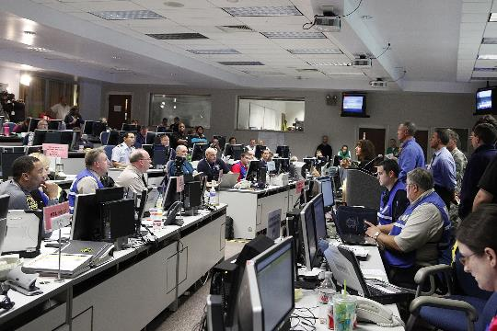
Damage assessment process
State Level:
Verification and Analysis
The State Director of Emergency Management is responsible for overseeing damage assessments, verification of local data, and validation activities to verify local damage assessment findings.

Slide 25
Damage assessment process
Joint PDA: Validate
Damage Assessment Data
If the severity and magnitude of the incident are expected to exceed the availability and capability of local and state resources to recover, the State Director of Emergency Management may request a Joint PDA from the FEMA Regional Administrator (RA) to validate damage and evaluate impact.
The purpose of the Joint PDA is to validate – not find – damage and impacts of the damage that have already been identified.
Notes:
Damage assessment contributes to determining the magnitude of a disaster and the potential for seeking a Presidential/Federal declaration for assistance.
Severity is the measure of the seriousness of the effects of an incident, and it address factors such as:
Number of people affected
Amount of lost capital
Number of uninhabitable buildings/homes
Impact to critical infrastructure and key resources
Magnitude is the measure of the strength of a disaster
Damage assessment involves more than simply collecting data and entering it into MI CIMS – it paints a picture to allow:
More rapid recovery for survivors and communities (it provides information to be used when formulating the recovery plan)
More information on the front end → more successful outcome → establish priorities
Helps to improve the Joint PDA process if FEMA assistance is requested
THE PRIMARY OBJECTIVE OF A JOINT PDA IS TO DETERMINE WHETHER THE VALIDATED IMPACTS OF A DISASTER WARRANT A PRESIDENTIAL DISASTER DECLARATION REQUEST.

Slide 26
PRELIMINARY DAMAGE ASSESSMENT (PDA)
The PDA process is a mechanism used to determine the impact and magnitude of damage and the resulting unmet needs of individuals, businesses, the public sector, and the community. Information collected is used by the state as a basis for the governor's request and by FEMA to document the recommendation made to the President in response to the governor's request.
With the support of the state, tribe, or territory, local governments first conduct initial damage assessments (IDA) to determine if they require federal support. Once SLTT governments determine their capability to respond to or recover from the event is exceeded, the state, tribe, or territory requests a joint PDA with FEMA.
Notes:
It paints a picture of the damages and impacts sustained as the result of a disaster.

Slide 27
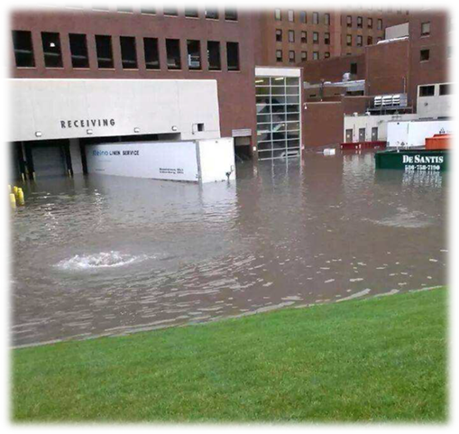
Damage Assessment – PA Factors
To determine need for Federal assistance:
Estimated cost of assistance
Localized impacts
Insurance coverage in force
Hazard Mitigation
Recent multiple disasters
Assistance available from other agencies
Documentation is REQUIRED to validate costs!!!
Notes:
Factors assessed to determine need (44 CFR 206.48):
Estimated cost of assistance
Localized impacts
*Capturing the impact that lost or damaged infrastructure had on the jurisdiction is essential.
*At times extraordinary concentrations of damages that might warrant Federal Assistance even if the per capita indicator is not met, which is why documenting impacts is so important
Insurance coverage in force
Hazard Mitigation
*FEMA considers the extent to which in-place hazard mitigation projects contributed to the reduction of disaster damage
*EXAMPLE an existing building code or HM likely reduced the cost of repairs
Recent multiple disasters
*FEMA considers other emergencies or disasters made by the Governor or President
Available assistance from other agencies
Documentation is REQUIRED to validate costs!!!!!

Slide 28
Preliminary damage assessment (PDA)
Step 1 – Identify Potential Applicants and Damaged Facilities
Step 2 – Document Damage, Work, and Cost
By Category
Labor (Force Account)
Equipment (Force Account)
Leased Equipment
Materials/Supplies
Notes:
Step 1 – Identify Potential Applicants and Damaged Facilities (including eligible critical infrastructure PNPs such as hospitals, nursing home facilities, schools, etc.)
Step 2 – Document Damage, Work, and Cost

Slide 29
Preliminary damage assessment – PA teams
Required Documentation:
Map of entire affected area, marking sites if possible
Work completed documentation or all actual costs incurred
Force account labor, equipment, and supply documentation from the
internal systems that establish the basis for costs claimed
Budget information
For debris costs, actual documentation or estimate of reasonable costs
Insurance policy
Videos, still photos or diagrams, especially for Emergency Work
Notes:
The more comprehensive the documentation provided, the more beneficial the results of the PDA.
Local and tribal representatives should be prepared to provide all disaster documentation as described below:
For work completed, documentation for actual costs incurred is ideal.
For force account costs (labor, equipment, or supplies), be prepared to provide all documentation from the jurisdiction’s internal systems that establish the basis for the costs claimed.
For debris costs incurred, be prepared to provide actual cost documentation. For any remaining debris costs anticipated, be prepared to provide an estimate of costs based on some reasonable estimating methodology.
For all public damages claimed, applicable insurance policy coverage must be provided. Each jurisdiction should have their risk management contact available to answer questions concerning the jurisdiction’s insurance coverage. They should also have a complete copy of the jurisdiction’s insurance policy available for review.
Any videos, still photos and diagrams, especially for Emergency Work should be provided for each site or facility, if available.
For all costs based on estimates, provide the estimating methodology or cost basis used.

Slide 30
Public assistance additional considerations

Slide 31
Procurement under Exigency or Emergency Circumstances
Emergency: an unexpected and unusually dangerous situation that calls for immediate action or an urgent need for assistance or relief. E.g. threat to life, public health or safety, improved property, and/or some other form of dangerous situation.
Exigency: something that is necessary in a particular situation that requires or demands immediate aid or action.
Procurement Disaster Assistance Team (PDAT) online provides tools and resources
Notes:
Emergency: an unexpected and unusually dangerous situation that calls for immediate action or an urgent need for assistance or relief. E.g. threat to life, public health or safety, improved property, and/or some other form of dangerous situation.
Example: A severed power line remains live and is dangling near an apartment building. If not addressed immediately, this live wire poses a risk of igniting the building on fire or causing bodily harm. The emergency would not extend to repair and restoration of the city’s power lines beyond resolution of this limited dangerous situation.
Exigency: something that is necessary in a particular situation that requires or demands immediate aid or action.
Example: Augusta, GA using a noncompetitive procurement in advance of The Masters Golf Tournament to remove debris blocking the roadways. If not removed immediately, the debris threatened to force cancellation of this major economic activity for the region. The exigency only existed up until the day that the tournament started. Full and open competition was required for procurements after the commencement of the tournament.
For more information please see the Fact Sheet: Procurement Under Grants Conducted Under Exigent or Emergency Circumstances
Procurement Disaster Assistance Team (PDAT) web site has many resources regarding procurement including:
36-minute video tutorial to help you understand how to properly contract during emergency and exigent circumstances
Fact Sheets regarding Procurement
Key points on how to avoid the top 10 Procurement Under Grants Mistakes

Slide 32
Sole-Source Procurement E&E
Situations that demand immediate aid or action
If using sole sourcing due to emergency or exigency, you must:
Emergency
Exigency
Justify with documentation
Need to alleviate a threat to life, public health or safety, or improved property
Need to avoid, prevent or alleviate serious harm or injury, financial or otherwise
Use only during the period of actual exigent or emergency circumstances
$
Transition to a competitive method as soon as period ends
Notes:
During the immediate exigent or emergency period, there may be a limited time period eligible for sole-source procurement.
The use of an exception to full and open competition is limited and only permissible during the period of actual exigency or emergency. Once this period ends, the non-state applicant must transition to a procurement compliant with the requirements of full and open competition.
Important Considerations:
The applicant needs to document the justification for using an emergency or exigency exception. The justification must be fact-based. Even if procurement by a noncompetitive proposal was necessary initially due to an exigency or emergency, that exception is not indefinite. Once that exigency or emergency ends, the applicant should transition to a competitively awarded contract when competition becomes feasible.
In some cases a state, local, or tribal law allows for the waiver of procurement requirements when an emergency is declared; however, those laws only allow for the waiver of the applicable state, local, or tribal procurement rules. An applicant must still abide by the Federal procurement standards under 2 C.F.R. sections 200.317 through 326.
When does the exigency or emergency exception apply and for how long?
Use of the public exigency or emergency exception is only permissible during the actual exigent or emergency circumstances. Exigency or emergency circumstances will vary for each incident, making it difficult to determine in advance or assign a particular time frame when noncompetitive procurements may be warranted. Exigent or emergency circumstances may exist for two days, two weeks, two months, or even longer in some cases. Non-state entities must ensure that work performed under the noncompetitively procured contracts is specifically related to the exigent or emergency circumstance in effect at the time of procurement. Importantly, because the exception to competitive procurement is available only while the exigent or emergency circumstances exist, non-state entities should, upon awarding a noncompetitive contract, immediately begin the process of competitively procuring similar goods and services in order to transition to the competitively procured contracts as soon as the exigent or emergency circumstances cease to exist.
FEMA may review a non-state entity’s justification that exigent or emergency circumstances warrant an exception to competitive procurement. If the agency determines that exigent or emergency circumstances did not exist or did not preclude a non-state entity from adhering to competitive procurement requirements, FEMA may disallow all or part of the non-state entity’s cost related to the contract or take other actions permitted by statute and regulation. (See 2 C.F.R. § 200.338).
What documentation is required to support the use of the exigency or emergency exception?
While FEMA approval is not required for a non-state entity to use noncompetitive procurement proposals under the emergency or exigency exception, non-state entities must document and provide justification for the use of the exigent or emergency exception. A list of elements that non-state entities may wish to include as part of their written justifications can be found at the end of this Fact Sheet. The justification must be included in the non-state entity’s records for each FEMA award, subaward, or project
Non-state entities must comply with the following requirements even when exigent or emergency circumstances exist:
• The non-state entity must complete a cost or price analysis to determine that the cost or price of the contract is fair and reasonable if the contract exceeds or is expected to exceed the Federal simplified acquisition threshold (2 C.F.R. § 200.323(a) and (b)).
• Contracts exceeding the Federal simplified acquisition threshold must include the Federal bonding requirements if the contract is for construction or facility improvement (2 C.F.R. § 200.325).

Slide 33
Procurement Under E&E
If sole-sourcing under the E&E exception, non-state entities MUST:
Include required contract clauses (also applicable to states)
2 C.F.R. § 200.326 & Appendix II
Follow time and materials contract requirements, if applicable
2 C.F.R. § 200.318(j)
NOT enter into cost-plus-percentage-of-cost contracts (prohibited)
2 C.F.R. § 200.323(c)
Award contract to a responsible contractor
2 C.F.R. § 200.318(h)
Follow documentation, oversight, conflict of interest requirements
2 C.F.R. § 200.318
Notes:
Non-state entities must comply with the following requirements even when exigent or emergency circumstances exist:
• Contracts must include the required contract clauses (2 C.F.R. § 200.326 & Appendix II) (also applicable to states).
• Use of time and materials contracts must comply with 2 C.F.R. § 200.318(j).
• The use of cost-plus-percentage-of-cost contracting is prohibited (2 C.F.R. § 200.323(c)).
Contracts must be awarded to a responsible contractor (2 C.F.R. § 200.318(h)).
• The non-state entity must follow documentation, oversight, and conflict of interest requirements among other general procurement requirements in 2 C.F.R. § 200.318. If a conflict of interest is unavoidable due to the exigent/emergency circumstances, the non-state entity must explain that in the procurement documentation.

Slide 34
Next steps

Slide 35
DOCUMENTATION NEXT STEPS
Locals
Submit
State Validates
State Requests Joint PDA?
Prioritized list of damages (form required)
Supporting documents for actual and estimated costs
General documents - labor, insurance, procurement policies
Supporting documents for each site
Assists locals to address ineligible items
IMPORTANT - Costs cannot be included without documentation
Based on its validation of costs, determines if the a joint preliminary damage assessment (locals, state, and FEMA) is warranted.
Notes:
Locals submit prioritized list of damages

Slide 36
NEXT STEPS – POTENTIAL PA APPLICANTS
Submit the following information:
List of damaged sites in order by priority and highest estimate
***Assigning each site a number for file naming is helpful
Detailed description of damages for each
Bills, invoices, and receipts for eligible work completed
Photos for each damaged site or a representative sample of photos
Labor policy in effect at the time of the incident
Maintenance records for each facility
Insurance policies (deduct anticipated insurance proceeds)
Procurement policies and pertinent contracts and MOAs

Slide 37
DAMAGE SUMMARY LIST (REQUIRED FORM)
Notes:
No lump sum amounts (cannot determine how amounts was arrived at)

Slide 38
DAMAGE SUMMARY LIST (REQUIRED FORM)
Basic information
Category - drop-down list of FEMA PA Categories
Name of damage/facility
Primary address
Notes:
The first five fields at the top are the basic contact information of the applicant.
The Category field is a drop-down list of the FEMA PA work categories.
Then you will add the name of damage/facility as well as the primary address.

Slide 39
DAMAGE SUMMARY LIST (REQUIRED FORM)
Enter address 2 (if applicable), city, state, zip, latitude and longitude
Describe Damage by providing a detailed description to that facility or site; be sure to include dimensions, materials, and the size or capacity, if applicable
Notes:
Address 2
City, State, Zip
Latitude/Longitude – FEMA may look up site on Google Earth to see the condition before the incident occurred
Provide a detailed description of the damage to that facility or site; be sure to include damage dimensions, materials, and the size or capacity of damaged facility elements if applicable.

Slide 40
DAMAGE SUMMARY LIST (REQUIRED FORM)
Primary Cause of Damage – drop-down list
Approx. Cost – include only eligible costs (exclude FHWA roads, anticipated insurance proceeds, etc.)
% Work Complete
Labor Type – choose from drop-down list (see list tab for acronym list)
Has received PA grants in the past for this facility, yes or no option
Priority Number – the number YOU assign to each
Applicant Priority – drop-down list (low, medium, high, urgent)
Notes:
Labor Types:
Mutual Aid - MAA
Mission Assigned - MA
Memorandum of Understanding - MOU
Force Account - FA
Contract - C
Force Account & Contract - FA/C
Donated Resource - DR

Slide 41
NEXT STEPS – MSP/EMHSD
Reviews and validates submitted disaster information for completeness and potential eligibility issues
Determines if a joint PDA with FEMA is warranted

Slide 42
fact sheets & guidance
Below is a list of FEMA Fact Sheets and Guidance:
Damage Inventory Form
Public Assistance Work Eligibility Matrix and Checklist
Initial Damage Assessment (IDA) Checklist
FEMA Fact Sheet: Procurement Under Grants Conducted Under Exigent or Emergency Circumstances
The federal procurement under grant rules are found at 2 C.F.R. §§ 200.317-200.326
Public Assistance Program and Policy Guide (PAPPG)

Slide 43
Important points to remember
Federal Highway Roads (FHWA) should NOT be included in road repair estimates
Anticipated insurance proceeds should be deducted from estimates
Provide photos as damage assessment should contain visual confirmation of damage information for the damage to be considered valid
List of sites with hardest impacted areas with most extensively damaged sites listed first (Damage Inventory Form)
Provide a detailed description of the damage to that facility or site; be sure to include damage dimensions, materials, and the size or capacity of damaged facility elements if applicable
No lump sum amounts (cannot determine how amounts was arrived at)
Remember to follow local and federal procurement rules
DOCUMENT, DOCUMENT, DOCUMENT!!!

Slide 44
LESSONS LEARNED
Pre-existing damages will be deducted and ineligible (i.e., alligator cracking, lack of gravel and other maintenance
Unable to demonstrate damages are directly related to the disaster
Codes & Standards (EGLE)
No lump sum amounts (cannot determine how amounts was arrived at)

Slide 45
Contact Information
Ms. Tiffany Vedder, PEM
State Public Assistance Officer
Cell: 517-599-5333
veddert@michigan.gov
Ms. Marisela Shellenbarger, PEM
Deputy Public Assistance Officer
Cell: 517-512-9676
shellenbargerm@michigan.gov
Ms. Ashley Goodwin
Public Assistance Analyst
Cell: 517-243-8617
goodwinA2@michigan.gov
Ms. Deressa Walker
Public Assistance Analyst
Cell: 517-614-6824
walkerd49@michigan.gov
Public Assistance Mailbox: MSP-EMHSD-DisasterPA@Michigan.gov

