Slide 1
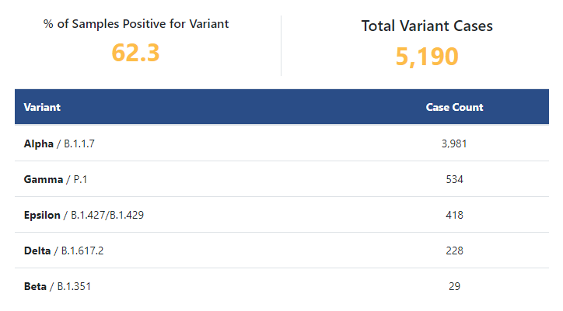
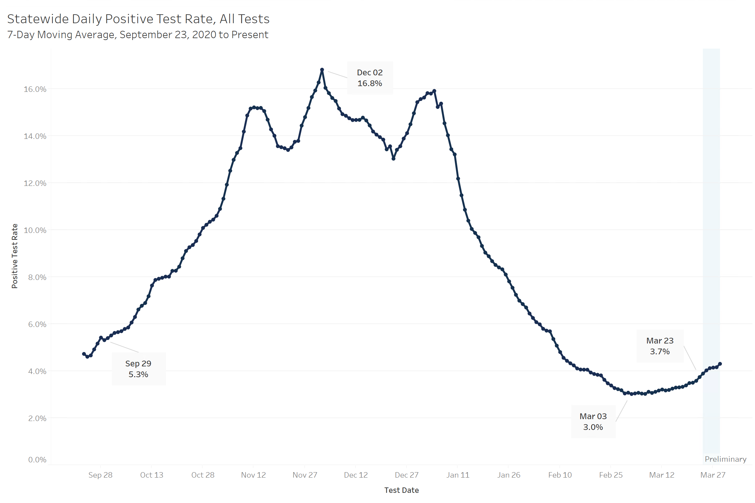
Variant cases in Indiana

Slide 2
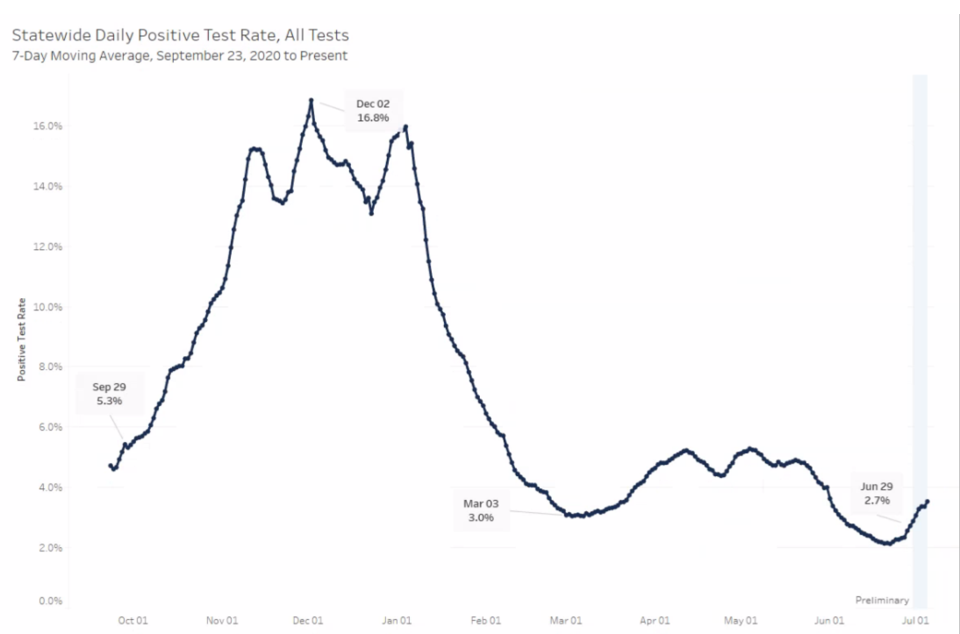
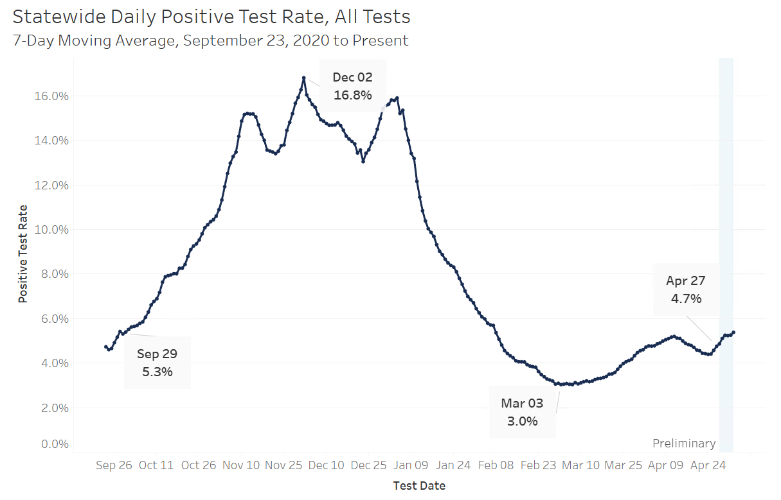
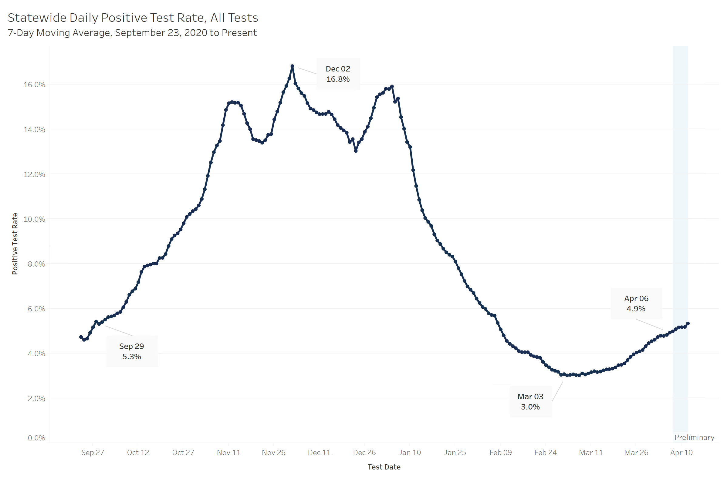
Positivity Rate

Slide 3

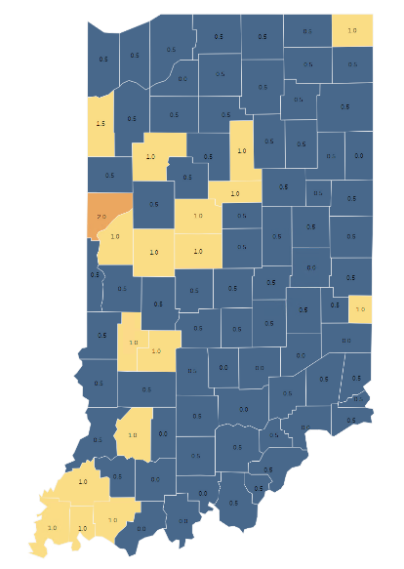

County metrics map
Information for schools, local officials
July 7
The metrics:
Blue (0 and .5)
Yellow (1 and 1.5)
Orange (2 and 2.5)
Red (3)

Slide 4
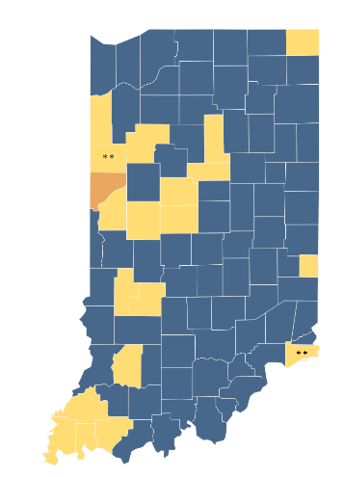
Advisory Level
County metrics map
July 7
Current Advisory Level
Blue
Yellow
Orange
Red

Slide 5
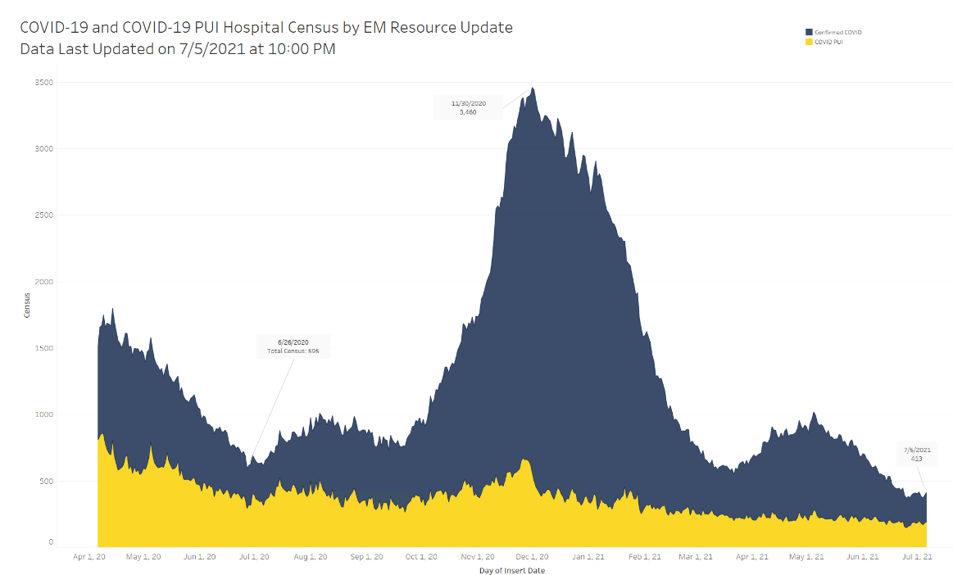
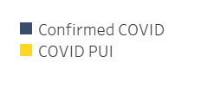
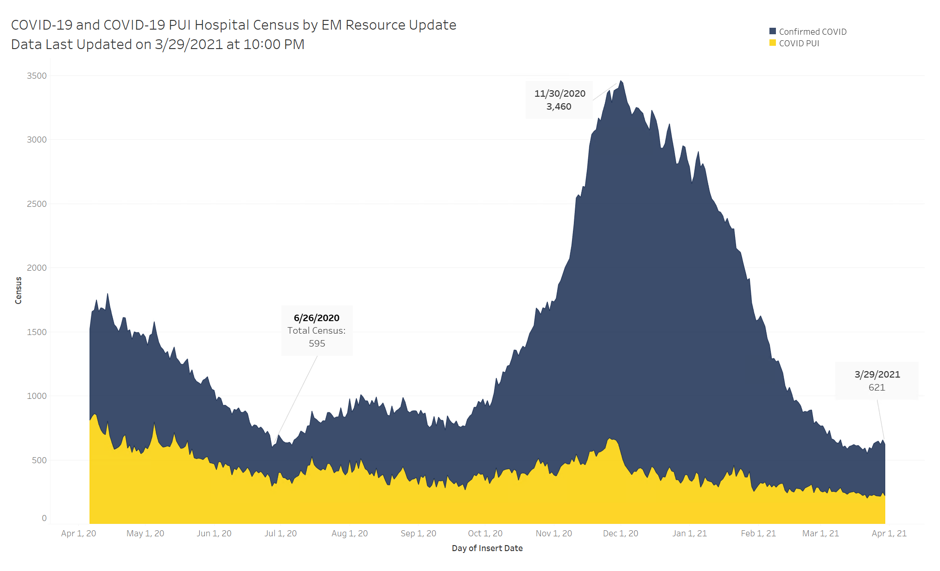
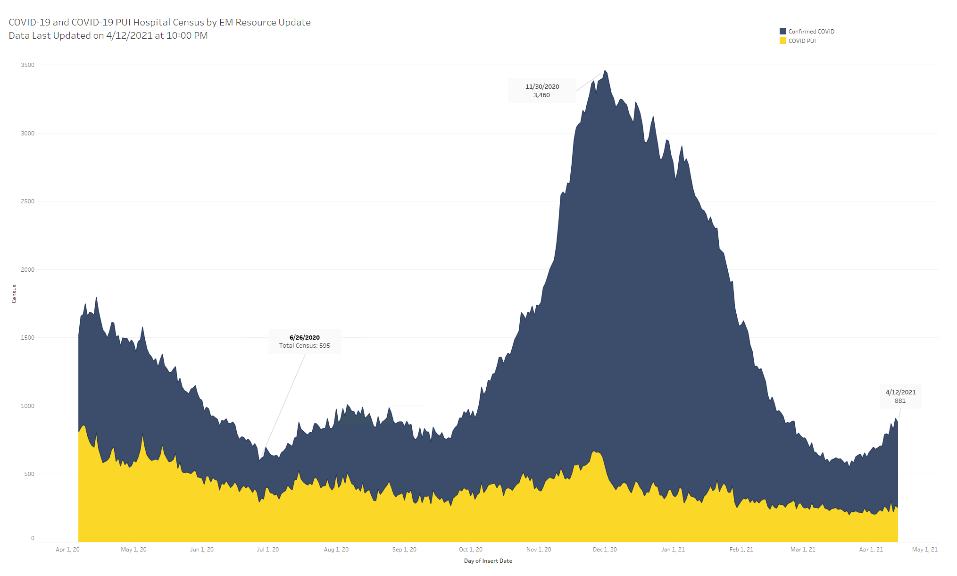
Statewide COVID-19 Hospital Census

Slide 6
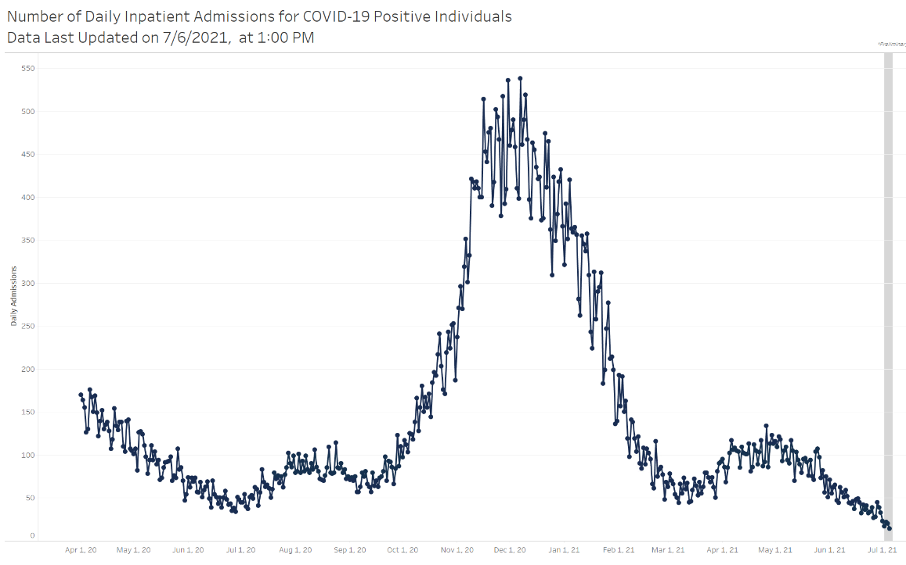
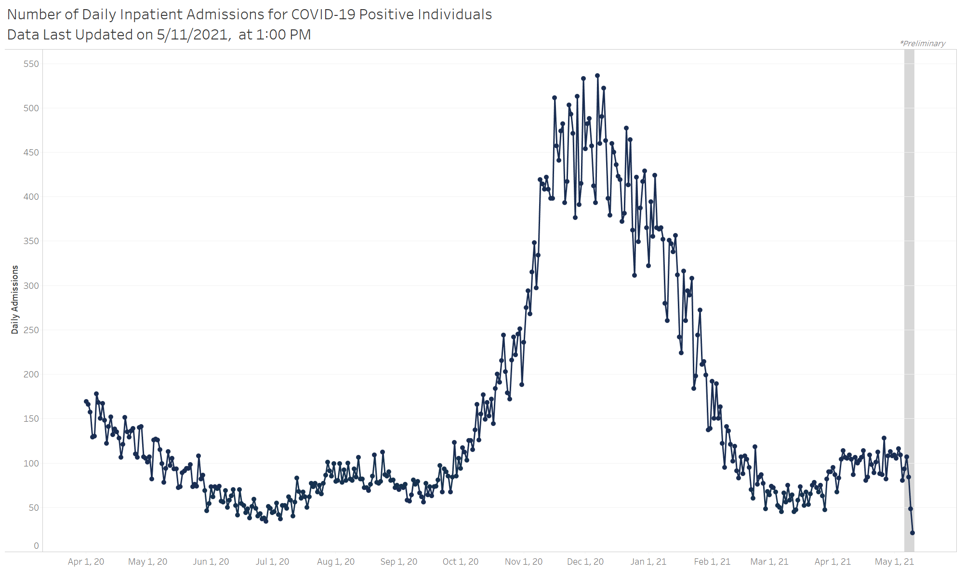
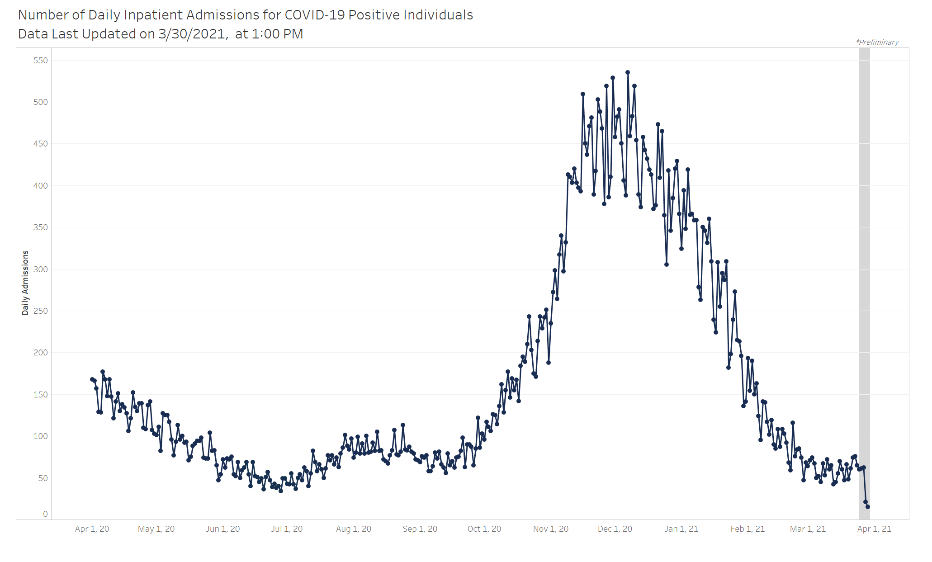
Statewide COVID-19 Hospital Admissions

Slide 7
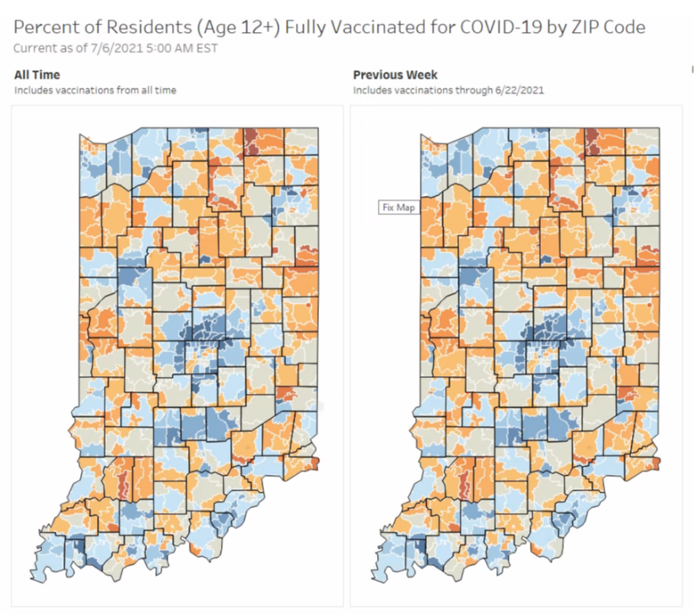
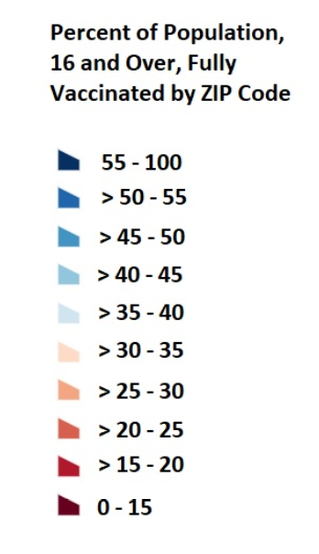
Vaccine uptake by ZIP code

Slide 8

MIS-C cases

Slide 9
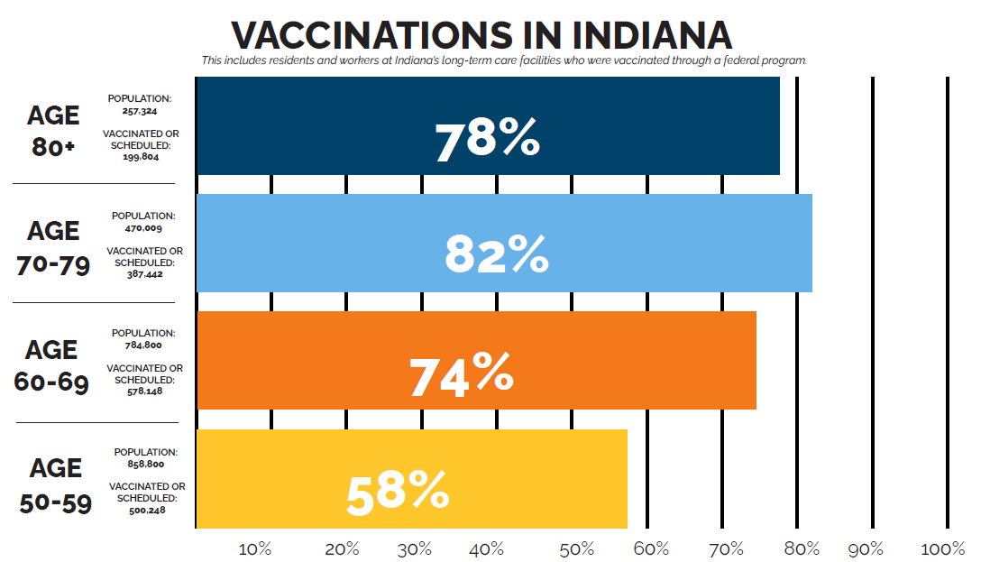
Vaccinations by age group

Slide 10
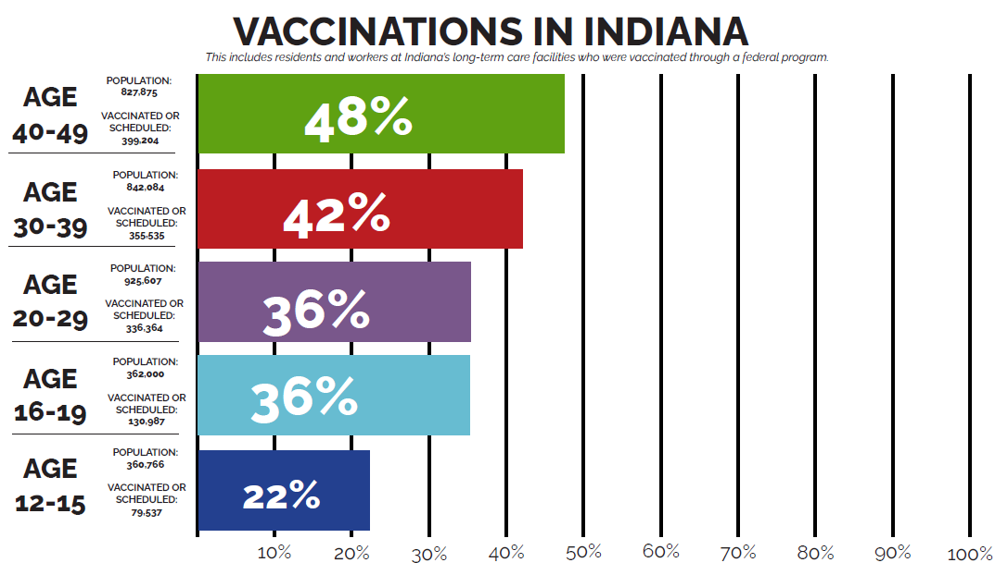
Vaccinations by age group

