Slide 1

INVOICE all-Electronic Submission and Signature Process
BLR 05620 & 05621
Bureau of Local Roads & Streets
July 27, 2021
Notes:
Welcome
This presentation will be recorded and posted in LMS
Please type all questions into the Q&A box, located in the bottom righthand corner of your screen
Please post your questions throughout the presentation, all questions will be addressed verbally at the end of the presentation.

Slide 2
Goals & Objectives
Increase processing of invoices / payments
Establish tracking & control system for all invoices
Modernize forms and process workflows
Meet departmental mandates of less paper, less cost, more efficient document throughout
Maintain District-level Quality Control (QC) process and work
Employment of 2-step Quality Assurance (QA) review process by Central Office:
Step 1: Initial high-level compliance review (48 to 72-hour review & acceptance / return)
Step 2: Detailed invoice review process

Slide 3
Rundown
3-part / division of responsibilities to assist in quality, validation of information, and participation (LPA / District / Central Office)
All-electronic version of BLR 05620 (Invoice form) & BLR 05621 (Local Public Agency Cost Plus Fixed Fee Invoice form) are now on website and available
Locals have the option of using BLR 05620 & BLR 05621 electronic form(s) or paper for invoice requirement submissions to District, if District agrees
Districts must use updated BLR 05620 Invoice form, electronic signature, electronic support documentation materials, and e-mail submittal process for all invoice information and documents sent to Central Office
CBLRS will not accept paper copies of the BLR 05620 Invoice form, nor supporting documentation packages after 9/07/2021

Slide 4
Presentation contents
Local Public Agency Responsibilities
District Requirements
Central Office Process
Electronic Signature Setup/Process
Questions

Slide 5
I. Local public agency responsibilities
Part 1 requires the main transmission of information and participation from the Local Public Agency (LPA)
Both Form BLR 05620 (Invoice form) & Form BLR 05621 (Consultant Cost Plus Fixed Fee Invoice form) have been converted and updated to accept electronic signatures
Form BLRS 05621 (when required), remains the same as with previous versions; however, Page 1 and 3 now permit both the Consultant and the LPA to apply their electronic signatures in the appropriate fields
Form BLRS 05620 has received a small reorganization, and other internally necessary processing improvements, to aid in the completion requirements, as well as the conversion of the Form to now permit the District to apply their electronic signature
Part 1 of this process also includes the important step of the electronic submission by the LPA (and Consultant through the LPA) of BLRS 05620 and all supporting documentation, which will all be encompassed in one, singular email from the LPA to the District for each Invoice
Optional – The LPA may continue to mail supporting documentation packet to District, if District agrees

Slide 6
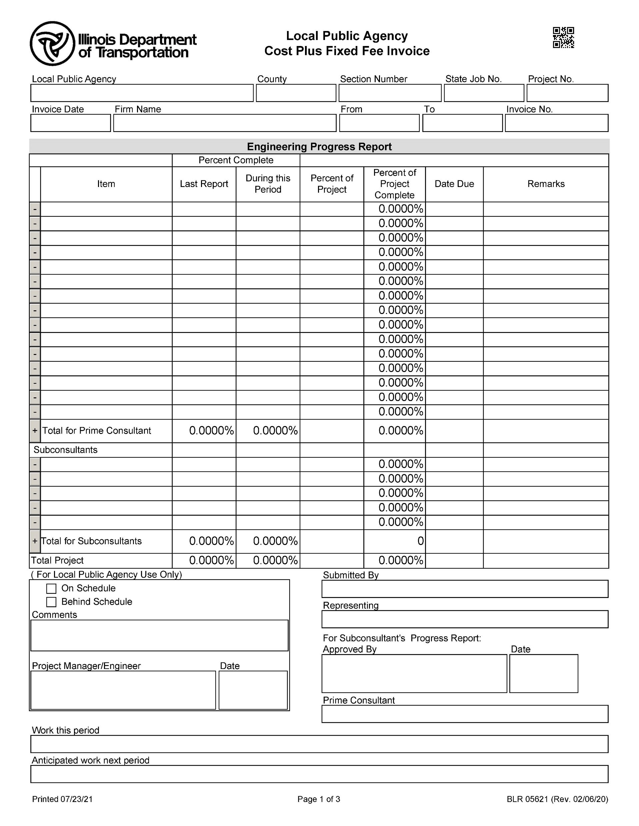
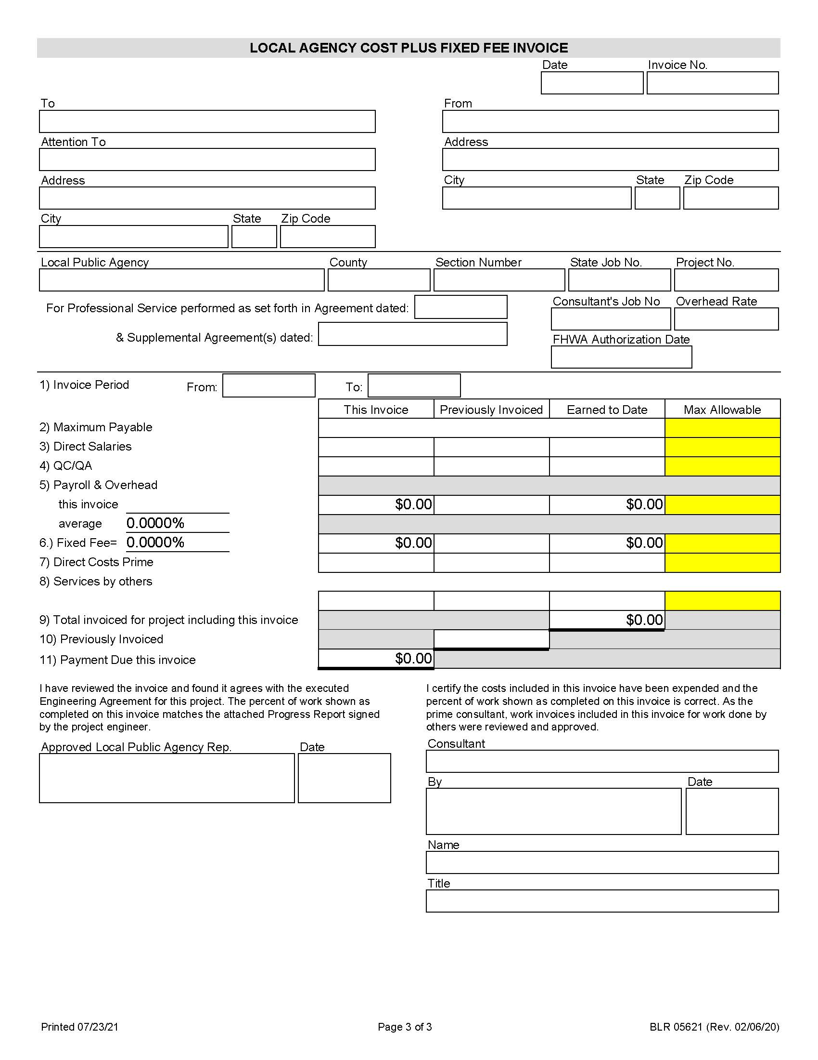
Blr 05621
Notes:
***NOT THE CORRECT FORM***FORM NOT POSTED YET***

Slide 7
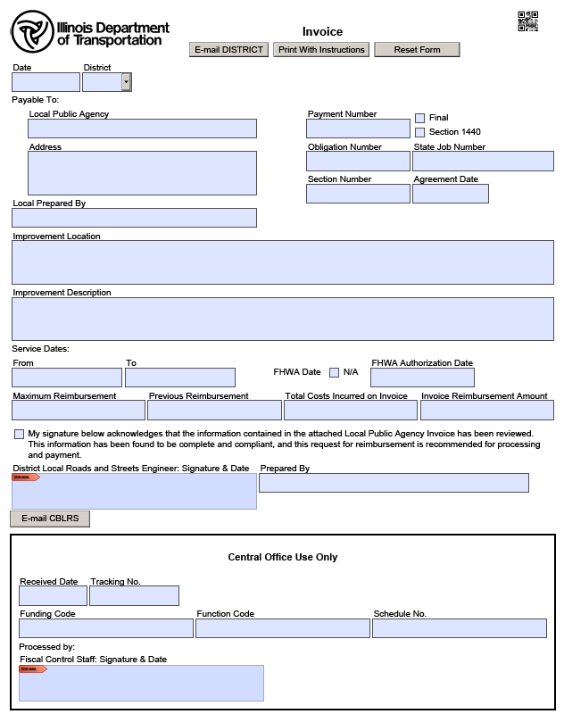
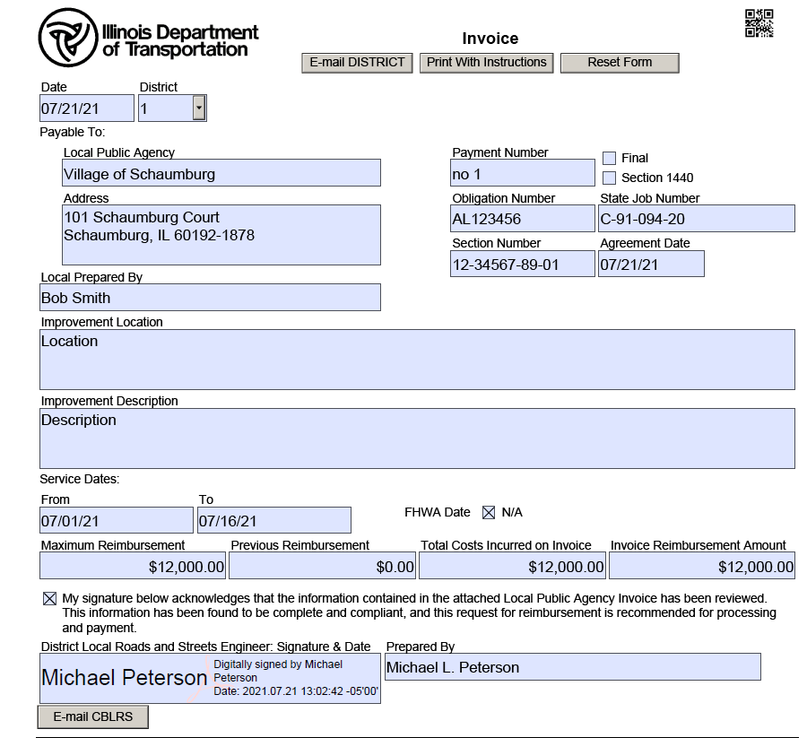
Blr 05620
Notes:
***NOT THE CORRECT FORM***FORM NOT POSTED YET***

Slide 8
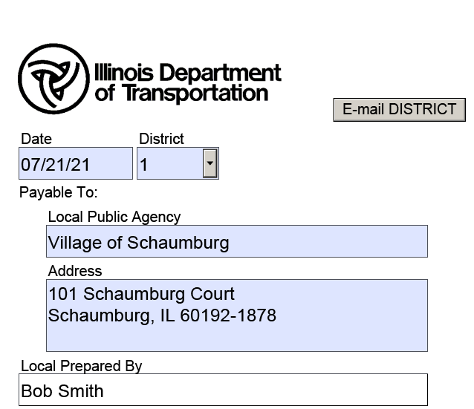
KEY INFORMATION for Lpa
BLRS 05620:
Required fields by the LPA:
Submittal Date / District Identifier
State Job Number & Section Number
Local Public Agency Name & Address
Local Prepared By
Improvement Location & Description
NOTE: If fields are not completed, an error message will be generated, and the BLR 05620 will not be able to be submitted
When completed, click “E-mail DISTRICT”
SUPPORTING DOCUMENTATION PACKAGE:
Scan/Create invoice supporting documentation packet, and attach to email
IMORTANT: Supporting documentation file must be one, singular PDF file. Also, do not provide a PDF “portfolio-style” document where each supporting document is a separate PDF within global PDF document (this will slow processing considerably)
Notes:
NOTE – These are the only fields required to submit to the District; other fields can be completed, but this is optional
If a Required field is NOT filled in, it will be noted by a message with a thin red line outlining the missing information

Slide 9
E-MAIL from lpa to DISTRICT
Form will be validated
Email to respective District-Level Local Roads invoice unit
“Subject” line in email will auto-populate showing the LPA Name & State Job Number
Pre-arranged email addresses for each District have already been established, and are linked to the “District” field values on BLRS 05620, to enable the “To” address to be auto-populated when engaging the “E-Mail to the District” button
For Reference:
D1 – DOT.D1.BLRS@illinois.gov D2 – DOT.D2.LocalRoadsInvoices@illinois.gov D3 – DOT.D3.LocalRoads@illinois.gov D4 – DOT.D4. LocalRoadsInvoices@illinois.gov D5 – DOT.D5. LocalRoadsInvoices@illinois.gov | D6 – DOT.D6. LocalRoadsInvoices@illinois.gov D7 – DOT.D7. LocalRoadsInvoices@illinois.gov D8 – DOT.D8. LocalRoadsInvoices@illinois.gov D9 – DOT.D9. LocalRoadsInvoices@illinois.gov
Notes:
Validation for completion of required fields
Proper email address will be automatically populated based on District dropdown selection

Slide 10
II. District Requirements
Part 2 requires the main transmission of information and participation from the District to Central Office
The District will still be required to perform an in-depth Quality Control check and review of all Forms (05621 and 05620), as well as all the contents of the supporting documentation package
Form BLRS 05620 will require completion of the fields / information beyond that supplied by the LPA
Each email submission from the District to Central Office will be inclusive of 2 (two) attachments only- BLRS 05620 Form and the supporting documentation package (Exception would be if supporting document package was too large to directly email)
The District must supply the BLRS 05620 and the supporting documentation packet to Central Office by email. Paper copies will no longer be accepted after 9/7/2021

Slide 11
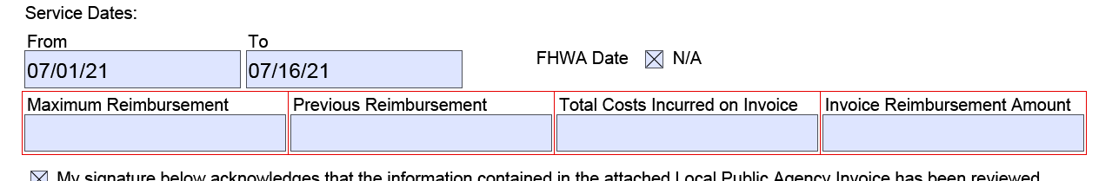
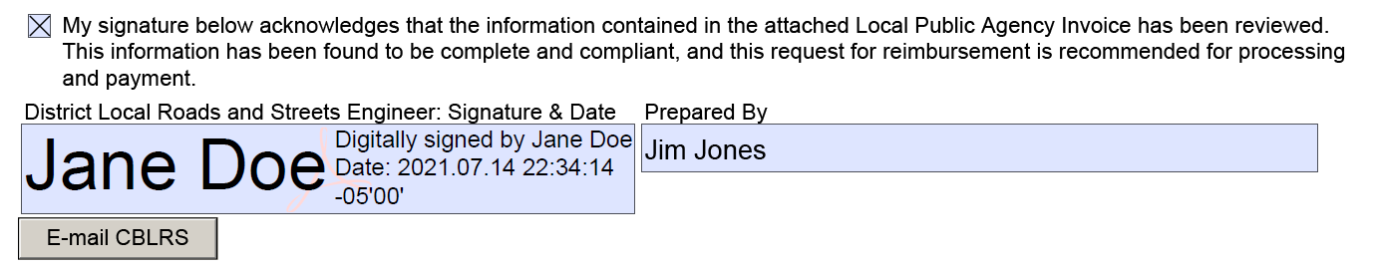
KEY INFORMATION for DISTRICTS
BLRS 05620:
Required fields by the District:
Invoice “Number” information
Service Dates Section
District-Level Bureau Chief Signature
NOTE: Like Part 1 (LPA to District), if fields
are not completed, an error message
will be generated, and the BLR 05620
will not be able to be submitted
When completed, click
“E-mail CENTRAL OFFICE”
SUPPORTING DOCUMENTATION PACKAGE:
Perform detailed Quality Control review of supporting documentation packet, and attach to email
IMORTANT: District to ensure that supporting documentation file is one, singular file as a PDF. Also do not provide a PDF portfolio-style document where each supporting document is a separate PDF within the global PDF document (this will slow processing considerably)
Notes:
NOTE – These are the only fields required to submit to the District; other fields can be completed, but this is optional
If a Required field is NOT filled in, it will be noted by a message with a thin red line outlining the missing information

Slide 12
E-MAIL from DISTRICT to CENTRAL OFFICE
BLRS 05620 form will again be validated
Email to Central Office Bureau of Local Roads invoice unit (only 1 unified address is available, per below)
“Subject” line in email will be auto-populated with key data we need (do not alter this information, but you may add additional information at the end of it)
NOTE: Do not batch invoices, meaning only 1 (one) invoice per email submission
For Reference:
DOT.BLRSFiscalControl@illinois.gov
Notes:
Validation for completion of required fields
Proper email address will be automatically populated based on District dropdown selection

Slide 13
III. Central office Process
Please Remember -- Central Office will only accept electronic submittals of invoices and invoice supporting documentation packets
Upon receipt of the District Invoice email (including the BLR 05620 and supporting documentation), CO Fiscal Control Team will commence a new Invoice Quality Assurance (IQA) process, that is a 2-step process:
Part A – Initial Completeness & Compliance Review (typically a 48 to 72-hour turnaround)
Part A (Revisions) – Revisions to BLRS 05620 and / or supporting invoice materials will be sent back to District for correction
Part A (Acceptance) – Upon Acceptance of materials, CBLRS Fiscal Control Team will assign a unique tracking Number
Part B – Detailed Completeness & Fiscal Review of all materials provided, and processing of payments if materials are all in compliance with IOC, Departmental and Bureau policies

Slide 14
CENTRAL OFFICE: Part A – Review Details
Part A – Initial Completeness & Compliance Review, limited to:
QA Review BLR 05620 inputs, including identifying information (Obligation Number, State Job Number, Section, LPA identifiers), service dates (special focus on timing and authorization dates), and request information (including maximum reimbursement and total costs)
Initial “completeness” (but not compliance) review of supporting documentation package materials
If information is accepted, the invoice will receive tracking number and logged – to be process in the order received
If corrections are required, CBLRS will Email District identify the required correction(s)
PLEASE NOTE: Per departmental and Bureau policies, no additions/corrections can be made by CBLRS staff upon receipt of submitted information as this would trigger the following:
Invalidation of the District’s signature
Internal audit finding that will delay information processing
May lead to additional errors and / or miscommunication
Eliminates Quality Assurance version / revision traceable trail

Slide 15
CENTRAL OFFICE: Part b – Review Details
Part B – Detailed Completeness & Fiscal Review, inclusive but not limited to the following:
Archive of Email and both attachments (BLR 05620 and supporting information package), with transmittal and received dates
Assignment of unique with Tracking Number, (FYIN-XXXXX-D#)
FY = Fiscal Year
IN = Constant value for Invoice
XXXXX = 5 Numbers indicating the internal sequential invoice received number
D# = District Identifier
Archive of Pre-Review Invoice to CBLRS internal “Shared Drive”
Completes BLR 05620 with Funding Code and Function Codes, and validates against COD
Process invoice in FOA
Combines BLR 05620 and invoice supporting documentation packet into single file
Upon processing and payment, archives files to WMFT Virtual File Room
Notes:
IN – Similar to format for other documents, example: Joint Agreements – FYJA-XXXXX-D#
May tweak email for Railroad Crossing ??

Slide 16
Completed blr 05620

Slide 17

IV. Electronic Signature

Slide 18
V. Questions

