Slide 1

Florida Division of Emergency Management
State Watch Office
Morning Situation Report

Slide 2

State Emergency Operations Center Activation Level

Slide 3
SERT On-Call Personnel

Slide 4

Response Regional Coordination Team
Region 7 Coverage Provided by Response Coordinator 6
Region 8 Coverage Provided by Response Coordinator 10
Status
Normal Operations
Out of Service / Unavailable

Slide 5
Recovery Regional Coordination Team
Region 4 Coverage Provided by Region 5 Coordinator
Region 7 Coverage Provided by Region 6 Coordinator & Recovery RC Supervisor
Region 8 Coverage Provided by Region 6 Coordinator & Recovery RC Supervisor
Region 9 Coverage Provided by Region 6 Coordinator & Recovery RC Supervisor
Status
Normal Operations
In Region / Delayed Response
Deployed / Delayed Response
Out of Service / Unavailable

Slide 6
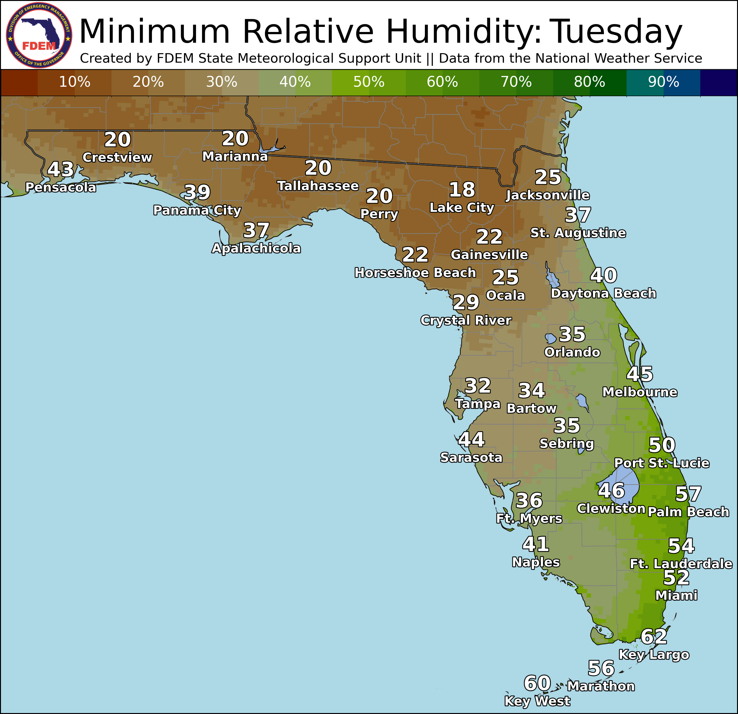
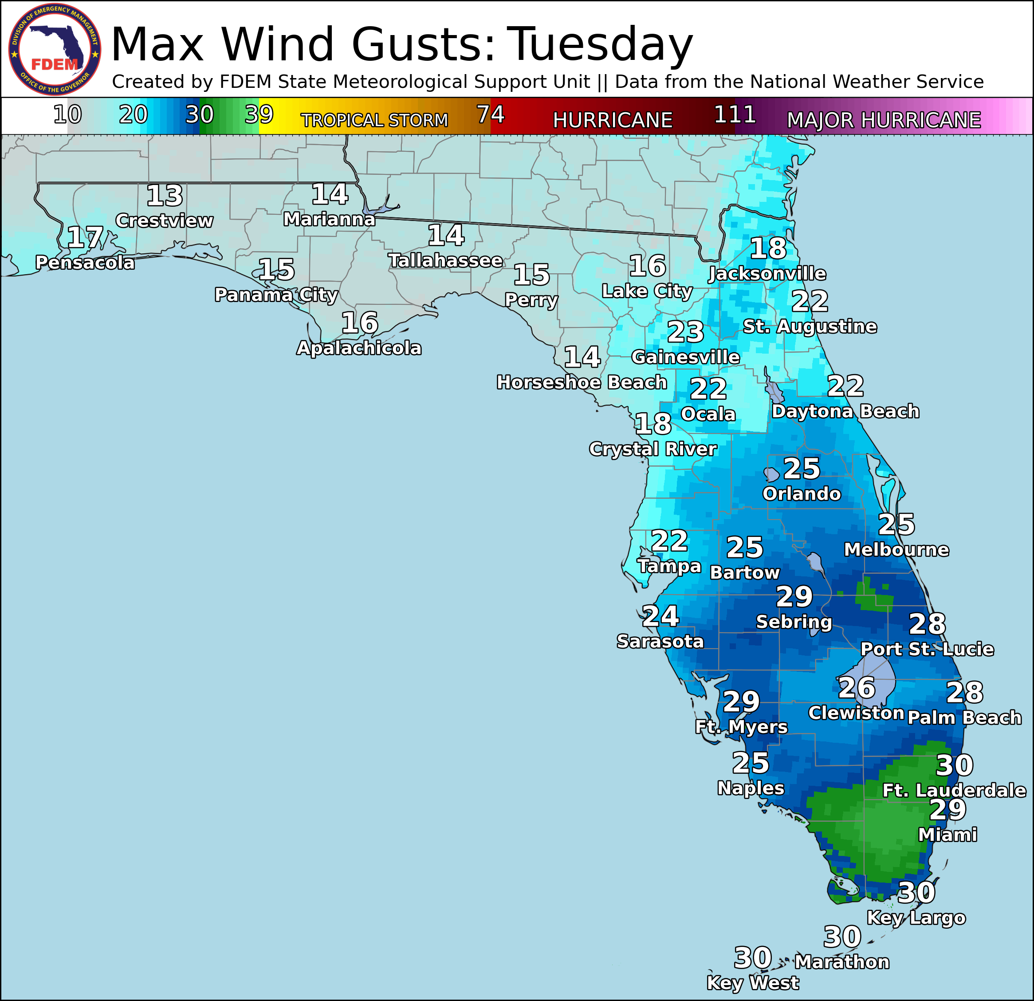
Meteorology Summary
Today’s Weather Map

Slide 7
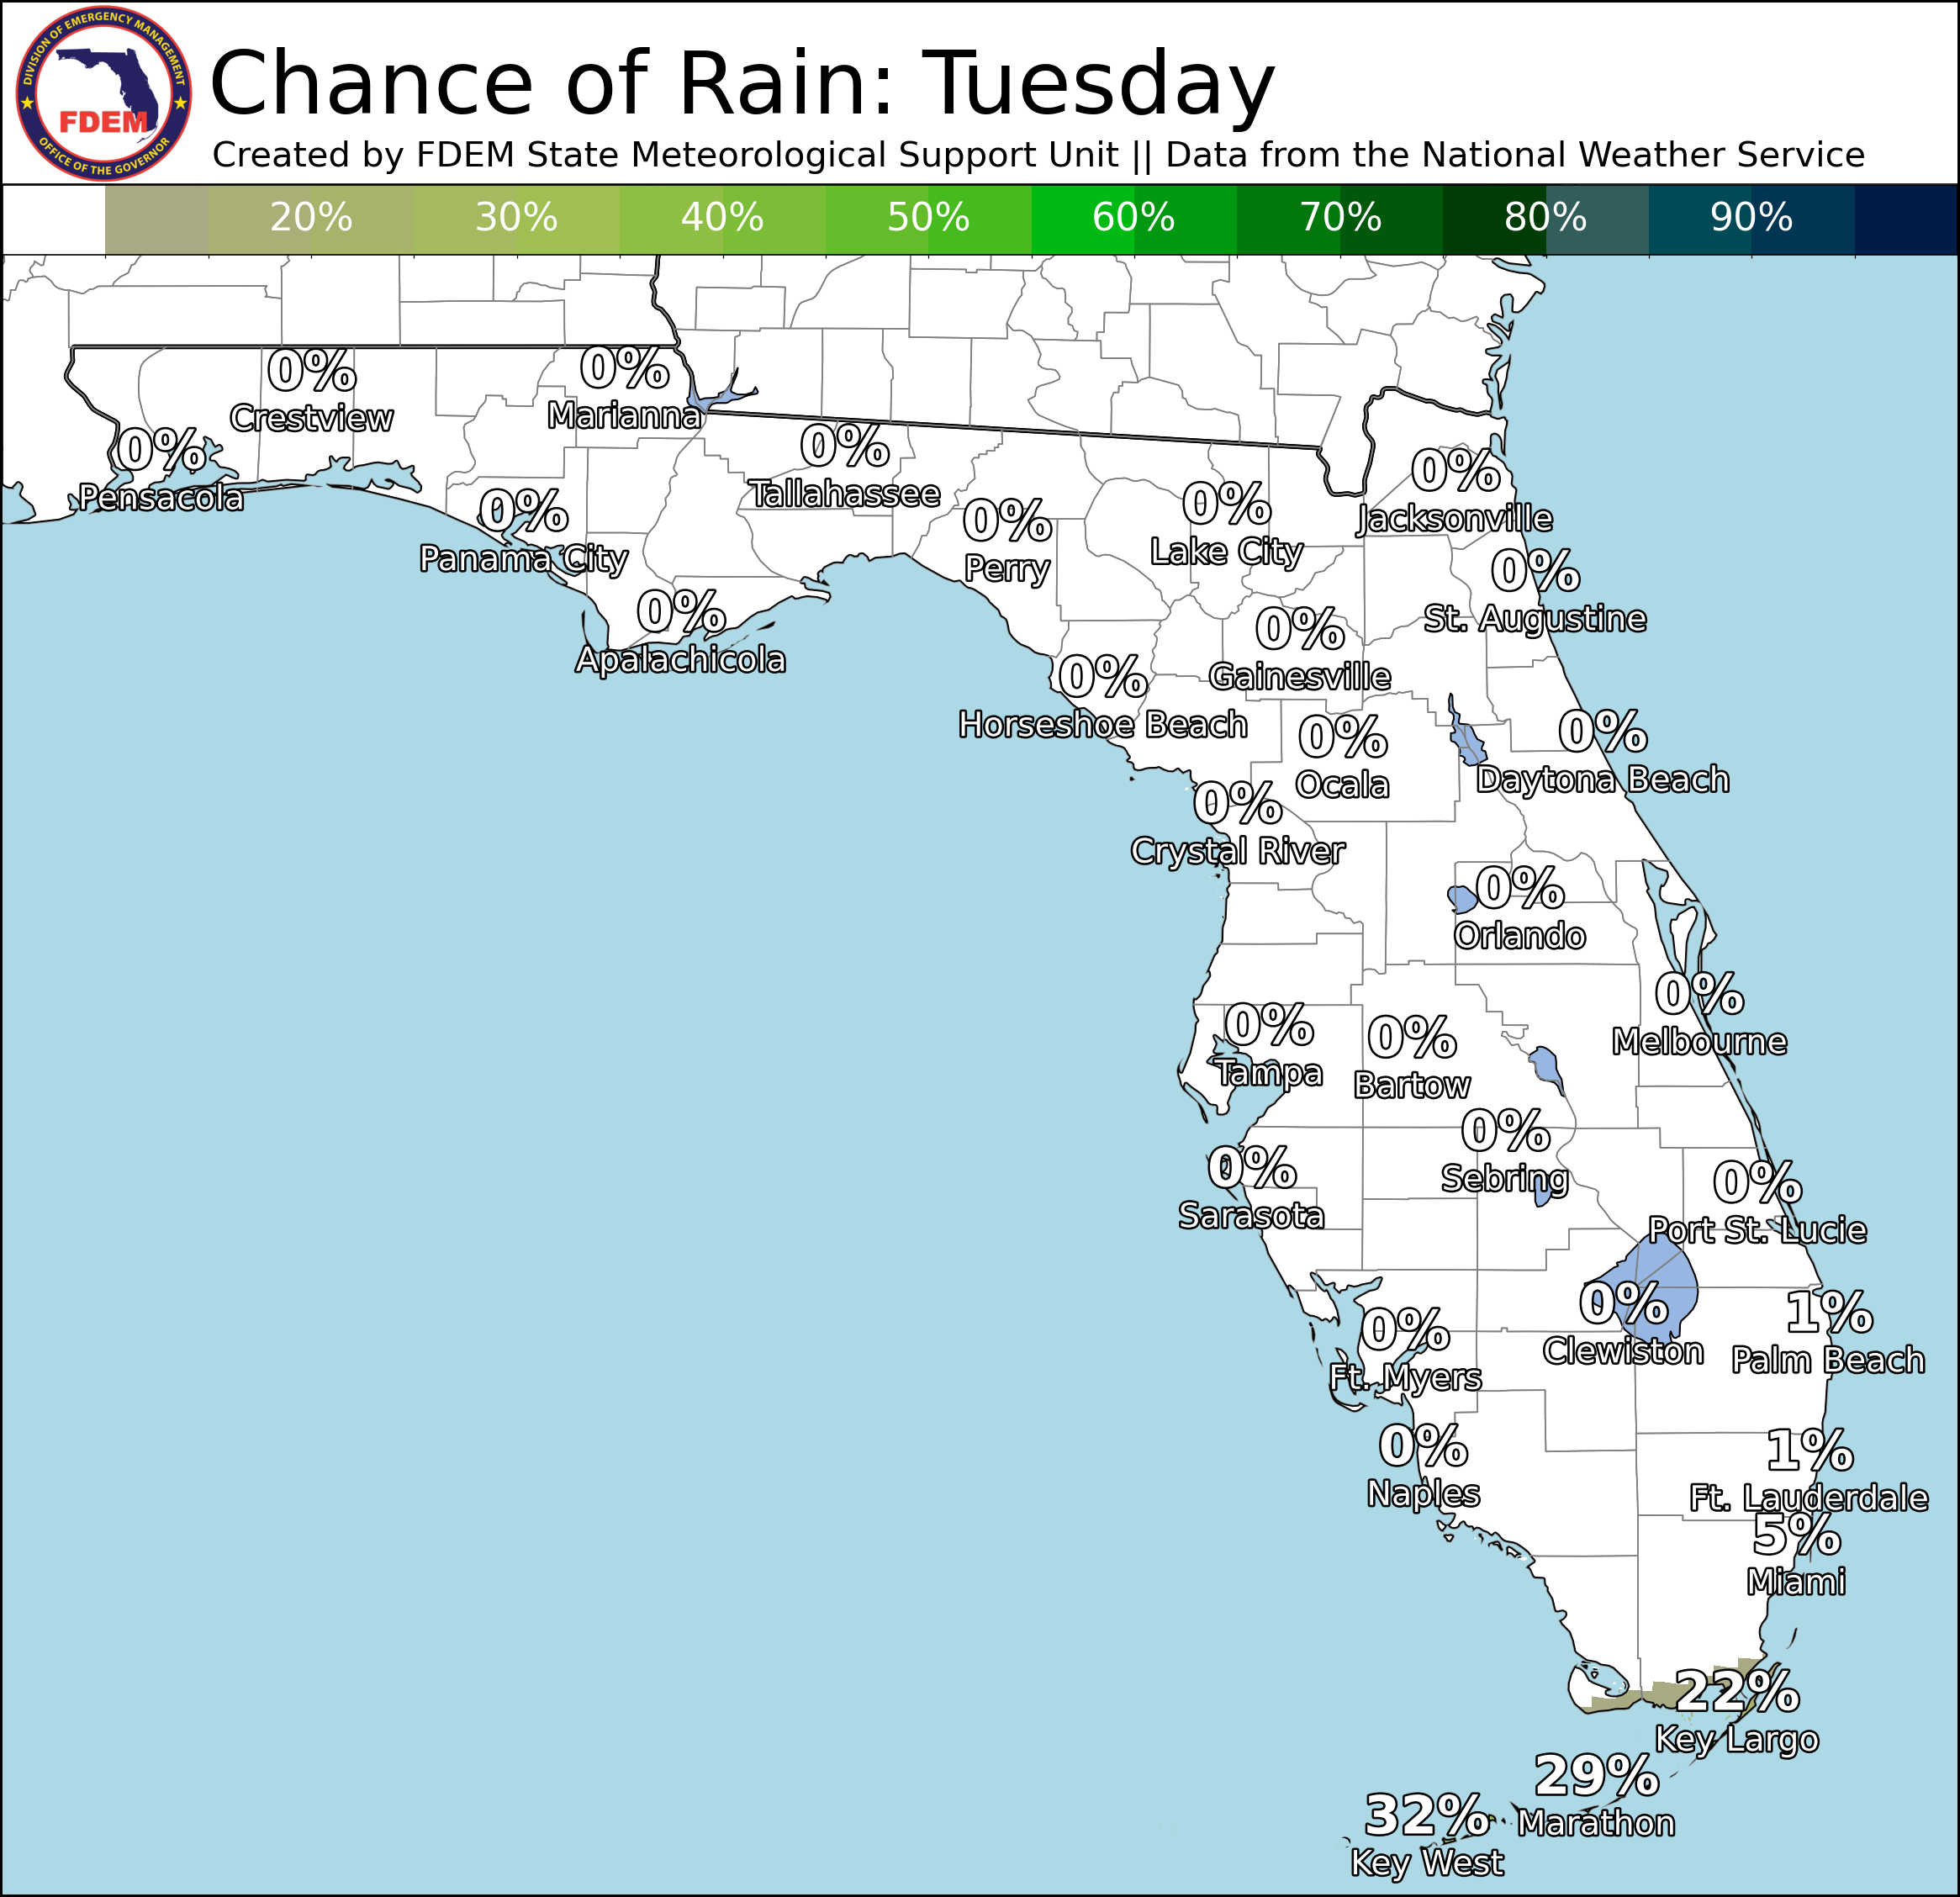
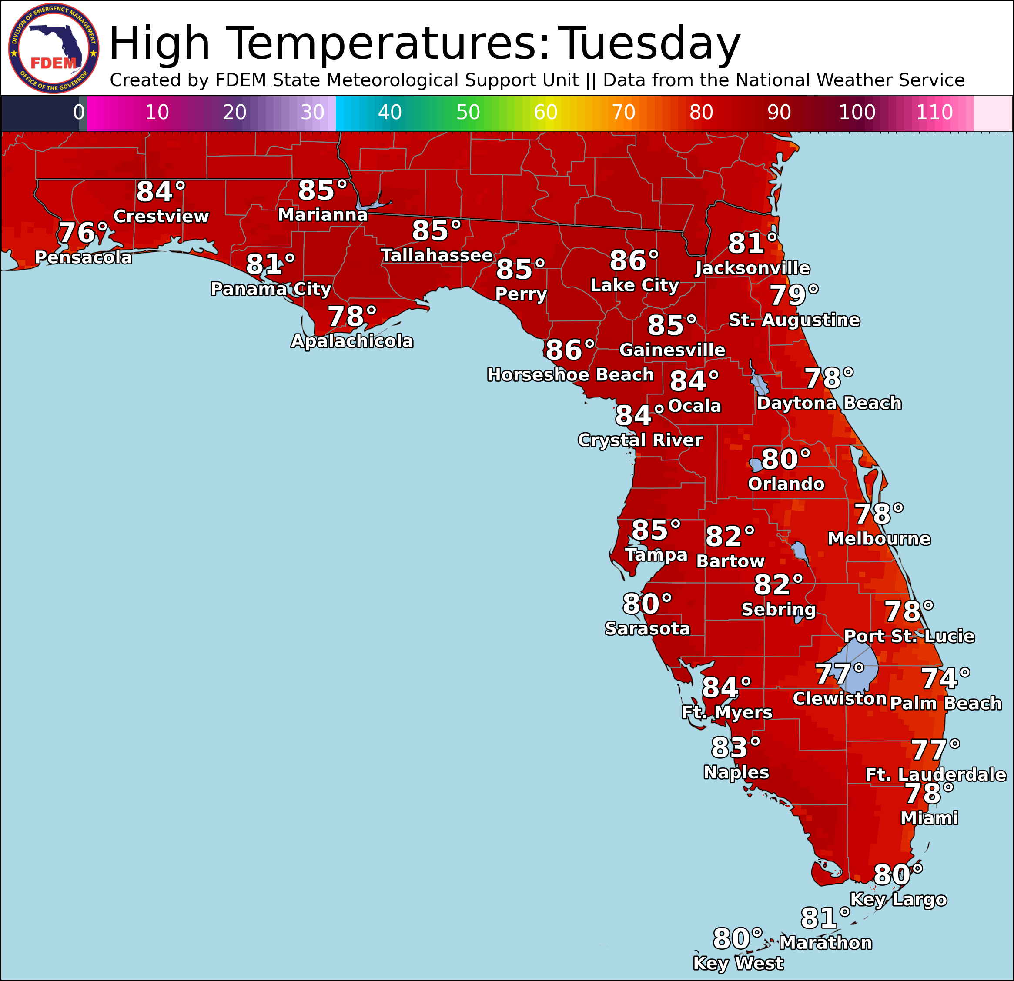
Meteorology Summary
Statewide Overview, Next 24 Hours:
Another chilly morning throughout much of North Florida with many locations waking up in the upper 30s to middle 40s. A few isolated showers are also ongoing across the Florida Keys this morning, though will continue exiting south through the morning (20-30% chance of rain). Temperatures will quickly warm as the sun rises, giving way to a sunny and dry day statewide. Very dry air will filter throughout the state today, with the lowest relative humidities throughout North and Central Florida (20-35% RH values). Breezy east-northeasterly winds with gusts upwards of 25-35 mph will overlap these critically low relative humidities across Northeast and Central Florida where a Red Flag Warning is in effect until 8 PM EDT for critical wildfire danger. Any wildfires that do develop will quickly spread and be hard to contain. Elsewhere across the state, elevated wildfire conditions are expected given the ongoing drought and still very dry air expected. High temperatures will climb into the upper 70s to middle 80s statewide.
Winds will become light across much of the state tonight, though some breezy gusts upwards of 20-25 mph will linger along the Southeast coast. Relative humidities are expected to quickly recover above critical thresholds overnight, which will help with any wildfire suppression efforts. Low temperatures will dip into the lower to middle 50s across much of interior North Florida tonight, with upper 50s to middle 60s across the rest of the state. The coastal Southeast metro and Keys will remain in the 70s.

Slide 8
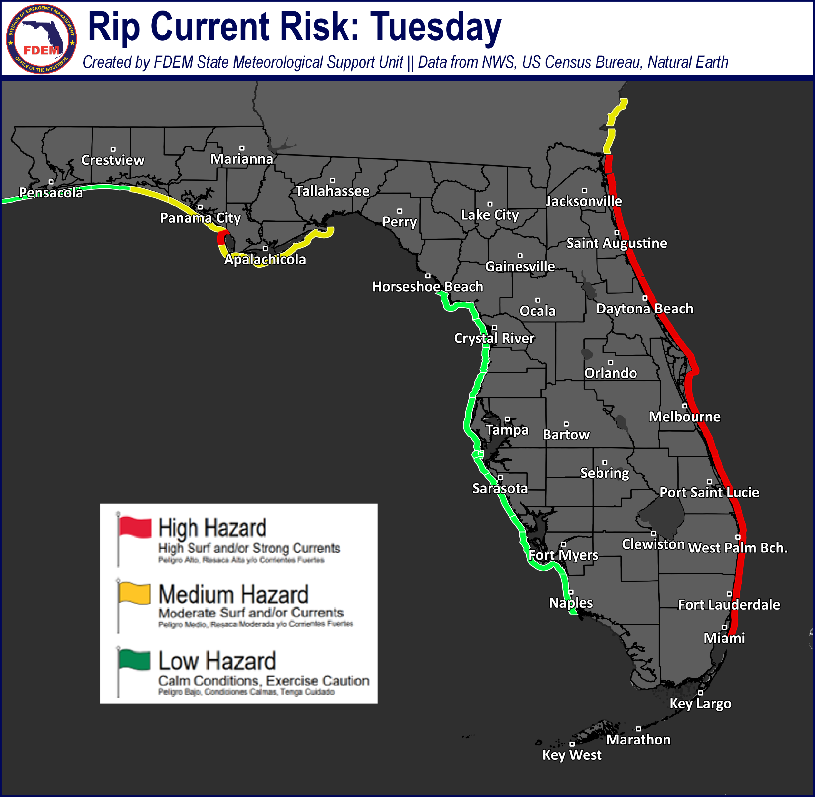
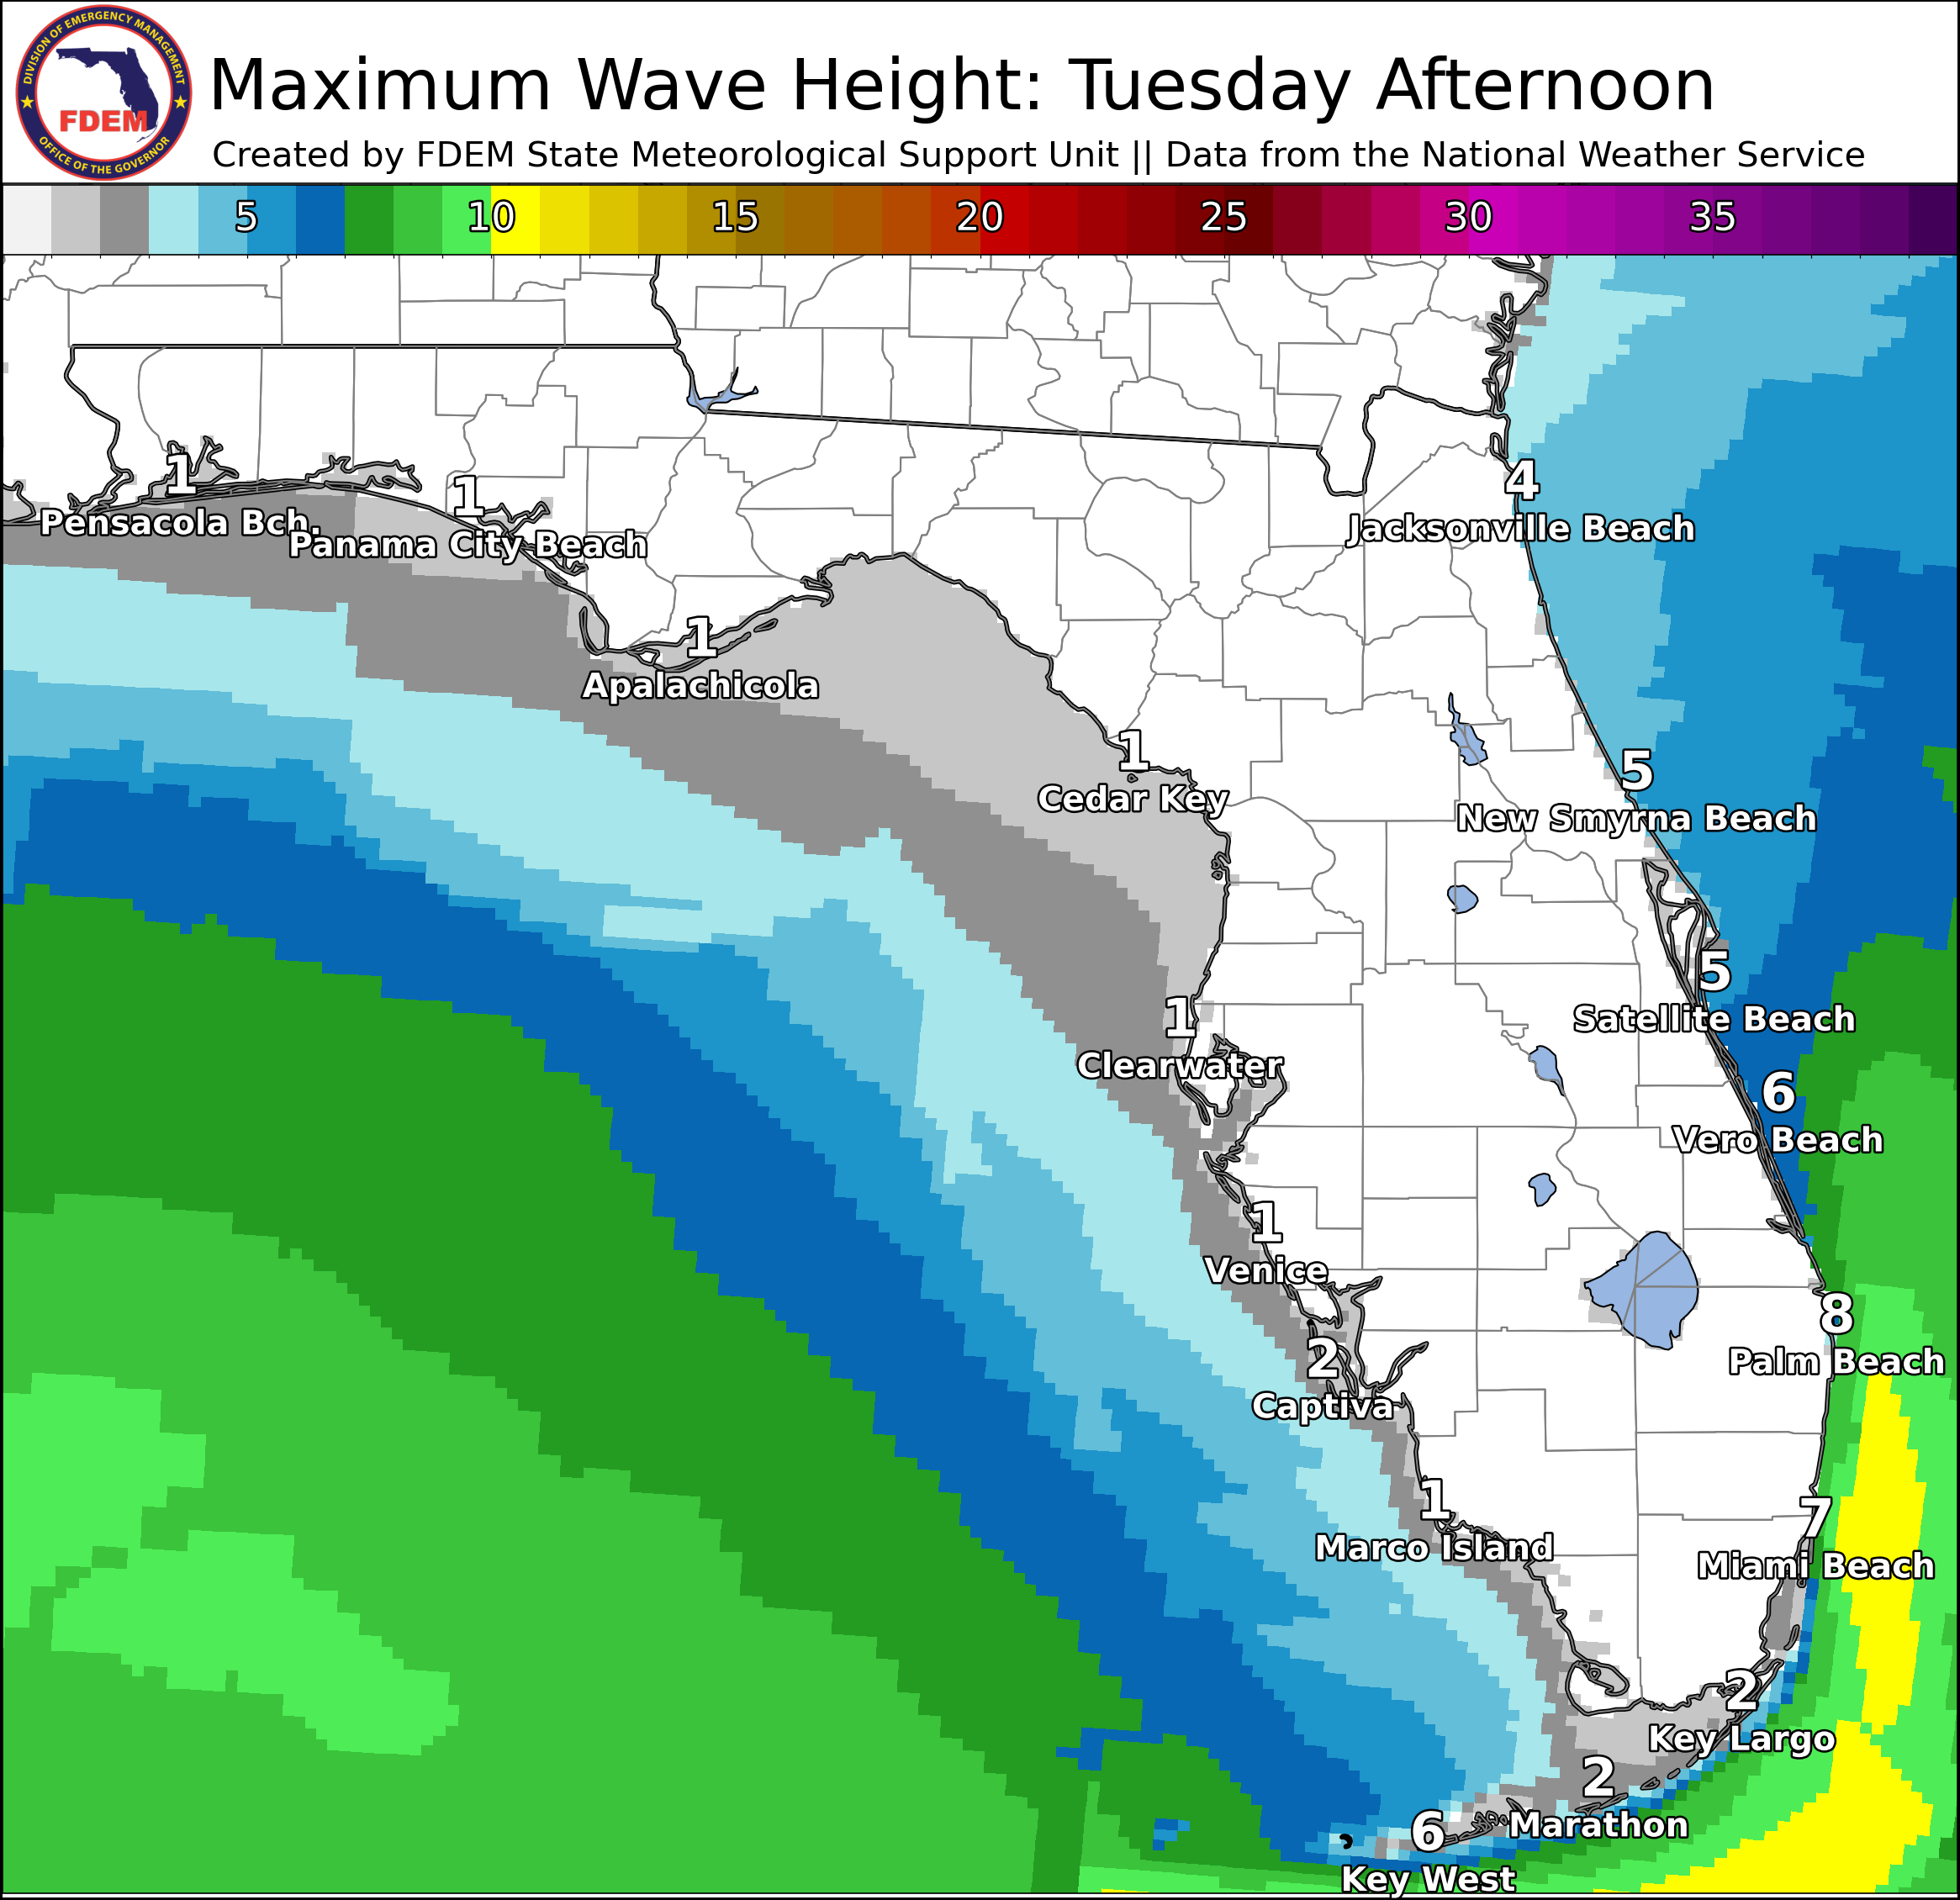
Coastal Hazards & Hydrology
Rip Currents: Breezy winds and elevated surf will bring a high risk for rip currents to all East Coast beaches today. A moderate risk for rip currents is expected for most Panhandle beaches today, with a low risk along the West Coast and Northwest Florida. For the latest Rip Current Outlook, visit www.weather.gov/beach.
Marine Hazards: High surf will continue to surge southward along the East Coast today, with waves diminishing along the First and Space Coast back down to 4-6’, though increasing along the Treasure and Gold Coast to 6-8’. A few waves upwards of 10’ will be possible in the surf zone across Southeast Florida and a High Surf Advisory remains in effect along Palm Beach County. Surf will diminish back down to 1-2’ for most Gulf-facing beaches today.
Red Tide was observed at background concentrations offshore Lee, Okaloosa, Escambia, and Gulf counties (valid 4/17/26).
Coastal Flooding: There is no risk for coastal flooding today.
Flash Flooding: There is no organized risk for flash flooding today across Florida.
Riverine Flooding: There are no riverine concerns across Florida. For more information, visit the River Forecast Center.
Lake Okeechobee’s average elevation is 11.94 feet, which is within the operational band and is 1.93 feet below normal for this time of year.

Slide 9
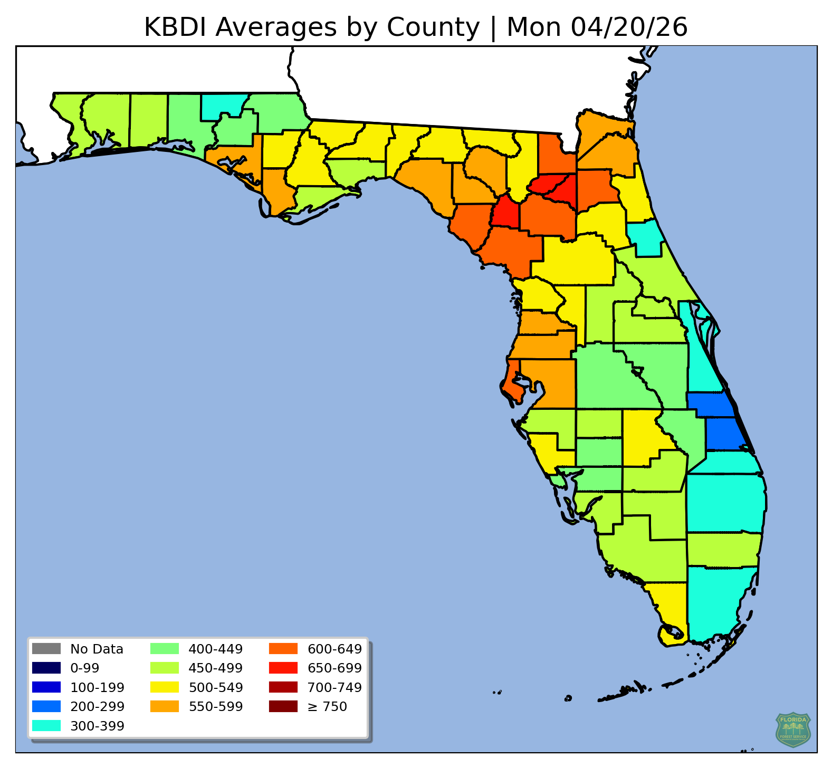
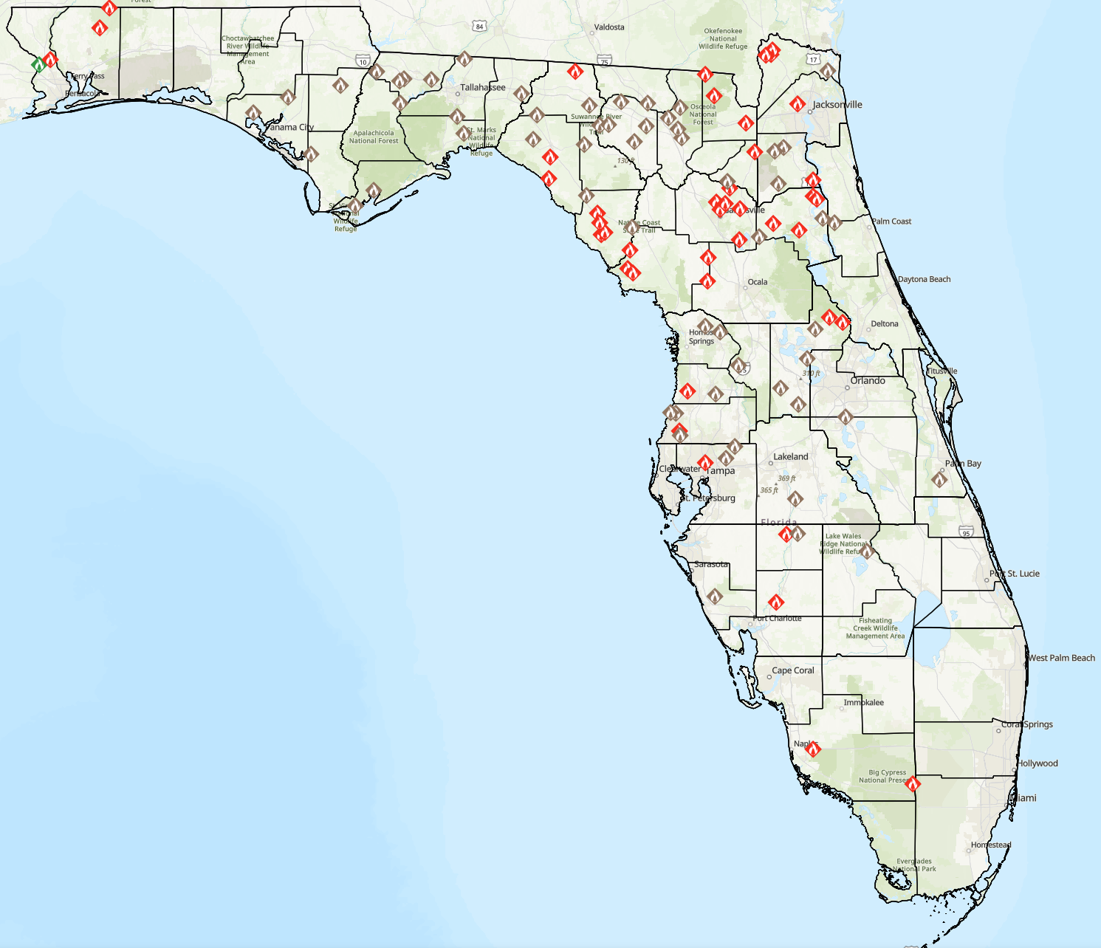
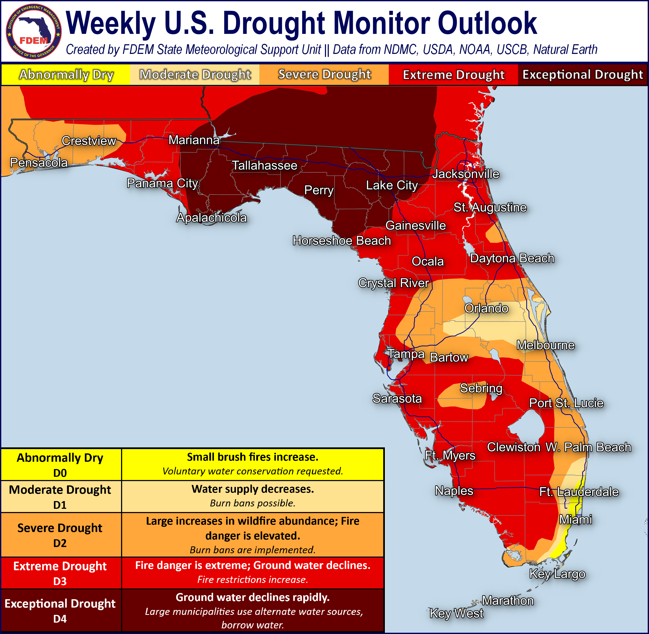
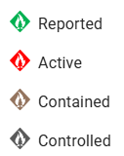
Drought & Fire Weather
Fire Weather: Very dry air will continue to filter into the Sunshine State today behind a frontal boundary just now entering the Florida Straits. Winds are expected to reach 15-20 mph this afternoon across Central Florida with frequent gusts upwards of 25-35 mph. Winds will be a bit lesser across Northeast Florida, though will still gust upwards of 20-25 mph. With these winds overlapping critically low relative humidities (25-35%), critical wildfire conditions are expected and a Red Flag Warning is in effect until 8 PM EDT. Elevated wildfire conditions are expected elsewhere across the state, especially across the Panhandle and Big Bend where dry air will continue filtering into the area with ongoing extreme to exceptional drought (level 3-4 of 4). Winds will begin to subside tonight across the state, though some breezy winds will linger throughout Southeast Florida. Relative humidities will quickly recover after sunset, helping with any wildfire suppression efforts. According to the Florida Forest Service, there are 113 active wildfires across the state burning approximately 12,852 acres.
Drought (4/16/26): Although rainfall has been sparce and nearly non-existent across the state in the last 5 days or so, last week’s rainfall that occurred on Tuesday and Wednesday (4/7 – 4/8) was included in this most recent Drought Monitor update which has brought some categorical improvements to South and Central Florida. Rainfall totals across coastal East-Central Florida during the middle of last week added up to 3-6”, with some localized areas exceeding 6”. Additionally, across Southeast Florida, a general 1-3” of rainfall was observed with localized amounts upwards of 5”. This has resulted in the extreme drought being reduced to a severe drought (level 2 of 4) across the Treasure Coast and much of the severe drought along the southeast coast reduced to a moderate drought (level 1 of 4). Across interior South-Central Florida, a pocket of locally heavier rainfall over Hardee, DeSoto, and Highlands counties has brought a return of a severe drought (level 2 of 4). Much of the I-4 corridor saw rainfall amounts between 0.5-2”, which was enough for some severe drought across the Space Coast to be reduced to a moderate drought (level 1 of 4). Otherwise, there were no observed changes on this week’s update across Southwest or West-Central Florida where an extreme drought (level 3 of 4) remains in place. North Florida continues to experience the worst drought due to severe and record low precipitation deficits. An exceptional drought (level 4 of 4) is still observed throughout much of the eastern Panhandle, Big Bend, and Suwannee River Valley with extreme drought (level 3 of 4) elsewhere. The Big Bend region remains one of the hardest hit locations, such as Tallahassee that has neared a 20-inch rainfall deficit dating back to September 1, 2025 (about 8 months ago). This has resulted in extremely low streamflows within all river basins, streams, lakes, and ponds. Looking ahead, very dry and near record warm conditions over the past week will continue through at least the beginning of next week. This will result in additional drought expansion throughout much of North Florida, with potential for worsening drought across Central and South Florida. Additionally, a dry cold front will sweep through North Florida on Sunday and Monday, bringing increasing winds and low relative humidities which will further dry out sensitive fuels.
The Keetch-Byram Drought Index average for Florida is 494 (+6) on a scale from 0 (very wet) to 800 (very dry). There are 35 Florida counties that have an average KBDI above 500 (drought/increased fire danger).
Current Wildfire Dashboard
Notes:
*** KBDI is back updating automatically ! *** For records: new KBDI link is https://weather.fdacs.gov/images/fl-kbdi-countymeans.png.

Slide 10
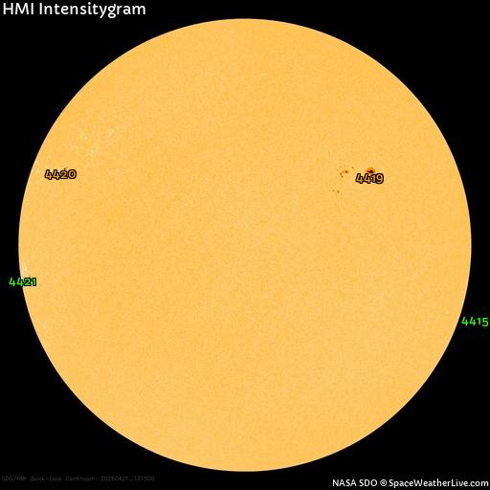
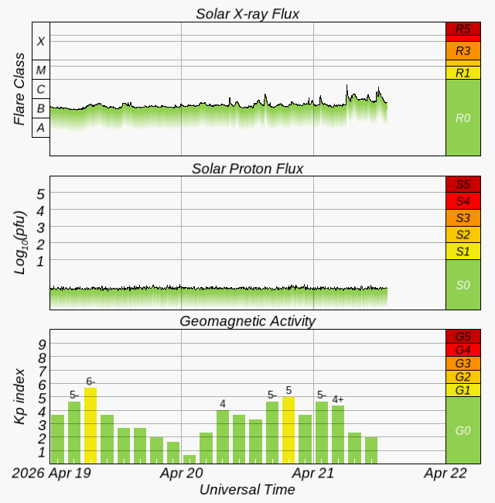
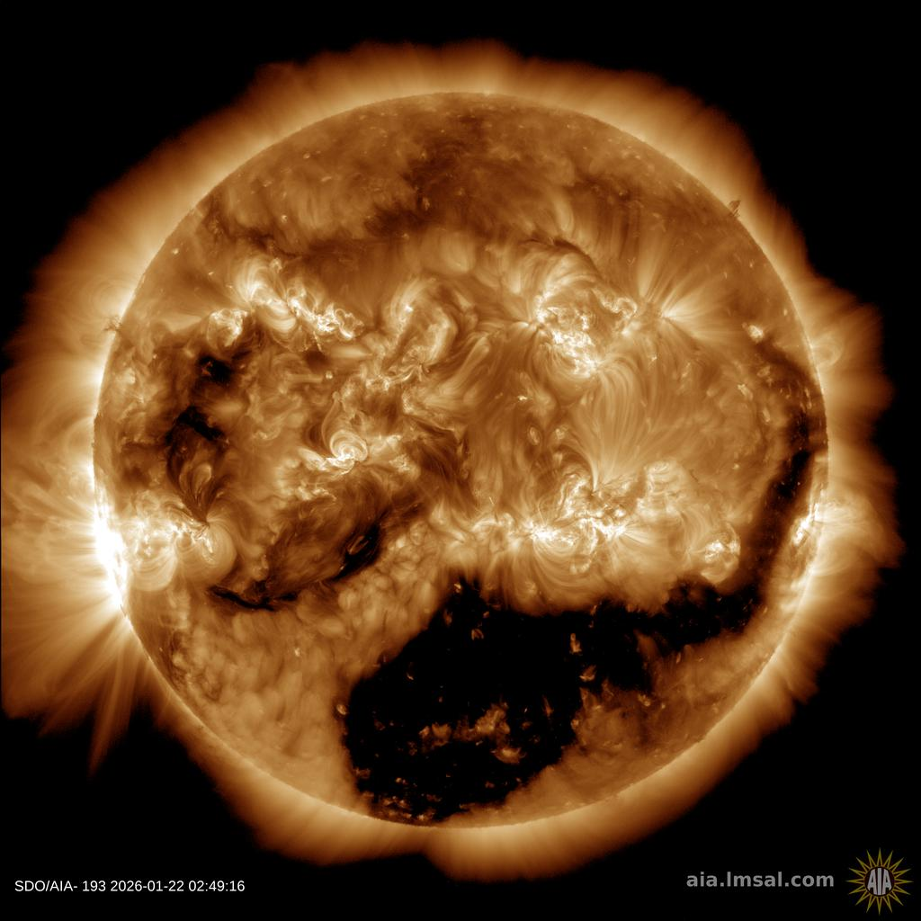
Space Weather
Solar Flare Risk | Active Watches & Warnings | Past 24 hours
M-class: 5% | Geomagnetic Storm: None | C5 Solar Flare
X-class: 1% | Radiation Storm: None | No Radio Blackout
Current Sunspots
48-Hour Geomagnetic Forecast
4/21 | 4/22
Max Kp= 4 (G0) | Max Kp= 3 (G0)
Chance of minor activity = 5% severe activity = 1% | Chance of minor activity = 5% severe activity = 1%
Earth-facing Coronal Holes
Space Weather: Solar activity is expected to be at very low levels with a slight chance for moderate (C-class) solar flares primarily due to sunspot region #4419. Weakening solar wind conditions are expected through Thursday as recurrent coronal hole influences wane. Mostly quiet to unsettled geomagnetic field levels are expected beginning today through the end of the week. The overall space weather threat to Florida remains very low.
Notes:
**** ALL IMAGES ON SPACE WEATHER SLIDE ARE NOW AUTOMATICALLY UPDATING! *****

Slide 11
SWO Communications Systems & Contact Information
Users wishing to subscribe (approval pending) to this distribution list, register at:
https://public.govdelivery.com/accounts/FLDEM/subscriber/new?topic_id=Morning_SITREP

