Slide 1

Florida Division of Emergency Management
State Watch Office
Morning Situation Report

Slide 2

State Emergency Operations Center Activation Level

Slide 3
SERT On-Call Personnel

Slide 4
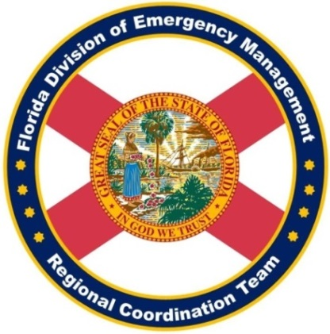
Response Regional Coordination Team
Region 2 Coverage Provided by Response Coordinator 3
Region 7 Coverage Provided by Response Coordinator 8
Status
Normal Operations
Out of Service / Unavailable

Slide 5
Recovery Regional Coordination Team
Region 5 and 6 Coverage Provided by Recovery Coordinator 4
Region 9 Coverage Provided by Recovery Coordinator 8
Status
Normal Operations
In Region / Delayed Response
Deployed / Delayed Response
Out of Service / Unavailable

Slide 6
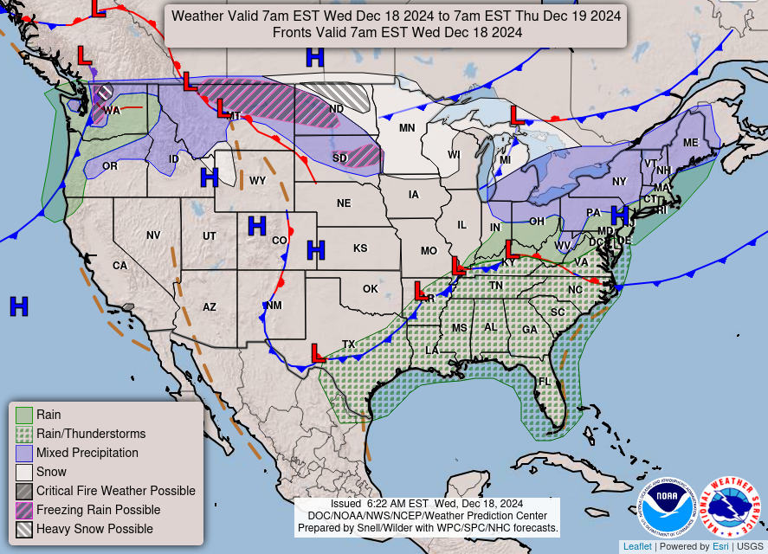
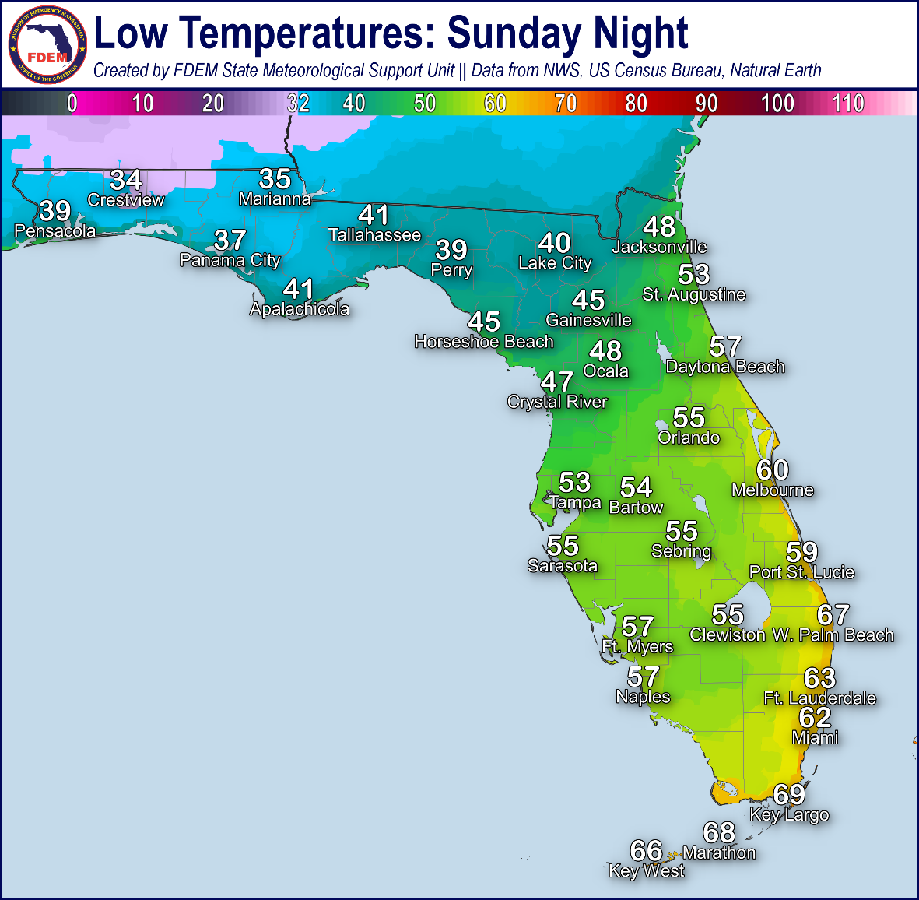
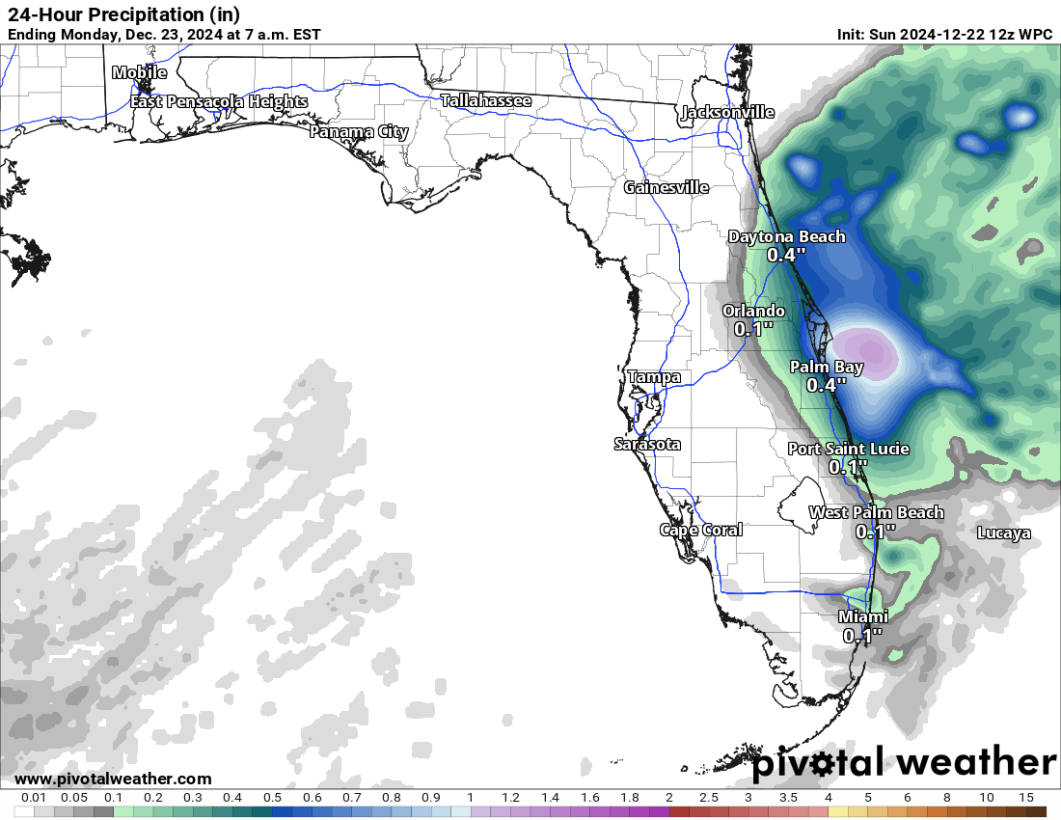
Meteorology Summary
Today’s Weather Map
24-Hour Forecast Rainfall Totals
Locally 3”+ Possible – Space Coast

Slide 7
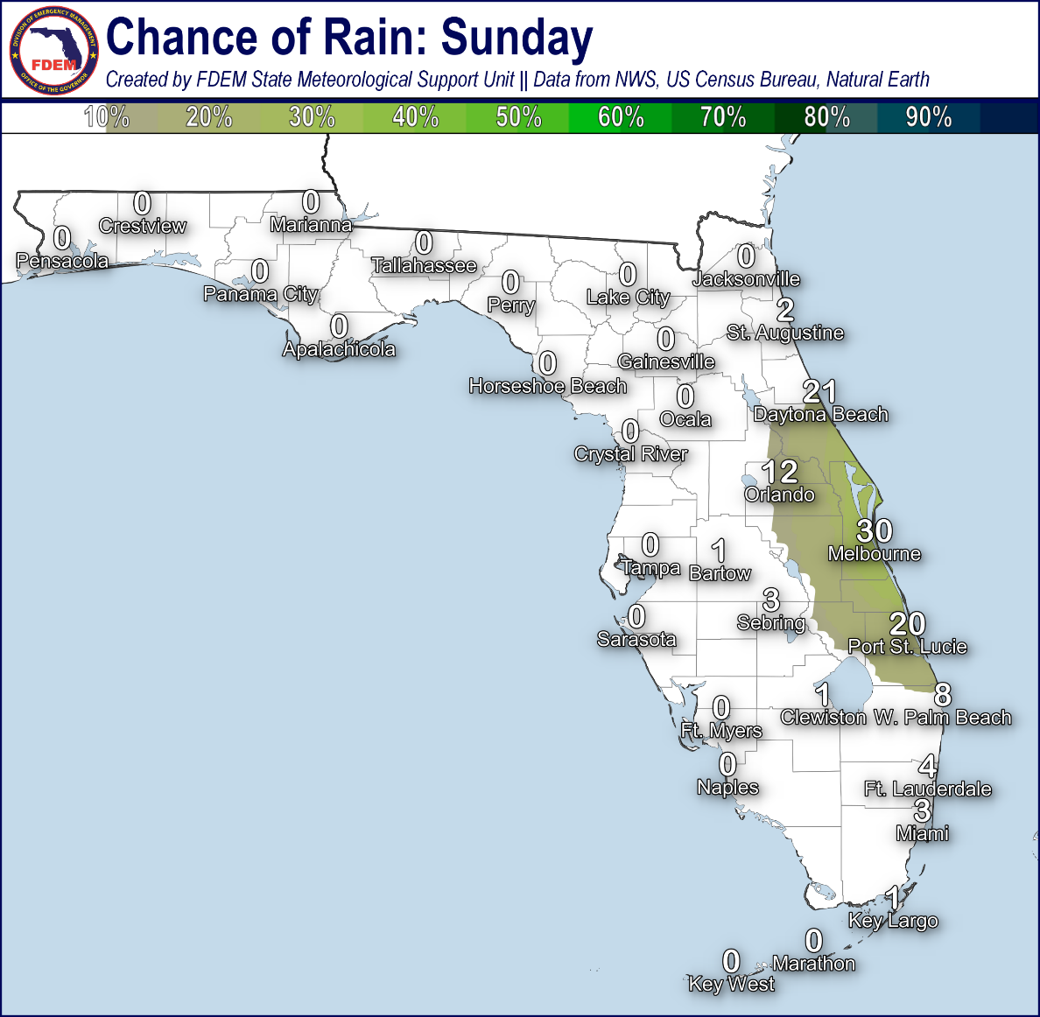
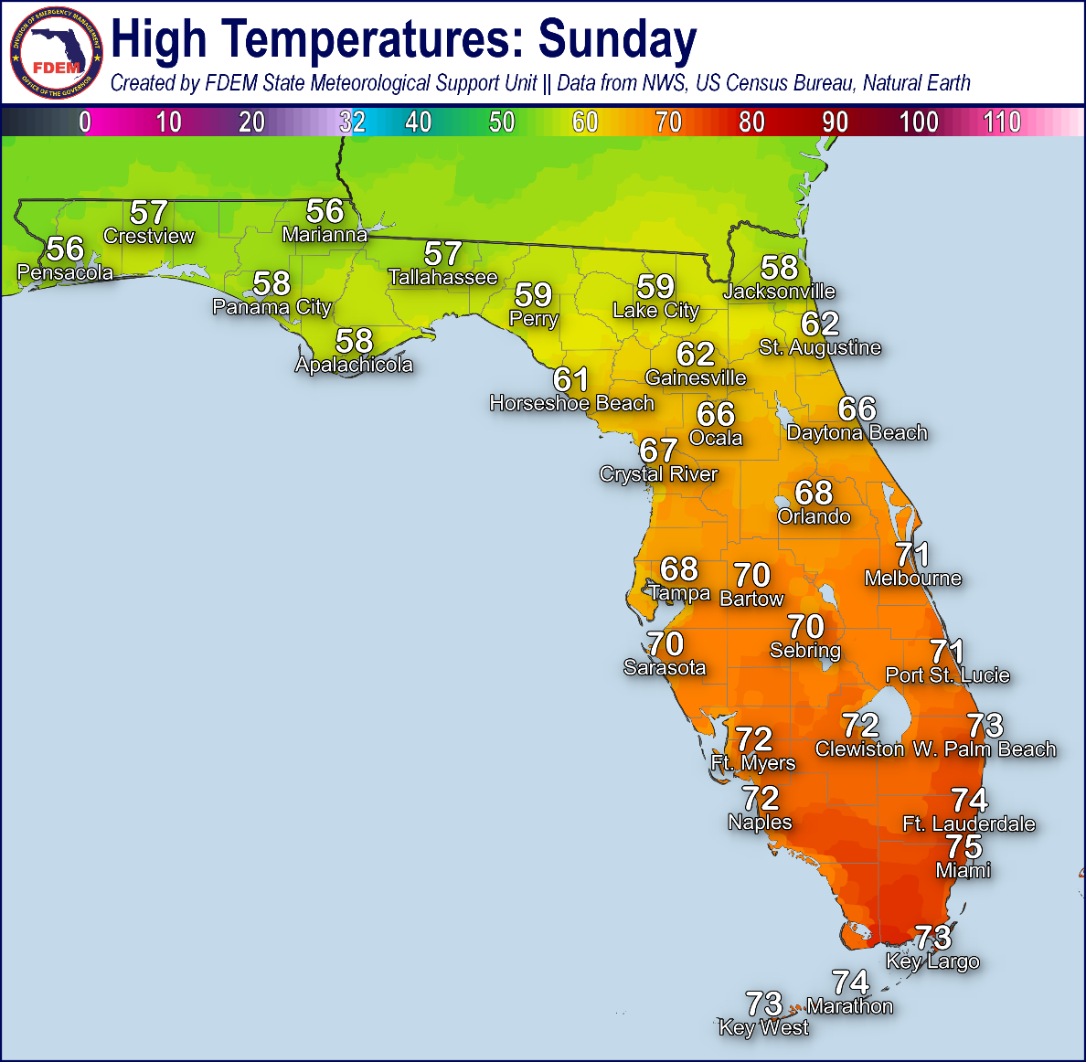
Meteorology Summary
Statewide Overview, Next 24 Hours:
Another chilly start across the Sunshine State, with many below freezing temperatures (27 to 31-degrees) observed across North Florida this morning. Northerly to northeasterly winds will continue to bring cooler and drier conditions throughout much of the state, courtesy of a dominant area high pressure. Winds will become breezy along the Northeast Florida Coast through the daytime hours, with gusts reaching 15-20 mph at times. Rain chances remain near-zero largely statewide; however, an upper-level disturbance approaching the Florida East Coast may allow isolated to widely scattered showers to move onshore (20-30% chance of rain). There is no organized risk for flash flooding today, but it is important to note some of the computer forecast model disagreement this morning regarding exact rainfall totals and where the heaviest rainfall rates occur along the I-95 corridor and Space Coast today. Coastal showers moving onshore the Space Coast, while very isolated in nature, may be capable of producing instances of localized flooding and ponding water should the heavier rainfall rates move on land (there are still many computer forecast models that keep the heaviest rainfall well offshore in the Atlantic, just a trend to monitor through the day).
Temperatures will gradually begin their upward trend across Florida; however, still topping out 3 to 6-degrees below normal for many North Florida locations. Afternoon highs will be in the middle to upper 50s across North Florida, the middle to upper 60s across Central Florida, and the lower 70s through the remainder of the Florida Peninsula and the Keys.
Rain chances this evening will gradually propagate further inland across East-Central Florida (20-30% chance of rain), with coastal showers remaining spotty to isolated in nature. Cloud cover increasing tonight will allow for overnight temperatures to moderate, with lows at or near freezing (35 to 32-degrees) confined to interior Northwest Florida. Lows will reach the upper 30s to lower 40s across the eastern Florida Panhandle, Big Bend, and Suwannee River Valley, with the 40s to 50s to the I-4 corridor and the 50s to 60s through South Florida.

Slide 8
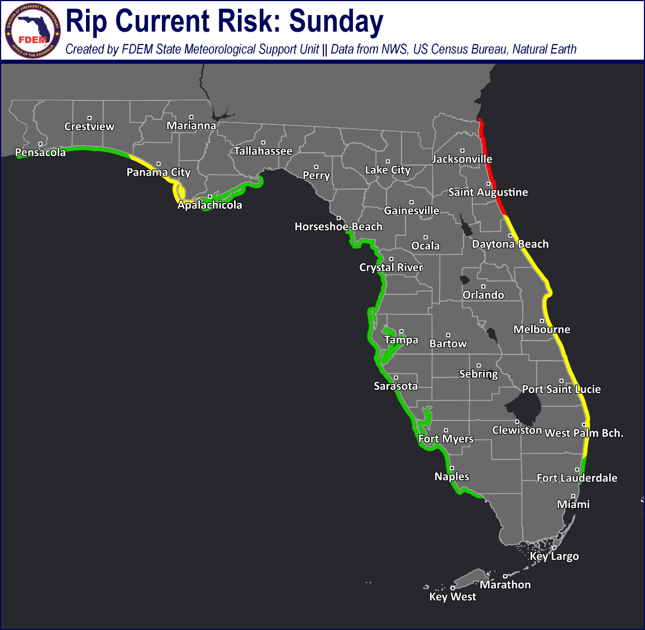
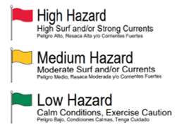
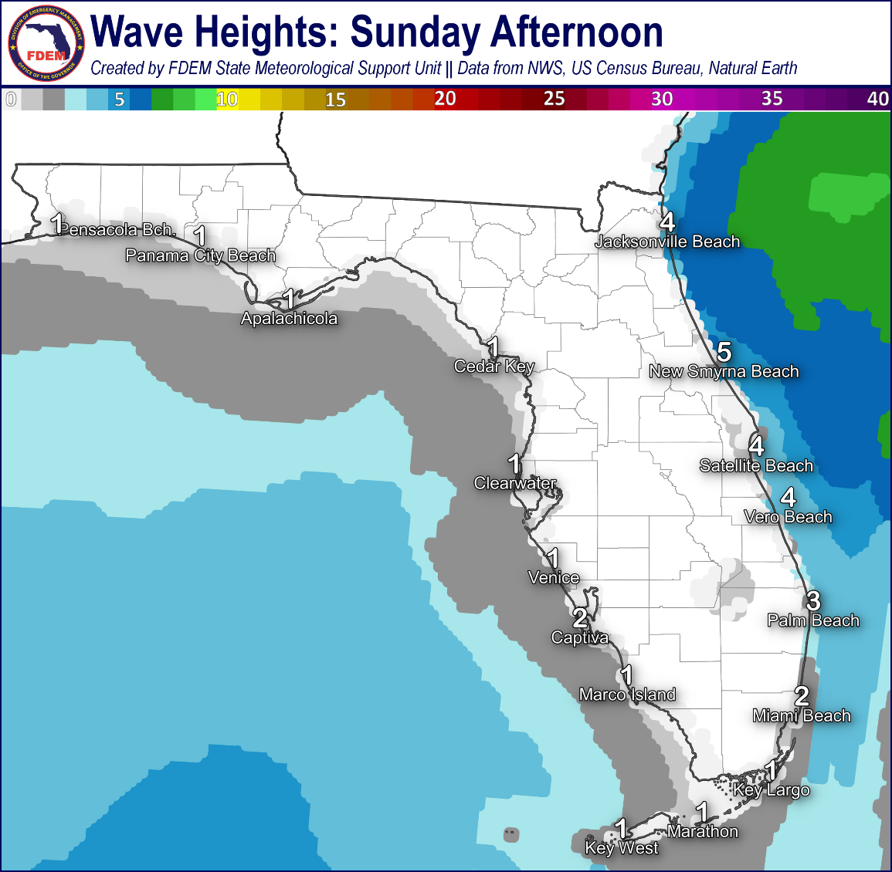
Coastal Hazards & Hydrology
Rip Currents: A moderate risk for rip currents can be expected along the central Florida Panhandle and the Florida East Coast. High rip current risk conditions arrive to Northeast Florida beaches today. For the latest Rip Current Outlook, visit www.weather.gov/beach.
Marine Hazards: Wave heights of 1-3’ can be expected to return to the Florida Gulf Coast today as winds have shifted to a northerly to northeasterly direction. Poor to hazardous marine conditions will begin to take shape along the Northeast Florida Coast as breakers in the surf zone are forecast to reach 4-6’ at times. Wave heights of 2-4’ can be expected along the remaining Florida East Coast.
Red Tide has been observed in 99 samples collected from the Gulf Coast of Florida over the past week (as of 12/20). Background to low concentrations were observed in and offshore of Pinellas County, with background to medium concentrations in and offshore of Hillsborough County, background to low concentrations in and offshore of Manatee County, background to medium concentrations in and offshore of Sarasota County, background to low concentrations in and offshore of Lee County, background to low concentrations in and offshore of Collier County, and very low concentrations in Franklin County. Fish kills suspected of being related to red tide were reported offshore of Pinellas County and along Sarasota and Lee Counties and respiratory irritation suspected to be related to red tide was reported in Sarasota and Lee Counties.
Coastal Flooding: Coastal flooding is not expected today.
Flash Flooding: There is no organized risk for flash flooding today. Coastal showers moving onshore the Florida Space Coast, while very isolated in nature, may be capable of producing instances of isolated flash flooding should the heavier rainfall rates progress inland. There remains model disagreement regarding the potential totals of this shower activity, especially how much rainfall manages to reach the I-95 corridor; however, a general 1-3” cannot be ruled out within the heavier coastal showers.
Riverine Flooding: There are no riverine flooding concerns across Florida. For more information, visit the River Forecast Center.
Lake Okeechobee’s average elevation is 15.29 feet, which is within the operational band and 0.60 feet above normal for this time of year.

Slide 9
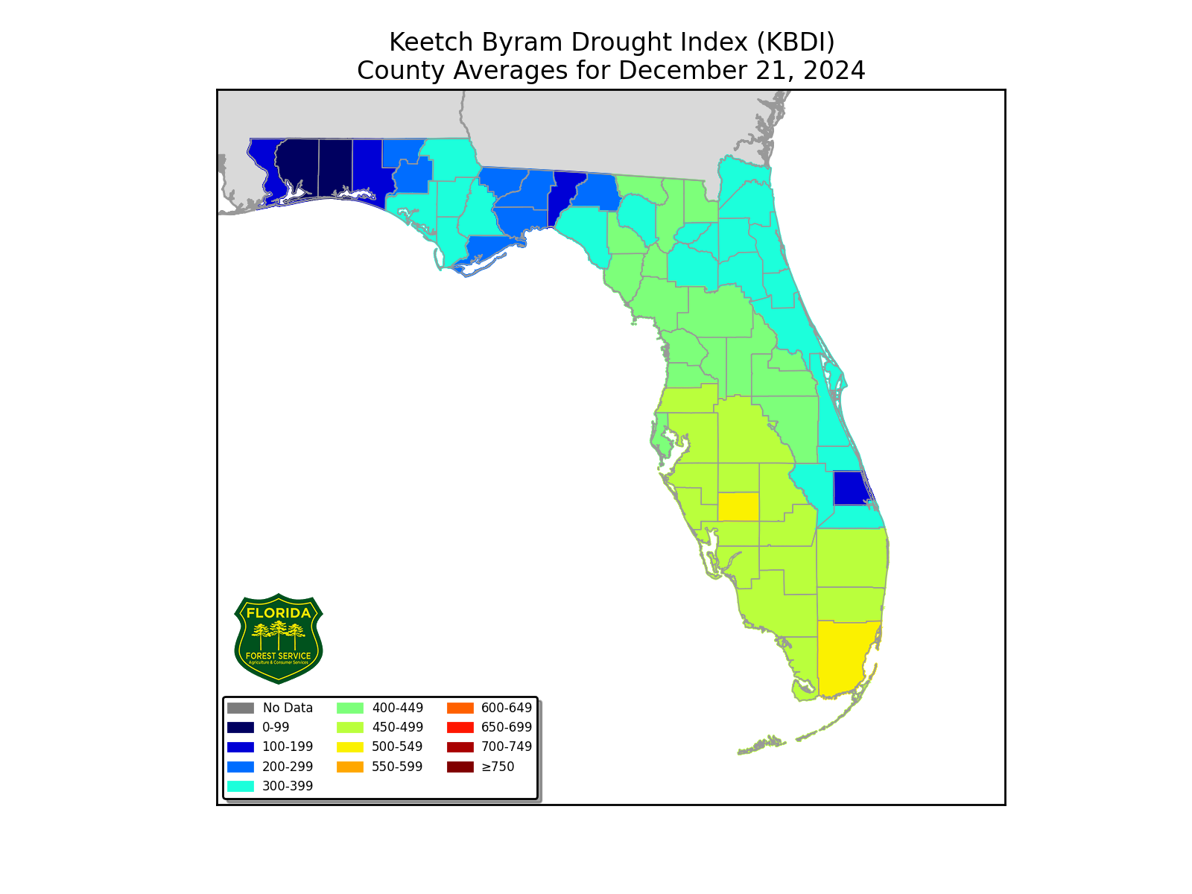
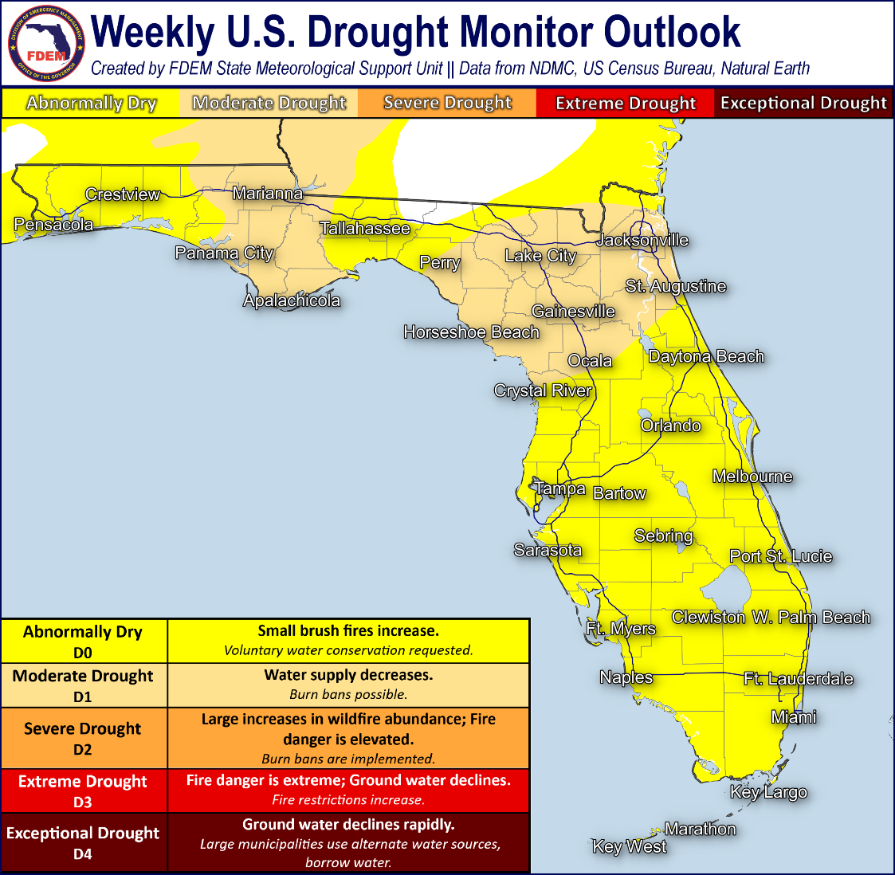
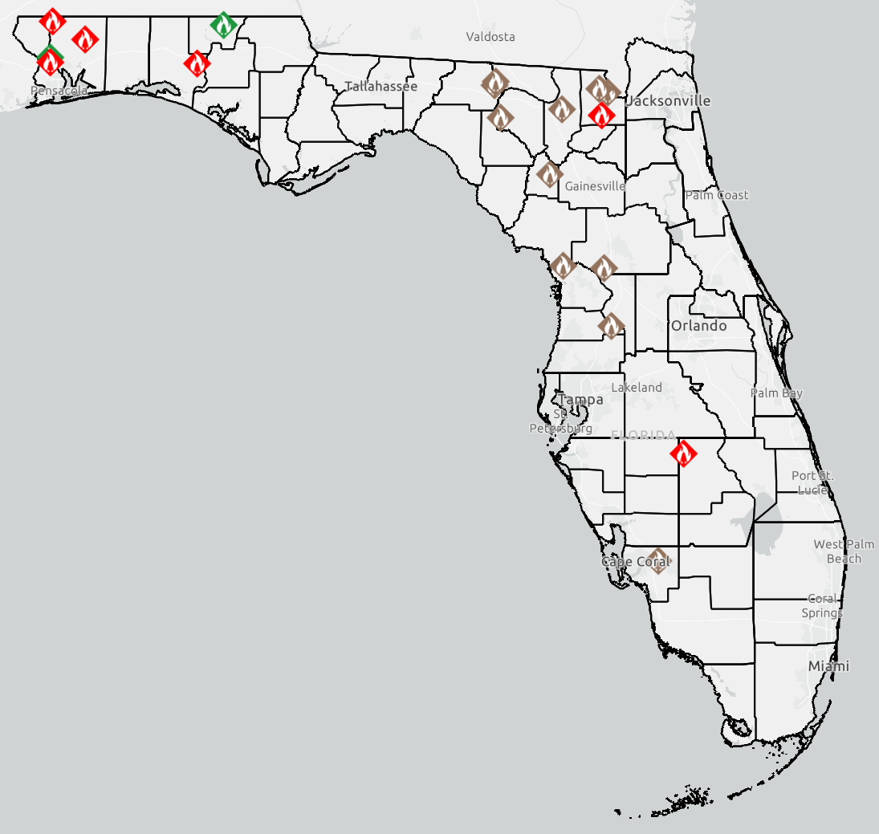
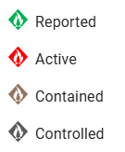
Drought & Fire Weather
Fire Weather: Mostly dry conditions can be expected across the state today and tonight as a large area of high pressure builds over the Eastern U.S., filtering in cool and dry air. Northerly to northeasterly winds can be expected today, largely 5-10 mph statewide; however, breezy onshore flow can be expected to develop along the Northeast Florida Coast where winds of 10-15 mph will be possible. Wind gusts of 10-15 mph cannot be ruled out during the daytime hours, with 15-20 mph possible for Northeast Florida. Locally sensitive wildfire conditions may be possible across portions of North Florida this afternoon as drier air continues to filter southward, lowering relative humidity values to near 35-45. According to the Florida Forest Service, there are 19 active wildfires across the state burning approximately 52 acres.
Drought: Near to slightly above normal temperatures and little to no rainfall across the Sunshine State over the past week have allowed for no significant change in drought conditions on the Drought Monitor update (as of 12/19). Moderate Drought conditions remain in place across the Eastern Panhandle through the Western Big Bend and across the Northern Peninsula with Abnormally Dry (emerging drought) Conditions expanding elsewhere statewide. The Climate Prediction Center (CPC) is outlooking above normal temperatures and near to slightly above normal rainfall over the next week or so which may allow for little adjustments in drought conditions.
The Keetch-Byram Drought Index average for Florida is 386 (+1) on a scale from 0 (very wet) to 800 (very dry). There is 1 Florida County (Miami-Dade) with an average KBDI over 500 (drought/increased fire danger) including DeSoto and Miami-Dade Counties.
Current FFS
Wildfire Dashboard

Slide 10
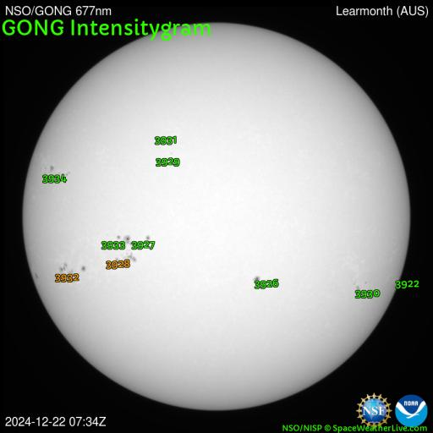
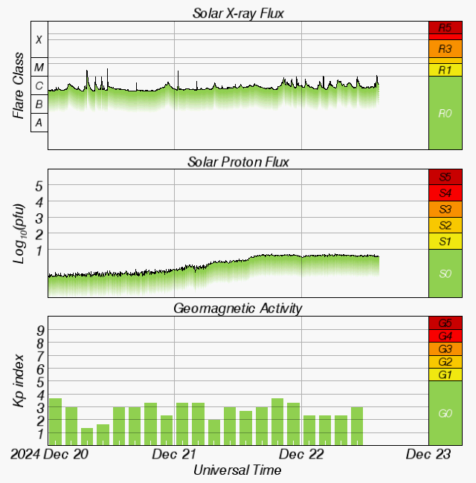
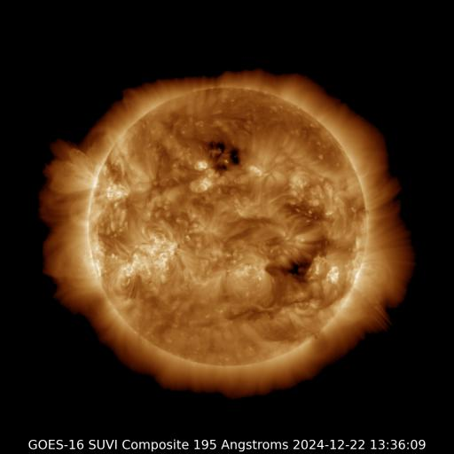
Space Weather
Solar Flare Risk | Active Watches & Warnings | Past 24 hours
M-class: 60% | Geomagnetic Storm: None | M1 Solar Flare
X-class: 10% | Radiation Storm: None | R1 Radio Blackout
Current Sunspots
48-Hour Geomagnetic Forecast
12/22 | 12/23
Max Kp= 3 (G0) | Max Kp= 3 (G0)
Chance of minor activity = 5% severe activity = 1% | Chance of minor activity = 5% severe activity = 1%
Earth-facing Coronal Holes
Space Weather: Moderate solar flare levels will be possible again today, particularly from the flare potential of the sunspot complex #3927-28, as minor (R1) radio blackouts may accompany the stronger and more organized flare activity. There is a slight chance for a significant (X-class) solar flare through the early part of this week. Enhanced solar wind conditions are expected to prevail today, courtesy of building coronal hole influences. We will continue to monitor the potential for glancing influences of a Coronal Mass Ejection (CME) from 12/20 by midweek. Organized geomagnetic storming is not anticipated, and the overall space weather threat to Florida remains very low.
Notes:
**** ALL IMAGES ON SPACE WEATHER SLIDE ARE NOW AUTOMATICALLY UPDATING! *****

Slide 11
SWO Communications Systems & Contact Information
Users wishing to subscribe (approval pending) to this distribution list, register at:
https://public.govdelivery.com/accounts/FLDEM/subscriber/new?topic_id=Morning_SITREP

