Slide 1

Florida Division of Emergency Management State Watch Office Morning Situation Report

Slide 2

State Emergency Operations Center Activation Level

Slide 3
SERT On-Call Personnel

Slide 4

Response Regional Coordination Team
Status
Normal Operations
Out of Service / Unavailable

Slide 5
Recovery Regional Coordination Team
Region 5 Coverage Provided by Recovery Coordinator 4
Status
Normal Operations
In Region / Delayed Response
Deployed / Delayed Response
Out of Service / Unavailable

Slide 6
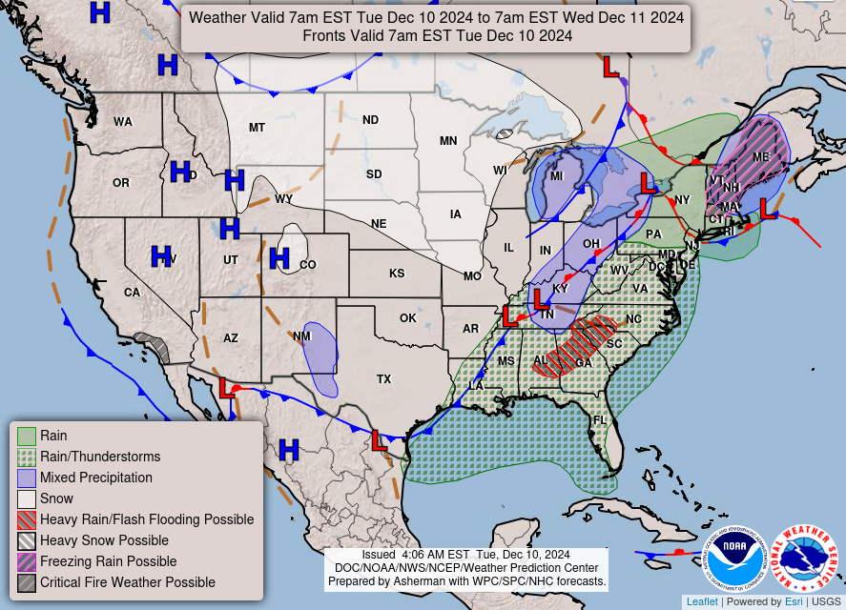
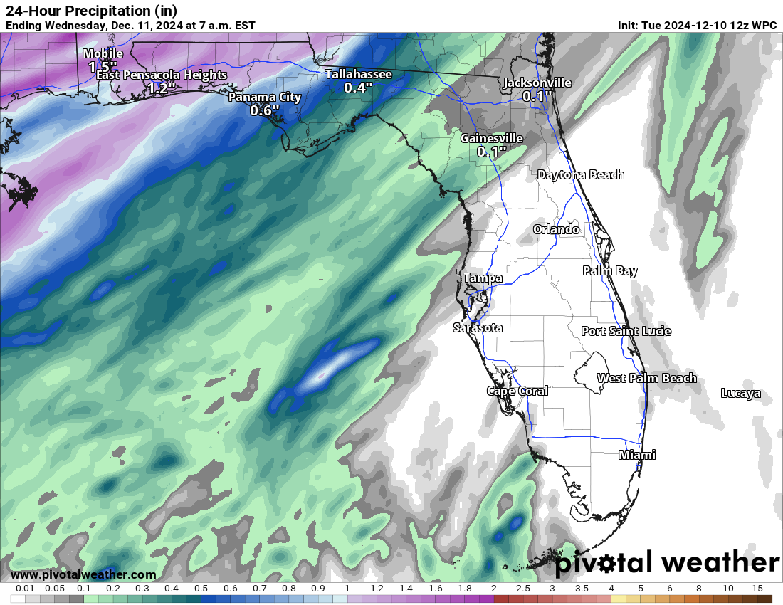
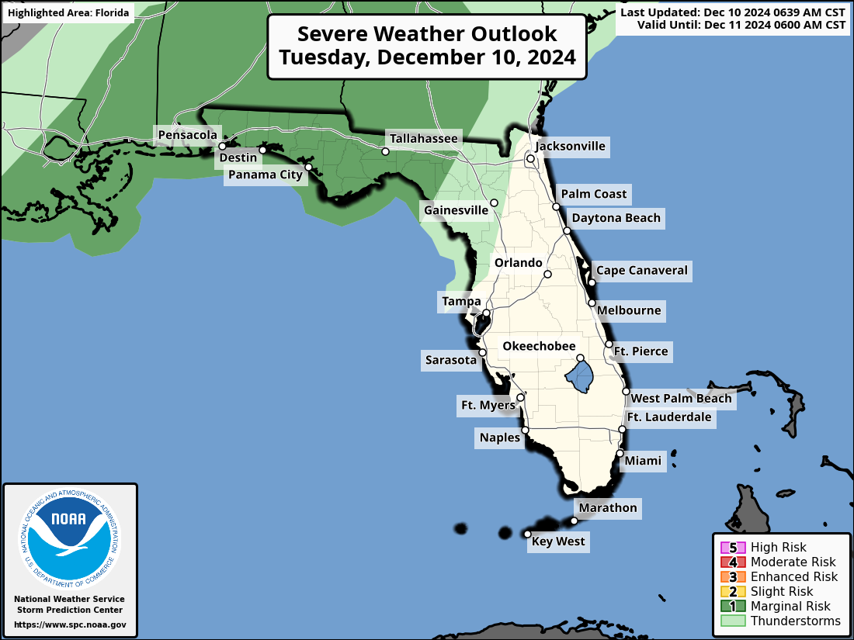
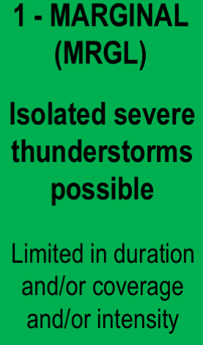
Meteorology Summary
Today’s Weather Map
24-Hour Forecast Rainfall Totals – Locally 3-5” Western Panhandle

Slide 7
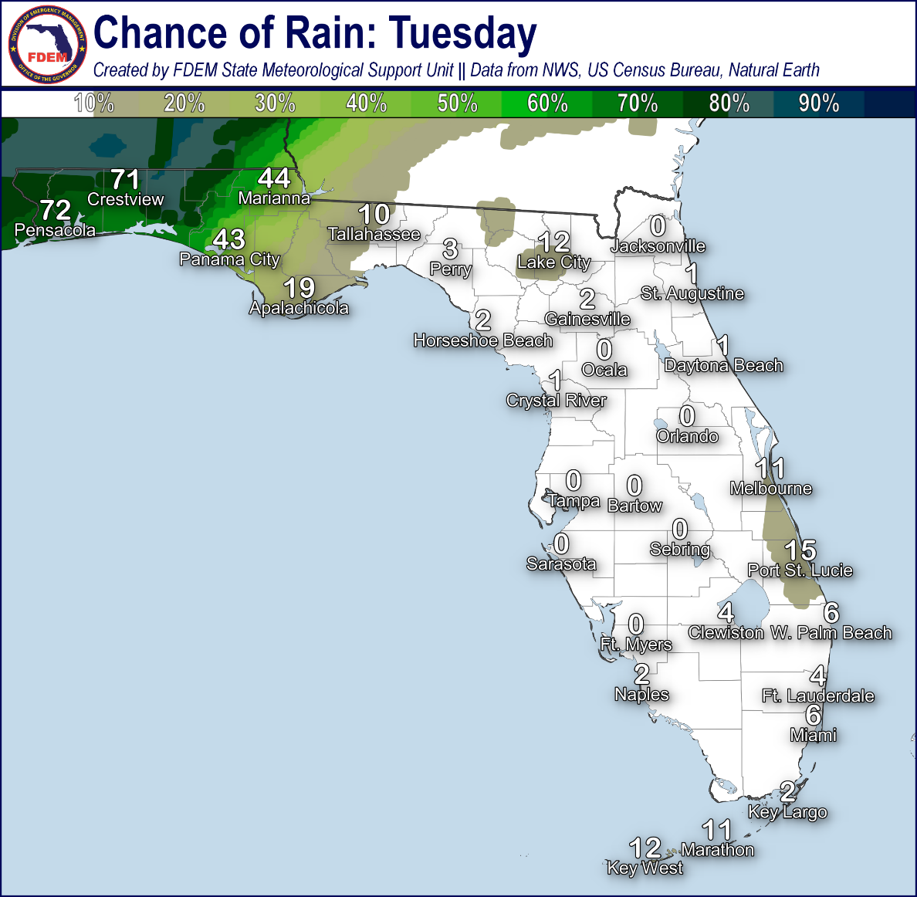
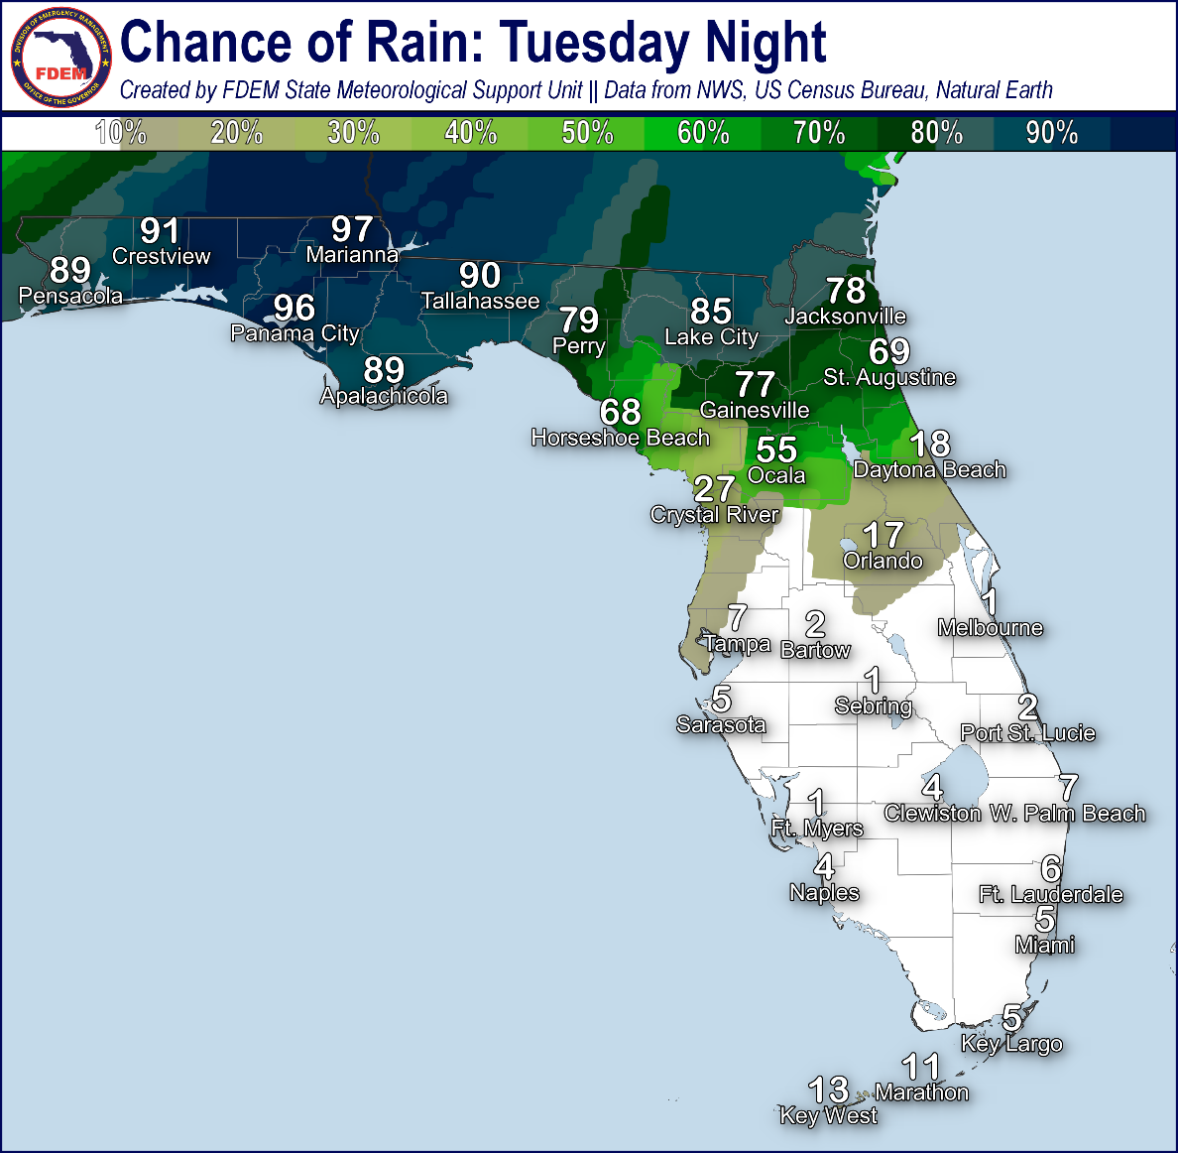
Meteorology Summary
Statewide Overview, Next 24 Hours:
An active weather pattern will begin later today, courtesy of an approaching frontal system. Scattered showers and embedded thunderstorms will become increasingly numerous west of the US-231 corridor this afternoon and evening (50-75% chance of rain), with the greatest coverage of shower and thunderstorm activity arriving tonight along the I-10 corridor (75-near 100% chance of rain). Given the slow-moving potential of this activity, there is a risk for isolated ponding water and flooding across the western Florida Panhandle – especially for low-lying and flood-prone locations that see multiple training rounds of showers and thunderstorms. Atmospheric conditions this afternoon appear somewhat conducive for isolated strong to locally severe thunderstorms along and ahead of the frontal boundary, and the Storm Prediction Center (SPC) is outlooking a Marginal Risk (level 1 of 5) for Severe Weather along the Florida Panhandle and western Florida Big Bend. While a few damaging wind gusts (45-60 mph) and a tornado or two will be possible within the more organized thunderstorm activity, a limiting factor for the severe weather potential will be the persistent cloud cover we have seen through the morning hours; radar and satellite trends will continue to be monitored this morning to determine the extent of the eventual severe weather concerns.
Elsewhere across the state, rain chances remain near zero with afternoon high temperatures rising into the lower to middle 80s. Ample moisture tonight will keep temperatures mild statewide, with low remaining in the 60s to 70s; however, post-frontal temperatures in the upper 40s can be expected for Northwest Florida tonight. Areas of patchy fog and low clouds cannot be ruled out along the coastal Florida Big Bend and through the Florida Peninsula tonight into Wednesday morning.

Slide 8
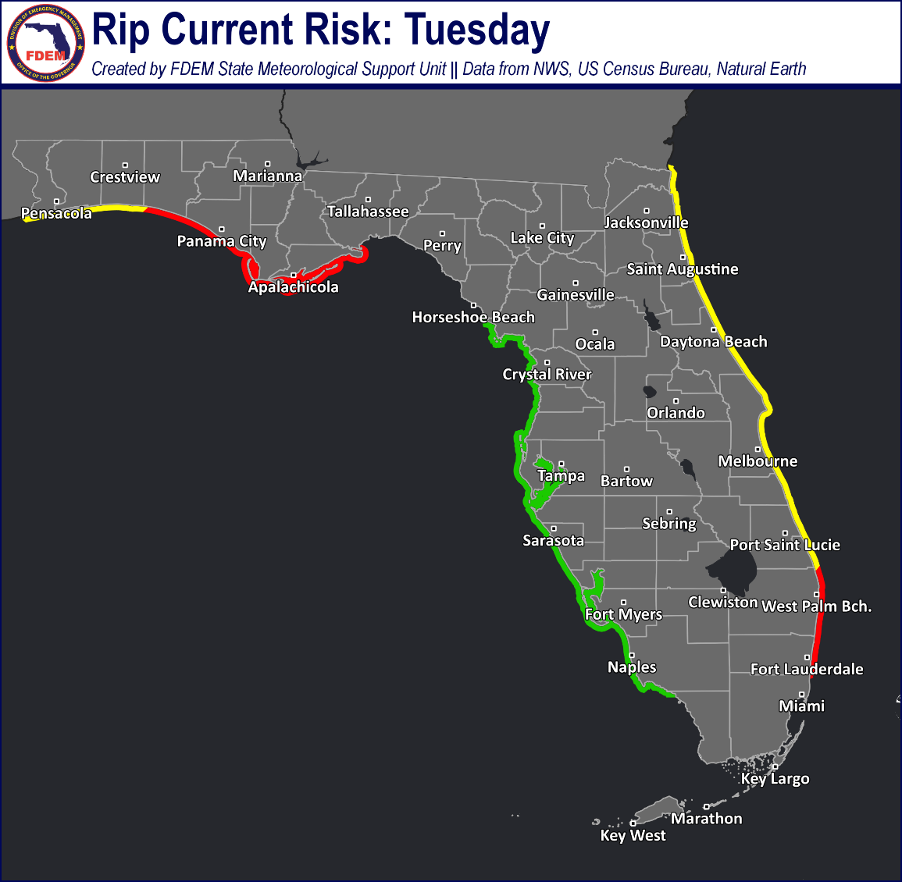
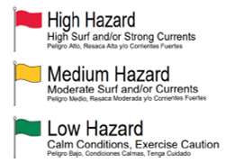
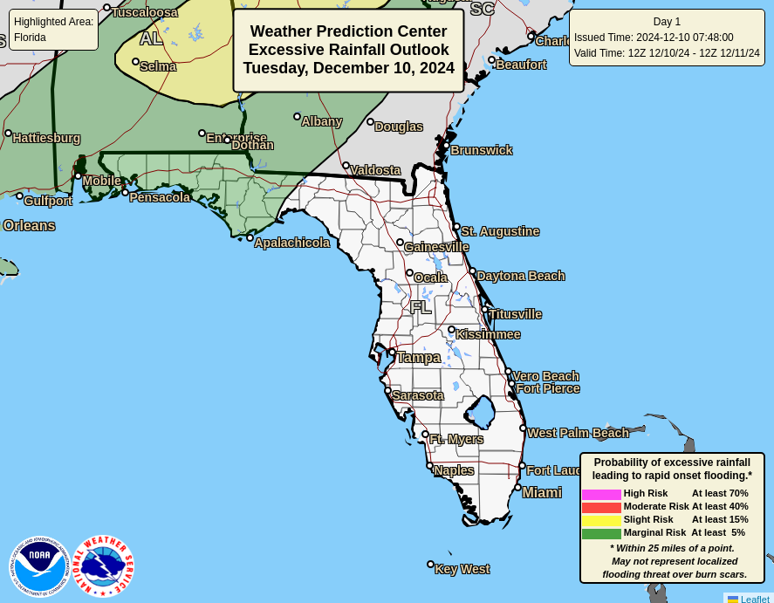
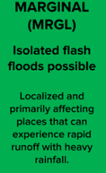
Coastal Hazards & Hydrology
Rip Currents: A moderate to locally high risk for rip currents persists along the Florida Panhandle and East Coast today with a low risk continuing along West Coast beaches. For the latest Rip Current Outlook, visit www.weather.gov/beach.
Marine Hazards: Building southerly winds today will influence wave heights of 2-4’ along Florida Panhandle beaches today, with breakers in the surf zone remaining near 1-3’ along the Florida West and Atlantic coastlines.
Red Tide has been observed in 54 samples collected from Southwest Florida over the past week (as of 12/6). Background to medium concentrations were observed in Pinellas County with low concentrations in Hillsborough County, background to low concentrations in Manatee County, background to medium concentrations in Sarasota County, low to medium concentrations in Charlotte County, and background to medium concentrations in and offshore of Lee County. Fish kills suspected to be related to red tide were reported along Pinellas County and respiratory irritation suspected to be related to red tide were reported in Pinellas and Sarasota Counties.
Coastal Flooding: There is no risk for coastal flooding today.
Flash Flooding: The Weather Prediction Center (WPC) is outlooking a Marginal Risk (level 1 of 4) for Flash Flooding across the Florida Panhandle as slow-moving showers and thunderstorms may produce locally heavy downpours over the same locations this afternoon into the overnight hours. The heaviest rainfall totals look to occur west of the US-231 corridor over the next 24 hours, with widespread 1-3” expected. Isolated higher totals of 3-5” cannot be ruled out within more organized thunderstorm activity; however, it appears the heavier rainfall concerns reside to the north and west over the interior Southeast U.S. Isolated nuisance ponding water and flooding will be possible in low-lying/flood-prone areas.
Riverine Flooding: Riverine flooding is not anticipated over the next couple days, even with the more active weather pattern and widespread rainfall. Rises within localized streams/waterways may occur with heavier downpours cannot be ruled out. For more information, visit the River Forecast Center.
Lake Okeechobee’s average elevation is 15.55 feet, which is within the operational band and 0.80 feet above normal for this time of year.

Slide 9
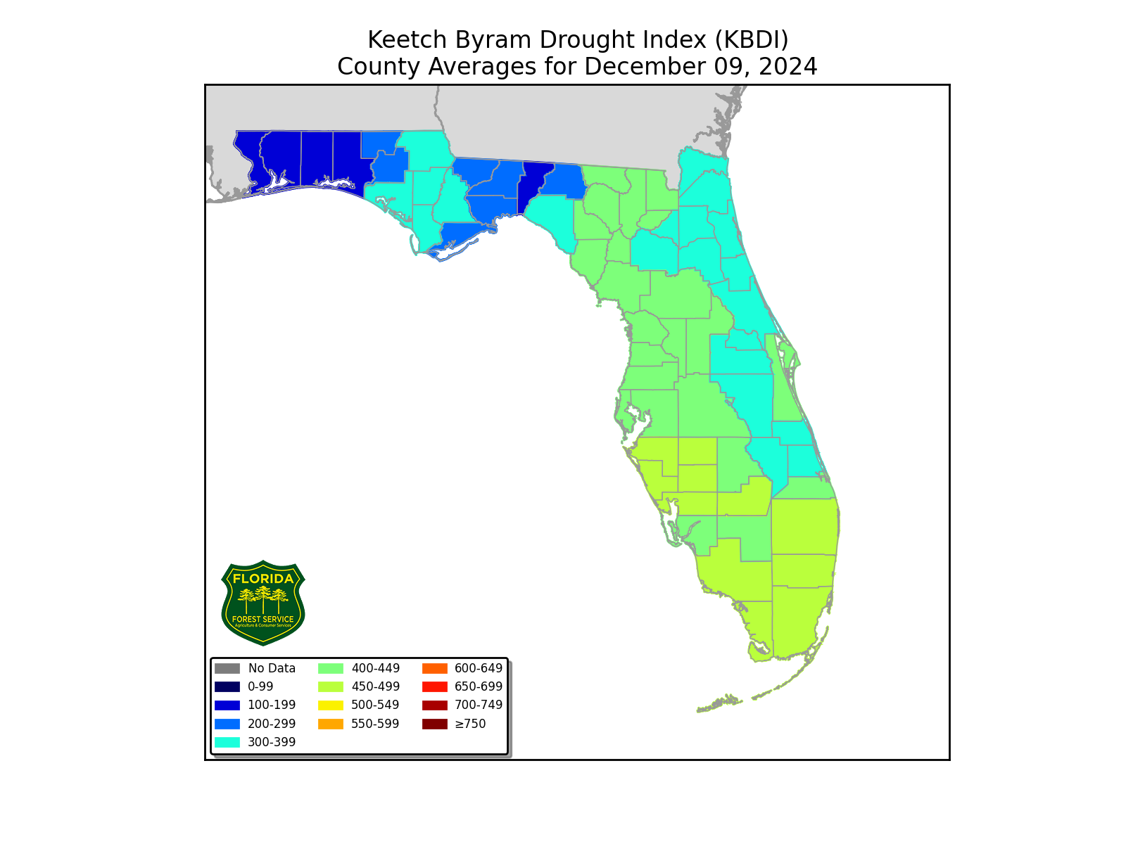
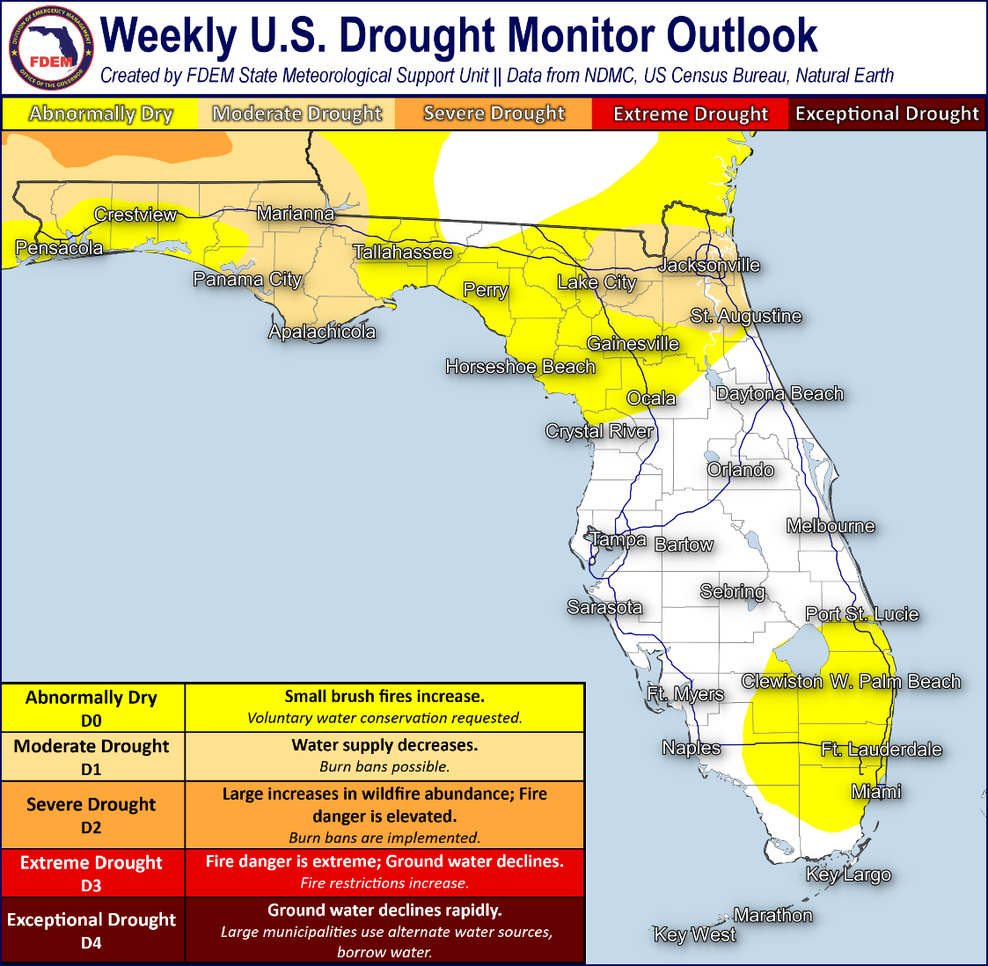
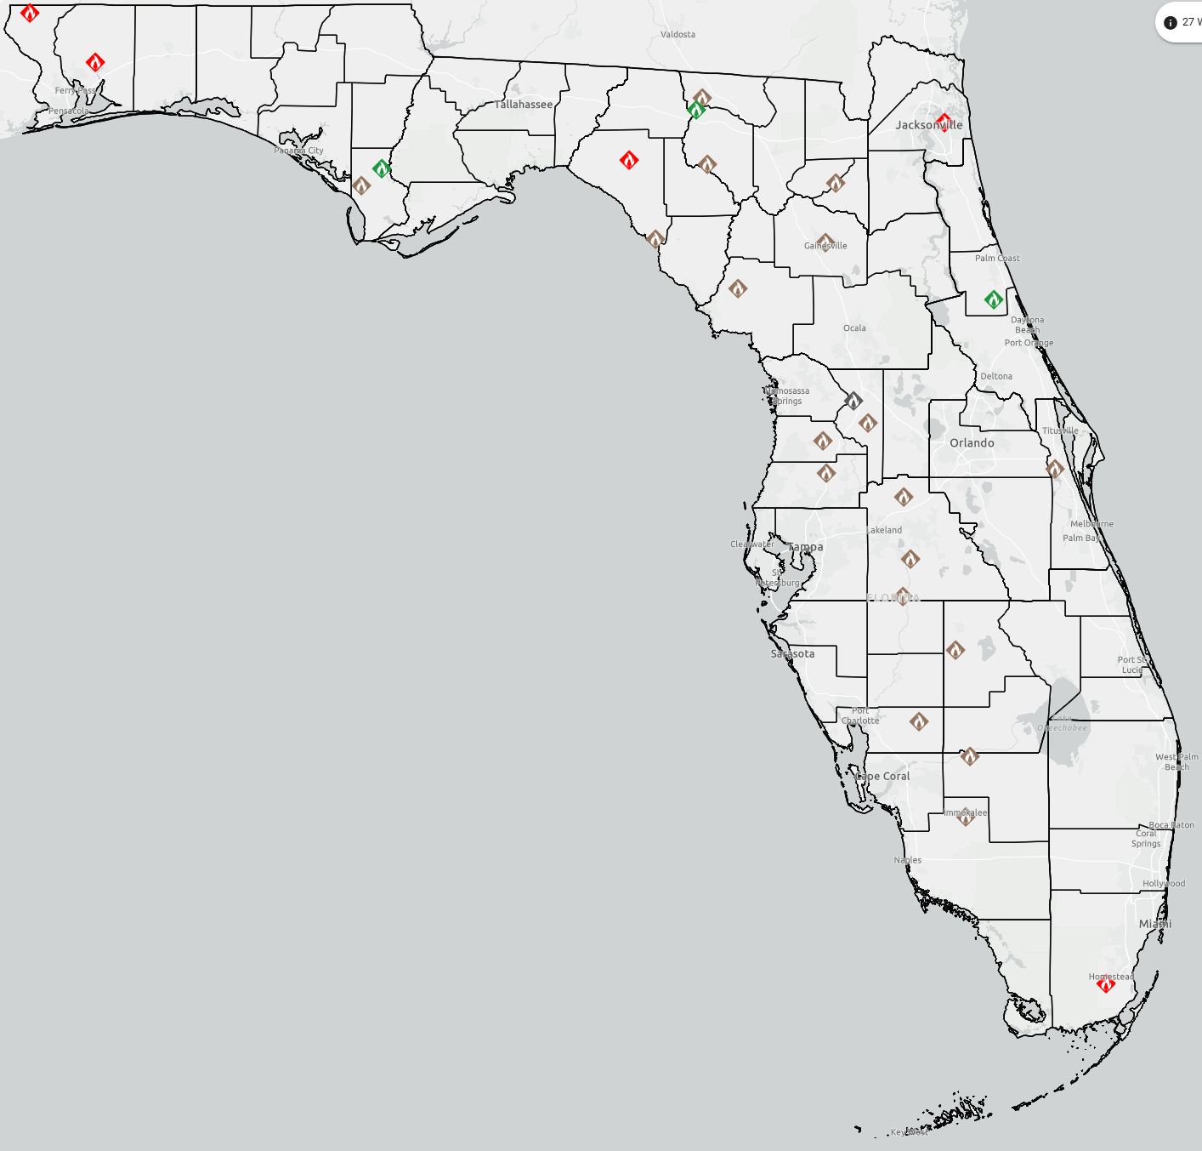
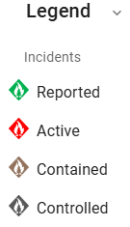
Drought & Fire Weather
Fire Weather: A cold front will set the stage for an active weather pattern across the Sunshine State through midweek, with increasing rain and thunderstorm chances arriving to the western Florida Panhandle this afternoon and evening. Moisture will return to Florida ahead of the approaching frontal system, courtesy of southerly winds, with relative humidity values remaining well above critical thresholds (greater than 55%). The risk for severe thunderstorms also brings the risk of lightning and locally damaging winds (45-60 mph); however, wetting rains will look to limit the extent of our wildfire threat today. Areas of patchy to locally dense fog may develop overnight across the Florida Peninsula; areas of fog and low clouds may further reduce visibility near ongoing wildfires or active burns. According to the Florida Forest Service, there are 27 active wildfires across the state burning approximately 118 acres.
Drought: Generally dry conditions have prevailed over the past week, with only isolated light precipitation observed, leading to worsening drought conditions as depicted in the Drought Monitor update (12/5). In Southeast Florida, short-term rainfall deficits in the past 30 days have led to a slight expansion of Abnormally Dry (emerging drought) conditions. Temperatures up to 2 to 6-degrees above normal across North Florida combined with dry conditions have led to further expansion of moderate drought conditions, which now resides through Gulf and Franklin Counties to the Apalachicola River basin in addition to the newly added Nassau County. Abnormally Dry conditions remain in place elsewhere across North Florida. While near to above-normal temperatures are expected to persist over the next week or so, above normal rainfall outlooked through the period may help to improve drought conditions over the next week.
The Keetch-Byram Drought Index average for Florida is 384 (+4) on a scale from 0 (very wet) to 800 (very dry). There are no Florida Counties with an average KBDI over 500 (drought/increased fire danger).
Current FFS
Wildfire Dashboard

Slide 10
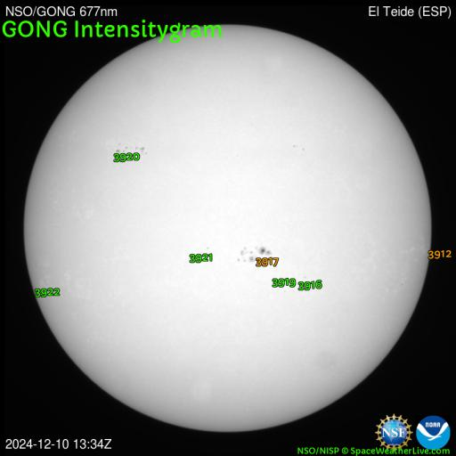
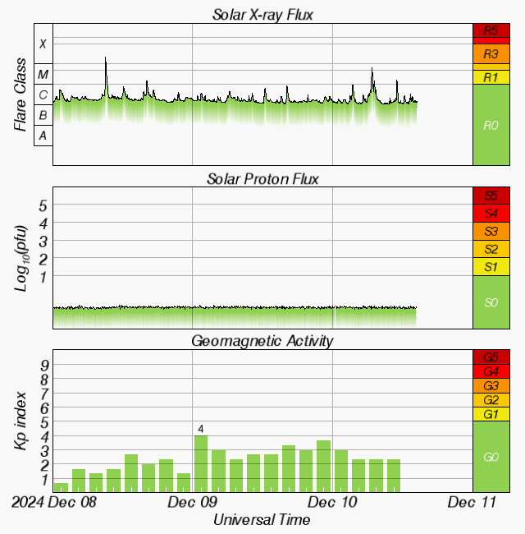
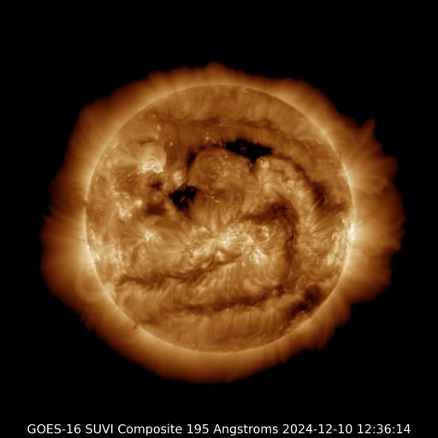
Space Weather
Solar Flare Risk | Active Watches & Warnings | Past 24 hours
M-class: 60% | Geomagnetic Storm: None | M6 Solar Flare
X-class: 10% | Radiation Storm: None | R2 Radio Blackouts
Current Sunspots
48-Hour Geomagnetic Forecast
12/10 | 12/11
Max Kp= 3 (G0) | Max Kp= 3 (G0)
Chance of minor activity = 5% severe activity = 1% | Chance of minor activity = 5% severe activity = 1%
Earth-facing Coronal Holes
Space Weather: Minor to moderate radio blackouts (R1-R2) will remain possible with solar flare activity, primarily from sunspots 3912, 3917, and 3922. A slight chance for a stronger radio blackout continues for any more organized solar flares (R3). Solar wind parameters are forecast to remain enhanced through midweek due to ongoing coronal hole influences. Isolated active geomagnetic periods can be expected today as the aforementioned coronal hole influences keep the field disturbed. However, widespread organized or strong geomagnetic storming is not anticipated, and the overall space weather threat to Florida remains very low.
Notes:
**** ALL IMAGES ON SPACE WEATHER SLIDE ARE NOW AUTOMATICALLY UPDATING! *****

Slide 11
SWO Communications Systems & Contact Information
Users wishing to subscribe (approval pending) to this distribution list, register at: https://public.govdelivery.com/accounts/FLDEM/subscriber/new?topic_id=Morning_SITREP

