Slide 1


Statewide Travel Management System
Quick Reference Guide

Slide 2
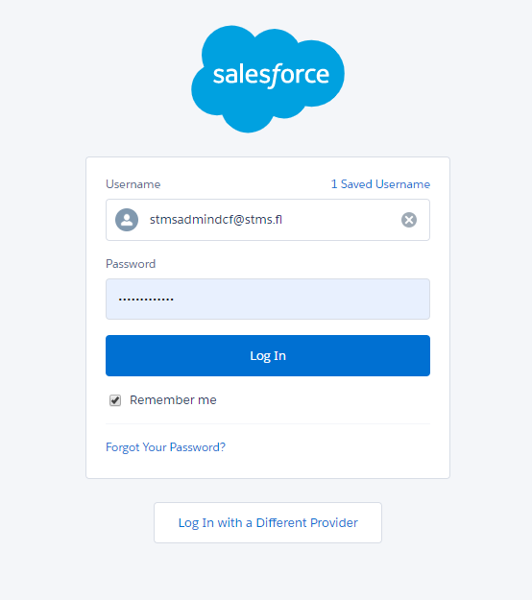
Logging In
Navigate to the Salesforce Homepage
Select “Log In with a Different Provider”
Select “DCF 600000” from the scrollable list. You will be re-routed to an alternate login page
Enter your Active Directory email address as your Username
Enter your Active Directory password in the Password field

Slide 3
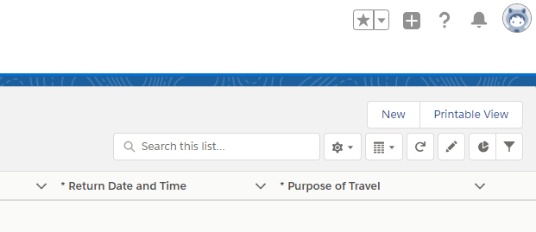
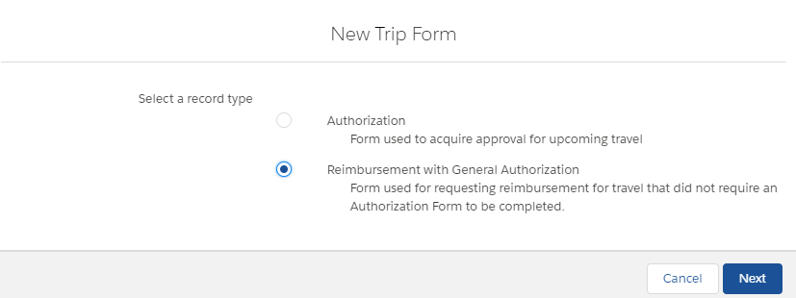
Creating a New Trip Form
1. After logging into the Statewide Travel Management System, select New in the upper righthand corner of the Home Screen
2. Select the radio button for Reimbursement with General Authorization

Slide 4
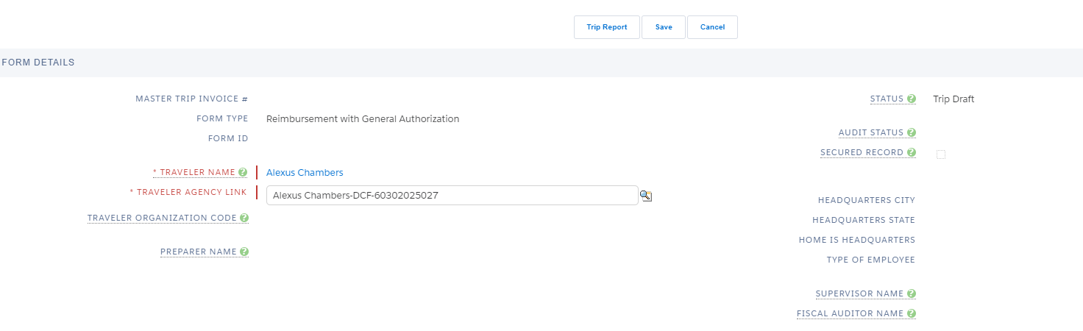
Form Details
Section 1: Form Details
This section will auto-populate after the subsequent Trip Details section has been completed and saved. Travelers will not enter any information here.
Preparers will use this section to select the name of the traveler. No other information must be entered.

Slide 5
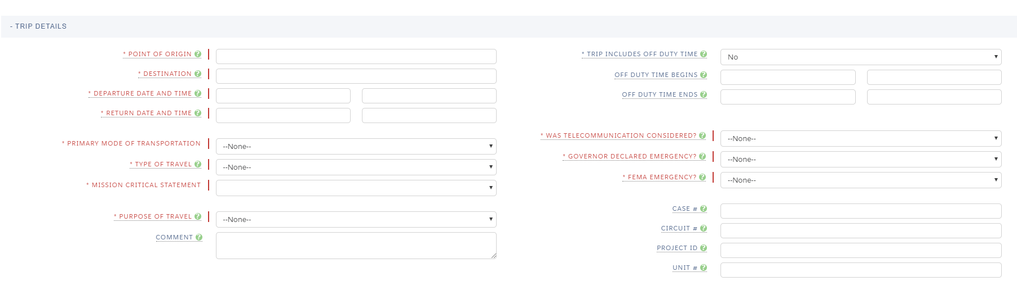
Trip Details
Section 2: Trip Details
Enter the appropriate information in the Trip Details fields. Please note that fields highlighted in red require a response.
For the field “Was Telecommunication Considered”, always select “Yes”.
After completing the Trip Details section, scroll to the bottom of the form and select Save.

Slide 6
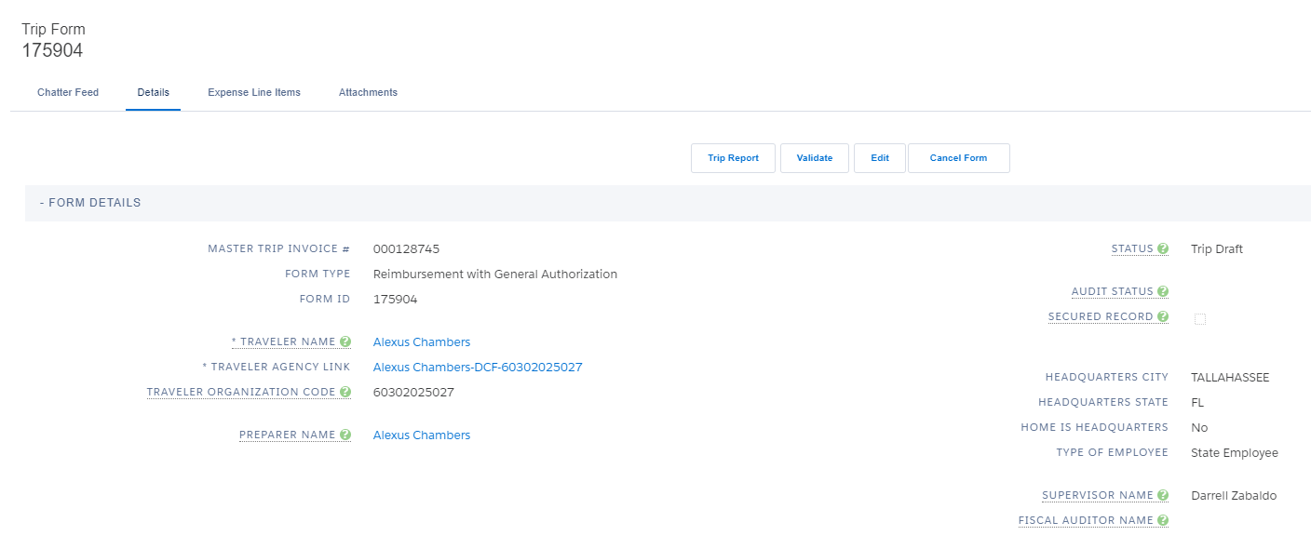

Note that a Trip Form ID Number is generated after saving, and Form Details information is auto-populated.
The option to enter Expense Line Items is now available.

Slide 7
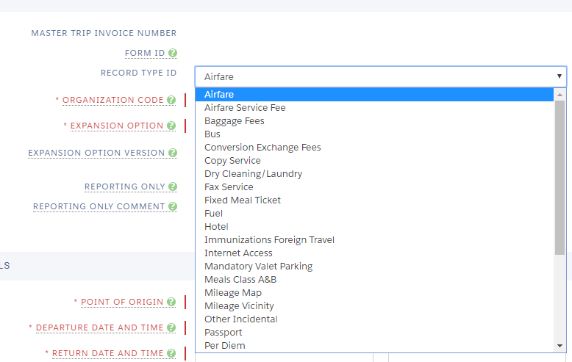

Entering an Expense Line Item
After selecting “Expense Line Items” on the Trip Form Details page, select “New” to create a line item.
Select the appropriate Record Type ID
Enter the Organization Code that should be used if it differs from what is auto-populated.
Select the corresponding Expansion Option from the dropdown menu.
Enter expense line item details. Required information will differ based on the Record Type.
Did You Know?
Some expense line items such as Meals Class A & B and Fuel have to be entered separately for each day of travel.

Slide 8
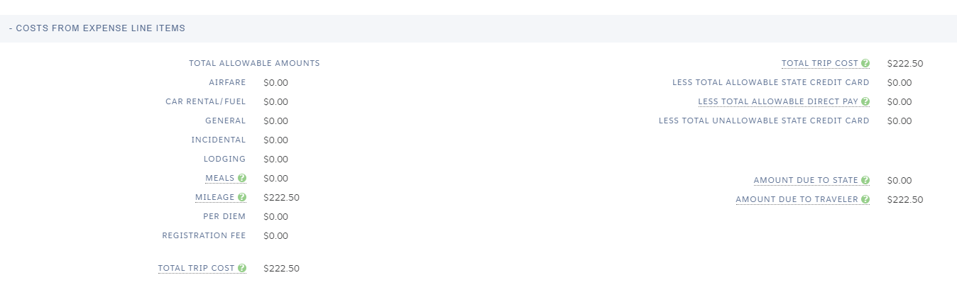
Expense Line Items
Section 3: Costs from Expense Line Items
Expense Line Items that have been entered and saved will auto-populate in this section of the Trip Form Details page and can be found directly below the Trip Details section.
Information cannot be manually entered here.

Slide 9
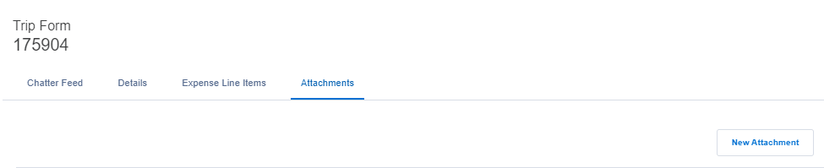
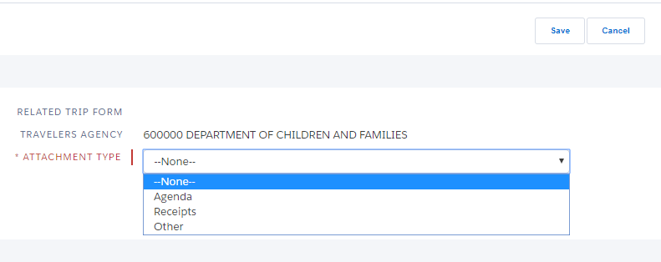
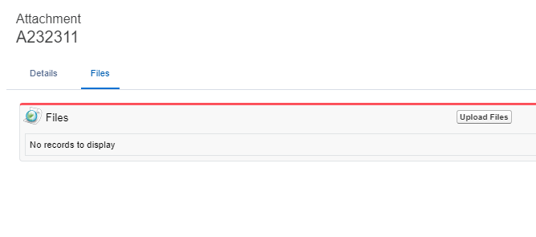
Attaching Supporting Documentation
Select the Attachments tab on the Trip Form home page.
Select “New Attachment” in the righthand corner of the page.
Choose an Attachment Type from the drop-down menu and select Save
Navigate to the Files tab and select “Upload Files”
Select the appropriate files and proceed to upload
Press the “Close” button once the upload is complete. The uploaded document can now be found under the Files tab.

Slide 10
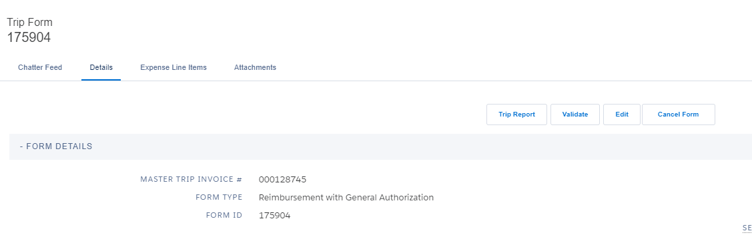
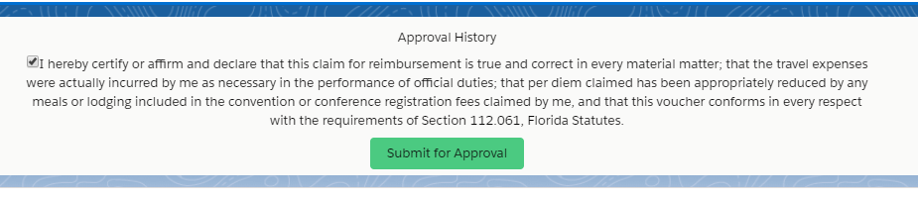
Submitting a Trip Form for Approval
Select “Validate” located in the top-center of the screen
Certify that the information provided is accurate and true and select “Submit for Approval”
The form will be routed to the employee’s supervisor
*If travel is prepared by a Preparer, submitting the form will route it to the employee for approval prior to routing to the supervisor.

Slide 11


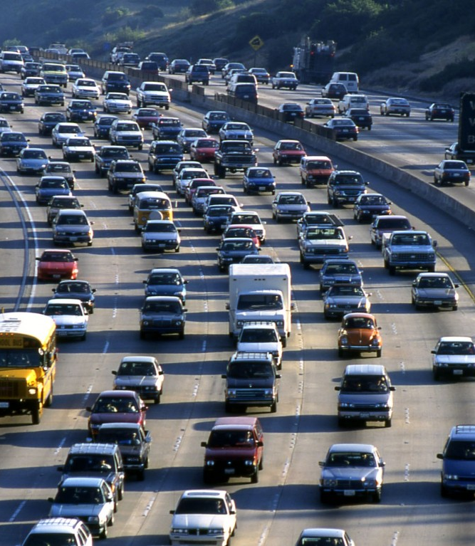
Special Instructions for Continuous Travel:
CPI/API Travelers

Slide 12
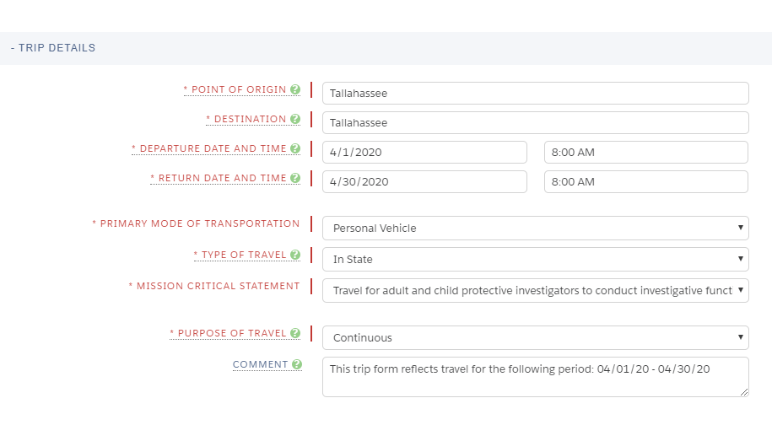
Entering Trip Form Details for Continuous Travel
1. Enter the starting point of travel as both Point of Origin and Destination. For this example, we have used Tallahassee, FL.
Enter the first and last date of travel as the Departure Date and Return Date respectively
*Please note that if any overnight travel occurred during the month of continuous travel, this will have to be entered as a separate entry. End the continuous travel form at the date prior to the start of the overnight travel, and submit the remaining continuous travel with a departure date that begins after the overnight travel.
3. Continue by selecting the appropriate options for Primary Mode of Transportation, Type of Travel, Mission Critical Statement, and Purpose of Travel.
*Note that for continuous travel (CPI/API Travel), “Continuous” should be selected for the Purpose of Travel in lieu of Routine Duties.

Slide 13


Entering Expense Line Items: Mileage Vicinity & Tolls

Slide 14
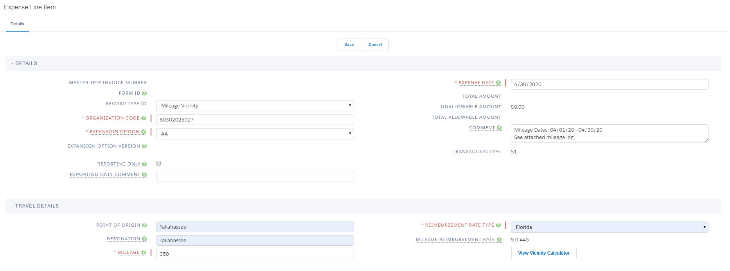
Entering Expense Line Item: Mileage Vicinity
Select “Mileage Vicinity” from the Record Type drop-down menu
Expense Date should be listed as the last date of travel
The starting point of travel should be listed for both Point of Origin and Destination
Enter mileage total in the Mileage field
Enter a comment in the Comment field that denotes the dates of travel covered
Select “Florida” for Reimbursement Rate Type
Scroll to the bottom of the page and select Save. The mileage amount owed will auto-calculate and transfer to the Costs from Expense Line Items section of the Trip Form Details page
Attach vicinity mileage logs to the trip form

Slide 15
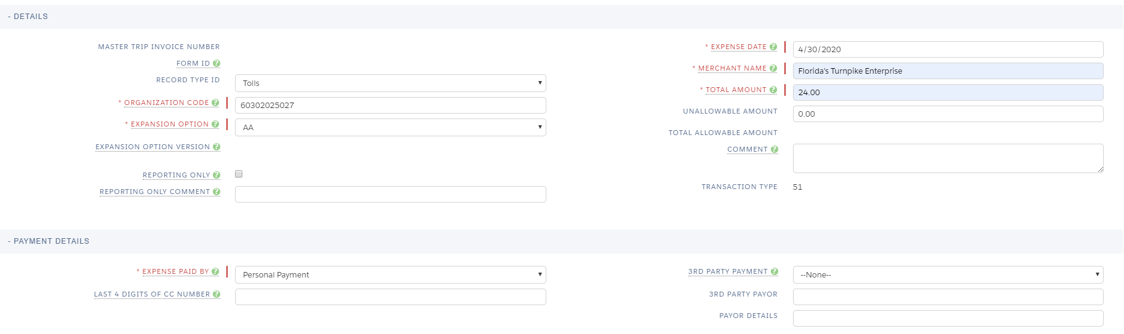
Entering Expense Line Item: Tolls
Select “Tolls” from the Record Type drop-down menu
Expense Date should be listed as the last date of travel
Enter the Merchant Name
Enter Total Amount of tolls expense
In the Payment Details section, select the appropriate form of payment and last four digits of CC number if applicable.
Scroll to the bottom of the page and select Save. The tolls amount owed will auto-calculate and transfer to the Costs from Expense Line Items section of the Trip Form Details page
Attach toll receipts to the trip form

