Slide 1
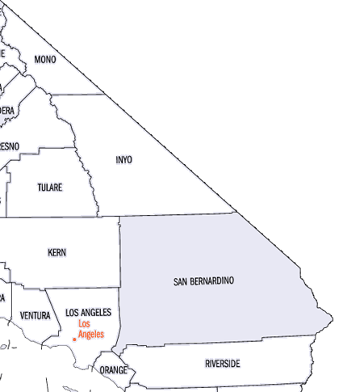
ATC History Auditor
Controller
Treasurer
Tax Collector
A Look Back In Time
1853 - Present

Slide 2
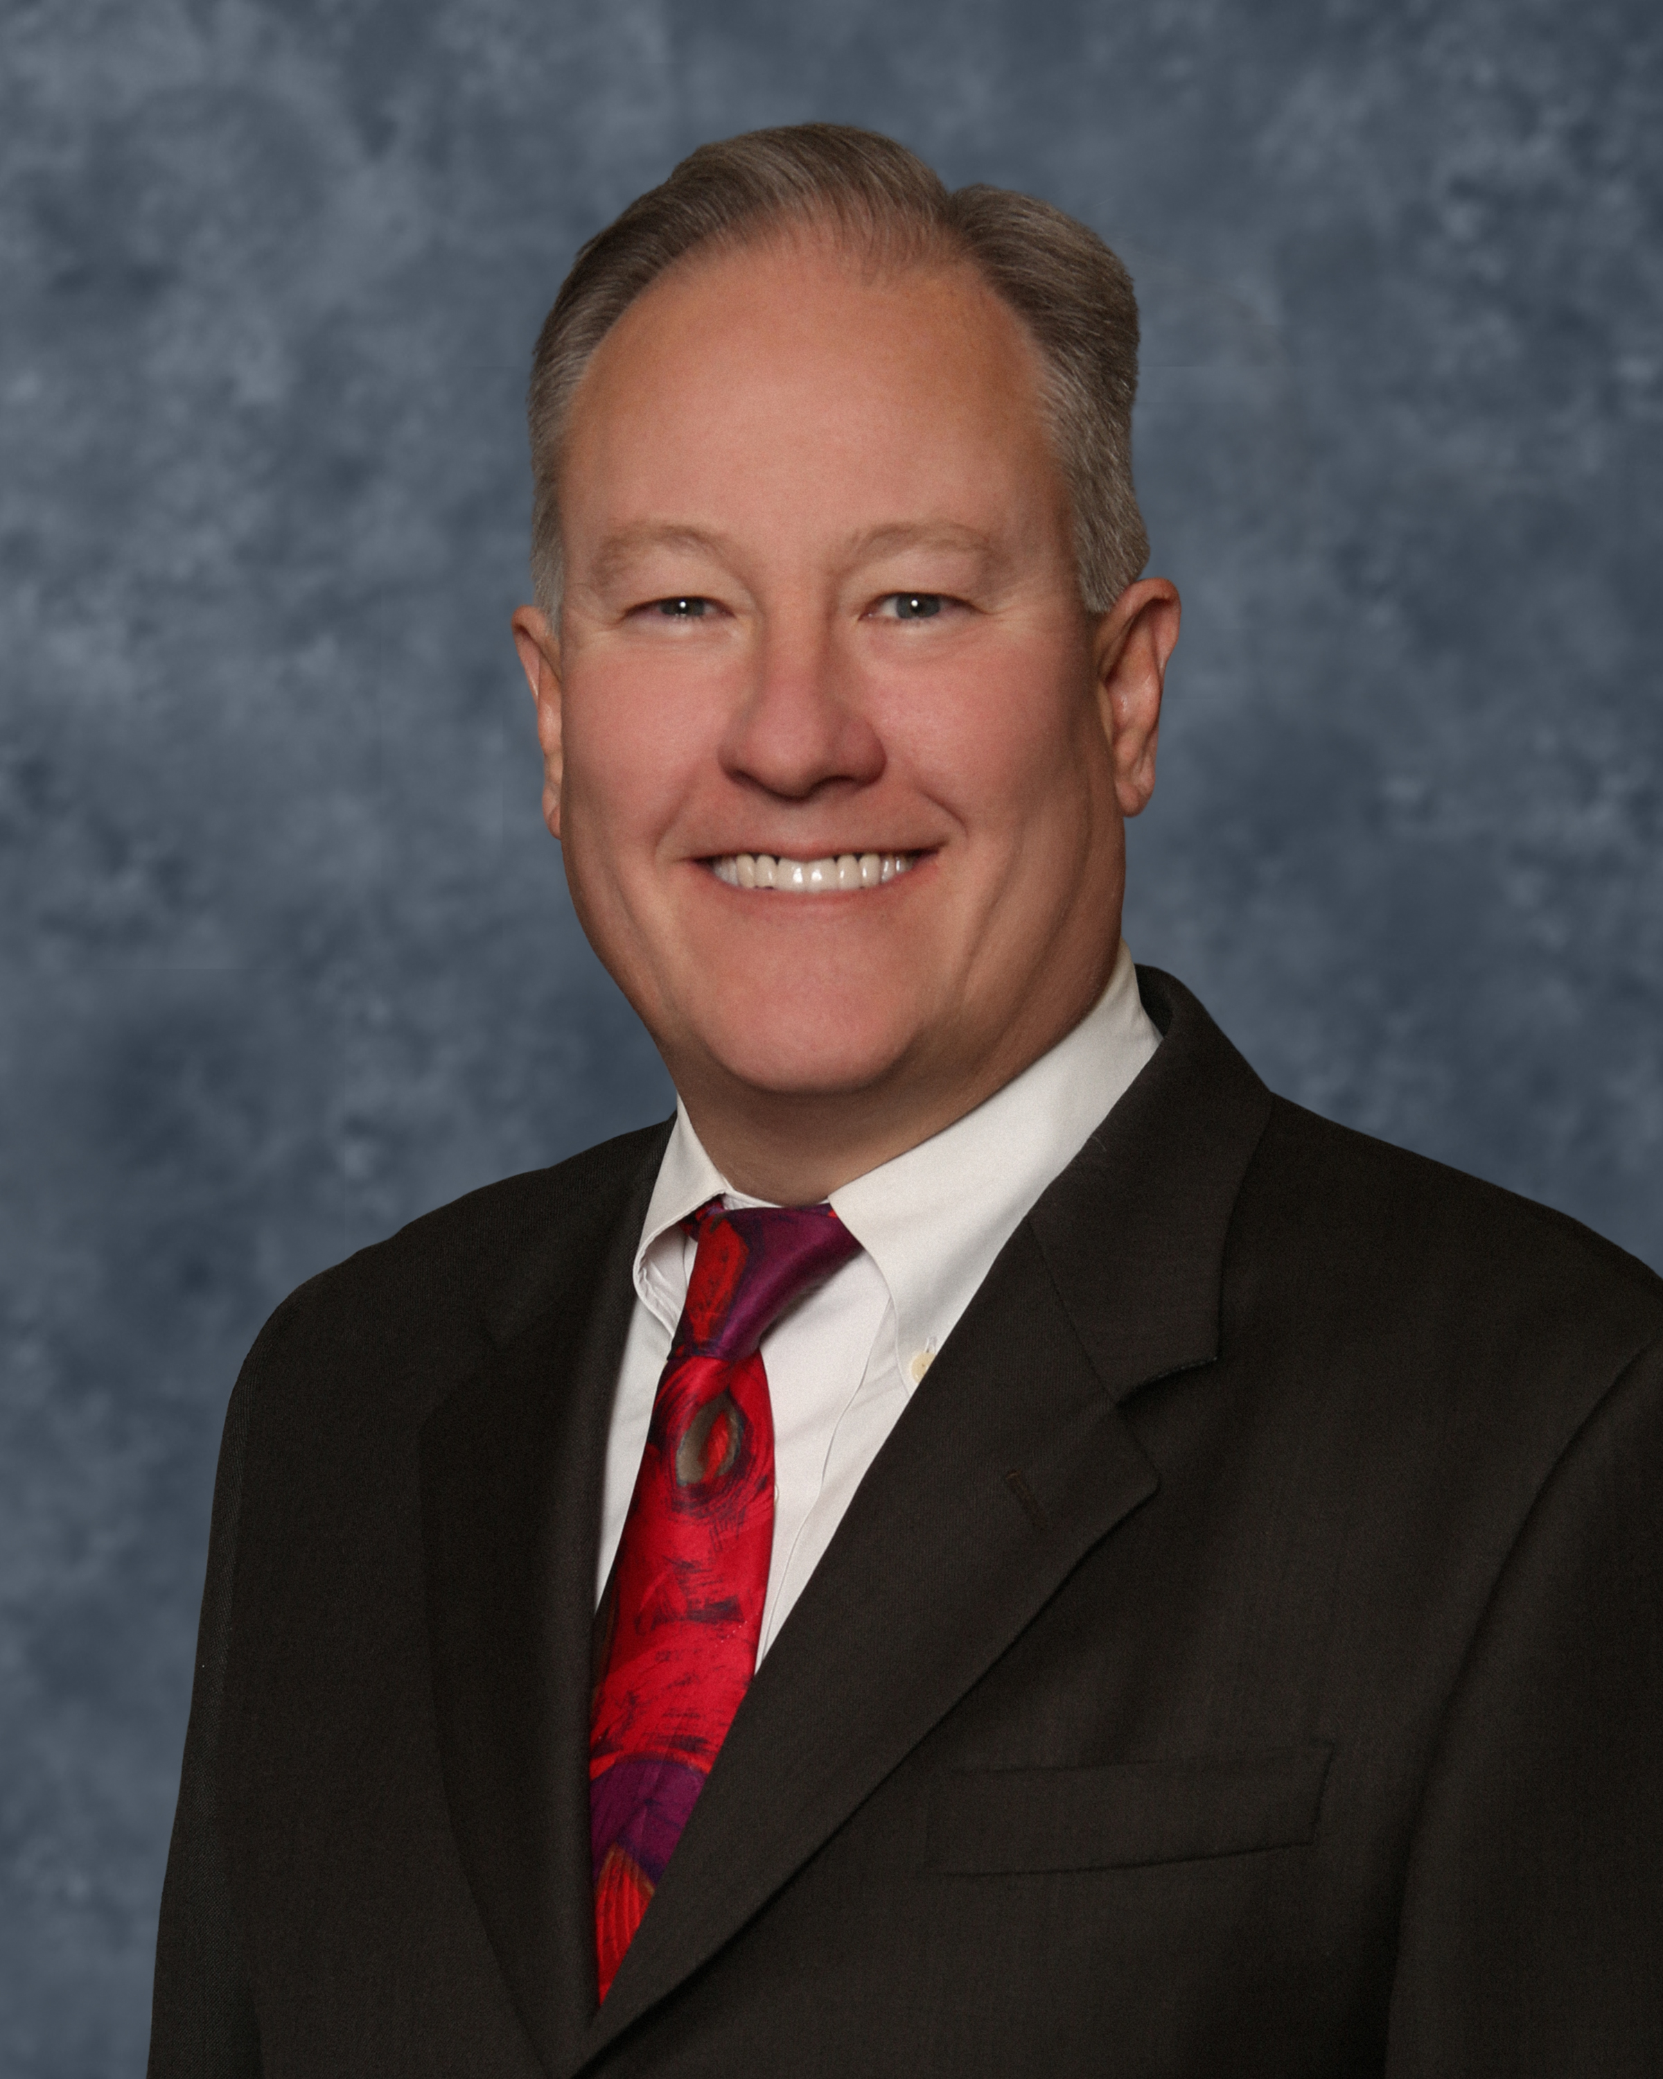
Ensen Mason CPA, CFA
Auditor-Controller/Treasurer/Tax Collector
2019 - current

Slide 3
Ensen Mason CPA, CFA
Ensen Mason was elected as the Auditor-Controller/Treasurer/Tax Collector (ATC) in June 2018. He brought over 30 years of experience in tax preparation and investment advising, and is both a Certified Public Accountant and a Chartered Financial Analyst.
He holds a Master of Business Administration (MBA) with an emphasis in finance from the University of Redlands.

Slide 4

Ensen Mason CPA, CFA
In his role as Auditor-Controller/Treasurer/Tax Collector, ATC Mason oversees 320 employees, directing the financial affairs of the County and managing an investment pool exceeding $15 billion.
He also serves as an Ex Officio Member of the San Bernardino County Employees’ Retirement Association Board of Retirement, assisting in the management of their investment portfolio, which has reached almost $16 billion.

Slide 5
Ensen Mason CPA, CFA
Ensen Mason is the fiscal watchdog for the County ensuring taxpayer dollars are protected and spent properly and efficiently.
He advocates for both taxpayers and County employees by maximizing their investment dollars.
He also ensures fair tax collection by providing full due process to taxpayers, while offering them convenient and accessible ways to fulfill their tax obligations.
He fosters innovation having garnered 27 NACo awards since 2019.
He provides government transparency by reporting the actual results of the County’s comprehensive financial operations, which have resulted in major awards for financial reporting.

Slide 6
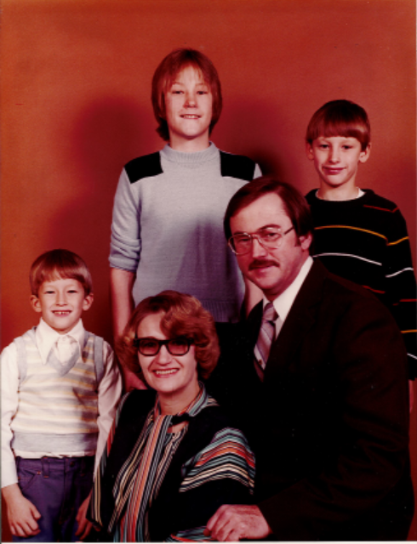
Ensen Mason CPA, CFA
Born in Albuquerque, New Mexico, Ensen Mason is the eldest of three boys raised by a military veteran father. He and his family moved to a New Jersey suburb of New York City when he was 5 years old.
At the age of 17, his father Thomas Mason was laid off during a major corporate restructuring at J.C. Penney’s. As a result, the family relocated to Thomas’ native California. Ensen’s strong mathematical abilities and his father’s expanding accounting practice inspired him to learn from his dad, eventually joining the practice before starting his own career.
The Mason Family in 1980

Slide 7
Ensen Mason CPA, CFA
At 19, Ensen began his accounting practice in a small office shared with a private mailbox business he owned, "The Mail Centre," located in the desert town of Phelan. By the age of 21, he had become an enrolled agent with the IRS, working long hours for modest pay. Despite the challenges, Mason Financial Services gradually grew into a respected accounting office in the city of Victorville.

Slide 8
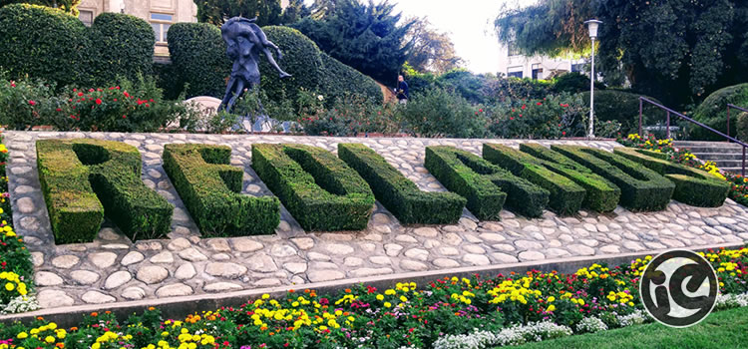
Ensen Mason CPA, CFA
In 2012, Ensen relocated both his home and accounting practice to Redlands, drawn by the small-town charm and quality of life. By the time he was elected to oversee the County’s tax system in 2018, Ensen had completed over 15,000 tax returns and earned a reputation as a Taxpayer Advocate, frequently battling and winning against the IRS and the state Franchise Tax Board on behalf of his clients. Expanding into wealth management at the request of his clients, Ensen earned his Chartered Financial Analyst (CFA) designation and several securities licenses, complementing his CPA and an MBA from the University of Redlands.

