Slide 1
Hepatitis B and C Clinical Information and Vaccination Recommendations May 22, 2024 Jordan Braunfeld, MD Los Angeles County Department of Public Health Vaccine Preventable Disease Control
Nava Yeganeh, MD MPH
Los Angeles County Department of Public Health
Vaccine Preventable Disease Control

Slide 2
Disclosures
There is no commercial support for today’s webinar.
Neither the speakers nor planners for today’s webinar have disclosed any financial interests related to the content of the meeting.
This presentation is meant only for educational purposes and is off the record. The information is current as of today: 5/22/2024
Notes:
There is no commercial support for this section of the webinar webinar and none of the speakers or planners have disclosed any financial interests related to the content of the meeting.

Slide 3
Hepatitis B and C Disease

Slide 4
Two viruses, one organ
Capable of causing acute liver damage/failure
Jaundice
Nausea/vomiting
Abdominal pain
Capable of maintaining chronic infection
Chronic infection can lead to liver cancer, cirrhosis, and liver failure
Transmitted by blood
Unprotected sex
Sharing needles
Transfusion of infected blood products
Needlesticks
Childbirth
Can last a long time on surfaces outside the body
Treatments exist!

Slide 5
Two viruses, one organ
Hepatitis B virus (HBV)
Hepatitis C virus (HCV)
Hepadnavirus – DNA
More likely to cause severe acute infection
Chronic infection 90% after infection at birth
Highly contagious
Longer incubation (>60 days)
Vaccine!
Flavivirus – RNA
More likely to cause chronic infection
Not quite as contagious
Shorter incubation (as short as 2 weeks)
No vaccine

Slide 6
Identifying Hepatitis B Infection

Slide 7
Who should you test?
Anyone with clinical signs of hepatitis!
All adults at least once, especially if they are at increased risk
Pregnant people (every pregnancy)
History of STIs or high-risk sexual practices
History of HCV infection
People who have a history of or actively inject drugs
People with HIV
Men who have sex with men
People with uncertain HBV vaccination status
Any infant born to a HBsAg-positive person*

Slide 8
What tests to send, and what they tell you
HBsAg – HBV surface antigen
This person is infected
Cannot determine acute vs chronic
HBsAb – Antibody against HBV surface antigen
The body has mounted an immune response to HBV
Can be positive in people who have been vaccinated OR previously infected
Cannot discern the difference
Generally negative during acute or chronic infection
Can decline over time, but doesn’t necessarily mean someone is vulnerable
HBcAb – Antibody against HBV core antigen
This person has been infected
IgM positive in acute infection*, IgG positive in chronic infection

Slide 9
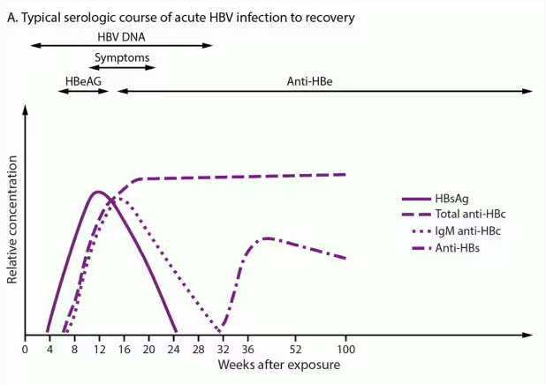
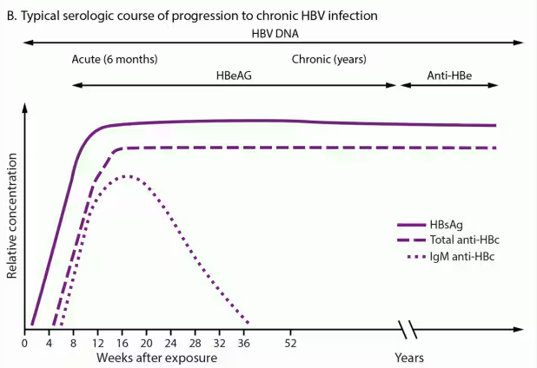
HBV test timelines

Slide 10
What these tests mean – a quick guide
 | HBsAg | HBsAb | HBcAb
Susceptible/non-immune | Negative | Negative | Negative
Vaccinated | Negative | Positive | Negative
Acute infection | Positive | Negative | Positive (IgM)
Resolved infection | Negative | Positive | Positive (IgG)
Chronic infection | Positive | Negative | Positive (IgG)

Slide 11
Special directions for pregnant people
Send HBsAg at first prenatal visit
If positive, check HBV DNA
If never previously tested, send HBsAg, HBsAb, and HBcAb
If HBsAb AND HBsAg negative, vaccinate!
Screen again at delivery in patients with clinical hepatitis or high-risk exposures during pregnancy

Slide 12
Hepatitis B Prevention and Treatment

Slide 13
Vaccines – they’re for everyone!
For kids – schedule depends on weight and mother’s HBV status
3 doses for single-antigen vaccine
4 doses for single-antigen + combo vaccine
For adults
3 dose series given at 0, 1, and 6 months
If previously vaccinated, no need for booster even if HBsAb is low
Unless someone with impaired immune system, getting dialysis

Slide 14
Treating HBV in most people
Do not treat acute infection!
Chronic infection - it depends
HBV treatment not generally curative
What are the patient’s long-term goals
Often treat to mitigate liver damage or possibility of transmission
Must be careful with HIV co-infection
Postexposure prophylaxis
HBV vaccine +/- HBIG

Slide 15
Treating HBV in pregnancy
Treat pregnant people with HBV DNA > 200,000 IU/mL to reduce perinatal spread
Treatment of infants born to HBV-positive mothers depends on weight
HBIG and single-antigen vaccine in separate limbs within 12 hours after birth for ALL
Weight > 4.4 lbs
2 additional doses of single-antigen vax OR 3 additional doses of combo vax
Weight < 4.4 lbs
3 additional doses of single-antigen OR combo vax
Final dose of vaccine should be given no earlier than 6 months of age
If child received HBIG, mother may breastfeed
Test the infant for HBsAg and HBsAb at 9-12 months (or 1-2 months after vaccine series completed if delayed)

Slide 16
Identifying Hepatitis C Infection

Slide 17
Who should you test?
Anyone with clinical signs of hepatitis!
All adults at least once, especially if they are at increased risk
Pregnant people (every pregnancy)
History of STIs or high-risk sexual practices
History of HBV infection
People who have a history of or actively inject drugs
People with HIV
Men who have sex with men
Any infant born to a person with HCV

Slide 18
What tests to send, and what they tell you
HCV Ab
If positive, this person has been infected before
Cannot determine prior (resolved) vs current acute/chronic infection
Stays positive for life
HCV NAT – Detects and quantifies HCV RNA
Only send if HCV Ab is positive, usually ordered as a reflex test
If positive, this person is presently infected
Cannot discern between acute and chronic infection
HCV Genotype – Only send if HCV NAT is positive
Will help determine treatment options

Slide 19
Hepatitis C Treatment

Slide 20
Treating HCV
Treatment should be offered to all, except pregnant people and children under 3
8-12 weeks of oral direct-acting antivirals – 95% curative
Can expect complete remission!
Be mindful of HBV co-infection – HCV treatment can cause worsening of HBV disease

Slide 21
A reminder about HAV
LAHAN 5/10/24

Slide 22
Thank you! For additional questions, please contact: LacipInfo@ph.lacounty.gov. For additional information, visit: http://publichealth.lacounty.gov/ip/index.htm.

