Slide 1
Update on Invasive Meningococcal Disease and Vaccination Recommendations April 10, 2024 Jordan Braunfeld, MD Los Angeles County Department of Public Health Vaccine Preventable Disease Control
Nava Yeganeh, MD MPH
Los Angeles County Department of Public Health
Vaccine Preventable Disease Control

Slide 2
Disclosures
There is no commercial support for today’s webinar.
Neither the speakers nor planners for today’s webinar have disclosed any financial interests related to the content of the meeting.
This presentation is meant only for educational purposes and is off the record. The information is current as of today: 4/10/2024
Notes:
There is no commercial support for this section of the webinar webinar and none of the speakers or planners have disclosed any financial interests related to the content of the meeting.

Slide 3
Invasive Meningococcal Disease

Slide 4
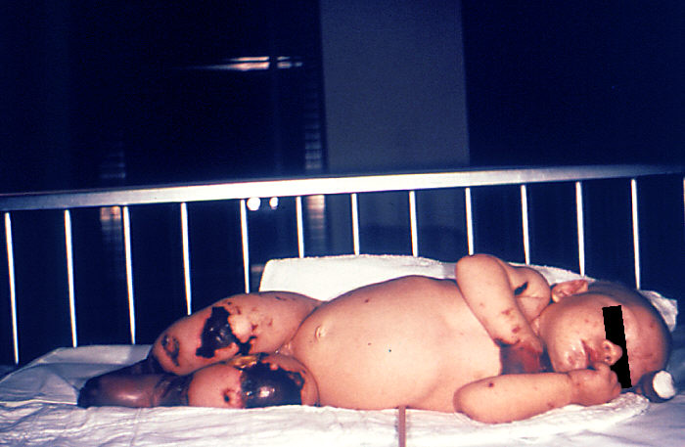
Causative agent and clinical syndrome
Neisseria meningitidis
Meningitis - Fever, headache, stiff neck, photophobia
Septicemia and dark purple rash in more severe cases
Spread via respiratory droplets
Children < 1 year and adolescents/young adults most affected
~11.5% case fatality even with treatment
Up to 20% with long-term disability such as loss of limb, deafness, or permanent neurological damage

Slide 5
Current situation
422 cases of meningococcal disease in 2023, most since 2014
As of March 25, 143 cases so far this year (81 by this date in 2023)
Current outbreaks in Colorado and Virginia
68% due to serogroup Y
Disproportionately occurring in the following groups:
Age 30-60 years (65%)
Black or African American persons (63%)
People living with HIV (15%)
Most cases involve something other than meningitis – 64% with bacteremia
18% case-fatality rate (historically 11% for serogroup Y)
CDC|Increase in Invasive Serogroup Y Meningococcal Disease in the United States

Slide 6
Prophylaxis considerations
Ciprofloxacin-resistant N. meningitidis is increasing
Use Rifampin, Ceftriaxone, or Azithromycin if BOTH are true during the last 12 months:
At least 2 cases of invasive meningococcal disease by ciprofloxacin-resistant strains
Cases caused by ciprofloxacin-resistant strains make up at least 20% of all reported cases of invasive meningococcal disease
Who should get prophylaxis?
People living in the same household
Roommates
Anyone with direct contact with patient’s oral secretions, such as a kissing partner
Healthcare worker (not using PPE) involved in close face-to-face activities such as intubation or airway suctioning
CDC|Meningococcal Disease Prevention
CDC|Infection Control of Meningococcal Disease
CDC|Threshold for Changing Meningococcal Disease Prophylaxis Antibiotics in Areas with Ciprofloxacin Resistance

Slide 7
Meningococcal Vaccination Recommendations

Slide 8
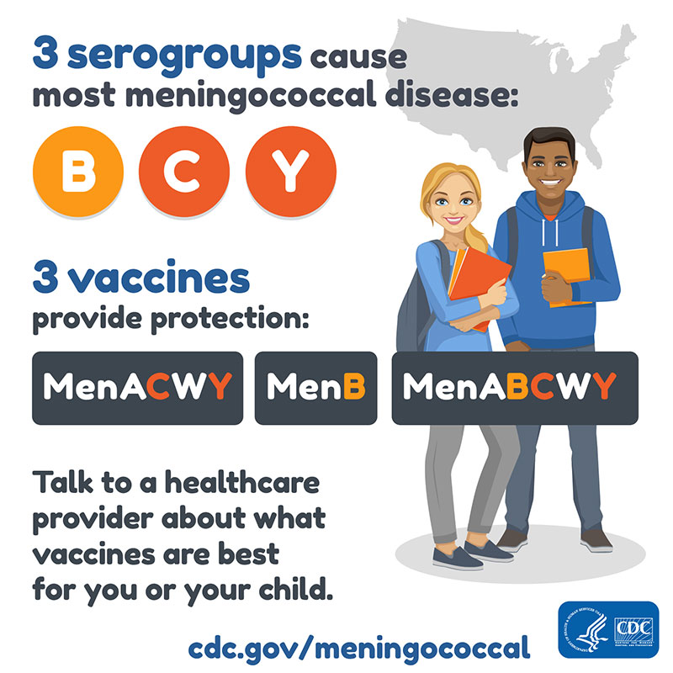
For adolescents
One dose of MenACWY vaccine between 11-12 years, booster dose at 16 years
If receiving first dose between 13-15 years, booster dose given at 16-18 years
If receiving first dose after 16 years, no booster required
Optional series of MenB vaccine at 16-18 years
Those with certain conditions should receive MenB vaccine
Booster 1 year after initial dose, then every 2-3 years thereafter
CDC|Meningococcal Vaccine Recommendations

Slide 9
MenACWY for young children (>2 months old) and adults
Keep in mind the differing minimum ages for the three brands of MenACWY vaccines
Menveo – 2 months
MenQuadfi – 2 years
Penbraya – 10 years
Attempt to maintain consistency – only give same vaccine as previously received
CDC|Meningococcal Vaccine Recommendations

Slide 10
MenACWY for young children (>2 months old) and adults
Primary series – 2 doses, 8 weeks apart for any one of the following conditions*:
Complement deficiency
Asplenia
HIV
Taking complement inhibitor
Residing in or traveling to countries in which serogroups A, C, W, or Y are common
College student not previously vaccinated
Part of a community in an active outbreak
Working in settings with routine exposure to N. meningitidis
Children < 7 years – booster 3 years after primary series, then every 5 years
All others – booster every 5 years after primary series
CDC|Meningococcal Vaccine Recommendations

Slide 11
MenB for those >10 years old
Should be given to anyone described by following:
Complement deficiency
Asplenia
Taking complement inhibitor
Part of a community in an active outbreak
Working in settings with routine exposure to N. meningitidis
Booster 1 year after initial dose, then every 2-3 years thereafter
Vaccines are not interchangeable – only give same vaccine as previously received
CDC|Meningococcal Vaccine Recommendations

Slide 12
Thank you! For additional questions, please contact: LacipInfo@ph.lacounty.gov. For additional information, visit: http://publichealth.lacounty.gov/ip/index.htm.

