Slide 1
Vaccine Management Updates Jerusalem Theodros and Wendi Cate

Slide 2
Agenda Topics
Short Dated Vaccines
BAP Waste Reporting
Updating Storage Units in myCAvax
VFA Ordering
Jynneos Commercialization

Slide 3
COVID-19 Vaccine Shelf Life Updates
COVID-19 vaccine expiration dates approaching
Double-check the expiry of your vaccine to ensure you are not inadvertently administering expired vaccine
Manufacturers will continue to ship vaccine until they are within 30 days of expiry
Providers should order smaller quantities of vaccine and re-order as needed to manage reduction in shelf life

Slide 4
BAP Waste Reporting in myCAvax
Expired and spoiled COVID-19 vaccine provided through the Bridge Access Program must be returned to McKesson and reported as waste in myCAvax.
A return shipping label will be sent to your Primary Vaccine Coordinator one business day after CDPH completes processing (every Wednesday), if email is selected as the return shipping label method.
McKesson return label communications will come from UPS Quantum View [mail to: pkginfo@ups.com]
Physical mail may take 3-5 business days
Drop-off vaccines at an applicable UPS location, or leave it with your UPS driver during a regular delivery
Cost of scheduled UPS pick-ups are not covered
30-day turnaround
CDPH Provider Call Center
Email: ProviderCallCenter@cdph.ca.gov
Phone: 833-502-1245
Job Aid: Recording Returns and Waste
myCAvax login required to access link
Notes:
Once a provider receives their return shipping label, they will have 30 days to return the vaccine to McKesson before the label expires.

Slide 5
Action Required: Update Location Storage Units in myCAvax
BAP, SGF, Outbreak, VFA, and LHD 317 providers
Add a location storage unit - update your storage units to indicate which program vaccines are being stored in a given unit
Storage unit information required for update:
Brand
Model
Thermometer model and serial number
If you are a VFA or LHD 317 provider and have not completed recertification yet, these changes can be made during the recertification process.
myCAvax transfers will not function properly for any program until these updates are made

Slide 6
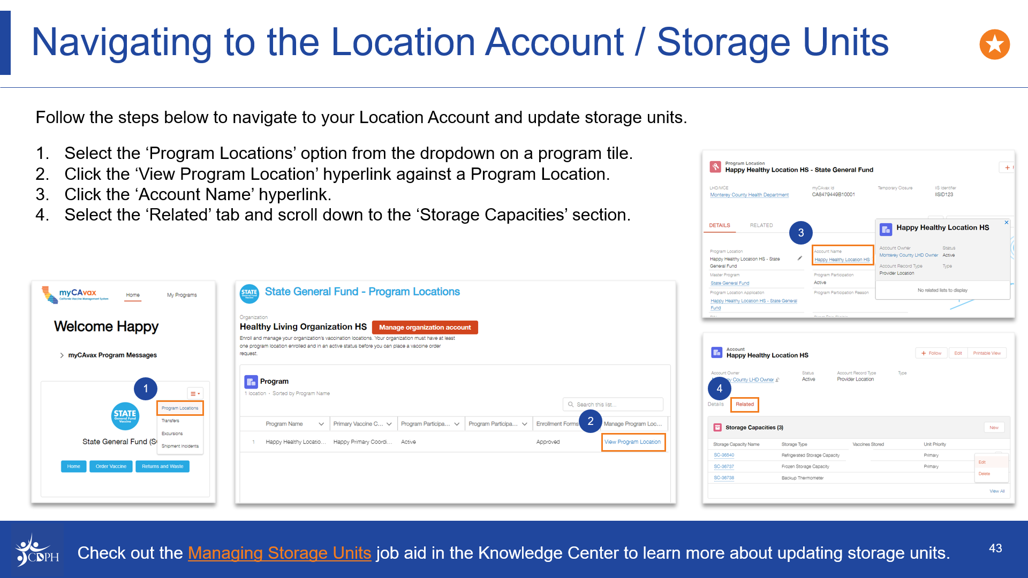

Slide 7
Vaccine Inventory Management Job Aids
Recording Shipment Incidents
Recording Temperature Excursions
Recording Returns and Waste
Recording a Vaccine Transfer

Slide 8
VFA Ordering
Ordering for VFA will open Monday, April 15.
Recertification completion is required to submit a VFA vaccine order.
HPV vaccine will not be available for ordering.
CDPH will be holding a VFA Office Hours on Tuesday, April 23, 2024, from 2:00 PM – 2:30 PM on Zoom.
There will be an opportunity for Q&A with CDPH.
Register for the webinar using this Zoom Registration Link.

Slide 9
JYNNEOS Commercialization
Bavarian Nordic, the maker of JYNNEOS, has opened ordering of the vaccine through commercial wholesalers.
To ensure equitable access to JYNNEOS, make sure that the vaccine is available to everyone who needs it, and to support success in circumstances where commercial product is not available there are no changes to the current ordering process through myCAvax currently.
The vaccine is available for purchase through three distributors currently and will be available through several others soon.
JYNNEOS has already been added to the Medi-Cal/Managed Care system along with several other health plans.

