Slide 1


AB1797 and CAIR2 March 27, 2024
Monica Monroy
Local CAIR Representative
Los Angeles County Region
California Department of Public Health – IZ Branch
cdph.ca.gov/cair

Slide 2
Agenda
Reporting Requirements under AB1797
Benefits of using CAIR2
Enrolling in CAIR2
Type of Setups: Manual and DX
Account Update Portal (Next Steps for New Enrollees)
LA County LCR Contact Info
Questions
Notes:
Please write down your questions throughout the presentation and we can address any that have not been answered by the presentation at the end.

Slide 3
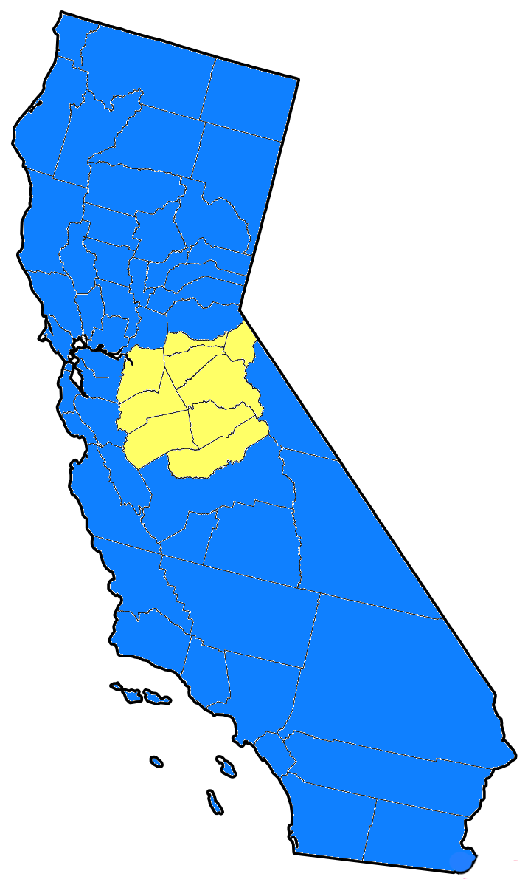
Reporting Requirements under AB1797
As of 1/1/2023, all California healthcare providers who administer vaccines are required to:
Enter/submit patient vaccination information to a CA Immunization Registry, either CAIR2 or Healthy Futures (HF)/RIDE
CAIR2 users submit to CAIR2; HF/RIDE users submit to HF/RIDE
Includes all vaccinations given for all ages
TB test results must be reported
Healthy Futures/RIDE
Alpine, Amador, Calaveras, Mariposa, Merced, San Joaquin, Stanislaus, Tuolumne
CAIR2
All LA County providers will submit to CAIR2

Slide 4
More on AB1797…
Healthcare providers must enter/submit Race and Ethnicity for each patient receiving vaccinations to CAIR2. This is to support the assessment of health disparities in immunization coverage.
If a patient prefers not to share this information, you may select the “Prefer not to say” option in CAIR2.
From 1/1/2023 to 1/1/2026, the law also allows Schools and licensed Childcare facilities to look-up students’ COVID-19 vaccination status for attendance purposes.
For more information & AB1797 FAQs: bit.ly/AB1797FAQ

Slide 5
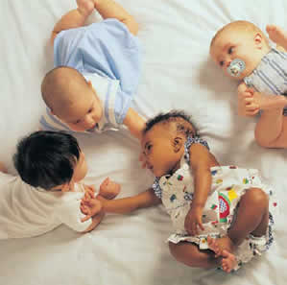

Benefits of using CAIR2
Shows what shots are due, based on ACIP recommendations
Keeps patient shot and TB test information in one location
Tracks your vaccine inventory
Generates Reports and Reminder/Recall postcards, letters, and lists
Notes:
To manually enter historical vaccines, consult the CAIR2 Guide to Adding Historical Immunizations (PDF) or the Adding Historical Immunizations video. Contact your Local CAIR Representative if you have questions.

Slide 6
More benefits of using CAIR2…
Able to record/view historical shots
(patients must provide a form of documentation)
To manually enter historical shots, you may refer to:
CAIR2 Guide to Adding Historical Immunizations
Adding Historical Immunizations video
Or contact your Local CAIR Representative if you have questions
Print the CA Immunization Record (Yellow Card)
Notes:
HX shot documentation can be from a previous yellow card, provider print-out, etc.
How to enter manual hx shots is covered during Regular User training

Slide 7
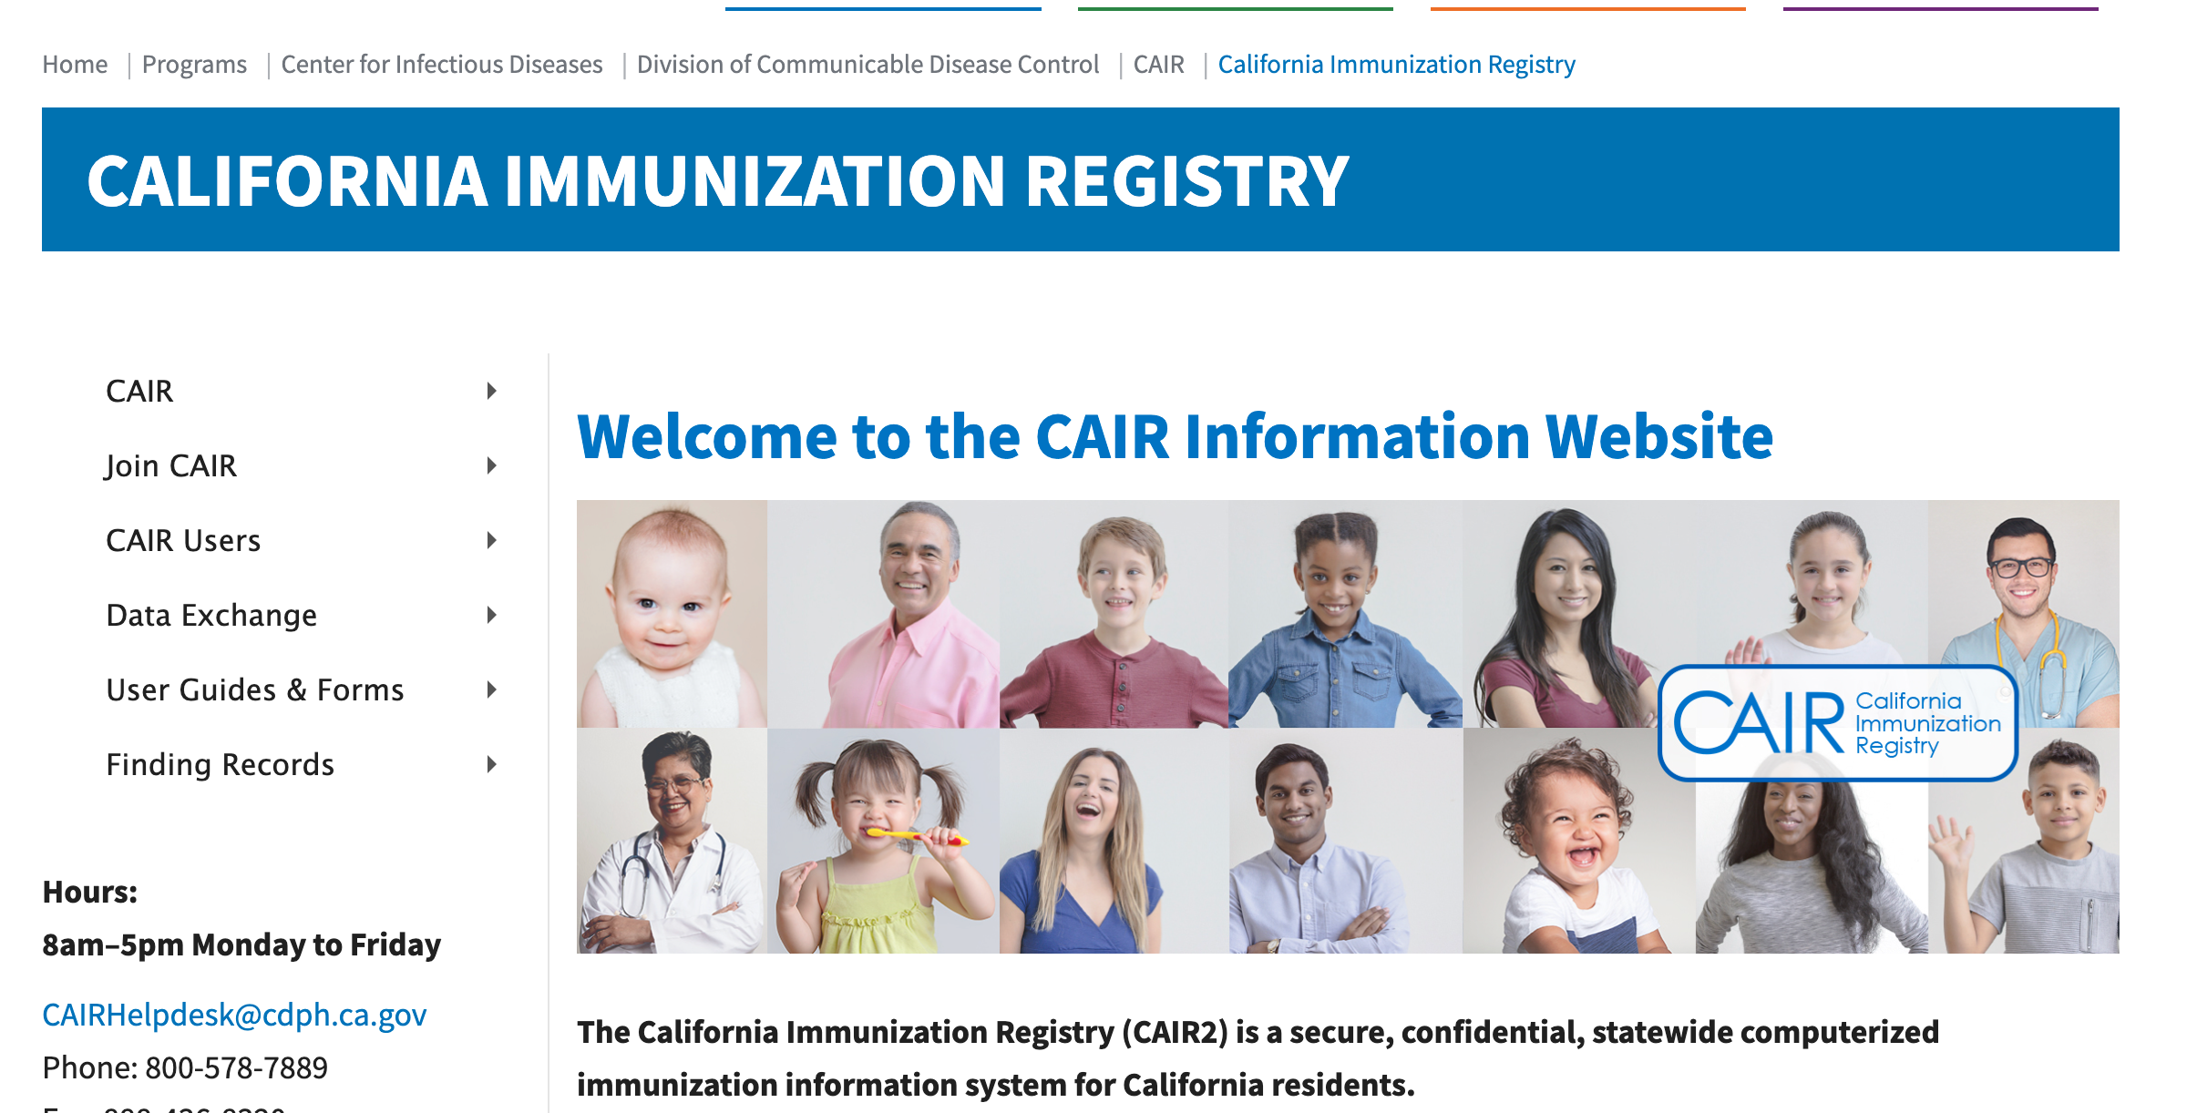
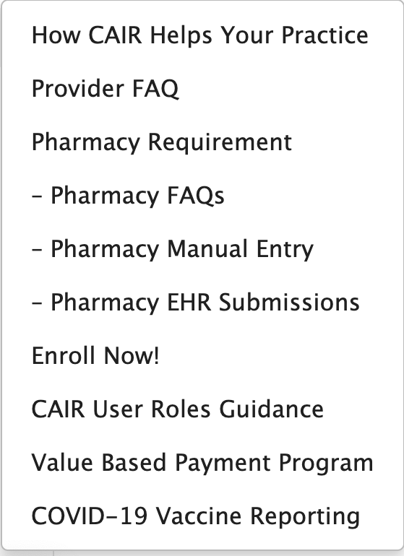
Enrolling in CAIR2

Slide 8
Type of Setups
Manual Entry
Data Exchange (DX)
For sites that do not have an EMR system or sites that wish to use CAIR2 separately from an EMR system.
Staff can login directly into CAIR2 to record doses into each individual patient’s record:
Regular User access is required for staff to record doses.
Power User access is required for staff if sites want to track vaccine inventory via CAIR2.
(must be active Regular User before Power User access)
For sites that have an EMR system with HL7 capability (contact your vendor to confirm)
Doses documented into a patient’s EMR chart will be sent electronically to a patient’s CAIR2 record.
Most staff at DX sites will only require Read-Only or QA User access.
However, some staff can be given Regular User access to edit or delete info directly in CAIR2 (limited to a few staff).
If site uses inventory, staff can be given Power User access too.

Slide 9
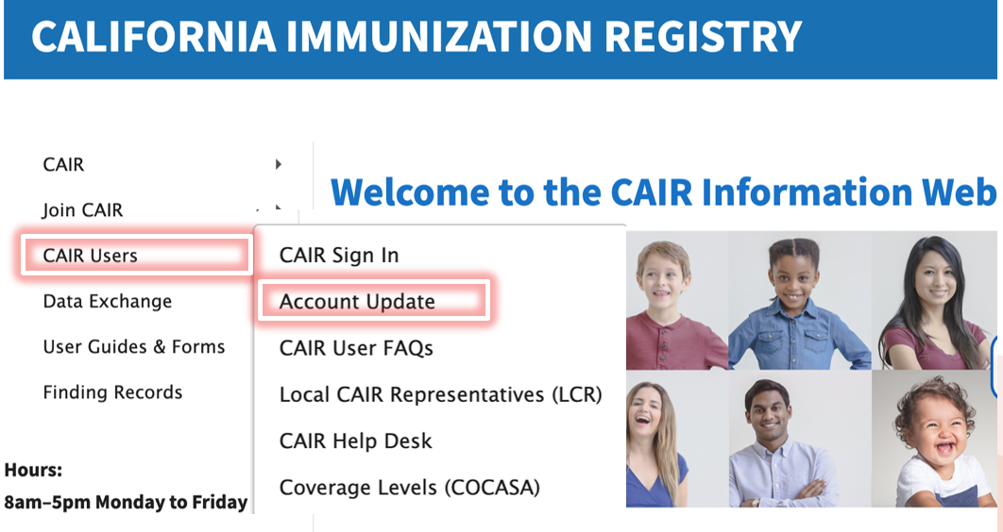
Account Update Portal (Next Steps for New Enrollees)
Newly enrolled sites will receive an automated email with next steps:
This will include instructions to access the Account Update Portal.
You will need the site ORG CODE and ZIP CODE to login
Please note: AU should only be accessed by the Primary CAIR Contact or Supervisor at the site.
What is AU used for?
Update site information (i.e., site contact info, address, provider of record, etc.)
Add/Transfer users
Inactivate/Activate users
Request New users
Add/Update Shot-givers
New enrollees and existing sites call all use AU for account requests!
https://accountupdate.cairweb.org/

Slide 10
More on Account Update (AU) Portal…
After you submit requests via AU, you will receive automated emails. These can include:
A confirmation that your request was submitted and received.
Emails sent to new Regular/Power users containing usernames and links to register for trainings.
Emails sent to new Read-Only/QA users with usernames and temporary passwords.
If a request is rejected, you will receive an email from a Help Desk staff member with an explanation and next steps to correct the request.
Make sure to follow up with the Help Desk staff member. You may also contact your LCR if needed.
Notes:
Example of rejections could be requesting a new user account for a staff member that has an existing account at a previous employer.

Slide 11
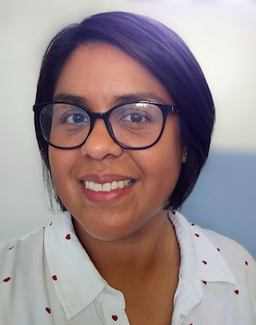
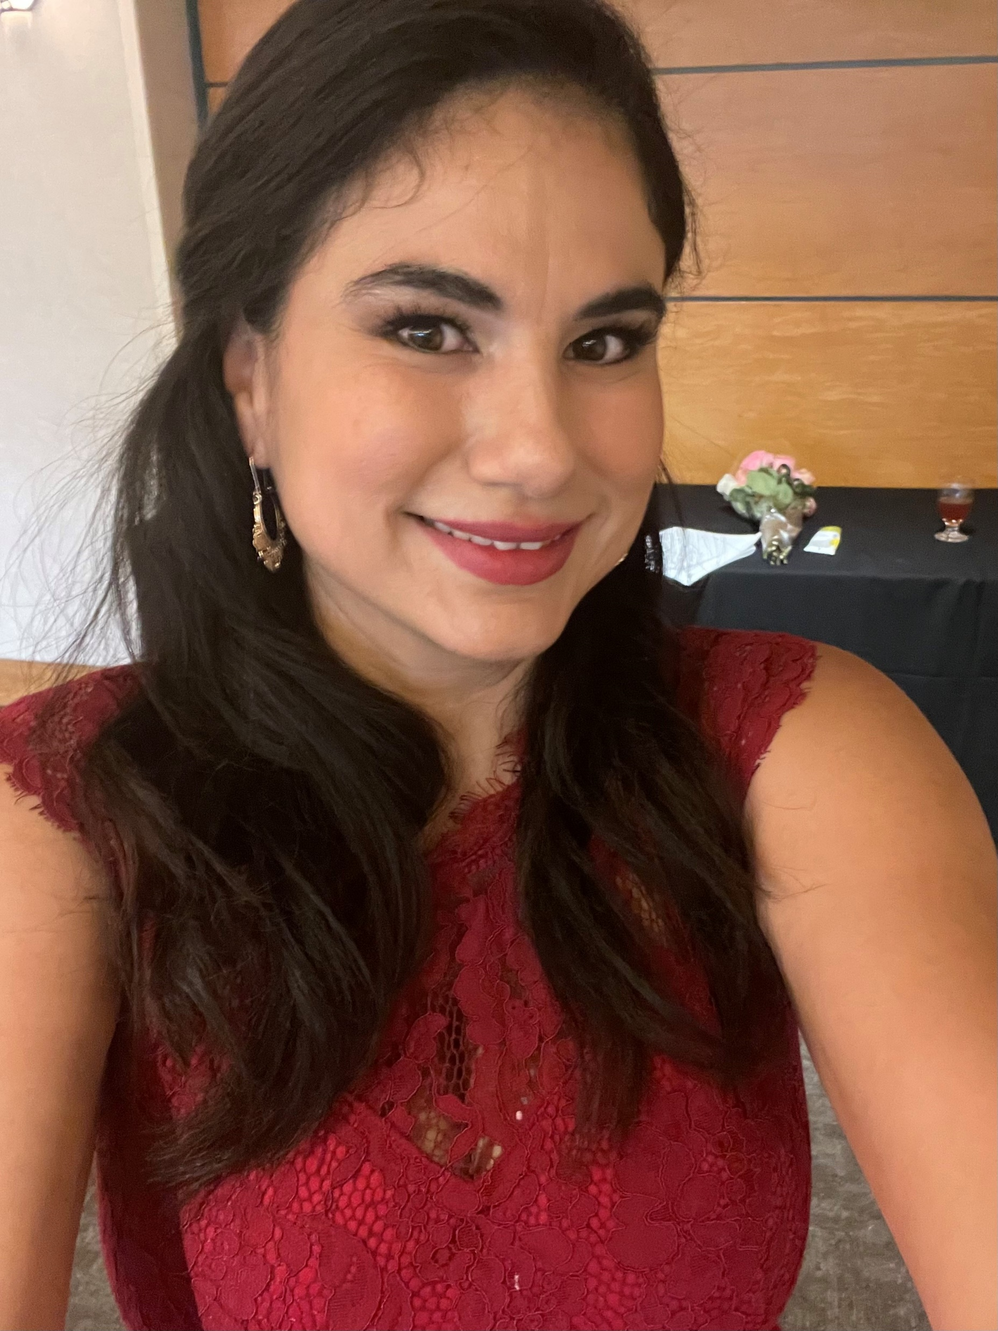


LA County LCR Contact Info
Monica Monroy
SPAs 1, 2, & 3
monica.monroy@cdph.ca.gov
(323) 422-6484
Grissel Barrios
SPAs 4, 6, & 7
grissel.barrios@cdph.ca.gov
(213)-905-9009
Leanne Alarid
SPAs 5, 8, & City of Long Beach
leanne.alarid@cdph.ca.gov
(213)359-4555
Destiny Sepulveda
City of Pasadena
destiny.sepulveda@cdph.ca.gov
(510)-951-1828
When contacting your LCR, please include the following information:
Your site name and Org Code
Your site address
Summary of the issue you are encountering
Whether your site uses Manual Entry or Data Exchange (DX)

Slide 12
Important CAIR Links & Contacts
CAIR Informational Website:
https://cdph.ca.gov/cair
CAIR User Guides:
https://www.cdph.ca.gov/Programs/CID/DCDC/CAIR/Pages/CAIR-Training-Guides.aspx
CAIR Forms:
https://www.cdph.ca.gov/Programs/CID/DCDC/CAIR/Pages/CAIR-records-forms.aspx
Provider Call Center
Phone: 833-502-1245
Email: providercallcenter@cdph.ca.gov
Local CAIR Representatives (LCRs):
go.cdph.ca.gov/cair-lcr
CAIR Help Desk
Phone: 800-578-7889 option #9
Email: CAIRHelpDesk@cdph.ca.gov
CAIR Data Exchange (DX) Specialists
Email: CAIRDataExchange@cdph.ca.gov

Slide 13

Questions?
Thank you!

