Slide 1
Vaccine Management Updates 01/17/2024

Slide 2
Pfizer (Comirnaty) 12 yrs+ COVID-19 Vaccine Storage & Handling
New vaccine comes as single-dose manufacturer-filled syringe and MUST BE STORED BETWEEN 2°C - 8°C (36°F and 46°F).
IMPORTANT: There are no temperature monitoring devices with the Comirnaty refrigerated product.
Shipments come packed to maintain temperatures for 84 hours.
Please check the shipment’s date (on the outside shipment label) to ensure it is received within this timeframe.
The expiration date is printed on the carton or syringe labels.
To avoid confusion, providers who have the previous presentation (Pfizer 12y+ Single-Dose Vials - 10 pack) on-hand should deplete their inventory before ordering the new presentation

Slide 3

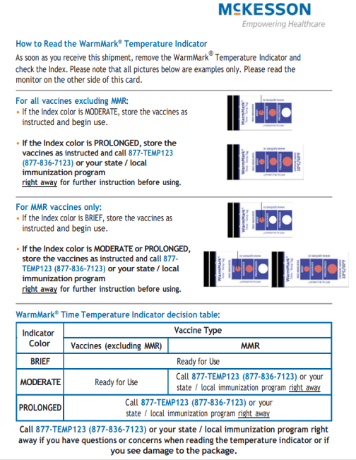
McKesson COVID-19 Vaccine Shipping Update
Beginning this week, McKesson will temporarily be using one of the two warm temperature monitors for vaccine shipment. Coolers may contain the familiar 3M monitor or the new monitor, SpotSee (WarmMark).
This temporary change in temperature monitors is expected to be in place until Thursday, February 1, 2024, when a new and improved temperature monitor will be used for refrigerated shipments. See Supplemental Resource on Temporary Loggers provided by McKesson for additional support.
Both the 3M and SpotSee monitors are one-time use only and should be disposed of once the vaccine has been properly stored.
Please follow the same process for checking any temperature excursions and follow the directions on the information card specific to the monitor received.

Slide 4
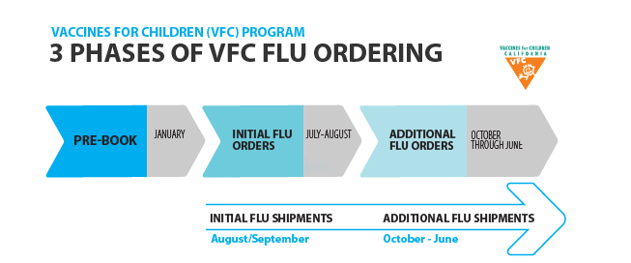
2024-2025 VFC Flu Vaccine Pre-Book Coming Soon
Pre-book will be available mid-to-late January and will be due February 2, 2024
Prebooking is the first of three phases of the 2024-2025 VFC flu vaccine order process and will be the providers’ ONLY chance to provide Flu Product brand preference AND the number of doses needed next season.
More information will be communicated in the coming weeks, including a flu pre-book worksheet.
NDC | Flu Vaccine | Manufacturer | Description
70461-0654-03 | Flucelvax | Seqirus (6 months - 18 years) | Inactivated, No Preservative, 0.5mL Single-Dose Syringe
19515-0810-52 | FluLaval | GSK (6 months - 18 years) | Inactivated, No Preservative, 0.5mL Single-Dose Syringe
49281-0424-50 | Fluzone | Sanofi (6 months - 18 years) | Inactivated, No Preservative, 0.5mL Single-Dose Syringe
66019-0311-10 | Flumist | AstraZeneca (2 - 18 years) | Live Attenuated, No Preservative, 0.20mL Nasal Sprayer
Anticipated 2024 VFC Flu products will include:

Slide 5
State General Fund Flu Vaccine
Please make sure you are accounting for all the doses you received and administered by mid-February. Unaccounted for doses could effect your ability to receive SFG flu vaccine next season.
We will be pulling usage data from CAIR to complete the initial CDPH SGF Flu Accountability report in late February.
Continue to vaccinate throughout the flu season.
Vaccine is still available to order through myCAvax.
If you are seeing uninsured or under-insured adults you can still enroll in the SGF program by emailing VaccineReq@ph.lacounty.gov.

Slide 6
VFC BeyfortusTM Supply Update
Additional allocations of the 100mg Beyfortus™ have been received from CDC this week
All VFC providers may order 50mg and 100 mg doses of nirsevimab (Beyfortus™) via supplemental orders
Current limits and eligibility are subject to change based on supply.

Slide 7
ABRYSVOTM Available for VFC Ordering this month
RSV vaccine ABRYSVO (NDC: 00069-0344-01) is provided through the VFC Program in a 1-pack, 1-dose vial.
The minimum order quantity is 1 dose.
ABRYSVO™ is recommended for pregnant people during 32 through 36 weeks gestation, using seasonal administration (Sept – January), to prevent RSV lower respiratory tract infection in infants.
Given the small size of the eligible population and the recommended window for vaccination, the amount of vaccine available within the VFC program is modest. As a result, CDC has allocated doses to each state.

Slide 8
VFC & VFA RECERTIFICATION
Due date: Wednesday, January 31, 2024
Annual 2024 Recertification is through myVFCvaccines
Annual Recertification and Training is a federal requirement to maintain active status in the VFC Program and receive publicly purchased vaccine
All public and private providers must recertify yearly
Recertification maintains the PIN’s active status
All VFC providers must enroll in CAIR and provide a CAIR ID to recertify.
If you’re not sure if your practice is already participating in an immunization registry, contact the CAIR Help Desk (CAIRHelpdesk@cdph.ca.gov or 800-578-7889).
CAIR also has Local CAIR Representatives that can support you with any questions you may have.
Vaccine Supply, Recertification and Holiday Operation Hours can be found here.
Who, When, Where and What You Need to Do for VFC Recertification can be found here.
VFC Recertification FAQs can be found here.

Slide 9
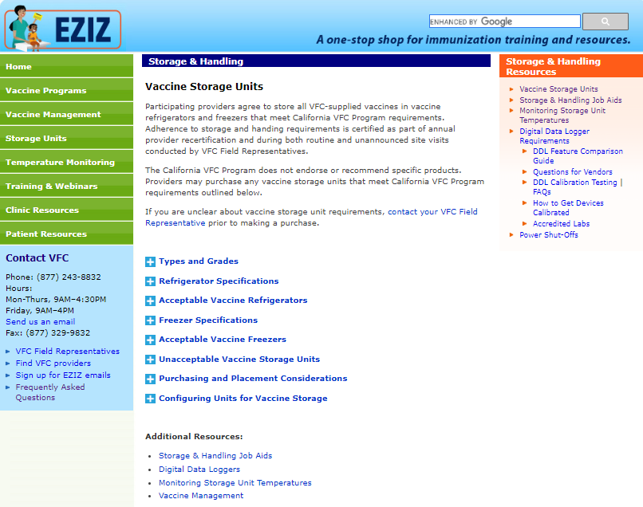
EZIZ Storage and Handling
Covers:
Vaccine Storage Units
Types and Grades
Refrigerator and Freezer Specifications
Configuring Units
More details
EZIZ Storage and Handling

Slide 10
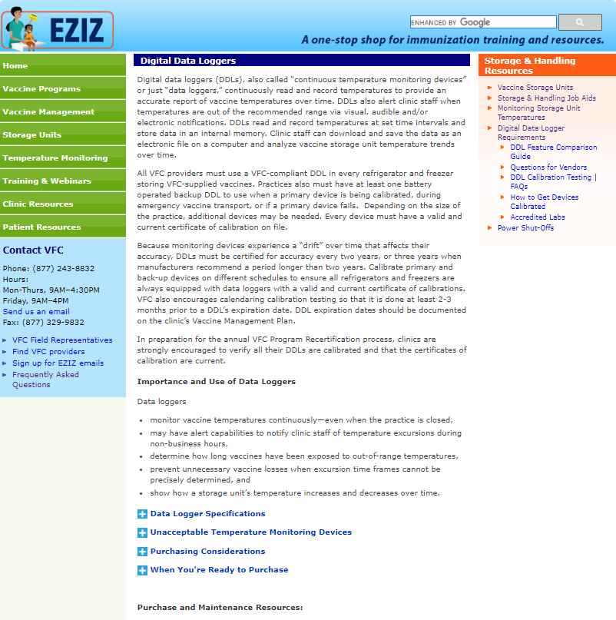
EZIZ Digital Data Loggers (DDLs)
DDLs information includes:
Specifications
Temperature Monitoring
Purchasing Considerations
EZIZ Digital Data Loggers (DDLs)

Slide 11
Recertification for LHD-317 and VFA Providers
VFC Recertification in myVFCvaccines must be completed by 1/31/2024, prior to the transition to myCAvax in February 2024 in order to:
Maintain PIN’s active status in the VFC Program
Capture the primary VFA contact. This contact will receive all communications related to the myCAvax transition
Part 2 of the LHD-317 and VFA Recertification process will be in myCAvax when those programs transition.
Update Key Practice Staff for the adult programs
The LHD-317 and VFA Provider of Record will sign the updated 2024 317 Provider Agreement or VFA Provider Agreement
The 317 and VFA Provider Agreements are not included in the VFC Recertification form so that the provider of record (POR) for the adult programs can sign these agreements in myCAvax.

Slide 12
VFA/LHD 317 Recertification and Data Migration
With the VFA / LHD 317 program being released in myCAvax on Tuesday, February 20, 2024, all VFA/LHD 317 providers must complete the recertification process.
During the VFC recertification process, all VFA and LHDs providers must:
Enter/update clinic information in myVFCvaccines by Wednesday, January 31, 2024; this information will be migrated and pre-populated in the myCAvax recertification form
Review and update their site’s VFA contact on myVFCvaccines. This will be the only key practice staff information migrated to myCAvax. The VFA contact will be designated as the Primary Vaccine Coordinator in myCAvax.
After VFA/LHD 317 release in myCAvax on Tuesday, February 20, 2024:
Complete the information verification process in myCAvax in February 2024
Update the key practice staff managing the adult population on myCAvax
Complete all required EZIZ training (Lesson details forthcoming)
The Provider of Record must review, acknowledge, and sign the VFA/LHD 317 Agreement and Addendum on myCAvax to complete the recertification process.

Slide 13
LHD 317 Upcoming Actions for LHDs (Preliminary)
January 31, 2024
February 15, 2024
February 19, 2024
February 20, 2024
Vaccine Orders
Order submission in myVFC Vaccines
Account Management
Recertification part 1 in MyVFCVaccines
Profile updates [updated Digital Data Logger (DDL), Vaccine Coordinator, etc.]
Vaccine Orders
Order corrections (for orders in MyVFCVaccines)
CDPH Training
LHD 317 101 for LHDs training at 11:00 am PST
Transition
Last day in MyVFCVaccines for
Viewing shipping history
Recording Shipment Incidents
Recording Temperature Excursions
Contacting the VFC Call Center for support (phone number and email changes)
Go Live
First day in myCAvax for
Completing recertification part 2 in myCAvax
Updating profiles (updated DDL, Vaccine Coordinator, etc.)
Submitting orders
Viewing shipping history
Recording Shipment Incidents
Recording Temperature Excursions
Recording Transfers
Returning spoiled, expired, or wasted vaccines
Contacting the Provider Call Center for support (phone number and email changes)
13

Slide 14
VFA Upcoming Actions for Providers (Preliminary)
January 31, 2024
February 15, 2024
February 19, 2024
February 20, 2024
February 22, 2024
February 29, 2024
Vaccine Orders
Quarterly Order submission in MyVFCVaccines
Account Management
Recertification part 1 in MyVFCVaccines
Profile updates [updated Digital Data Logger (DDL), Vaccine Coordinator, etc.]
Vaccine Orders
Order corrections (for orders in MyVFCVaccines)
Transition
Last day in MyVFCVaccines for
Viewing shipping history
Recording Shipment Incidents
Recording Temperature Excursions
Contacting the VFC Call Center for support (phone number and email changes)
Go Live
First day in myCAvax for
Completing recertification part 2 in myCAvax
Updating profiles (updated DDL, Vaccine Coordinator, etc.)
Ordering will be closed until next VFA Quarterly Cycle (April 2024)
Viewing shipping history
Recording Shipment Incidents
Recording Temperature Excursions
Recording Transfers
Returning spoiled, expired, or wasted vaccines
Contacting the Provider Call Center for support (phone number and email changes)
CDPH Training
VFA 101 Training for Providers at 11:00 am PST
CDPH Training
VFA 102 Training for Providers at 11:00 am PST
14

Slide 15
VFA / LHD 317 Upcoming Training Awareness
With the VFA / LHD 317 program being released in myCAvax on Tuesday, February 20, 2024, CDPH will begin system training for LHDs and providers.
LHDs should attend the LHD 317 101 for LHDs training on Thursday, February 15 at 11:00 am PST.
Providers should attend 2 trainings:
VFA 101 Training for Providers on Thursday, February 22, 2024, at 11:00 am PST
VFA 102 Training for Providers on Thursday, February 29, 2024, at 11:00 am PST
The registration links will be shared in the coming weeks. Stay tuned!

