Slide 1
RSV immunizations for infants and older adults September 13, 2023 Jordan Braunfeld, MD Los Angeles County Department of Public Health Vaccine Preventable Disease Control
Nava Yeganeh, MD MPH
Los Angeles County Department of Public Health
Vaccine Preventable Disease Control

Slide 2
Disclosures
There is no commercial support for today’s webinar.
Neither the speakers nor planners for today’s webinar have disclosed any financial interests related to the content of the meeting.
This presentation is meant only for educational purposes and is off the record. The information is current as of today: 9/13/2023
Notes:
There is no commercial support for this section of the webinar webinar and none of the speakers or planners have disclosed any financial interests related to the content of the meeting.

Slide 3
RSV – Characteristics and Public Health Implications

Slide 4
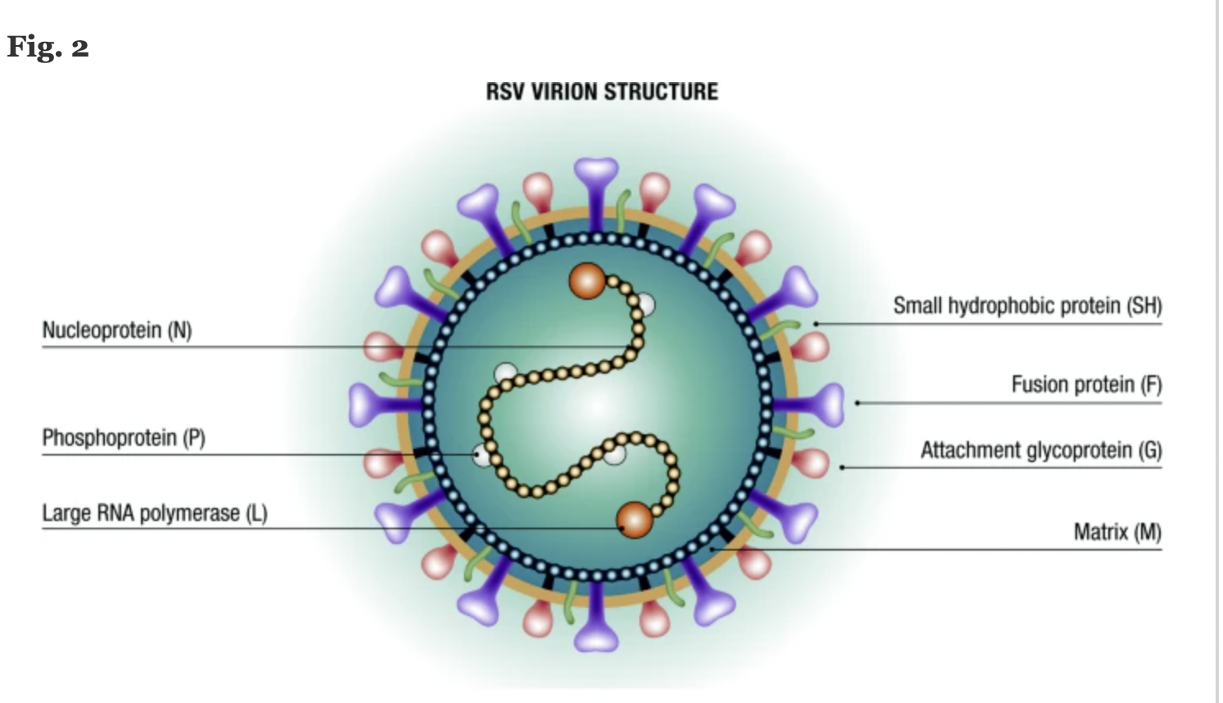
Respiratory Syncytial Virus (RSV)
Discovered in 1956
Member of the pneumovirus genus of the family Paramyxoviridae
Negative-sense RNA virus
Two antigenic subgroups (RSV A and B)
Subgroups can co-circulate
RNA codes 11 proteins
Nonstructural proteins (NS1, NS2, M2-2)
8 Structural Proteins
F (fusion) glycoprotein
G (attachment) glycoprotein
Both crucial for infectivity
F is the main neutralizing antigen, highly conserved and essential for virus viability
Azzari C. Journal of Peds, 2021
Notes:
The G protein targets the ciliated cells of the airways and mediates adherence to the host cells. The F protein initiates viral penetration by fusing viral and cellular membranes, and late in the infection it causes infected cells to fuse inducing the characteristic syncytia.

Slide 5
Seasonality
RSV circulation varies by climate
Tropical climates: RSV circulates year round
Infants born in tropical climates are exposed shortly after birth
Temperate climates: RSV circulates yearly in seasons
Typically starts in mid-September to mid-November and ends in mid-April to mid May
Infants born in temperate climates are usually exposed to RSV by approximately 7 months of life
COVID-19 pandemic disrupted RSV seasonality during 2020-2022
California had an early and very severe RSV season in 2022-2023

Slide 6
Clinical Disease: RSV in children
Most (68%) infants are infected in the first year of life and nearly all (97%) by age 2 years
Leading cause of viral lower respiratory tract infection (LRTI) in infants and toddlers
Bronchiolitis
Pneumonia
Most common cause of hospitalization in infants in the US, especially in the first months of life
60,000-80,000 hospitalizations and 100-300 deaths each year in the US in children <5 years
RSV in infancy has been strongly associated with increased wheezing and asthma
1,900 children followed 5 years of life, 54% infected with RSV during infancy
18% developed asthma by the age of 5
21% of those infected by RSV vs 16 % of those who hadn’t had RSV.
Hall, C et al. NEJM. 2009.
Mejias, A et al. Pediatric Allergy and Immunology. 2019
Rosas-Salazaar, C et al. Lancet. 2023

Slide 7
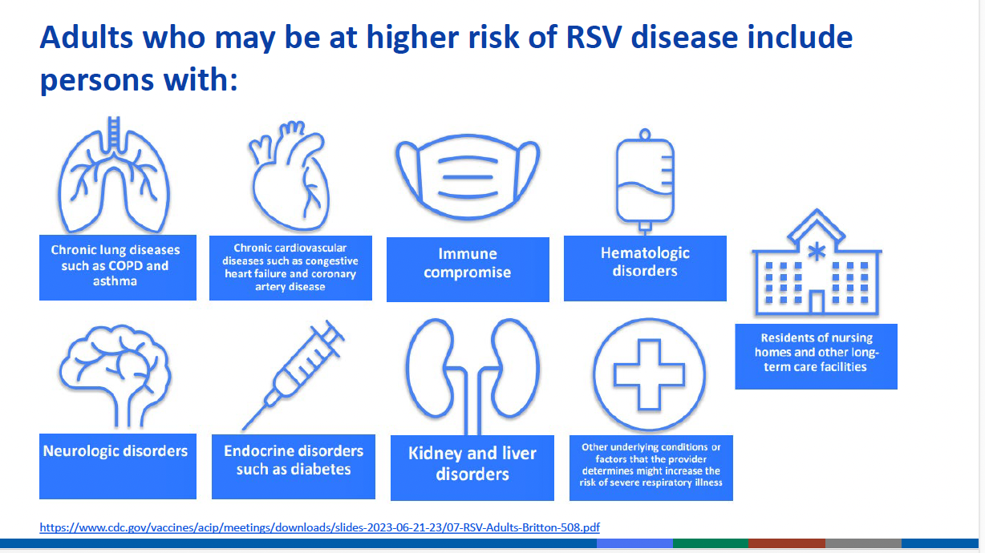
Clinical Disease : RSV disease in adults
RSV is responsible for 5%–10% of LRTI, with hospitalization rates of 255 per 100 000
60,000–160,000 hospitalizations among adults aged ≥65 years each year
6,000-10,000 deaths each in year in United States, especially in those with chronic medical conditions
McLaughlin JM et al. Open Forum Infect Dis 2022
Branche AR, et al. Clin Infect Dis 2022
.

Slide 8
RSV Immunizations

Slide 9
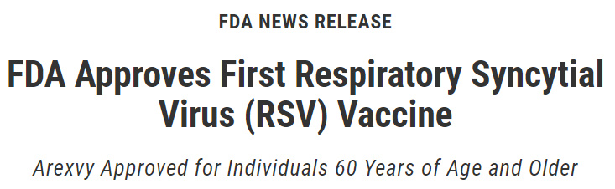
RSV vaccine for adults
2 FDA approved products:
Pfizer bivalent vaccine (Abrysvo)
GSK adjuvanted vaccine (Arexvy)
Both vaccines more than 80% effective in preventing RSV-associated LRTI in adults 60 and older during the first season after administration
Side effects similar to other vaccines, no special concerns in the safety profile
Small number of cases of inflammatory neurological events and atrial fibrillation
FDA Approves First Respiratory Syncytial Virus (RSV) Vaccine | FDA
Notes:
Notably, patients with immunocompromising conditions were not included in the clinical trials for these vaccines, so how well these vaccines work in this population is unknown. Also, the studies did not include many older adults aged 75 to 80 and older.

Slide 10
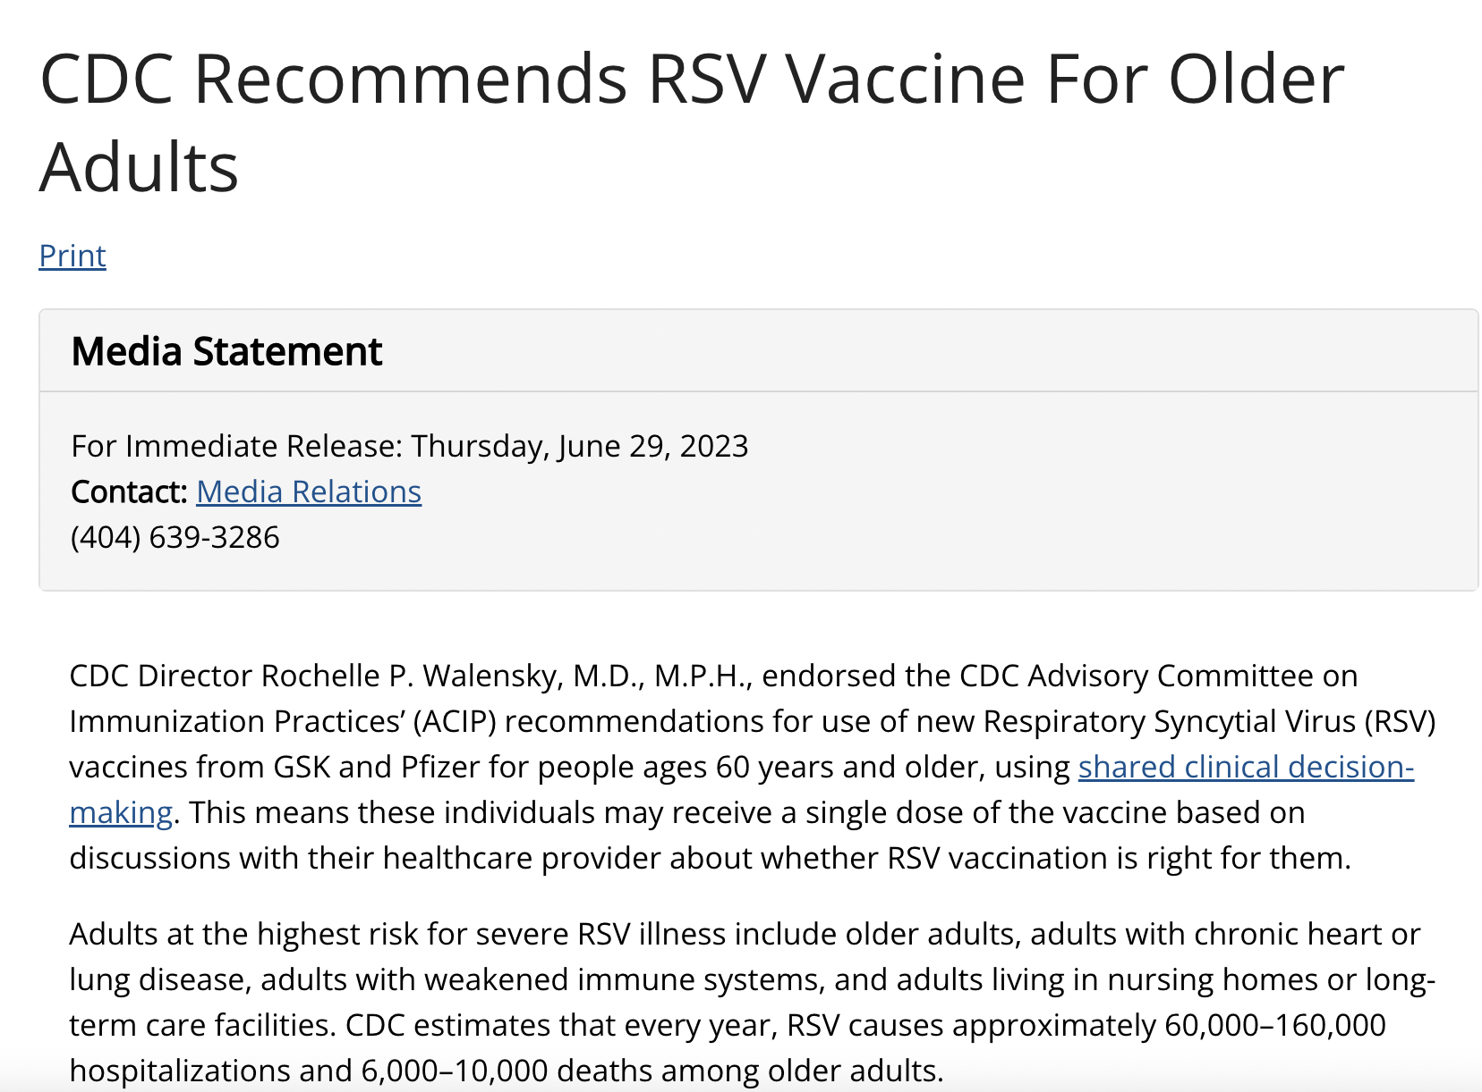
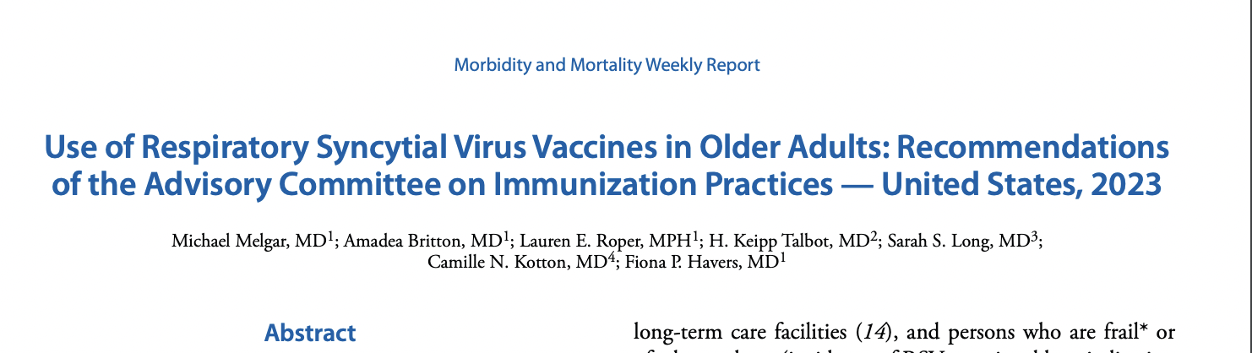
RSV vaccine for adults
CDC recommends that adults 60 and older may receive RSV vaccination, using shared clinical decision-making.
“The decision to vaccinate an individual patient should be based on a discussion between the healthcare provider and the patient, and may be informed by the patient’s risk of severe RSV disease and their characteristics, values, and preferences; the healthcare provider’s clinical discretion; and the characteristics of the vaccine.”
https://www.cdc.gov/mmwr/volumes/72/wr/pdfs/mm7229a4-H.pdf

Slide 11
Offering RSV vaccine to adults
Consider risk factors for severe RSV disease
Consider coadministration of RSV vaccines with other vaccines
No required interval between RSV vaccine and other vaccines
Report administration of RSV vaccines to CAIR
Notes:
Consider risk factors for severe RSV-associated such as frailty, advanced age, residence at skilled nursing facilities or long term care, chronic medical conditions (lung, cardiovascular), moderate/severe immunocompromise, diabetes
Consider administering RSV vaccines with other vaccines such as flu, pneumococcal, shingles, COVID.

Slide 12
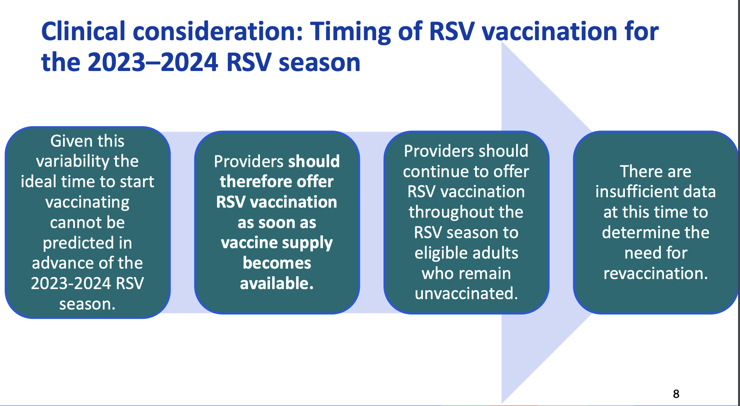

Slide 13
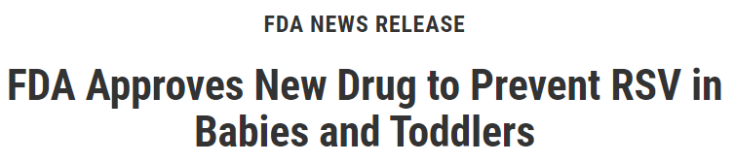
Nirsevimab for children
FDA-approved long-acting monoclonal antibody: “vaccine-like” product
Efficacy of 80% for preventing hospitalizations due to RSV-associated LRTI
Well-tolerated without any serious adverse events
Protection expected to last at least 150 days
Included in the Vaccines for Children Program

Slide 14
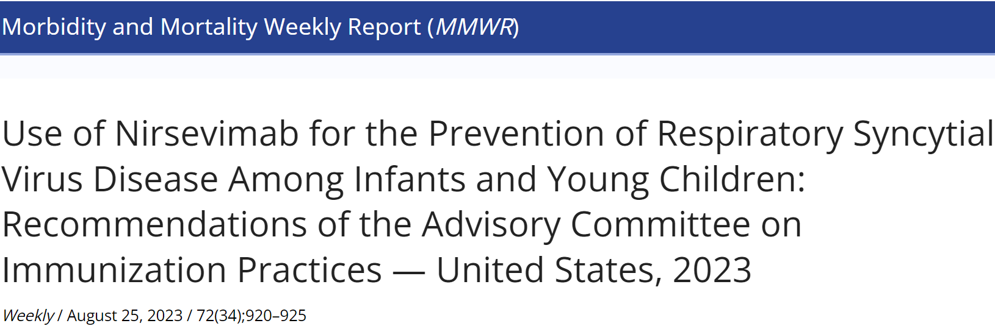
Nirsevimab for children
CDC and the American Academy of Pediatrics (AAP) recommend:
a single dose of nirsevimab be administered to all infants under 8 months of age entering their first RSV season. Well-tolerated without any serious adverse events
Additionally, infants and children 8-19 months of age who are at increased risk for severe RSV disease and entering their second RSV season should receive nirsevimab.
Children who have received nirsevimab should not receive palivizumab (Synagis) for the same RSV season
Notes:
Children at increased risk of severe RSV disease include those with chronic lung disease of prematurity who require medical support during the 6 months prior to the start of their second RSV season, severe immunocompromise, CF with manifestations of severe lung disease or weight for length <10th percentile, and AI/AN children

Slide 15
Offering nirsevimab to children
Procure nirsevimab now ahead of the RSV season
Sign up for LA County DPH Influenza Watch to learn when RSV activity is increasing locally – email influenza@ph.lacounty.gov to register
Ideally offer first dose of nirsevimab within one week of birth at the same time as Hepatitis B vaccine for all those born just before or during their first RSV season
Coadminister nirsevimab with other age-appropriate vaccines if they are due
Report administration of nirsevimab to CAIR

Slide 16
On the horizon
Maternal immunization with Pfizer Abrysvo (32-36 weeks of gestation)—FDA Approved
Advantages over immunizing infants
Newborns representing the greatest proportion of RSV-associated hospitalizations
Inability of immune system to mount an effective antibody response against RSV
Maternal immunization is an attractive, established strategy, with proven efficacy for prevention of tetanus, pertussis, and influenza in young infants
CDC/ACIP recommendations to follow later this fall

Slide 17
Summary
RSV is an important cause of illness, hospitalizations, and death in infants and older adults
Two vaccines to prevent severe illness are now available and recommended for those 60 years of age and older
Co-administration of RSV and Flu vaccines showed acceptable immunogenicity
A long-acting monoclonal antibody is recommended for all infants <8 months to prevent RSV disease
A vaccine for pregnant women is FDA approved for pregnant women 32-36 weeks GA and may garner CDC recommendation in the coming months
Ongoing vaccine administration reporting for evaluation of population immunization rates

Slide 18
Thank you! For additional questions, please contact: LACSNF@ph.lacounty.gov.

