Slide 1
DPH Provider Vaccine Office Hours:
Vaccine Updates
9/13/23

Slide 2
FDA Takes Action on Updated mRNA COVID-19 Vaccines to Better Protect Against Currently Circulating Variants (9/11/2023)
Updated vaccines include a monovalent (single) component that corresponds to the Omicron variant XBB.1.5.
The updated mRNA vaccines are
  Authorized under emergency use for individuals 6 months through 11 years of age
  Approved (fully licensed) for individuals 12 years of age and older
Bivalent Moderna and Pfizer-BioNTech COVID-19 vaccines are no longer authorized for use in the United States.
FDA Press Release 9/11/23
2

Slide 3
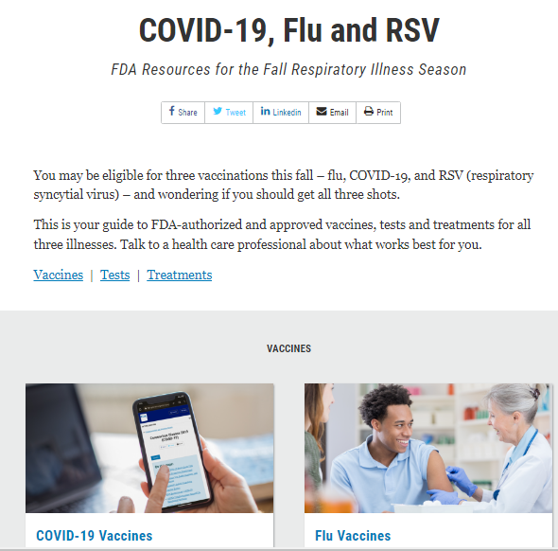
Updated FDA Materials
Moderna and Pfizer:
Fact Sheet for Recipient and Caregivers
Fact Sheet for Healthcare Providers
Dear Healthcare Provider Letters
3
3

Slide 4

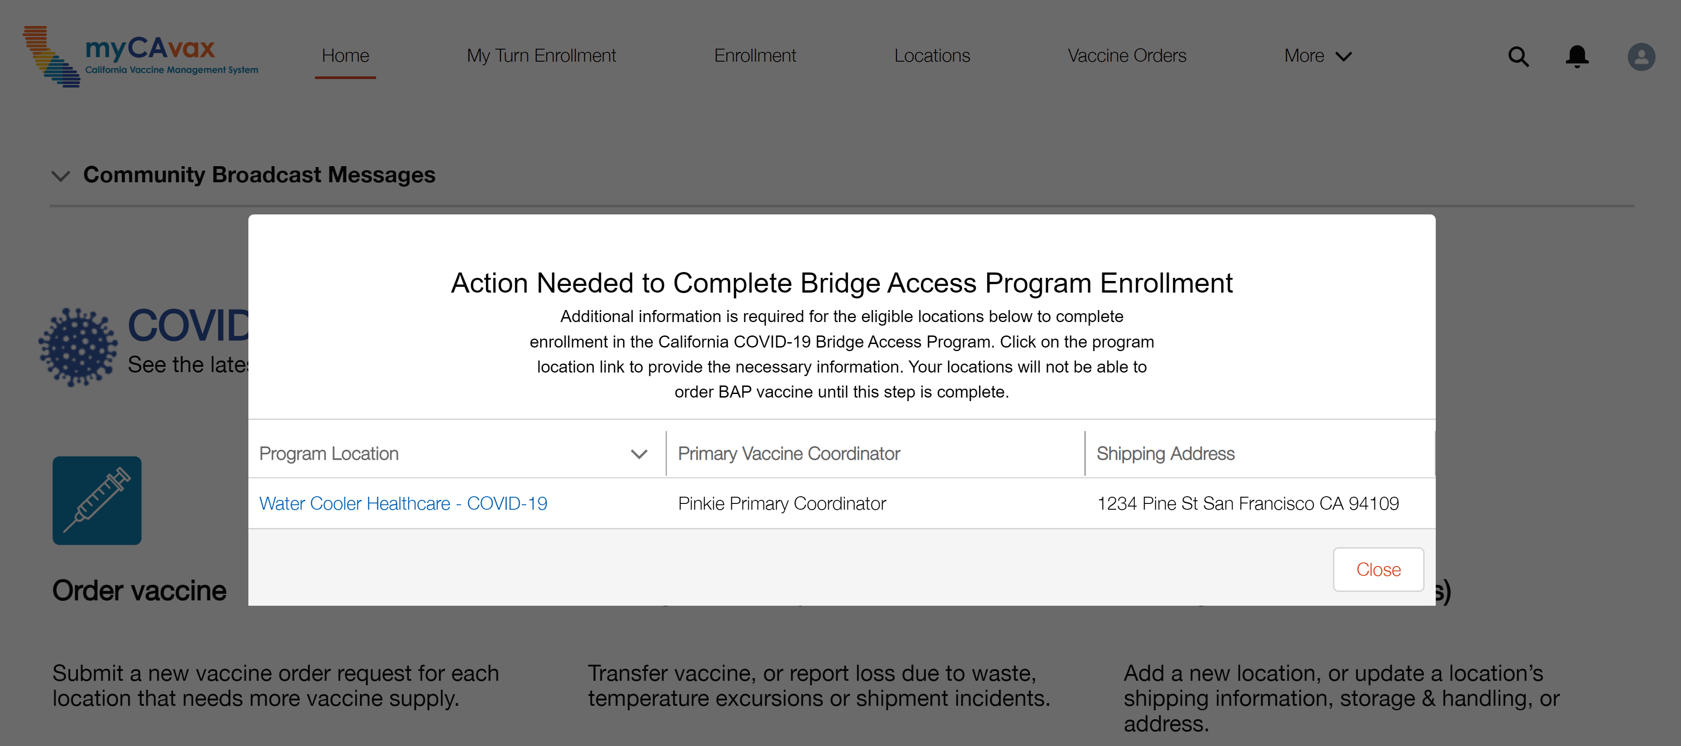
Beginning BAP Enrollment for Selected Providers
If you were selected to participate in the Bridge Access Program, upon logging in to myCAvax, eligible locations will pop up on the home page after completing the required training.
4

Slide 5
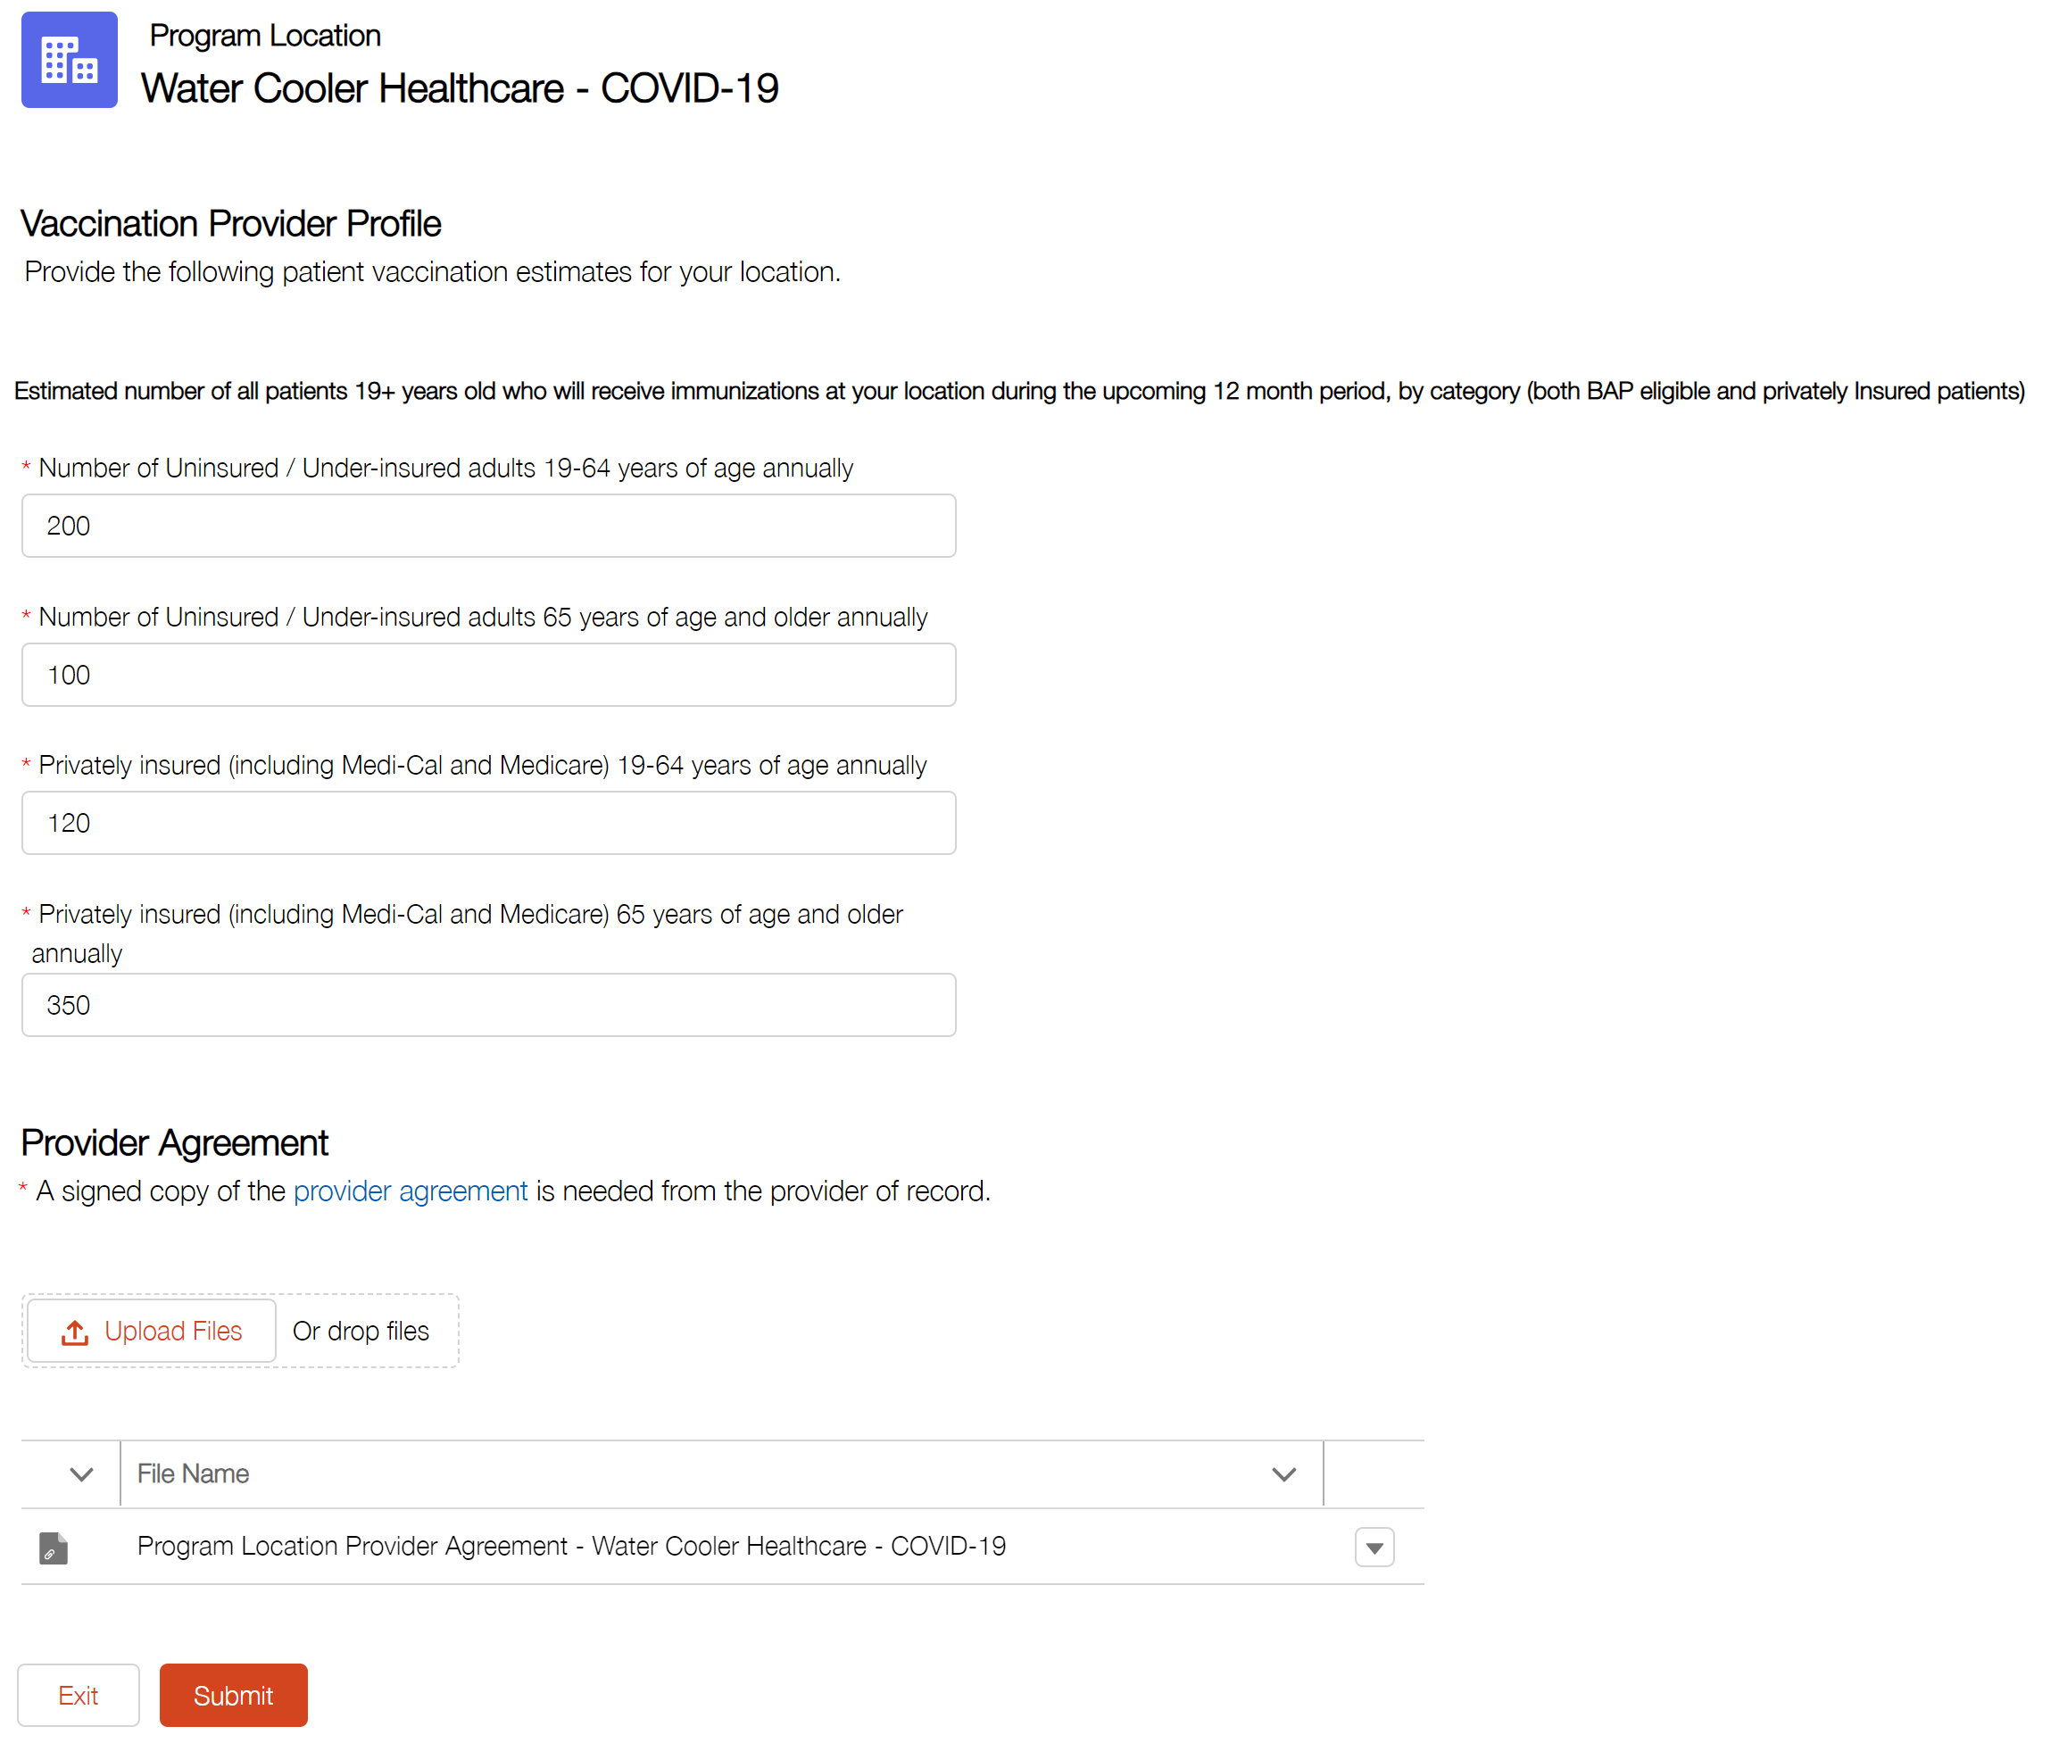

Completing BAP Enrollment for Selected Providers
Your Provider of Record will need to sign the Bridge Access Program (BAP) Provider Participation Agreement, which is available on EZIZ.
5

Slide 6



Disposing of Deauthorized Vaccine and Reporting Waste in myCAvax
Providers, dispose of deauthorized bivalent vaccine immediately and report as waste in myCAvax. A release will go-live tonight deactivating all USG COVID-19 Program Locations and enabling all Providers, regardless of COVID-19 Program Location status, to report waste and manage vaccine inventory.
Questions? Reach out to the Provider Call Center at COVIDVaccineReq@ph.lacounty.gov or (833) 502505-0761,
Monday through Friday from 8:00 AM – 5:00 PM PT.

Slide 7
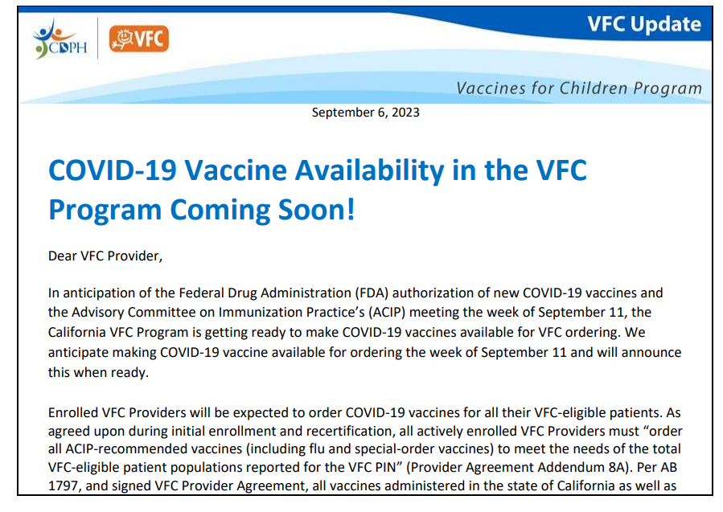
VFC and COVID Vaccine Ordering
VFC plans to open COVID vaccine ordering the week of September 18
There will be a cap on the number of doses that can be ordered because of limited available inventory
Orders can be placed on a monthly basis regardless of normal VFC ordering cycle
If it has been less than 30 days since your last order for all other VFC vaccines, you will not need to submit a full inventory; if it has been more than 30 days you will need to submit full inventory to avoid any accountability issues.

Slide 8
Storage and Handling Basics
Vaccine S&H basics have not changed
Please see, EZIZ Vaccine Storage and Handling
The webpage addresses:
  Types and grades of refrigerators and freezers
  Acceptable and unacceptable units
  Digital Data Loggers & temperature monitoring
  Vaccine management

Slide 9
Commercialized Moderna and Spikevax
Presentations
  Spikevax, Ages 12+
    Single dose vials. 0.5 mL injection volume.
    Prefilled Syringes
  Moderna COVID-19 Vaccine, Ages 6 months - 11years
    Single dose vials. 0.25 mL injection volume.
Minimum Order
  10 doses (Note: minimum order may be larger if purchasing through a wholesaler, e.g., + 60 doses)

Slide 10
CAP Colors
Moderna:
  6 months – 11 years is blue cap/green label;
  12+ years is blue cap/blue label
Novavax:
  12+ is blue
Pfizer:
  6 months – 4 years is yellow;
  5 – 11 years is blue;
  12+ years is gray

Slide 11
Commercialized Moderna (Spikevax)
Storage
  Long-term frozen storage or
  Refrigerated storage for up to 30 days
Offering returns?
  Yes

Slide 12
Commercialized Novavax
Presentation
  Ages 12+: 5 dose multi-dose vials. 0.5mL injection volume.
Minimum Order
  10 doses, 2 vials
Storage
  Refrigerated
Offering returns?
  Yes, up to 100% for opened and unopened vials

Slide 13
Commercialized Pfizer and Comirnaty
Presentations
  Pfizer COVID-19 Vaccine, 6 months – 4 years: Requires diluent (1.1 mL normal saline). 3 dose multi-dose vials. 0.3 mL injection volume.
  Pfizer COVID-19 Vaccine, 5 years – 11 years: No diluent required. Single dose vials. 0.3 mL injection volume.
  Comirnaty,12 years+: No diluent required. Single dose vials. 0.3 mL injection volume.
Minimum Order
  6 months – 4 years: 30 doses
  5 years – 11 years: 10 doses (government supplied vaccine), 100 doses private purchase
  12 years+: 10 doses (government supplied vaccine), 100 doses private purchase

Slide 14
Commercialized Pfizer (Comirnaty)
Storage
  Long-term storage at ultracold temperatures, if vaccine was received at ultracold temperatures
  Short-term storage (10 weeks) at refrigerated temperatures (most wholesalers have said they plan to ship this way)
Returns Offered?
  Yes

Slide 15
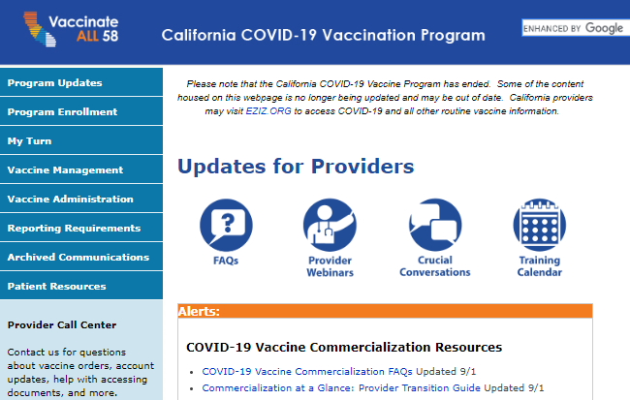
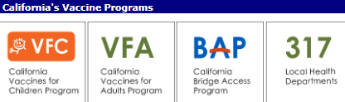
Update!
Provider Resources on eziz.org/covid
Content is migrating to https://eziz.org/
BAP Program Enrollment
VFC (Vaccines for Children)
VFA (Vaccines for Adults)
317
Education & Support Materials
More to explore!

Slide 16
State General Fund (SGF) for Uninsured Adults
  VPDC enrolling flu partners in myCAvax for SGF flu
    Collecting needed information for partners including:
      Agreement of Use signed
      Collect Provider of Record name and prescribing license number
  Night of September 22 myCAvax go live for SGF participants
  Direct ship and local delivery will be available
  More details to come
  Email questions to VaccineReq@ph.lacounty.gov
Activities are subject to change as the program is built out.
16

