Slide 1
DPH Provider Vaccine Office Hours:​ ​COVID-19 Vaccine Updates​ 07/19/2023

Slide 2
COVID-19 Vaccine:
Availability after Sunsetting of the
U.S. COVID-19 Vaccine Program

Slide 3
Commercialization Definition
Commercialization is the transition of COVID-19 medical countermeasures, including vaccines, treatments, and test kits previously purchased by the U.S. Government (USG), to established pathways of procurement (commercial market), distribution, and payment by both public and private payers.

Slide 4

COVID-19 Vaccine Transition to Commercialization - Children
Anticipated timeline: Early Fall 2023
Vaccine availability for pediatric and adult populations to follow current models for non-COVID-19 vaccines
Pediatric populations:
Vaccines will be made available through the Vaccines for Children (VFC) Program for eligible children under 19 years of age.
Vaccines for privately insured patients will be purchased following similar established mechanisms in healthcare for non-COVID-19 vaccines.

Slide 5
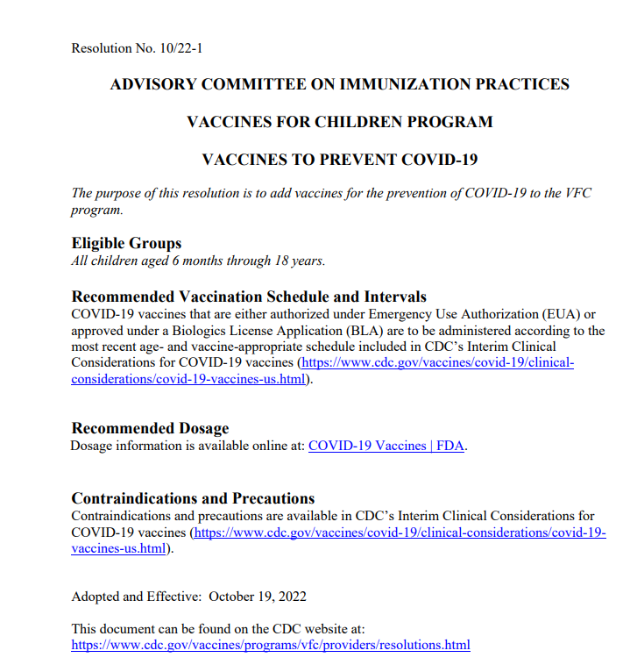
COVID-19 Vaccines: Addition to VFC Program
COVID-19 vaccine is already a routinely recommended ACIP vaccine, and has been officially voted into the VFC Program
It is expected that ordering and availability for this vaccine, via routine VFC Program ordering processes, will occur after the sunset of the COVID-19 Program (Fall 2023)
*Advisory Committee on Immunization Practices-CDC
**Vaccines for Children

Slide 6



COVID-19 Vaccines: Addition to VFC Program
It is likely myVFCVACCINES will be the system used to support vaccine ordering and distribution.
Still have ~1/3 of VFC providers that have not enrolled in the COVID-19 program, eliminating need to enroll sites in myCAvax
COVID-19 vaccines can quickly be added to the VFC formulary, providing one system for ordering
Will have visibility into COVID-19 vaccine ordering consistent with how other routine vaccines are reviewed
VFC routine vaccines
VFC Flu
317 Vaccines LHD 317 Vaccines VFA

Slide 7
COVID-19 Vaccine Transition to Commercialization - Adults
Adult populations:
Anticipate limited vaccine supply will be made available through the HHS Bridge Access Program (BAP) for uninsured/under-insured adults
Vaccines for insured adults will be through private supplies obtained via established processes, like non-COVID vaccines
For most private insurance plans, vaccines recommended for routine use by the Advisory Committee on Immunization Practices (ACIP), including COVID-19 vaccines, will be fully covered without a co-pay (Affordable Care Act)
For Medicare Part B beneficiaries, COVID-19 vaccinations are covered without cost sharing, and this will continue
For Medicare Part D/equivalent plans, ACIP-recommended vaccines will be fully covered at no cost (included in the Inflation Reduction Act)
Anticipate that Medi-Cal will cover COVID-19 vaccines

Slide 8
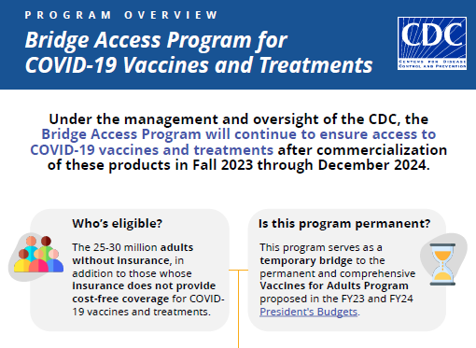
Background – HHS Bridge Access Program
The purpose of this program is to help maintain access to COVID-19 care (vaccines and therapeutics) for uninsured adults, 19 years of age and older, through existing public health infrastructure, HRSA-supported health centers (i.e., Health Centers), and participating pharmacies, via two major components:
Provide support for the existing public sector vaccine safety net, implemented and maintained by state immunization programs, Local Health Departments, and HRSA supported health centers.
Create a funded partnership with pharmacy chains that will enable them to continue offering free COVID-19 vaccinations and treatments.
HSS Bridge Access Program

Slide 9
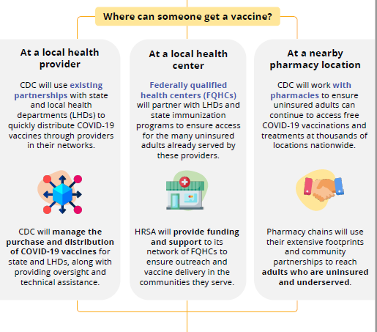
HHS Bridge Access Program: Existing Public Health Infrastructure Component (Preliminary Details)
CDC will negotiate federal contracts with manufacturers and purchase COVID-19 vaccines made available to states for ordering
Vaccines will be purchased with Section 317 Funds and must be used exclusively for vaccinating uninsured/under-insured adults
Program participation requirements will be guided by the 317 Vaccine Program
Details on how the program will be implemented this fall are still forthcoming.
Likely Vaccine Ordering and Provider Management will continue to be supported by myCAvax systems and COVID teams

Slide 10
HHS Bridge Access Program – Pharmacies
The HHS Bridge Access Program is “a novel, funded partnership with pharmacy chains”:
Leverage the public commitments by drug manufacturers to provide vaccines and treatments free-of-charge for the uninsured
COVID-19 vaccine manufacturers have committed to provide vaccines at no cost for the uninsured
Program will provide a per-dose payment to pharmacies
HHS expects that manufacturers ensure vaccines will be made readily available directly to pharmacies
Manufacturers’ patient assistance programs will provide appropriate reimbursement or replacement for COVID-19 vaccines
Notes:
Ed starts here…

Slide 11
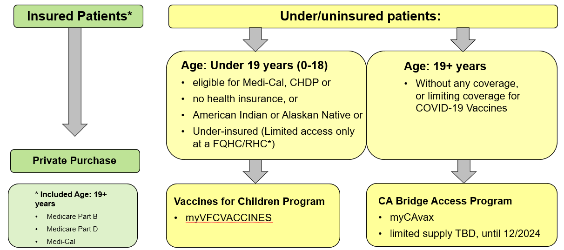
COVID-19 Vaccine Ordering & Distribution Post-Commercialization
CDPH Commercialization at a Glance: Provider Transition Guide

Slide 12
Transition to Commercialization
CDC State Health Officer letter was released Monday, July 17, emphasizing the importance of maintaining access to vaccine during the transition to commercialization
Providers should continue to offer COVID-19 vaccines during this transitional time
Providers should adhere to the COVID-19 Provider Agreement
Patients should NOT be charged for an office visit or any other fee if the only service provided is COVID-19 vaccination

Slide 13
Small Orders Available
Small orders will be available from the DPH warehouse up to commercialization (mid- to late-September)
Small orders will be available after standard orders close
Place all standard orders by Monday, July 31st at 5pm
Procedures for small orders will not change
Ships at refrigerated temp
Show a photo ID (work badge, drivers license, etc.) and sign to receive the vaccine
Contact the Provider Call Center with questions: covidvaccinereq@ph.lacounty.gov

