Slide 1
DPH Provider Vaccine Office Hours: COVID-19 Vaccine Updates 03/29/2023

Slide 2

In observance of César Chávez Day, on Friday, March 31, 2023:
CDPH Friday Provider Webinar is cancelled
CDPH COVID-19 Provider Call Center will be closed.
CDPH My Turn and myCAvax Help Desk will be closed.
No vaccine deliveries from the TPR, Pfizer, or McKesson

Slide 3

Next Crucial Conversations Webinar: Talking with Older Adults about COVID-19 Vaccines and Treatment
Please join #ThisIsOurShot/#VacunateYa for a webinar on talking with older adult patients about COVID-19 vaccines and treatment.
When: Wednesday, April 5 at 12:00PM-1:00PM PST
Register here!
Continuing Medical Education (CME) credit available!
This activity has been planned and implemented in accordance with the accreditation requirements and policies of the Accreditation Council for Continuing Medical Education (ACCME) through the joint providership of the California Medical Association (CMA) and the California Department of Public Health. CMA is accredited by ACCME to provide continuing medical education for physicians.
The California Medical Association designates this enduring material for a maximum of 1 AMA PRA Category 1 CreditsTM. Physicians should claim only the credit commensurate with the extent of their participation in the activity.
COVID-19 Crucial Conversations Campaign

Slide 4


Webinar: Set Up For Success Supporting Patients and Providers Through Video Visits
Date: Wednesday, April 5, 2023
Time: 12PM – 1PM, PT (Live Webinar)
1PM – 1:30PM Q&A w/Speakers
Registration Link
Care Innovations Events

Slide 5

Upcoming Webinar: Addressing Vaccine Hesitancy with Patients with Disabilities and their Families
Please join Noemi Spinazzi, MD, FAAP, to discuss addressing vaccine hesitancy with patients with disabilities and their families.
When: Thursday, April 6 at 12:00PM-1:00PM PST
Register here!
Noemi Spinazzi, MD, FAAP, is a primary care physician at UCSF Benioff Children's Hospital Oakland. She provides primary care services to hundreds of children with complex care needs and developmental disabilities. She is the founder and medical director of Charlie's Clinic, a specialized clinic serving patients with Down syndrome. She is also the director of the developmental and behavioral pediatrics resident rotation at Children's Oakland. She serves on the board of the National Down Syndrome Congress and of Through the Looking Glass.

Slide 6

CA Immunization Coalition: Annual Summit
When: May 8 – May 9, 2023
Location: Riverside, CA
2023 Summit Objectives:
Disseminate innovative approaches to promote and deliver immunizations to all Californians across the lifespan
Provide support and technical assistance to enhance existing education, communication, and outreach efforts
Share successful strategies and best practices to strengthen local and statewide advocacy efforts
Review new recommendations, issues and trends in immunizations and vaccine-preventable diseases
Registration Information

Slide 7
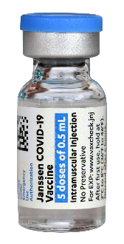

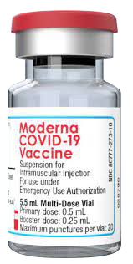
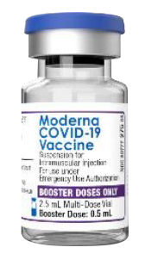
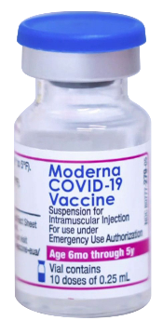
COVID-19 Monovalent Vaccine Products: Status
COVID-19 Vaccine Product | Janssen (J&J) | Novavax | Moderna | Moderna | Moderna
COVID-19 Vaccine Product Description | Adult 18+ years | Primary 12+ years Monovalent Booster 18+ | Adol/Adult Primary Series 12+ years | Pediatric Primary Series 6-11 years* | Infant/Toddler 6 months–5 years
Cap Color | Blue Cap | Royal Blue Cap | Red Cap | Dark Blue Cap | Dark Blue Cap
Anticipated Retirement* | 5/6/23 | 4/30/23 (Future federal purchase possible) | 4/1/23 | 4/9/23 | 6/20/23
Order Status | Not available to order | Unavailable soon | Not available to order | Not available to order | Still available to order
2nd Dose Primary Series: Options for completing primary series if vaccine expires mid-series¹ | N/A | Pfizer Monovalent 12+ or Moderna Monovalent 12+ (Unavailable after April 2023) | Pfizer Monovalent 12+ or Novavax Monovalent 12+ (unavailable after April 2023) | Pfizer Pediatric monovalent 5 yrs. -11yrs. Old | TBD
Commercialization | No | Potentially Fall 2023 | No commercialization of Moderna monovalent vaccines anticipated.
Note: ¹ In general, all COVID-19 vaccine primary series doses should be from the same manufacturer. CDC guidance states that if the same vaccine is not available, a different vaccine may be administered to complete a primary series at a minimum of 28 days from the last COVID-19 vaccine dose.
*Vaccine may expire sooner than retirement. Enter your lot numbers into the vaccine product expiry checker.
Janssen: https://vaxcheck.jnj/
Moderna: https://modernacovid19global.com/vial-lookup?#
Pfizer: https://lotexpiry.cvdvaccine.com/
Novavax: https://us.novavaxcovidvaccine.com/hcp
As of 3.28.23; Information subject to change

Slide 8



Scheduling Pfizer Infant / Toddler Bivalent Booster Appointment
Children aged 6 months – 4 years who previously completed a three dose Monovalent Pfizer COVID-19 vaccine primary series can receive one Bivalent Pfizer COVID-19 Booster dose at least 2 months after completing the primary series.

Slide 9
Pfizer & Moderna Infant / Toddler Bivalent Covid-19 Vaccines-Allocations Update
Allocations of Pfizer (6 months – 4 years) and Moderna (6 months – 5 years) Infant / Toddler Bivalent products will be available for LHDs / MCEs, anticipated by April 7th, 2023.
CDPH anticipates adding a 2–3-week supply for Pfizer (6 months – 4 years) Bivalent vaccine based on the average orders approved over the past few weeks. There will be more allocations made for Moderna (6 months – 5 years) Bivalent vaccine due to more doses being available.
Note: Supply limitations are still in place, and these 2 products do not have allocation threshold increases/updates from CDC.

Slide 10
Cesar Chavez Holiday Ordering Cadence
There will only be one order submission and processing cycle this week .
Please approve orders by tomorrow, March 29, 2023.
There will be no catch-up order submission or deliveries on Friday, March 31, 2023.
March Holiday Ordering & Delivery Cadence

Slide 11
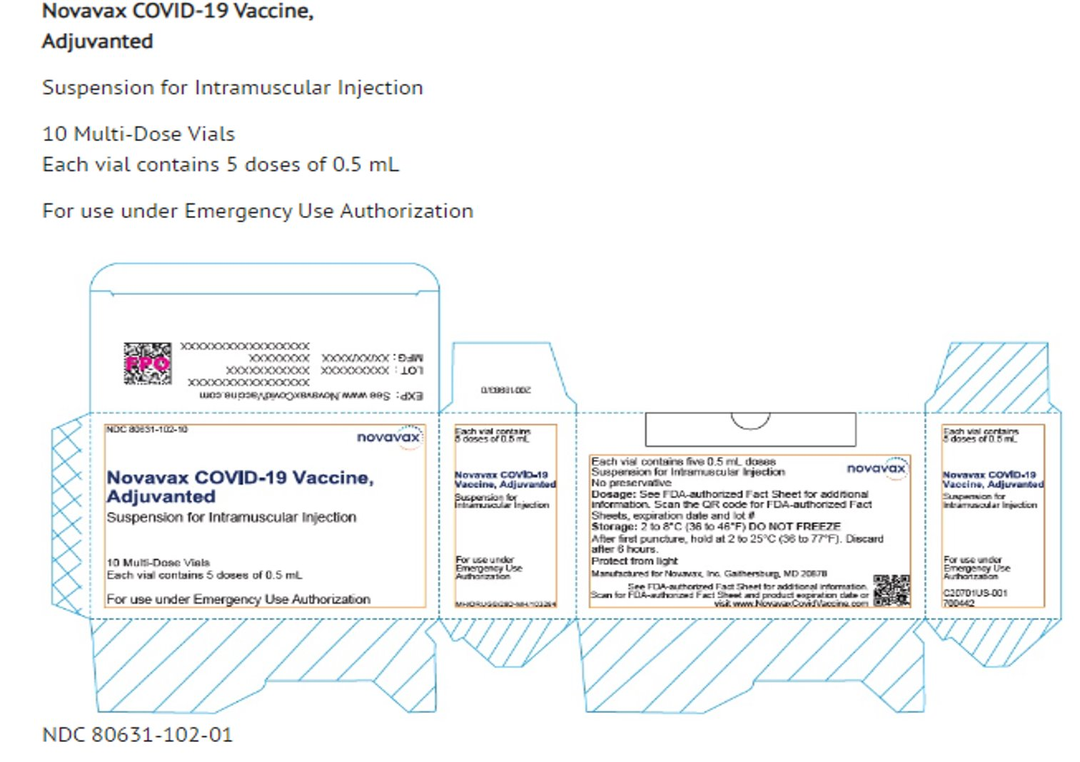
Novavax 5-Dose Vial – Expected by End of April

Slide 12
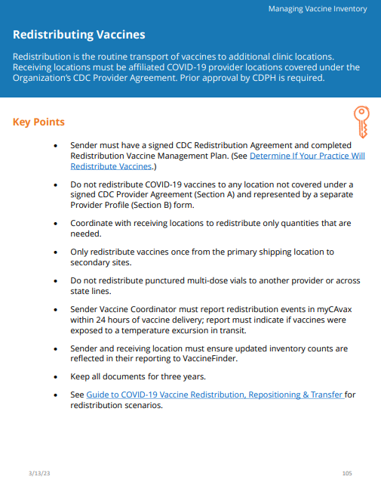
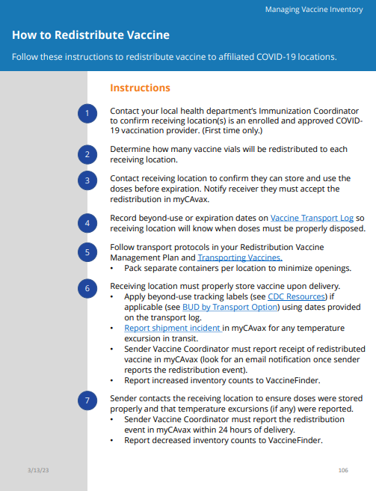
Third Party Redistributor Timeline
Contract through June 2024
Likely will continue through commercialization (expected in fall of 2023)
Note: Redistributing Vaccines Redistribution is the routine transport of vaccines to additional clinic locations. Receiving locations must be affiliated COVID-19 provider locations covered under the Organization’s CDC Provider Agreement. Prior approval by CDPH is required.
Provider Operations Manual (POM) pp. 104-105

Slide 13
Beyond Use Date vs. Expiration Date
Expiration dates
The dates determined by the manufacturer beyond which the vaccine is no longer acceptable to administer to patients regardless of storage condition.
Beyond Use Dates (BUD)
The last day that the COVID vaccine can be safely used after it has been moved from the ULT (Pfizer) or Freezer (Moderna) to the refrigerator.
The BUD replaces the manufacturer’s expiration date but never extends it.
CDC Beyond Use Date Labels
Moderna
Pfizer

Slide 14





Vaccine Marketplace Reminders
Providers: please use the Vaccine Marketplace to REPORT & REQUEST EXCESS DOSES (all vaccine types) approaching the expiry date. Especially as vaccines begin to be phased out.
Providers: please follow appropriate vaccine transport guidelines outlined in the Transferring Vaccines job aid .
Providers are responsible for disposing of vaccine waste as per local regulations and vaccines must not be returned in the shippers.
HRSA Providers can post HRSA/Federal vaccine in Vaccine Marketplace and have other Providers not participating in HRSA receive the product.
Please reference this link for more information regarding the Vaccine Marketplace & this link for a new interactive myCAvax guide
Notes:
Transferring Vaccines Job Aid: https://eziz.org/assets/docs/COVID19/IMM-1346.pdf
Vaccine Marketplace Helpful Introduction: http://www.icontact-archive.com/archive?c=1685203&f=9345&s=18845&m=196623&t=d5d015e4788f297ec3d6b7891198a53fcca5a1742d50d1e37d378774c06114fa
myCAvax Interactive Guide Provider Operations Manual: https://eziz.org/assets/docs/COVID19/IMM-1425.pdf

