Slide 1
DPH Provider Vaccine Office Hours: COVID-19 Vaccine Updates 2/01/2023

Slide 2
FDA’s VRBPAC Meeting Updates
FDA’s Vaccines and Related Biological Products Advisory Committee (VRBPAC) met 1/26/23 to discuss future COVID-19 vaccination regimens
Voted unanimously to recommend a single vaccine strain composition for all vaccines administered (primary and boosters)
Would simplify the COVID-19 vaccination regimen
Limits to how often strain can be updated
Manufacturing constraints
Availability of data on which to base decisions
No changes to FDA or CDC guidance have been made
Continue with monovalent for primary, bivalent for boosters
Meeting materials and recording of meeting available on the FDA’s website

Slide 3
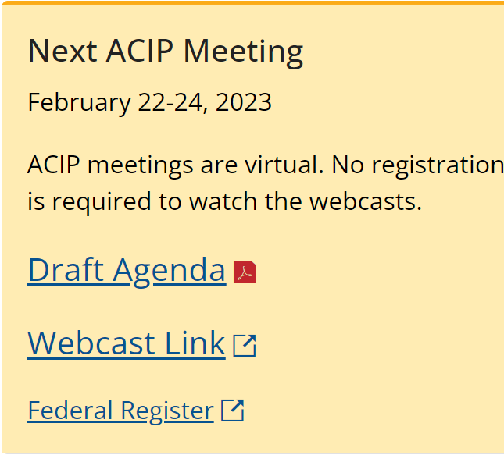
Upcoming ACIP Meeting
Regular meeting of CDC’s Advisory Committee on Immunization Practices scheduled for February
Added a day (2/24) to discuss COVID-19 vaccines 5:00 am – 10:00 am PT
No details available yet but agenda should be updated
Meeting materials and details are available on the CDC’s ACIP website

Slide 4
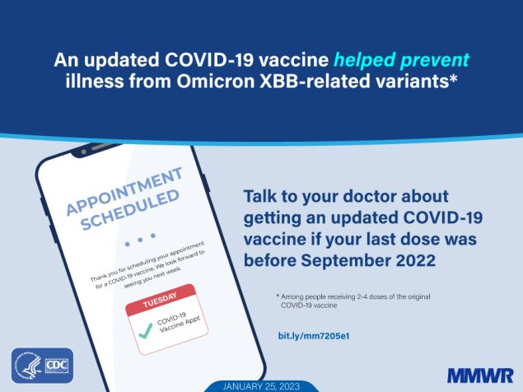
MMWR: Early Estimates of Bivalent Booster Vaccine Effectiveness
On 1/25/23, CDC published a new MMWR on bivalent mRNA booster vaccine effectiveness in preventing symptomatic COVID
Looking at BA.2 sublineages, including XBB and XBB.1.5 (new sub-variants) from December 2022–January 2023, the results showed that a bivalent mRNA booster dose provided additional protection against symptomatic XBB/XBB.1.5 infection for at least the first 3 months after vaccination in persons who had previously received 2–4 monovalent vaccine doses

Slide 5

ACOG: Free Online Training
The American College of Obstetricians and Gynecologists (ACOG) is offering a free, online, CME-accredited* training entitled "Inform to Empower: Building COVID-19 Vaccine Confidence One Conversation at a Time” to help clinicians hold effective conversations with their patients about COVID-19 vaccines. Training highlights include evidence-based patient communication strategies such as: Motivational interviewing Techniques for dispelling myths and misinformation Tips for creating a culture of vaccine confidence among staff and peers. Each module is supplemented with a toolkit comprised of educational materials for healthcare personnel and patients.
*This training is accredited to provide 1.5 Continuing Medical Education credits for physicians. It is accessible on the ACOG Learning Management System and can be accessed by non-ACOG members through free and simple account creation.

Slide 6

Program Highlights: KidsVaxGrant 3.0
Application Cycle: EXTENSION! January 12th – February 17th, 2023, or until all funds are disbursed
As of January 23, 2023: 6 applicants requesting $85,000 with $2,365,000 funds remaining. 17 eligible providers have enrolled in myCAvax. 10+ VFC providers have started myCAvax applications since launch of the grant.
Eligibility Criteria: All Vaccines for Children (VFC) Providers who have not previously enrolled their practice location in the California COVID-19 vaccine program (myCAvax) or enroll between October 15, 2022, and February 3, 2023, or until all funding is disbursed
Grant Funding Opportunities:
$10,000 for target VFC providers who enroll in myCAvax and attest to placing a minimum of 1 vaccine order within 30 days of award notification
$5,000 supplemental grant to those myCAvax enrollees who elect to opt in to enhance/upgrade their current electronic health record system
Outreach continues for myCAvax enrollment
PHC is hosting office hours for myCAvax and grant application information as needed and continues 1:1 outreach to
identified providers.
How Do Providers Meet Eligibility? Step 1: Enroll in myCAvax .
Where Do Providers Learn More about KidsVaxGrant 3.0: www.kidsvaxgrant.org or 916-551-2565

Slide 7

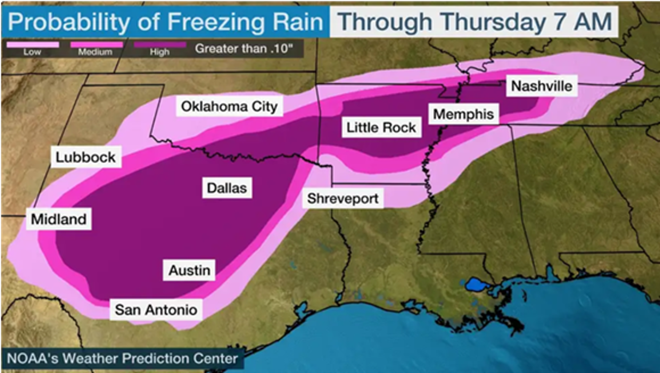
Possible Shipment Delays: Routine and COVID Vaccines
A current winter storm is impacting FedEx, UPS main hubs, and some vaccine distribution centers.
Vaccine shipments for both routine and COVID-19 programs may be delayed this week!

Slide 8
Vaccine Product Updates
Novavax
No longer available for Standard Orders
Small Orders are still available through February (as supplies remain)
All inventory expires at the end of February
Do expect Novavax to be available as program shifts to commercial availability
Janssen/J&J
All inventory in the field expires at the end of February
USG does have more in inventory with longer expiration
Moderna
Monovalent products expire in February and March
Awaiting additional details about ongoing product availability

Slide 9





Vaccine Marketplace Reminders
Providers: please use the Vaccine Marketplace to REPORT & REQUEST EXCESS DOSES (all vaccine types) approaching the expiry date. Especially as vaccines begin to be phased out.
Providers: please follow appropriate vaccine transport guidelines outlined in the Transferring Vaccines job aid .
Providers are responsible for disposing of vaccine waste as per local regulations and vaccines must not be returned in the shippers.
HRSA Providers can post HRSA/Federal vaccine in Vaccine Marketplace and have other Providers not participating in HRSA receive the product.
Please reference this link for more information regarding the Vaccine Marketplace & this link for a new interactive myCAvax guide
Notes:
Transferring Vaccines Job Aid: https://eziz.org/assets/docs/COVID19/IMM-1346.pdf
Vaccine Marketplace Helpful Introduction: http://www.icontact-archive.com/archive?c=1685203&f=9345&s=18845&m=196623&t=d5d015e4788f297ec3d6b7891198a53fcca5a1742d50d1e37d378774c06114fa
myCAvax Interactive Guide: https://cdphvax.lightning.force.com/lightning/r/Knowledge__kav/ka0t0000000wke8AAA/view

