Slide 1
DPH Provider Vaccine Office Hours: COVID-19 Vaccine Updates 1/18/2023

Slide 2
My Turn/myCAvax System Upgrades
The My Turn/myCAvax system upgrades for unified login went live 1/16/23
Users for both systems now have one login for accessing either system
If you encounter any issues with accessing My Turn, contact the Help Desk at MyTurnClinic.HD@cdph.ca.gov
Beginning today and continuing until 1/23/23, both myCAvax and My Turn will be unavailable between 12 am – 5 am PT for system maintenance
Both systems will be available and operating normally outside of these hours

Slide 3
Limited Supply of Infant/Toddler Pfizer Bivalent Vaccine
Supply of the Pfizer bivalent product for infants/toddlers 6 months-4 years remains somewhat limited
CDPH sent a message about this supply issue on 1/13/23
USG didn’t buy a large supply as eligible population remains low
CDPH closely monitoring all requests
Order review will consider reported usage (CAIR) and inventory (VaccineFinder)

Slide 4
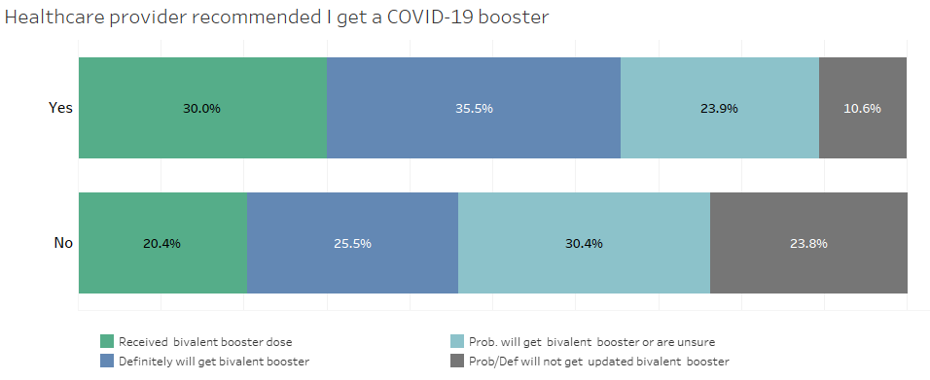
CDC National Immunization Survey-Adult COVID-19 Module
NIS survey results reveal critical role provider recommendation plays in receipt of COVID-19 vaccine
Respondents in CA were 1.5 times more likely to have received their booster if they received a HCP recommendation
CDC National Immunization Survey - Adult Covid-19 Module (NIS -ACM)

Slide 5
Potential Safety Signal for Bivalent Pfizer – 65+
FDA and CDC released a joint statement on 1/13/23 regarding potential safety signal detected via routine Vaccine Safety Datalink (VSD) surveillance
Possible increased risk of stroke for 65+ who received Pfizer bivalent vaccine
No increased risk detected in any other monitoring systems monovalent vaccine or for bivalent vaccine outside of VSD
No increased risk detected in VSD for those who received Moderna bivalent vaccine
Data currently suggest it is unlikely that VSD signal represents true clinical risk
No changes in vaccine recommendation are recommended
Update on investigation is expected at VRBPAC meeting on 1/26/23

Slide 6
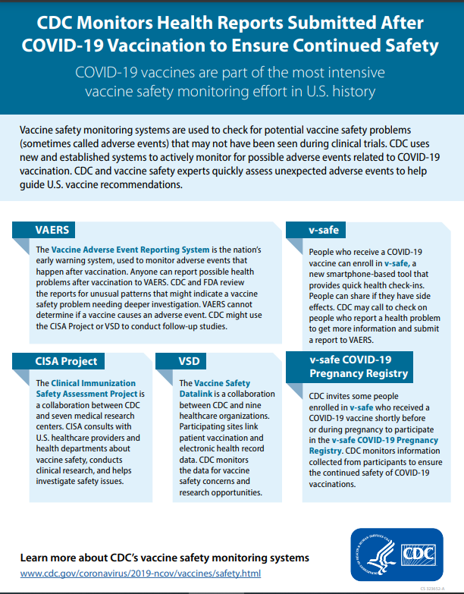
CDC COVID-19 Vaccine Safety Monitoring Systems
Surveillance Systems
Safety Monitoring Information Sheet
VAERS
v-safe
v-safe COVID-19 Pregnancy Registry
Clinical Immunization Safety Assessment (CISA) Project
Vaccine Safety Datalink (VSD)

Slide 7
Planning for COVID-19 Vaccine Commercialization
Planning underway for ensuring ongoing access to vaccine and therapeutics for those who need them
HHS and USG understanding of the importance of planning and ample notice for this transition away from government-provided resources
Congress directed a timeline be shared by mid-February
VRBPAC meeting on 1/26/23 will be discussing this issue, with ACIP meeting to follow in February

Slide 8
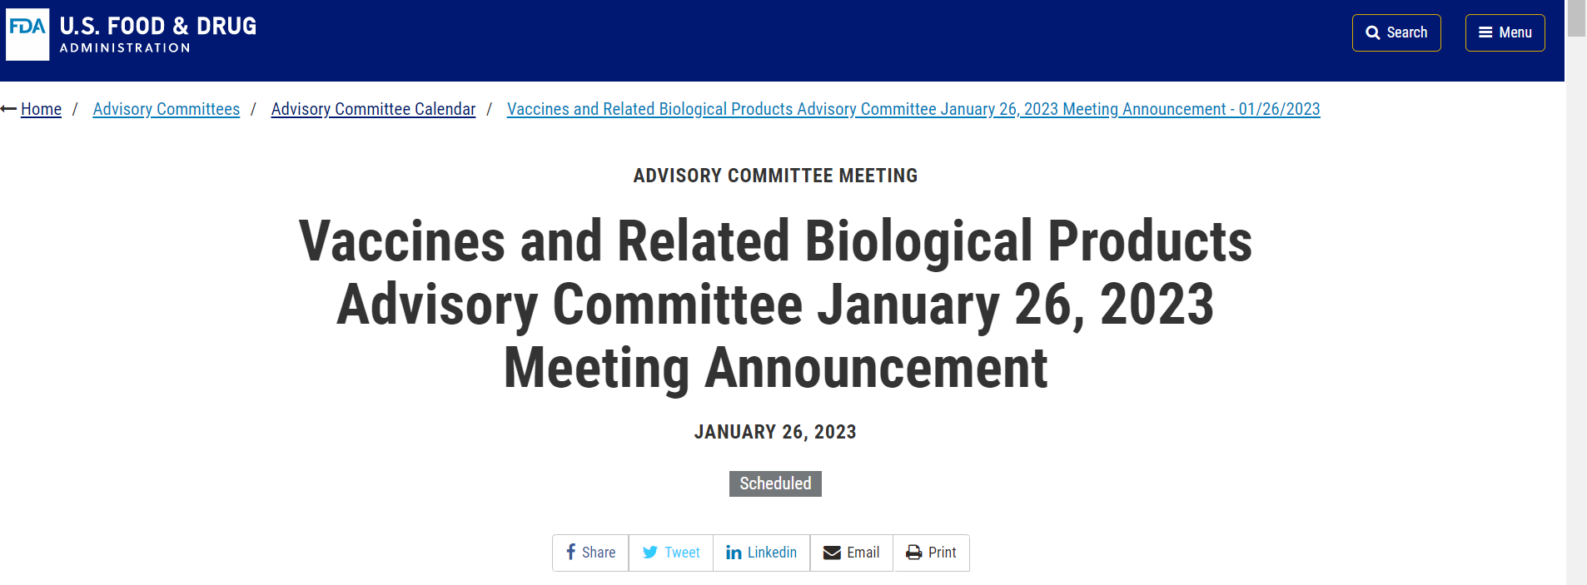
FDA’s Upcoming VRBPAC Meeting
FDA’s Vaccines and Related Biological Products Advisory Committee (VRBPAC) will meet 1/26/23 from 8:30 am – 5:30 pm ET
Will discuss future vaccine regimens addressing COVID-19 vaccines
Expect discussion of primary series vaccine composition and booster schedule
Meeting materials and updates will be available on the FDA’s website

Slide 9


Reminder for VFC Providers: KidsVaxGrant 3.0
Target outreach population
978 identified Vaccines for Children (VFC) registered providers who have not enrolled in myCAvax
Grant funding opportunities
$10,000 for target VFC providers who enroll in myCAvax and attest to placing a minimum of 1 vaccine order within 30-days of award notification
$5,000 supplemental grant to those myCAvax enrollees who elect to opt in to enhance/upgrade their electronic health record system
Outreach began the week of 12/20 for myCAvax enrollment
PHC will begin hosting office hours for myCAvax and grant application information.
Inquiries over the holiday were minimal, primarily thanking us for the opportunity to apply to 3.0 and confirming Step 1 is enrollment into myCAvax to become eligible for grant.
Application now open
Details and application at KidsVaxGrant.org
9

Slide 10
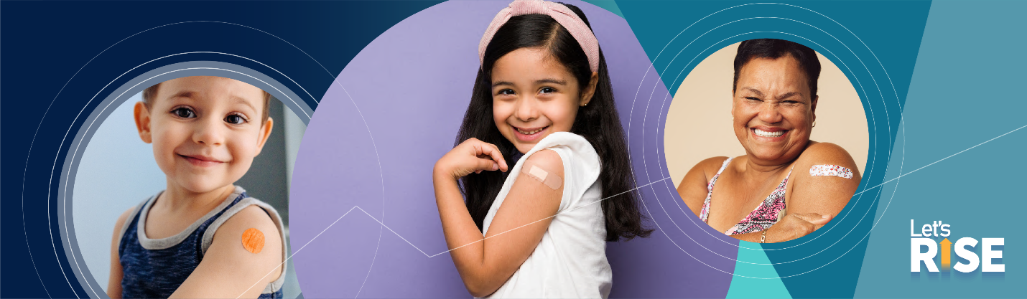
CDC Launches Let’s RISE Initiative to Get Routine Immunizations Back on Track
During the COVID-19 pandemic, we saw a concerning drop in routine immunizations for adults and children. Routine vaccination is rebounding but unevenly and has not yet recovered among all groups. While we continue to investigate the impact of the pandemic on routine immunizations, it is crucial that we take steps to help get everyone back on schedule with their routine immunizations. That’s why the Centers for Disease Control and Prevention is launching the Let’s Rise initiative. The purpose of Let’s Rise is to use evidence-based strategies and available resources and data to encourage catch up on routine vaccinations. CDC will also communicate the importance of why being up to date on routine vaccinations is critical for staying healthy so that families and adults can make informed decisions. As trusted community leaders, health care professionals, and partners, you can Prioritize ensuring everyone catches up on routine vaccination Identify individuals behind on their vaccinations, Encourage vaccination catch-up through reminders, recall, and outreach Make strong vaccine recommendations Make vaccines easy for everyone to find and afford Please stay tuned for the first comprehensive summary of CDC data on the impact of COVID-19 on routine immunization coverage and priority groups for catch-up in the coming weeks. Together, Let’s Rise and get routine vaccinations back on track! More information about Let’s RISE and access to routine immunization resources and data can be found at Let’s RISE.

