Slide 1
DPH Provider Vaccine Office Hours: COVID-19 Vaccine Updates 1/11/2023

Slide 2
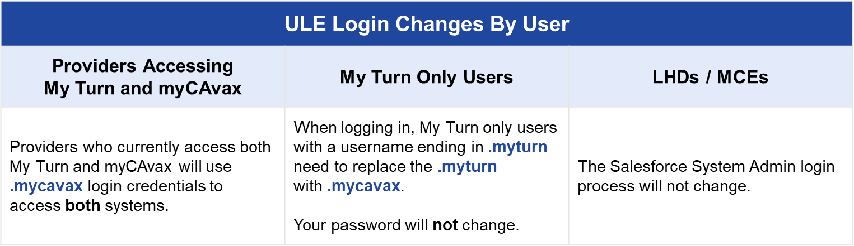
My Turn/myCAvax System Upgrades
CDPH will be implementing the system updates to My Turn and myCAvax that were deferred from last month
These updates will provide a unified login experience for users (no separate logins required for these two systems)
Both myCAvax and My Turn will be unavailable from Friday, 1/13/23 at 6 pm to Monday, 1/16/23 at 8 am
COVID Call Center Message re: My Turn/myCAvax System Outage

Slide 3




Help Desk Holiday Availability
In observation of the Martin Luther King Jr. holiday, the COVID-19 Provider Call Center will be closed on Monday, January 16, 2023.
If you have any questions or need support on that day, please reach out to the My Turn (MyTurn.Clinic.HD@cdph.ca.gov) and myCAvax (myCAvax.HD@cdph.ca.gov) Help Desk.

Slide 4
TPR Redistribution of Moderna Bivalent Boosters
CDPH is working with AmerisourceBergen, the Third-Party Redistributor (TPR) to provide them with all they need to begin redistribution of the Moderna bivalent boosters
Expect to begin redistribution in mid- to late-January 2023

Slide 5


Reminder for VFC Providers: KidsVaxGrant 3.0
Target outreach population
978 identified Vaccines for Children (VFC) registered providers who have not enrolled in myCAvax
Grant funding opportunities
$10,000 for target VFC providers who enroll in myCAvax and attest to placing a minimum of 1 vaccine order within 30-days of award notification
$5,000 supplemental grant to those myCAvax enrollees who elect to opt in to enhance/upgrade their electronic health record system
Outreach began the week of 12/20 for myCAvax enrollment
PHC will begin hosting office hours for myCAvax and grant application information.
Inquiries over the holiday were minimal, primarily thanking us for the opportunity to apply to 3.0 and confirming Step 1 is enrollment into myCAvax to become eligible for grant.
Application now open
Details and application at KidsVaxGrant.org
5

Slide 6
Western States Scientific Review Workgroup (WSSRW)
Formed to ensure safety of COVID-19 vaccines
Given anticipated move to incorporate COVID-19 vaccines into routine vaccination schedules, WSSSRW is disbanding
Future national recommendations (ACIP) are expected to suffice for California

Slide 7
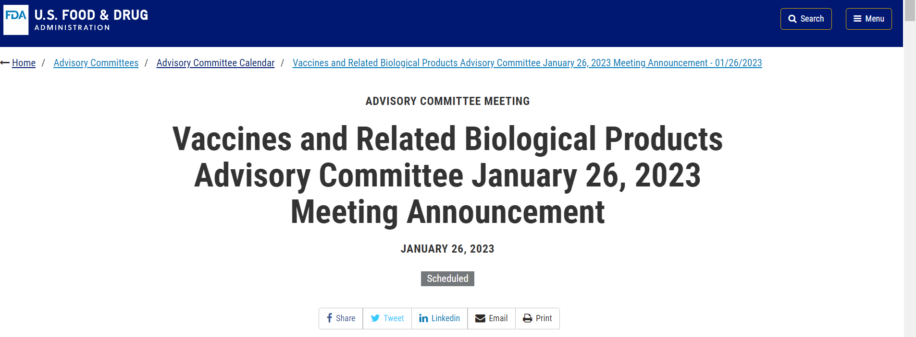
FDA’s Upcoming VRBPAC Meeting
FDA’s Vaccines and Related Biological Products Advisory Committee (VRBPAC) will meet 1/26/23 from 8:30 am – 5:30 pm ET
Will discuss future vaccine regimens addressing COVID-19 vaccines
Expect discussion of primary series vaccine composition and booster schedule
Meeting materials and updates will be available on the FDA’s website

Slide 8

CDC Launches Let’s Rise Initiative to Get Routine Immunizations Back on Track
During the COVID-19 pandemic, we saw a concerning drop in routine immunizations for adults and children. Routine vaccination is rebounding but unevenly and has not yet recovered among all groups. While we continue to investigate the impact of the pandemic on routine immunizations, it is crucial that we take steps to help get everyone back on schedule with their routine immunizations. That’s why the Centers for Disease Control and Prevention is launching the Let’s Rise initiative. The purpose of Let’s Rise is to use evidence-based strategies and available resources and data to encourage catch up on routine vaccinations. CDC will also communicate the importance of why being up to date on routine vaccinations is critical for staying healthy so that families and adults can make informed decisions. As trusted community leaders, health care professionals, and partners, you can Prioritize ensuring everyone catches up on routine vaccination Identify individuals behind on their vaccinations, Encourage vaccination catch-up through reminders, recall, and outreach Make strong vaccine recommendations Make vaccines easy for everyone to find and afford Please stay tuned for the first comprehensive summary of CDC data on the impact of COVID-19 on routine immunization coverage and priority groups for catch-up in the coming weeks. Together, Let’s Rise and get routine vaccinations back on track! More information about Let’s RISE and access to routine immunization resources and data can be found at Let’s RISE.

