Slide 1
COVID-19 Vaccine Updates 11/23/2022

Slide 2

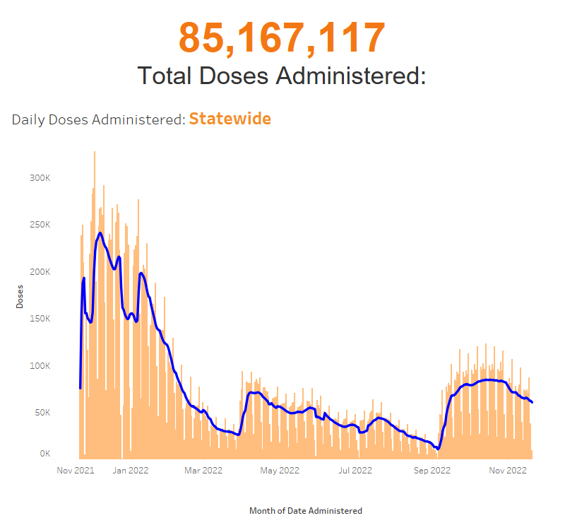
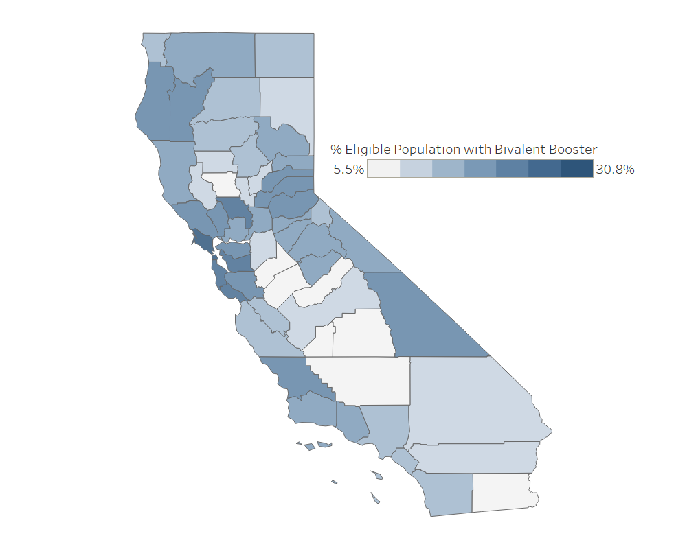
Vaccine Administration Summary as of November 21, 2022
4,811,013
Total Bivalent Booster Doses Administered:
Percent Eligible Population with Bivalent Booster
Public Dashboard Link

Slide 3
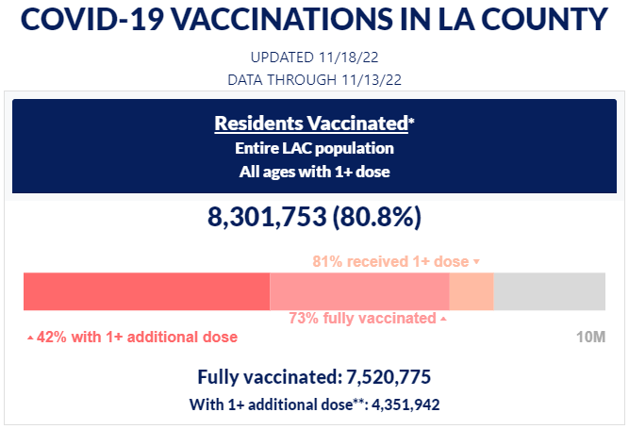
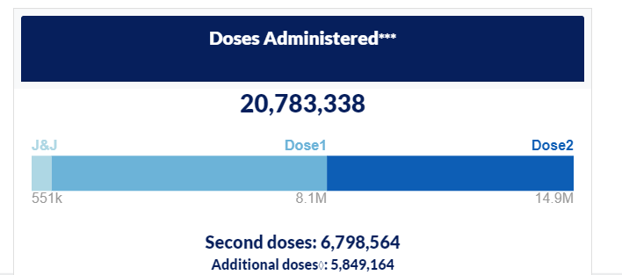
Vaccine Administration

Slide 4
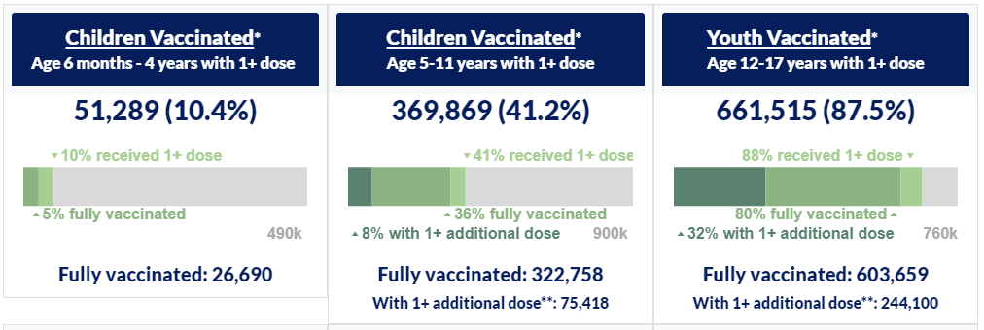
Vaccine Administration – LA County

Slide 5




Single Dose Pfizer (12+ years) Bivalent Ordering
CDC has allocated limited doses of the new Single Dose Pfizer (12+ years) Bivalent product to all the states. TPR small orders are expected to be available within the next 2-3 weeks. The minimum order is 50 doses, and the maximum order is 150 doses.
CDPH anticipates changing the maximum order to 50 doses in order to stretch limited supply when ordering opens for Providers the week of November 28, 2022. Due to limited supply, MCEs have not yet received allocations for this product. Additional allocations are not expected until after the first of the year.

Slide 6
Pfizer Single-Dose Vials
National Drug Code (NDC): 59267-1404-02
Configuration: 10 single-dose vials/carton
Minimum quantity per order: 50 doses
Maximum quantity per order: 150 doses
Product dimensions: 1.457 in length × 1.535 in width × 3.504 in height
Storage and handling: Same as other Pfizer tris products (e.g., store at ultra-low temperature until expiry, may refrigerate up to 10 weeks within expiry period)
No ancillary kits included with single-dose vial orders
Single-dose vials do not require the use of low-dead-volume (LDV) syringes

Slide 7
Reminder: Monovalent Boosters – No Longer Authorized
Monovalent mRNA COVID-19 vaccines are no longer authorized as booster doses for individuals 5 years of age and older.
You are up to date with your COVID 19 vaccines if you have completed a COVID-19 vaccine primary series and received the most recent booster dose recommended for you by CDC.
Anyone over the age of 5 is currently recommended to receive a bivalent booster.

Slide 8
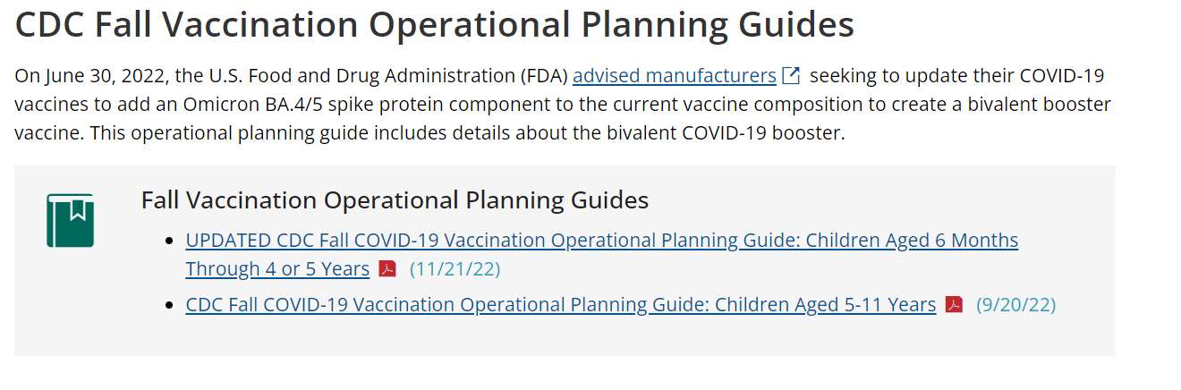
Youngest Pediatric Bivalent Products: 6 mos-4 yrs
CDC released guidance this week
Does appear that there will be a single pre-order wave for the Pfizer and Moderna products
Expect that Pfizer will be authorized as part of the primary series
Expect that Moderna will be authorized as a booster dose
More information will be shared as it becomes available

Slide 9
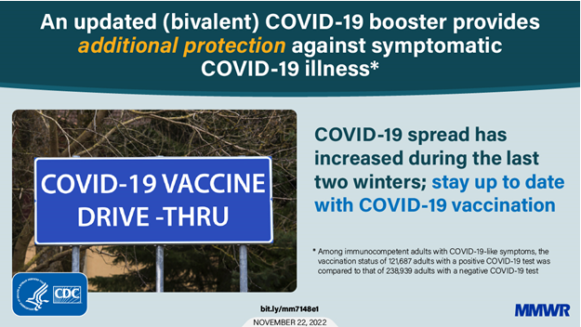
MMWR – Updated Bivalent COVID-19 Boosters

Slide 10
MMWR: Effectiveness of Bivalent mRNA Vaccines in Preventing Symptomatic SARS-CoV-2 Infection — Increasing Community Access to Testing Program, United States, September–November 2022
Vaccine effectiveness data show that updated (bivalent) boosters help protect against COVID-19 illness and COVID-19-associated death.
Early surveillance data posted to COVID Data Tracker show that people who received the updated (bivalent) booster dose were 15 times less likely to die from COVID-19 compared to people who were not vaccinated.
Getting the updated (bivalent) booster restored protection that had decreased over time since receiving the last vaccine dose.
CDC also published an MMWR with early vaccine effectiveness (VE) data that showed that the updated (bivalent) booster provided additional protection from COVID-19 illness in people who had already received a monovalent booster dose or multiple monovalent booster doses.
The updated (bivalent) booster protects against the original strain of the virus and BA.4 and BA.5 variants, so this holiday season, stay up to date on COVID-19 vaccines to prevent severe disease and death. CDC recommends that people ages 5 years and older get one updated (bivalent) booster if it has been at least 2 months since they got their last COVID-19 dose (either primary series or original monovalent booster).
CDC is making these early data available to the public and will continue to monitor VE data, respond to the trends we see, and evaluate VE against emerging variants.

Slide 11

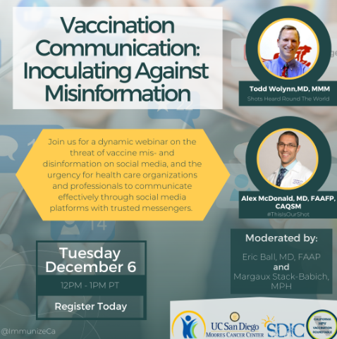

California Immunization Coalition Vaccination Communication: Inoculating Against Misinformation
A dynamic webinar on the threat of vaccine mis- and disinformation on social media, and the urgency for health care organizations and professionals to communicate effectively through social media platforms with trusted messengers.
CIC and UC San Diego Moores Cancer Center to host Dr. Todd Wolynn, MD, MMM and Dr. Alex McDonald, MD, FAAFP, CAQSM.
When: Tuesday, December 6, 2022
Time: 12:00PM – 1:00PM, PST
Register here

Slide 12

Upcoming Crucial Conversations Webinar: Talking with Patients about COVID-19 and Flu Vaccines
Please join Alex McDonald, MD, FAAFP, CAQSM, co-founder of #ThisIsOurShot and CDC Immunization Champion Award recipient for a webinar on talking with patients about COVID-19 and flu vaccines
When: Wednesday, December 7, 2022
Time: 12:00PM – 1:00PM, PST
Register here

Slide 13
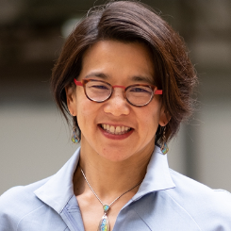
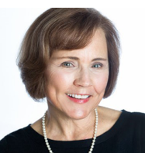

California Medical Association Virtual Grand Rounds
In this Virtual Grand Rounds, Erica Pan, M.D., MPH, will bring us up to speed on COVID-19 and monkeypox (MPX). Joining her will be Carol Glaser, M.D., who will educate us on emerging enterovirus activity that is causing several respiratory illness and acute flaccid myelitis. Dr. Glaser will also speak on polio and the possible implications in California.
Erica Pan, M.D., MPH, California State Epidemiologist and Deputy Director, California Department of Public Health, Center of Infectious Diseases
Carol Glaser, DVM, MPVM, M.D., Assistant Deputy Director, Office State Public Health Laboratory Director and Medical Officer, Infectious Disease Laboratories, California Department of Public Health
When: Tuesday, December 13, 2022
Time: 12:00PM – 1:00PM
For event information and to register, visit
CMA Virtual Grand Rounds COVID-19 Updates

Slide 14
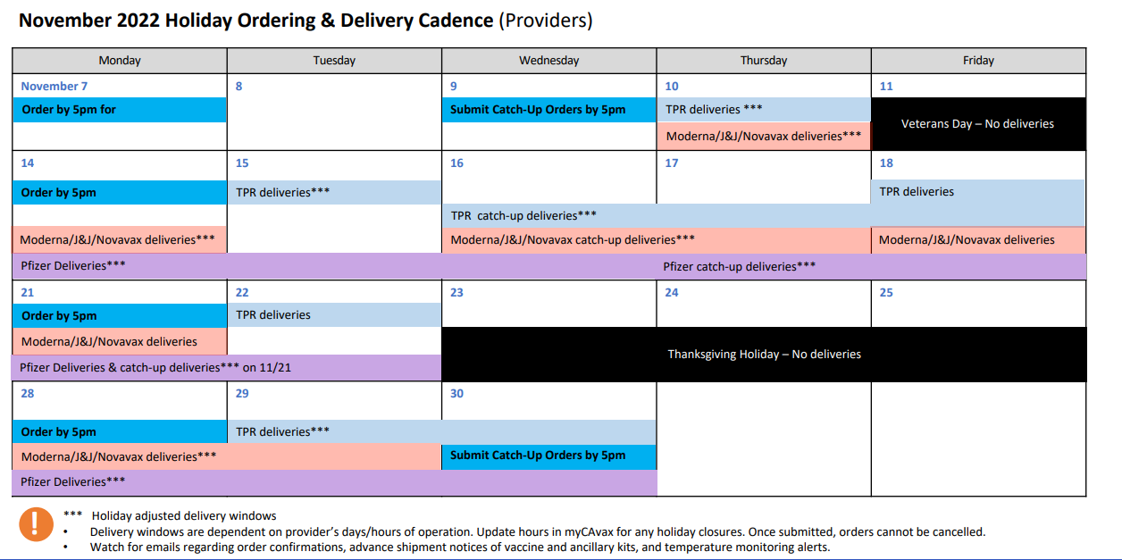
Holiday Ordering & Delivery Calendar

Slide 15
Calling all FQHCs & Look-Alikes: RFA due 12/09/22
The California Department of Public Health (CDPH) Immunization Branch is announcing a Request for Applications (RFA) for a grant to assess and improve adult immunization rates in Community Health Centers (CHCs). CDPH is seeking a large Federally Qualified Health Center (FQHC) or look-alike to assess immunization levels and implement quality improvement activities aimed to increase immunization rates in an identified adult patient population. CDPH Immunization Branch staff will provide support and technical assistance to the selected grantee. Funding will be available through June 2023 for up to $127,000. Applications are due December 9, 2022. Please share this communication with organizations that could benefit from this funding.

