Slide 1
COVID Vaccine Updates 11/9/2022

Slide 2
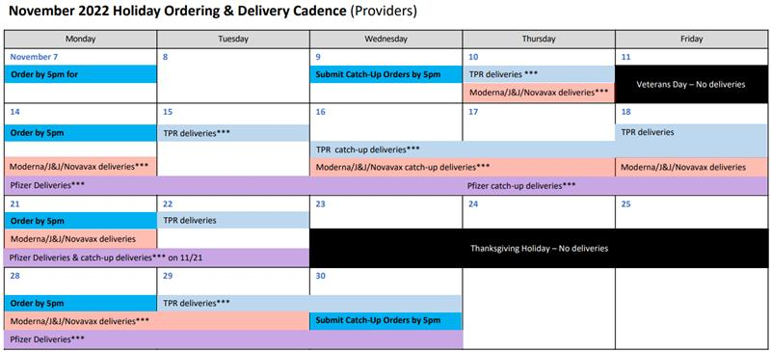
November Holiday Ordering & Delivery Cadence
In preparation for upcoming November holidays, please keep the following points in mind:
There will be no catch-up orders the week before and of Thanksgiving.
Providers should place larger orders of vaccine at the beginning of the month, as CDPH expects delayed delivery windows around the holidays.
Regular ordering will resume the week after Thanksgiving.
Please see the for November Holiday Ordering & Delivery Cadence Calendar

Slide 3


Afternoon TEAch
Register here
(Note: Please register early due to limited space.)
Webinar Objectives:
Discuss pediatric COVID-19 vaccination trends and booster guidance
Review best practices and resources to prevent the top 5 quality assurance issues
Share tips for integrating COVID-19 vaccination into clinic workflow
Review techniques for talking with patients about COVID vaccines
If you have questions that you would like addressed during the webinar, please submit on the registration page. The webinar will be recorded and available for on-demand viewing on EZIZ Afternoon TEAch.
Save the Date!

Slide 4

Next Crucial Conversations Webinar: Talking with Patients about the Updated COVID-19 Booster
Please join Hussain Lalani, M.D., M.P.P., co-founder of #ThisIsOurShot, to discuss talking with patients about the updated COVID-19 booster.
This webinar will cover:
Recent data on updated booster dose effectiveness
Communication strategies for effective patient conversations
When: Thursday, November 10 at 1:00PM-2:00PM
Register here!

Slide 5



What’s Next in My Turn? - Release 33
New updates for My Turn Public and Clinic will launch on November 16, 2022
Release Highlights
CMs will be unable to edit/create appointments, create clinics, or add new Monovalent Booster supply.
VAs will be able to mark that a patient has health insurance but does not want to provide information during the walk-in flow.
VAs will be able to add Novavax Monovalent Booster appointments during walk-flow and using bulk upload.
CMs and VAs will be able to view two new columns, brand and dose, in the list view under the IIS Status tab.
CMs and VAs will view job aids in new categories in the Knowledge Center and access updated links embedded into the clinic portal.
VAs, when filtering for appointments via the Appointments tab, will no longer see age in the brand filter dropdown.
Release Highlights
Patients will be unable to schedule appointments for Pfizer and Moderna Monovalent Booster vaccines.
The expiration date for clinic-specific links will automatically update to match the clinic’s closing date.
Descriptions for patient information and final steps pages will be added.
The eligibility page will be reconfigured to enhance the user experience.
My Turn Public
My Turn Clinic

Slide 6
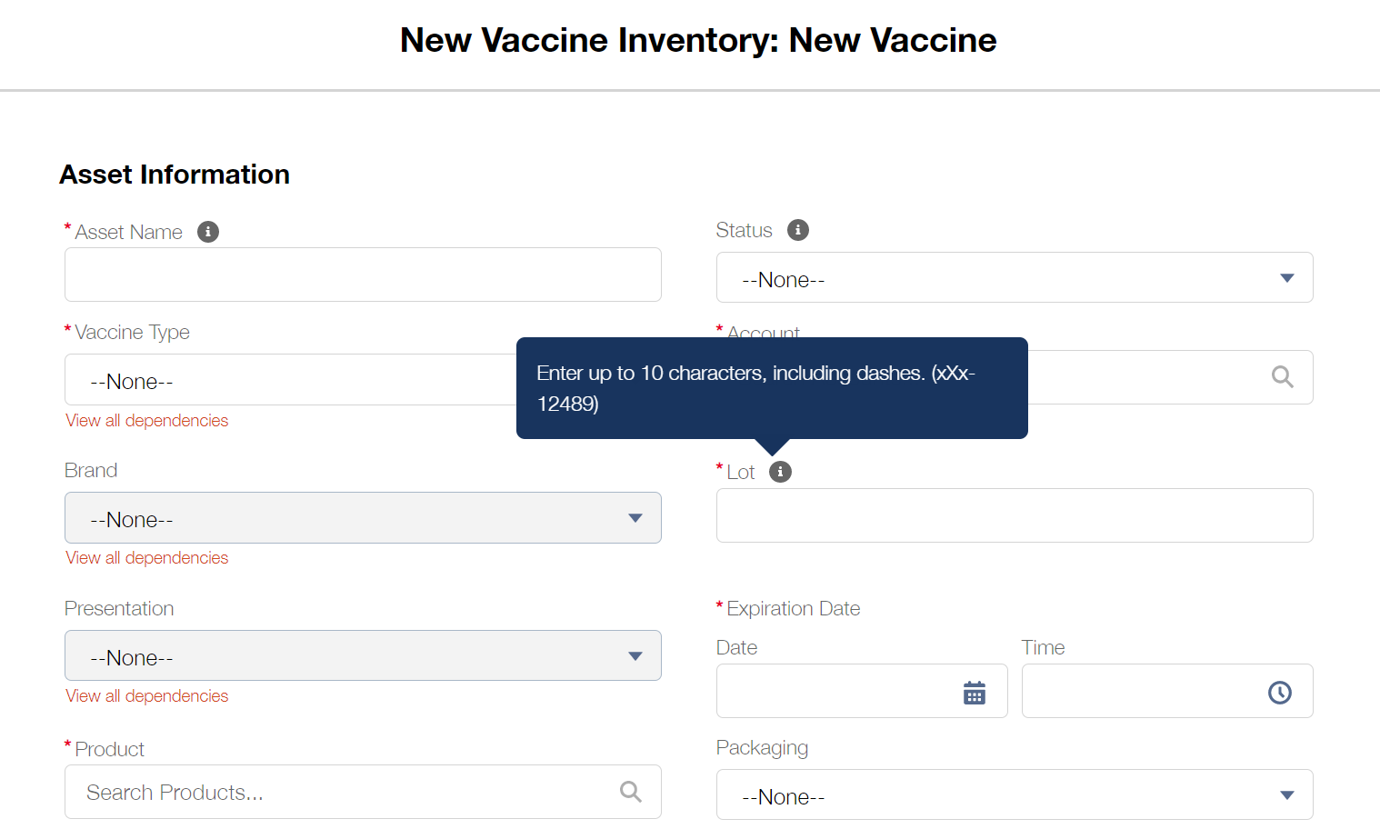


Entering Valid Lot Numbers
When creating Vaccine Inventory and entering lot numbers in the ‘Lot’ field, only input the lot number as it appears on the vial. Please do not provide any additional information in the ‘Lot’ field. Refer to the tooltip for more information.
Incorrect Lot Number
12345 – STATE
Correct Lot Number
12345

Slide 7

Extended Vaccine Administrator Clinic Hours
As of Wednesday, November 2, 2022, Vaccine Administrator clinic hours have been extended to midnight (12:00AM PT).

Slide 8
What’s New in myCAvax? - Release 32
New updates for LHDs / MCEs and Providers launched on
November 3, 2022.
Release Highlights
Providers will be able to scroll through the available list of products on the New Transfer page and select the required product for a vaccine transfer.
Providers will only be able to enter and save whole numbers when providing the Total Doses Wasted for creating a new waste event.
Providers
LHDs / MCEs

Slide 9

Friday Provider Office Hours and myCAvax LHJ Council Update
The Provider Office Hours scheduled for Friday, November 11, 2022, has been canceled in observance of Veteran’s Day.

Slide 10
Coming Soon: New Help Desk Email Addresses
Beginning Tuesday, November 15, 2022, contact the My Turn and myCAvax Help Desk at their new email addresses: MyTurn.Clinic.HD@cdph.ca.gov and myCAvax.HD@cdph.ca.gov. Please update any county websites and materials that contain the Help Desk contact information with the new email on November 15th, 2022.
On Tuesday, November 15, 2022, the existing Accenture email will auto-reply and direct you to contact the new CDPH email addresses. After Thursday, December 15, 2022, the Accenture Help Desk email will be permanently disabled.

Slide 11

Upcoming Vaccine Expiry
Many lots of Pfizer and Moderna are expiring in the coming weeks, so:
Pay close attention to the expiration dates of your vaccines.
Always double check expiration date before administering the vaccine.
Always quarantine or dispose of any expired vaccine to avoid accidental administration.

Slide 12
Moderna Monovalent Adult 12+ Years Shelf-Life Extension
Expiry dates of the following Moderna10 products have been extended.
Moderna has verified the new expiry dates to the right and updated the Moderna Vial Expiration Checker: https://modernacovid19global.com/vial-lookup?#vialLookUpTool
Lot Number | Old Expiry (9 months) | New Expiry (12 Months)
054A22A | 2022-11-01 | Feb 1, 2023
055A22A | 2022-11-02 | Feb 2, 2023
057A22A | 2022-11-06 | Feb 6, 2023
056A22A | 2022-11-07 | Feb 7, 2023
059A22A | 2022-11-09 | Feb 9, 2023
058A22-2A | 2022-11-10 | Feb 10, 2023
060A22A | 2022-11-10 | Feb 10, 2023
014B22A | 2022-11-11 | Feb 11, 2023
015B22A | 2022-11-12 | Feb 12, 2023
016B22A | 2022-11-13 | Feb 13, 2023
017B22A | 2022-11-14 | Feb 14, 2023
011B22A | 2022-11-18 | Feb 18, 2023

Slide 13
Short Dated Monovalent Vaccine, Pfizer
Pfizer will submit a request to the FDA for a shelf-life extension of their Orange (5 years-11 years) and Gray Cap (12 years+) presentations.
The goal is to prevent a supply gap for any of these vaccines.

Slide 14

Single Dose Pfizer (12+ Years) Bivalent Ordering
CDC has notified states that limited allocations of the new Single Dose Pfizer product will be available as early as next week.
Because of the limited size of the allocation, CDPH will leave the product on ‘blackout’ for provider ordering.
Ordering for Providers will open once additional supply is received. More information to come next week once we have allocation numbers.
Local Health Departments and potentially the Third-Party Redistributor will be allowed to order supply for their small order redistribution needs.
Further details on requesting single dose product will be made available once LA has guidance and inventory numbers from CDPH.
There will be no ancillary kits provided with the single dose product

Slide 15
COVID-19 Vaccine Administration Errors
Take steps to prevent administration errors
IMM-1410 Preventing Administration Errors
If you do have an administration error, immediately take the necessary steps to report
COVID-19 Provider Operations Manual
Assess how you can improve your process for next time.

