Slide 1
Arizona Emissions Bank and emission reduction credits
Proposed Changes

Slide 2
Agenda
Background
Voice of Customer
Value
What does the Customer Value?
e.g. ease of use, certainty
Design Principles
(Conceptual Design)
e.g. 1 Rule for Whole State
[Break]
Existing Work

Slide 3
Agenda
Background
How the Bank Works Today
How the Bank Doesn’t Work Today
How Many Credits are in the Bank?
How the Bank Could Work
Potential New Types of Credits

Slide 4
Background
The Arizona Emissions Bank is authorized by A.R.S. 49-410 and A.A.C. 18-2-1201, et. seq.
ADEQ and MCAQD are contemplating changes to the bank and the emission credit program, which require action by the state legislature

Slide 5
Who needs Emission Credits?
Located in NAAQS Nonattainment Area
Is a major source or major modification?
Emission offsets required
Major Source = 100 tpy of Criteria Pollutant or Precursors
Major Modification = “Significant” (R18-2-101) increase of emissions
Criteria Pollutant = CO, O₃, Lead, SO₂, NO₂, Particulate Matter (10 & 2.5)

Slide 6
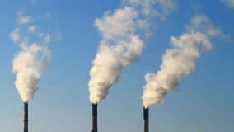
How the Emissions Bank Works Today
^Doesn’t
Reduction in Facility Emissions or Shut down
Permitting Authority Certifies Credit
New or Modified Facility Purchases Credits
Problem: Too few credits available

Slide 7
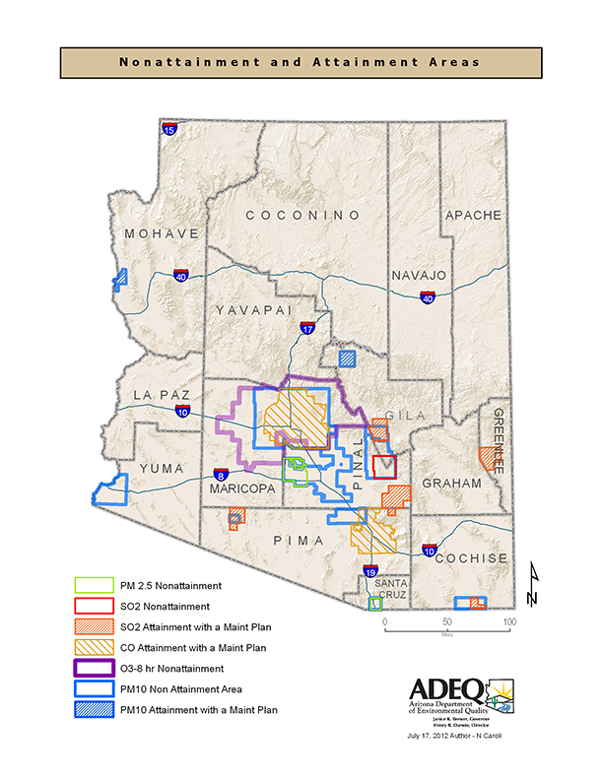
How many credits are there?
Phoenix Metropolitan Area
14.14 tons NO_{X}
0.16 tons SO₂
14.3 tons CO
266.13 tons VOC
4.79 tons PM₁₀
Hayden, Miami, Pinal, Nogales, Douglas/Paul Spur, and Yuma non-attainment areas
No credits in bank

Slide 8
How the Emissions Bank Works Today
Reduction in Facility Emissions or Shut down
Permitting Authority Certifies Credit
New or Modified Facility Purchases Credits

Slide 9
How the Emissions Bank Could Work
Emission Credit is Generated
Permitting Authority Certifies Credit
New or Modified Facility Purchases Credits

Slide 10
What is required for a credit?
Permanent
Surplus
Quantifiable
Enforceable
Real
Credit

Slide 11
Potential Types of Emission Reduction Credits
Traditional
Non-Traditional
Govt-Generated
Privately-Generated
Privately-Generated
Govt-Generated
Credit
Currently allowed in emission bank

Slide 12
Abandoned Credits
Abandoned credits are traditional credits (i.e. generated by a reduction in emissions from a permitted facility) that were generated by the closure of a facility and were never claimed.
One option would be for ADEQ or another state agency to claim these credits and make them available for sale in the bank. Raises same issues as state sale of government-generated credits discussed later. Need to make sure credits are truly abandoned.

Slide 13
Potential Types of Emission Reduction Credits
Traditional
Non-Traditional
Govt-Generated
Privately-Generated
Privately-Generated
Govt-Generated
Credit
Currently allowed in emission bank

Slide 14
Non-Traditional Credits
Non-traditional credits are generated by projects that meet the criteria for a credit but are not a reduction from a permitted facility.
Examples: Paving of unpaved roads, repowering of vehicles (school busses or garbage trucks)
Anyone can generate these, but they need to be permanent, enforceable, etc.
MCAQD Rule 242 has a federally enforceable way of generating PM₁₀ offsets from the voluntary paving of unpaved roads.

Slide 15
Potential Types of Emission Reduction Credits
Traditional
Non-Traditional
Govt-Generated
Privately-Generated
Privately-Generated
Govt-Generated
Credit
Currently allowed in emission bank

Slide 16
Government Generated Credits
Because most nonattainment areas are either multi-county or under ADEQ jurisdiction, ADEQ or another state agency could be given ownership of these and in order to sell them in the bank
Statewide consistency for ease of end user
Questions that we need to answer:
What criteria should ADEQ use to evaluate potential buyers and uses?
Avoid Hoarding and Retirement of Credits
Where should the money go?
What price should ADEQ sell them for?

Slide 17
Questions for Government Owned Credits
What criteria should ADEQ use to evaluate potential buyers?
We don’t want to discriminate on type of industry or ownership
Project feasibility?
Other criteria?

Slide 18
Questions for Government Owned Credits
Where should money go?
Economic development?
Emission reduction for areas near nonattainment?
What Price Should Govt Owned Credits be sold for?
Free
Problem: Ruins market for private sellers
“Market Price”
Problem: Relatively few transactions
Problem: ADEQ is not aware of all transactions
Set Price
Problem: How do we set a price?

Slide 19
Future Actions
Revise Statue 49-410
Statue contains general authority and direction for program
Funds must be created by statue
Revise Applicable State & County Regulations
Requires SIP revision (EPA approval)
Contain details on how to run program
Future stakeholder meetings to discuss specific language

Slide 20
Thank you!

