Slide 1

Maricopa County
Air Quality Department
Philip McNeely
Director

Slide 2
Ever Lower Ozone Standards
Date | Standard | Status
1979 1 hr | 125 ppb | Redesignated to Attainment 6/14/2005
1997 8 hr | 85 ppb | Redesignated to Attainment 10/17/2014
2008 8 hr | 75 ppb | Nonattainment - Moderate
2015 8 hr | 70 ppb | Nonattainment

Slide 4
Emission Reduction Credits (ERC) and Offsets

Slide 5
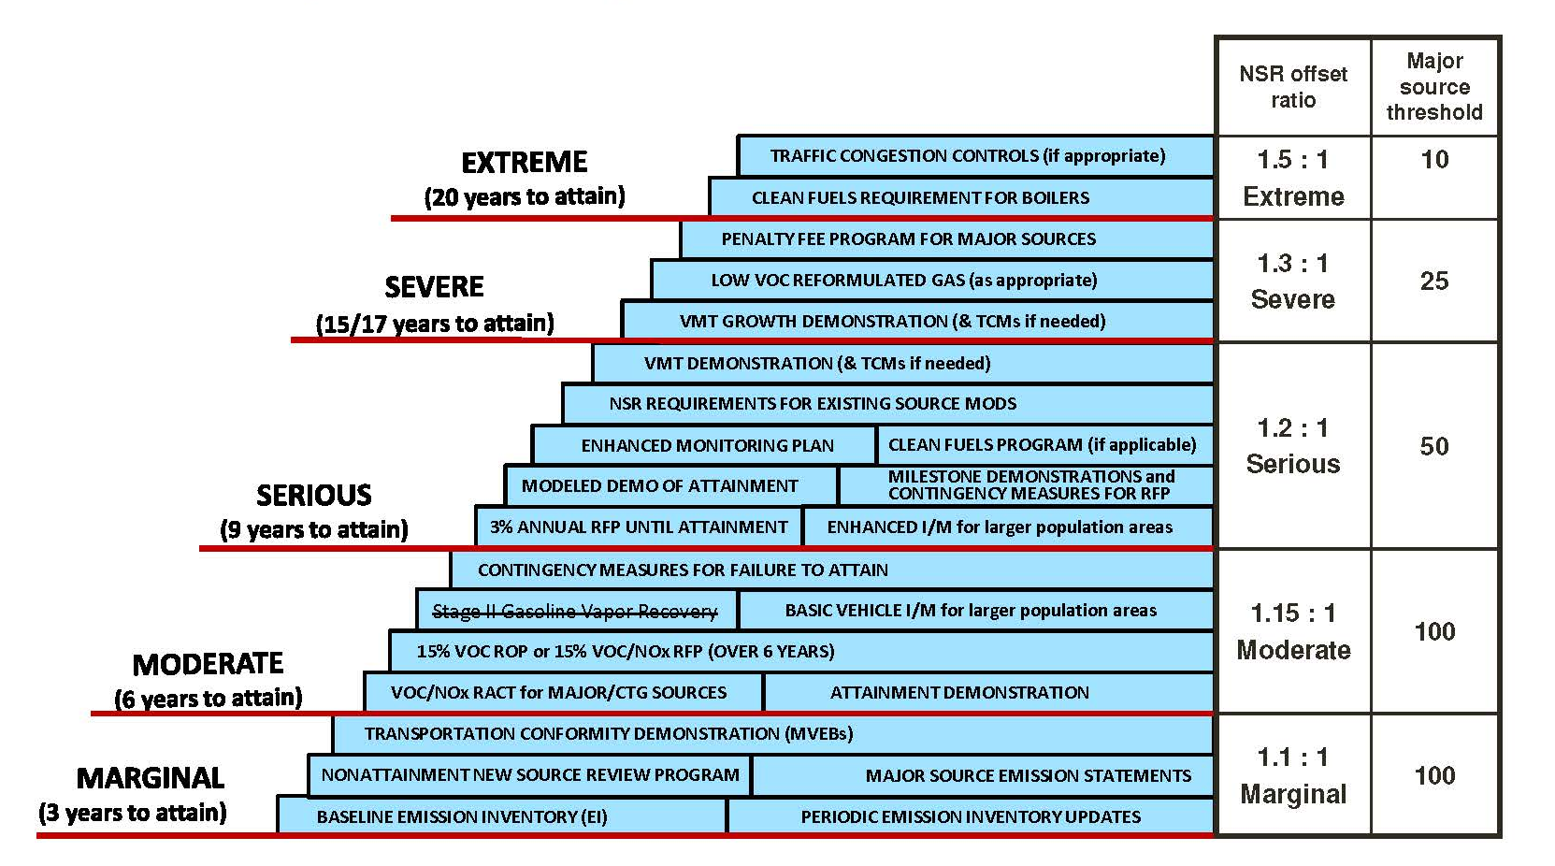

Overview of CAA Ozone Nonattainment Area Planning & Control Requirements by Classification
Courtesy of EPA

Slide 6
Offsets
Emission reductions that have occurred and continue to occur within Maricopa County used to mitigate emission increases from new or modified major sources.
The purpose for requiring offsetting emissions decreases is to allow an area to move towards attainment of the NAAQS while still allowing industrial growth.
Emissions must be included in the latest emissions inventory.

Slide 7
Certified Emission Reduction Credits
Credits that have been certified by Maricopa County (MCAQD Rule 204 & Rule 242) by satisfying the following criteria:
  A Reduction in Actual Emissions
  A Quantifiable Reduction
  A Permanent Reduction
  An Enforceable Reduction
  Surplus to Regulatory Requirements

Slide 8
Emission Reduction Credits
Challenge: Insufficient ERCs exist in ADEQ’s Emissions Bank (A.R.S. §49-410) to permit large new or expanded projects.

Slide 9
Available Emissions Reduction Credits as of December 31, 2016
Facility Name | ERC Date | Emission Reduction Credits (tons/yr)
 |  | VOC | NO_{x} | CO
Freescale Semiconductor, Inc. | 3/1/2004 | 17.1 | 9.8 | 14.3
Intel Corporation | 3/4/2005 | 178.33
Madison 51, LLC (Thornwood) | 10/8/2012 | 53.1
Penn Racquet Sports Inc. | 3/6/2009 |  | 4.34
Woodstuff Manufacturing Inc. | 11/30/2007 | 17.6
Totals: |  | 266.13 | 14.14 | 14.3

Slide 10
Potential sources of ERC for VOC or NO_{x}
Permit No. | Facility Name | City, ZIP | Potential ERCs (tons/yr)
 |  |  | VOC | NO_{x}
100087 | Di-Matrix Precision Manufacturing | Phoenix, 85040 | 17.4
110178 | Saint Gobain Solar Glass Facility | Goodyear, 85338 | 9.9
020005 | Jabil | Tempe, 85281 | 8.5
010233 | All Pro Industrial Finishes | Tempe, 85281 | 8.4
150049 | Artisan Natural Stone Products LLP | Phoenix, 85034 | 7.8
010240 | Wells Cargo Inc./Haulmark Industries Inc. | Phoenix, 85043 | 6.0
110195 | Crown Custom Millwork LLC | Phoenix, 85085 | 5.0
990152 | Wickenburg Oil Company LLC | Wickenburg, 85390 | 4.2
020189 | American Case & Pedestal Mfg. Co. | Phoenix, 85009 | 4.0
990254 | Benchmark Electronics Phoenix, Inc. | Phoenix, 85023 | 2.1
090003 | Phoenix San-Man Inc. | Buckeye, 85326 |  | 9.9
010143 | Gro-Well Brands Inc. | Phoenix, 85009 |  | 8.3
970349 | Cemex – Central Ave. Plant | Phoenix, 85041 |  | 7.5
090298 | Phoenix Brick Yard | Phoenix, 85007 |  | 3.1
Totals: |  |  | 73.3 | 28.8

Slide 11
Source Categories
Nonroad Mobile
Nonpoint
(Area)
Point
Onroad Mobile
Biogenic

Slide 12
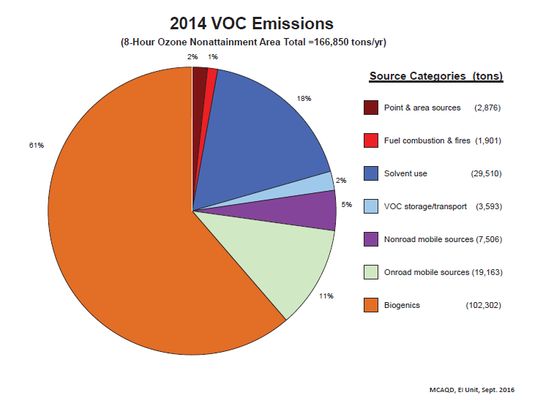
2014 VOC Emissions

Slide 13
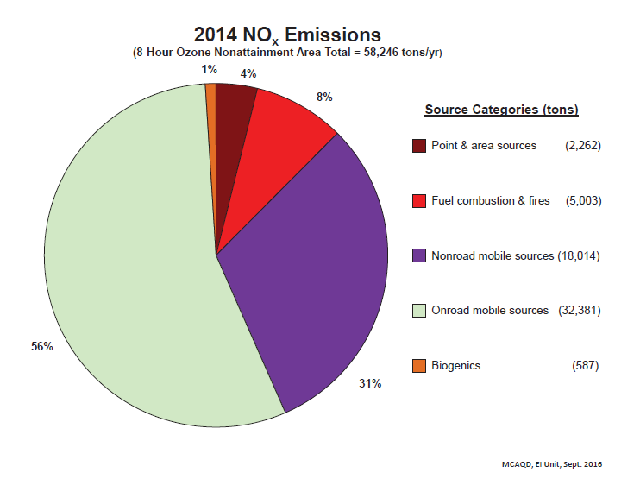
2014 NOX Emissions

Slide 14
Generating Credits
Credits currently generated by:
  Certifying shutdown credits from existing sources
  Controlling emissions greater than required by rule and banking the credits
Potential sources of credits:
  Bank orphan credits
  Non-traditional (unpermitted, mobile) sources

Slide 15
Potential Legislation & Rules
Propose A.R.S. §49-410 Revisions
  Eliminate sunset date (July 2019)
  Eliminate 10% banking “Fee”
  Authorize non-traditional (unpermitted, mobile) ERC
MCAQD Rule Development
  Revise Rule 204 to address non-traditional ERC

Slide 16

ERC Benchmarking
Eastern Research Group Presentation

Slide 17

ERC Benchmarking
Paula Fields Simms
Matt Haber
Eastern Research Group, Inc. (ERG)
January 5, 2017

Slide 18
ERC Benchmarking Research
Identify other agencies with ERC banking systems
24 agencies identified
  Priority given to Region 9 agencies
6 agencies interviewed
  Ohio EPA
  New Jersey DEP
  Texas (TCEQ)
  San Diego APCD
  Butte Co. AQMD
  Massachusetts DEP

Slide 19
ERC Benchmarking
Maricopa County
  Moderate ozone NAA
  Inventory has few major sources
  Few existing banked ERCs
  Outlook for growth
Focus of ERG Research
  Bank orphan credits
  Non-traditional (unpermitted sources, mobile sources)

Slide 20
ERC Benchmarking Findings
Many agencies have rules covering non-traditional ERCs and gathering of orphan ERCs
Most agencies have not used those provisions
  Adequate traditional ERCs are available
  Lack of stakeholder support for orphaned shutdowns
  Challenges in distributing orphaned ERCs
  Resistance to federal enforceability
  High relative cost of non-traditional ERCs

Slide 21
Successful Non-traditional ERC Programs
San Diego APCD
  SIP approved rule
  ERCs from refuse trucks and harbor vessels
  Used to build power plant
TCEQ
  Currently revising rules to allow ERCs from mobile and area sources
  Proposal in March 2017, final in August 2017
Common elements
  Stakeholder support
  Need for more ERCs
  EPA participation

Slide 22
Thank You!
Paula Fields Simms, ERG
  Paula.Fields@erg.com
Matt Haber, ERG
  Matt.Haber@erg.com

