Slide 1
Agency and PMI’s web-site

Slide 2
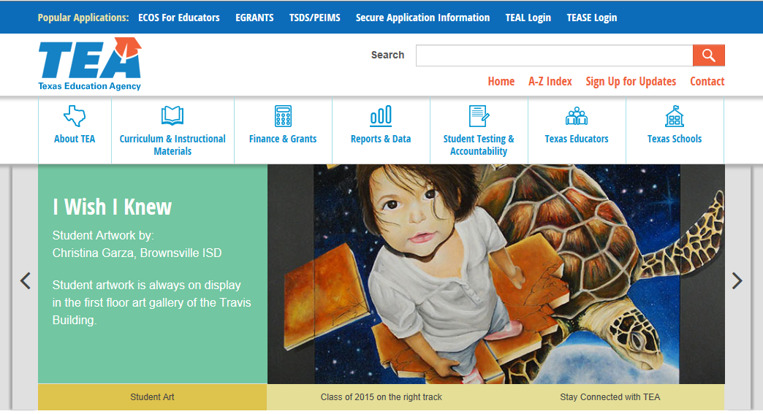
The agency is launching a new web-site on November 10, 2014
It will have a new look, new logo and a new web-address
The new website is tea.texas.gov
To locate the PMI web-site click on the Student Testing and Accountability section

Slide 3
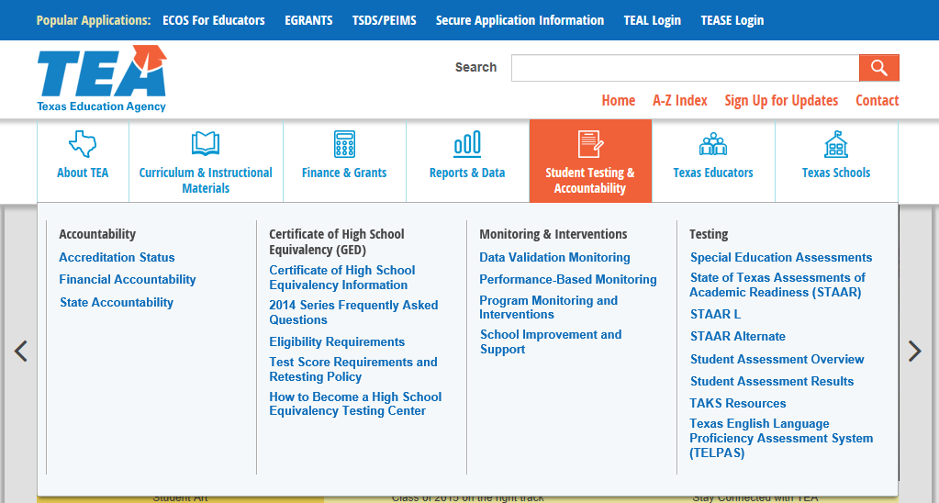
After selecting Student Testing and Accountability there are four categories
Accountability
Certificate of High School Equivalency (GED)
Monitoring and Interventions
Testing
Under the Monitoring and Interventions subcategory select Program Monitoring and Interventions

Slide 4
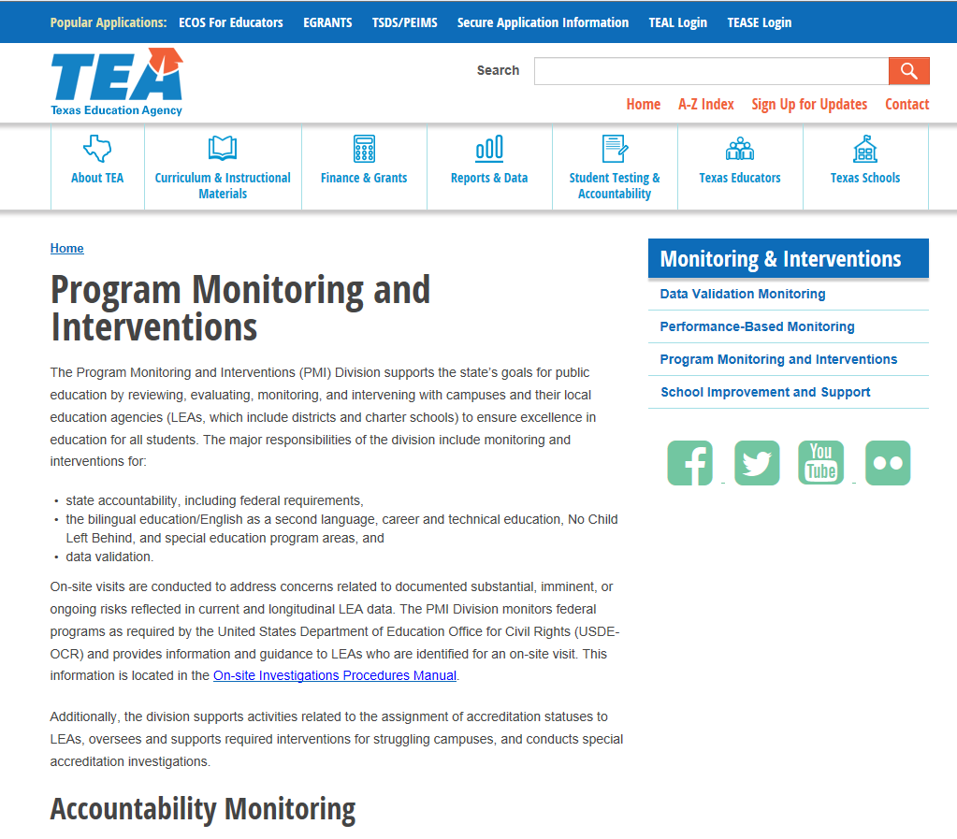
The content of the pages are the same
New look and feel with navigating the agency’s website

Slide 5
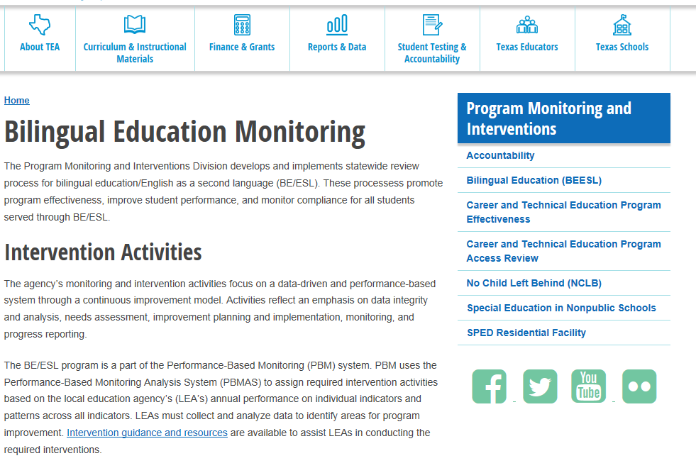
Example of the Bilingual Page
Ability to quickly move to additional program pages

