Slide 1
Affordable Care Act
Update
September 2015

Slide 2
Agenda
Counting hours refresher
IRS reporting
Penalties
1411 certifications
Questions

Slide 3
Counting hours overview
Effective January 1, 2015, the State of Oklahoma, as a Large Employer with various agencies as components of the Large Employer, is required to redefine who is eligible for benefits to comply with key provisions of the Patient Protection Affordable Care Act.
  Current benefit eligible employees are unaffected.
  Those employees who are not benefit eligible may become benefit eligible if certain conditions are met.
Effective January 1, 2015 those that are not benefit eligible needed to be classified into the following categories in order to determine benefit eligibility:
  Variable hour employees, broadly defined as anyone who is not currently benefit eligible and is not considered a seasonal employee. Seasonal employees, defined under PPACA as employees who are employed during the same time of year each year, and for which the duration of the “season” is no greater than six months (note: OMES is working on legislation to match OK statute with ACA definitions)

Slide 4

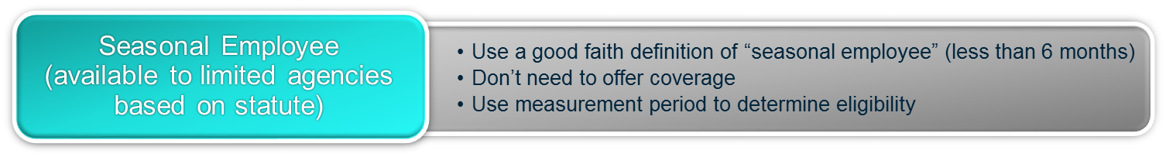
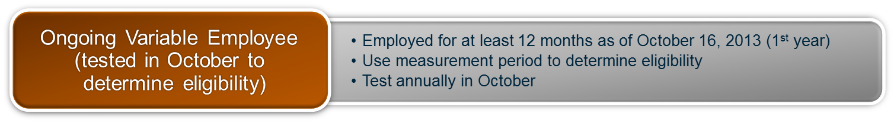
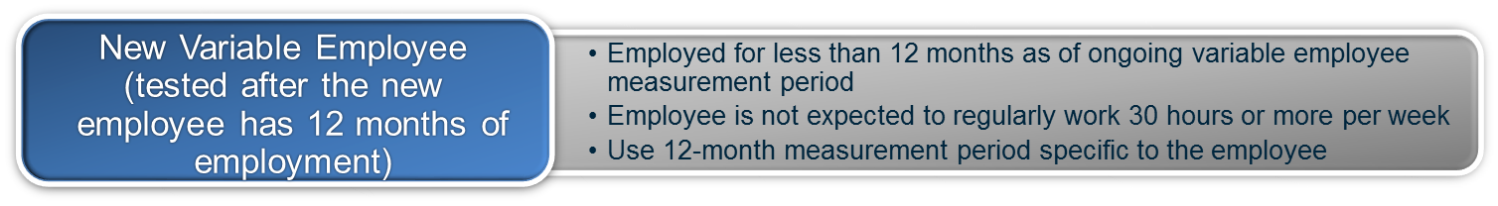
ACA employee classifications

Slide 5
Variable hour employees
For employees who are hired to be regularly scheduled to work 30 hours or more per week for more than three months (90 days):
  Departments and agencies should have identified those employees in September 2014 to ensure they are provided coverage effective January 1, 2015.
  Departments and agencies will be required to submit the newly eligible form to trigger benefit eligibility.
  For new variable hour employees hired after the onset of the initial measurement period (hired after October 17, 2014), hiring managers must make the determination if the employee will be regularly scheduled to work 30 hours or more per week for more than three months (90 days) – if yes, the employee must be provided benefits in a manner consistent with current benefit eligible employees.

Slide 6
Variable hour employee
For employees who are hired with an irregular work schedule, and it is unknown if they will work on average more than 30 hours per week:
  OMES Information Services developed reporting to test each individual in order to validate if, over a 12 month period, that employee worked on average more than 30 hours per week.
    OMES Information Services will only be developing the reporting modules for those departments and agencies on PeopleSoft.
    Any departments and agencies running proprietary time and attendance systems will be responsible for generating the necessary reports for testing.
      Note: OMES Information Services will be available to meet with you to answer questions and help in any way possible.
  Departments and agencies will be responsible for testing their employees:
    Once in October for ongoing variable hour employees
    Monthly for new variable hour employees
    Departments and agencies will be responsible for Federal assessments, if any, due to inaccurate reporting

Slide 7
Variable hour employee

Slide 8
Special rules for testing
Any compensable hour should be counted as an hour worked. This will include the following:
  Regular/overtime pay, military leave pay, call pay, workers compensation pay, vacation pay, jury duty pay, sick/enforced leave pay, administrative leave pay, holiday pay, etc.
Certain hours that are non-compensable hours will be counted as if they were compensable hours, so that they do not count against the employee. This will include the following:
  FMLA and USERRA (unpaid military leave)
If an employee has a break in service longer than 13 weeks, that employee should be considered as a new hire.
  If the break in services is shorter than 13 weeks, that employee will be treated as if they had not left the State with no compensable hours during that period, provided the employee’s length of employment was greater than 13 weeks.
    If the employee’s break in service was longer than the employee’s length of employment, that employee would be treated as a new employee.

Slide 9
Testing calendar

Slide 10
Reports in PeopleSoft
GO_HR_ACA_HIRE_NO_ACA_STATUS
  Determine if any of your recent new hires or rehires are missing data
GO_HR_ACA_TERMS_NO_ACA_STATUS
  Determine if any of your terminations since Jan. 1, 2015 are missing a termination row on the ACA page
GO_HR_ACA_EMPL_LIST
  View the current ACA status for all your employees

Slide 11
IRS reporting
Address the 6055 and 6056 reporting requirements of the ACA:
  6055 addresses the individual mandate
  6056 addresses the employer mandate
    Counting hours
First reporting year will be calendar year 2015, reported in January 2016
Reporting process, but will be similar to W-2 reporting process (the timing)
  Each agency will be responsible for ensuring their data is loaded into the reporting system
  Will be required to submit taxes
  For 2014, it was the honor system
Will show each month the employee and members were covered
  6055: individual mandate
Will show each month the employee was eligible to be covered
  6056: employer mandate (counting hours)

Slide 12
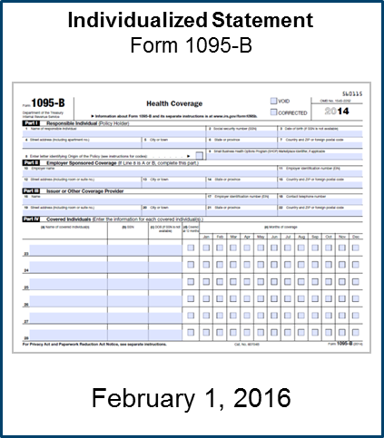
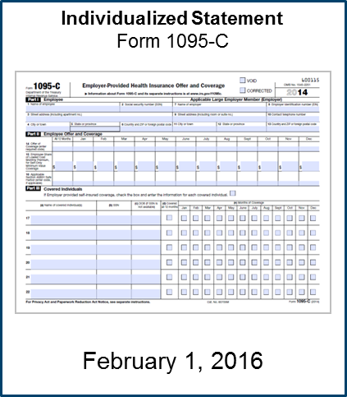
1095B and 1095C
HMOs/HealthChoice will send 1095-B
State will send
Note: employees will get two forms if enrolled in medical coverage

Slide 13
IRS reporting – things to note
Employees that are enrolled on a medical plan will receive two IRS forms
  1095B from the HMO or HealthChoice
  1095C from the State
The 1095B will indicate each member that was covered and the months they were covered under the plan
  If they changed carriers during the year due to a qualifying event, they will receive multiple 1095Bs
The 1095C will indicate the months they were eligible for coverage
  Note: the 1095C will indicate the lowest cost plan for employee only coverage that offers minimum value and is considered affordable under the ACA
    Regardless of plan actually selected
      Will likely show the employee is enrolled in the HealthChoice Basic plan
    Regardless of the tier actually selected
      Will show the employee is enrolled in employee only coverage

Slide 14
Penalties
Individual penalties
  Assessed to individuals for not having insurance
    2015 tax year, the greater of $325 per person or 2% of income
    2016 tax year, the greater of $695 per person or 2.5% of income
Employer penalties
  Assessed to the agency for failure of making an affordable offer of coverage to an eligible employee (counting hours)
    Up to $3,000 (indexed annually), if the employee goes to the exchange and qualifies for a subsidy
      Each agency will be responsible any penalties assessed for failure to offer coverage to an eligible employee

Slide 15
1411 certifications
Open enrollment on the exchange: Nov 1, 2015 – Jan 31, 2016
1411 certification will be sent to the employer if the individual claims they were not made an affordable offer of coverage
  Marketplace (exchange) notifies employer of employee gaining coverage with premium assistance
    This may come to the agency or OMES – do not disregard it
  State may appeal within 90 days

Slide 16
Contacts
All questions should be directed to the Human Capital Management
  carrie.towery@omes.ok.gov
  405.522.0264
or
  kristin.elsenbeck@omes.ok.gov
  405.521.3947
  or
  humanresources@omes.ok.gov
Additional information is available:
http://www.ok.gov/opm/HR_and_Employee_Services/ACA/
  * No Legal Advice Intended: The information presented by Arthur J. Gallagher & Co. and Human Capital Management is not intended, and should not be taken, as legal advice on any particular set of facts or circumstances. You should contact your own legal counsel for advice on specific legal problems concerning the Patient Protection and Affordable Care Act.

Slide 17
Questions
Thank You!

